Slide 1
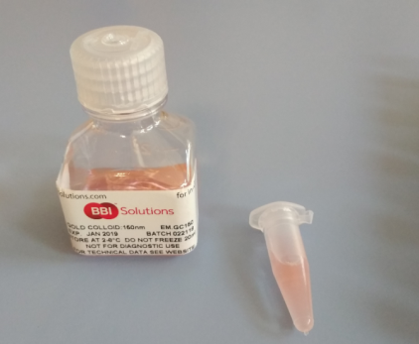
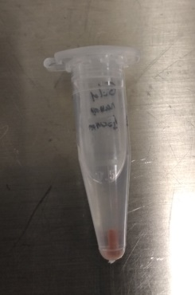
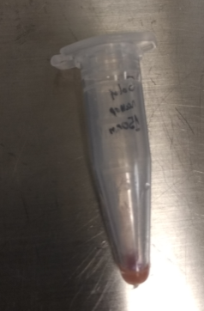
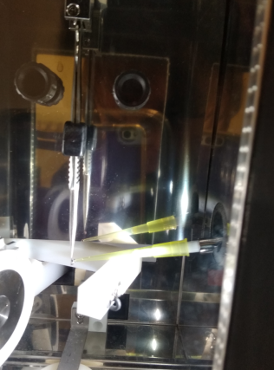
Protocol for Sample Preparation on grids
Fiducial addition:
The stock solution (3.60x10⁸ particles per mL) of 100-150-250-nm gold nanoparticles (Chemical reference: Gold nanoparticles 100 nm (EMGC100, BBI Group, Cardiff, UK) was resuspended and dispensed into 1mL aliquots. The gold was allowed to settle, and immediately prior to use, 900 mL of the supernatant was removed from the aliquot.
The 3-mm TEM grids were picked up from the p60 with the tweezers taking great care not to bend the grid. Immediately prior to freezing, 1.5 uL of 100-150-250-nm gold fiducial aliquot was added to the grid.

Slide 2
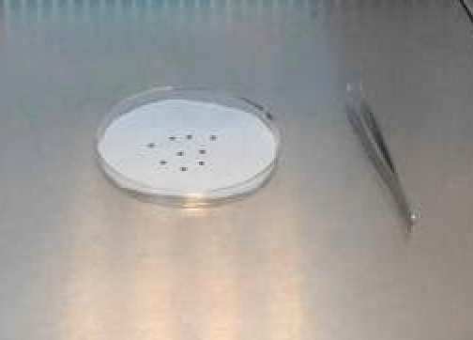
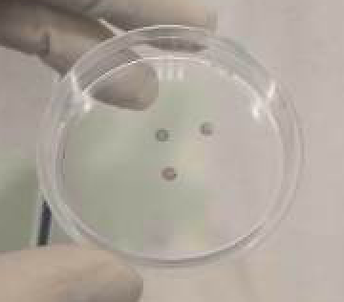
Growing adherent cells on grids
The grids ((Quantifoil Micro Tools GmbH, email: kay@quantifoil.com) QUANTIFOIL® R 2/2 on Au G200F1 finder grids, Holey Carbon Films / Item# N1-C16nAuG1-01) placed with the carbon film facing upward in a glass Petri dish p60
2) The Petri dish with the grid has to be radiated by 3hours with UV with a paper or without.

Slide 3
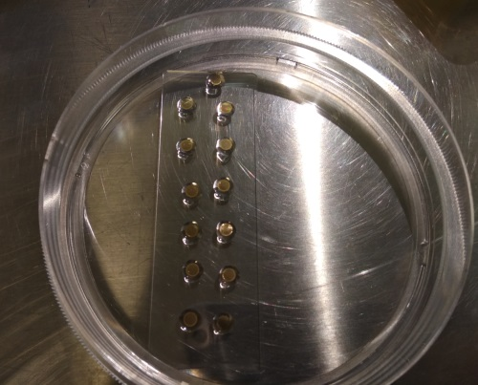
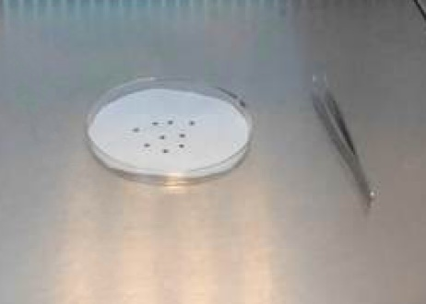
Optional grid treatment with Polilysine
If the cells confluency is low you can increase the seed number of cells or adding polilysine for increasing the cellular attachment to the carbon.
The grids are Quantifoil Micro Tools GmbH, (email: kay@quantifoil.com) QUANTIFOIL® R 2/2 on Au G200F1 finder grids, Holey Carbon Films / Item# N1-C16nAuG1-01)
2) Functionalization of the grids with Polilysine:
In a glass Petri add 20ul drops of polilysine, then placed the grid with the carbon film on the drop.
Other option could be placed the grids with the carbon film facing
upward in a glass Petri dish and adding a drop of 60ul on the grid
Incubate 30min at 37ºC
Blotted the polilysine with a using Whatman® No.1 filter paper.
3) The Petri dish with the filter paper with the grid placed with the carbon film facing upward has to be radiated by 3hours with UV.

Slide 4
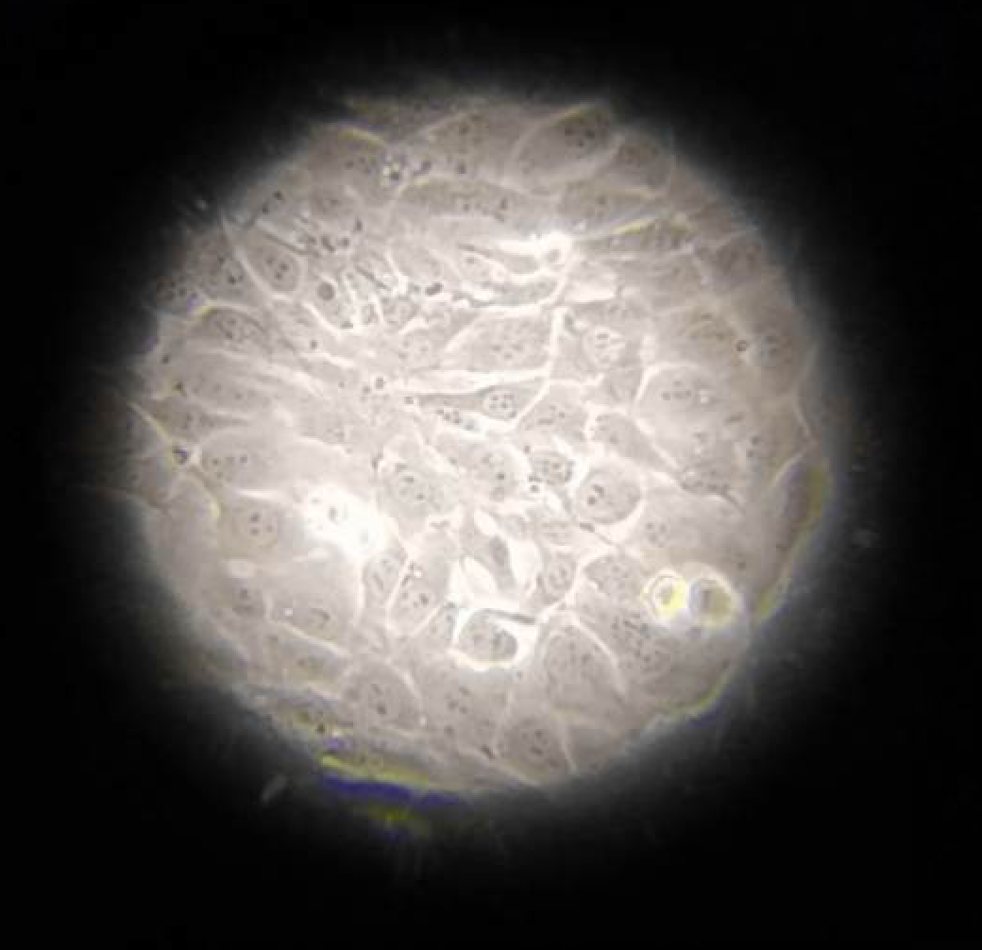
3) The P100 petri dish with 80-90% confluence has to be washed and the cells have to be counted
Usually you have to be diluted at 90% and ¼ of the cells are spreading into the p60 petri dish (Seed 2x10E⁵ cells/for petri dish, 3ml)

Slide 5
4) There are two methods of addition the cells:
The addition of the cell culture medium with the cells has to be really carefully with the carbon film facing upward in a glass Petri dish p60.
Seed 2x10E5 cells/ml on top of the grids in the P60 petri dishes (3ml total).

Slide 6
4) There are two methods of addition the cells:
The grid are introduce into the cell culture medium in the P60 with the carbon film facing upward in a glass Petri dish p60.

Slide 7
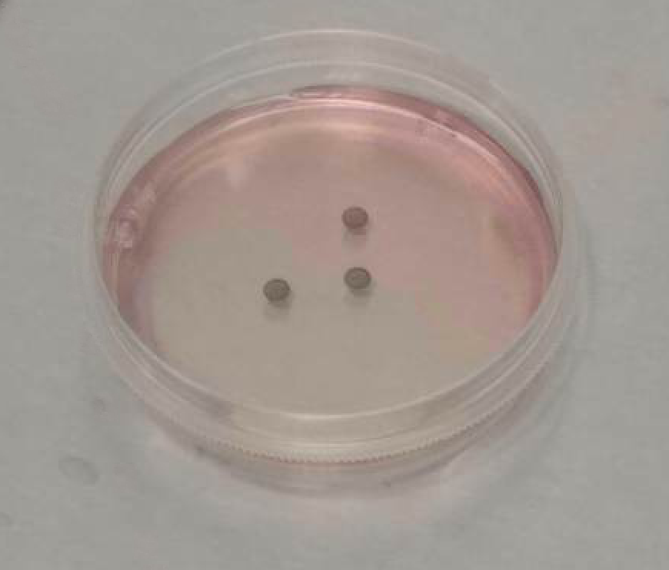
5) Cells were added and allowed to settle for 24 h
Prior to freezing, the grids can be imaged and assayed in terms of the integrity of the carbon film and the cell confluency

Slide 8
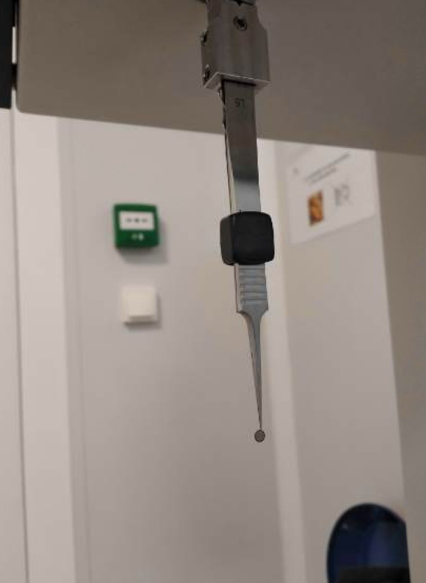
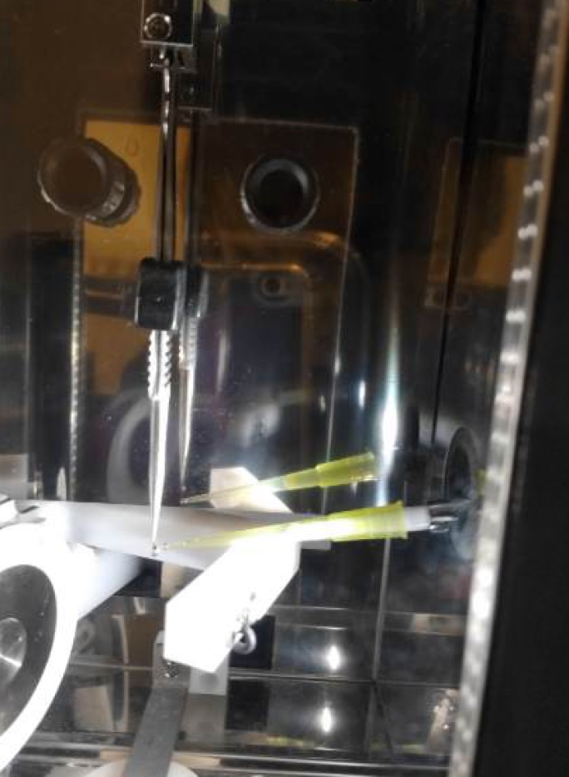
6) Fish the grids with the Leica tweezers from the microscope slide, secure the tweezers and mount them in the plunger (use load forceps position for that). The cells should stay in the right side when you mount the tweezers (H letter in front). Held the chamber at 70% relative humidity and 37ºC.
7) Over carbon film facing, follow the fiducial addition protocol and add 2 ul nanobeads

Slide 9
8) Blotting 1-3s depending on the cell density and Plunge freezing

Slide 10
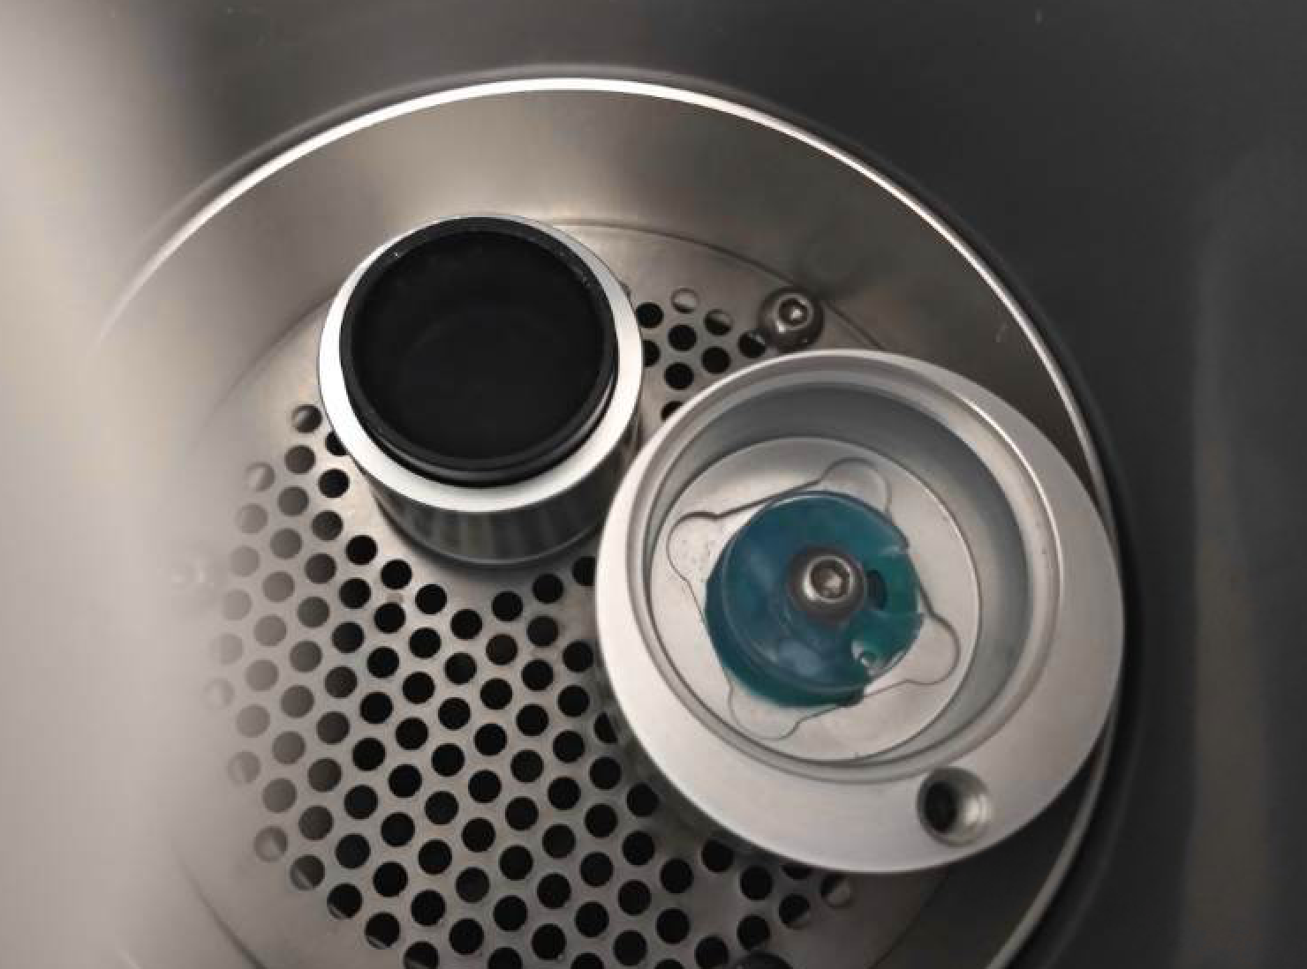
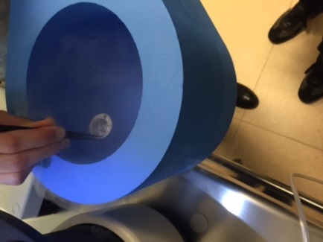
9) Take tweezers and remove lock (grabbing them firmly to maintain the grid). Transfer rapidly to the LN2 vessel. Once under the LN2, transfer to the holder quietly.
10) Repeat the cycles for each grid (go to step 4). We usually vitrified 4 grids of each condition and store in a white cryobox (that it has place exactly for 4 grids) properly labelled before the freezing.
11) Once filled, take LN2 vessel with holder and transfer to a rubber N2 dewar .

Slide 11
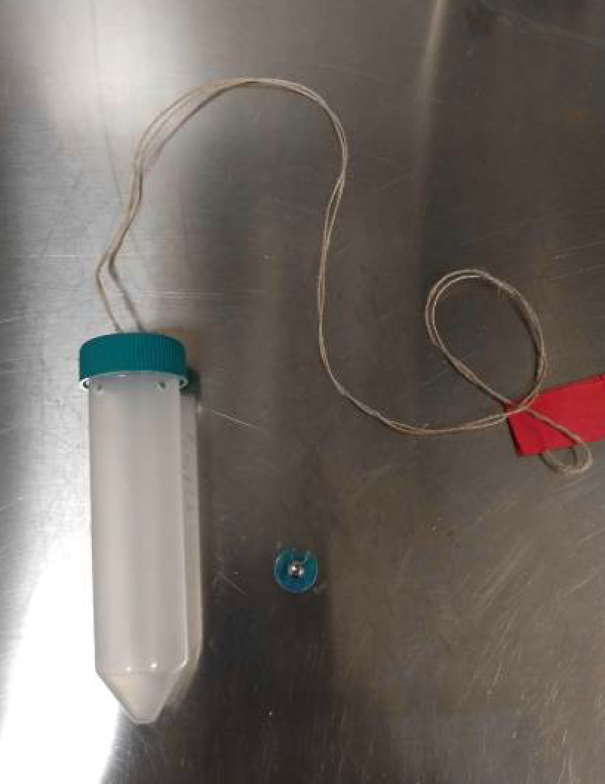
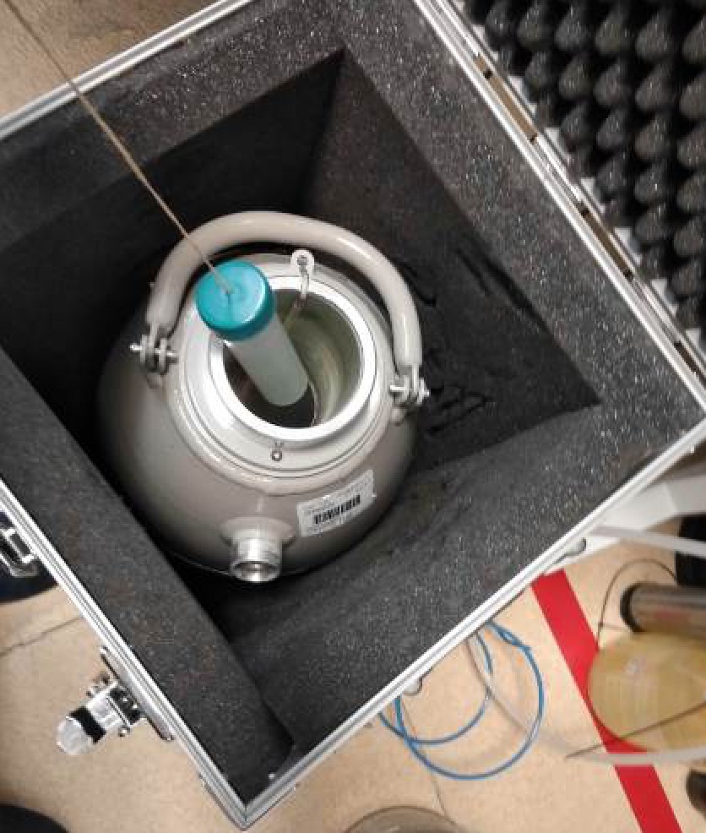
12) The cryo-grids boxes were transferred under liquid nitrogen conditions and stored in a 50-mL falcon tube with holes and a labeled rope in a transport dewar

