Slide 1
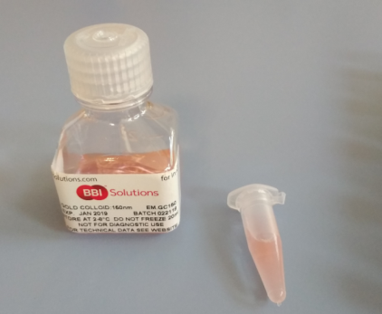
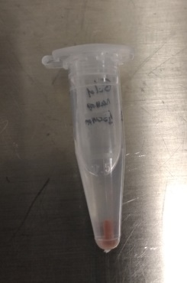
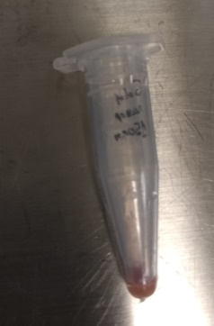
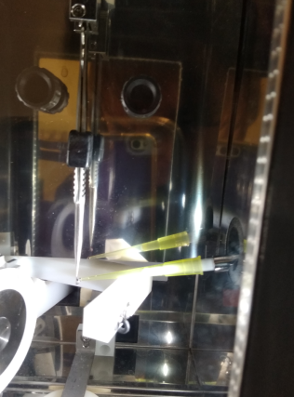
Protocol for Sample Preparation on grids
Fiducial addition:
The stock solution (3.60x10⁸ particles per mL) of 100-150-250-nm gold nanoparticles (Chemical reference: Gold nanoparticles 100 nm (EMGC100, BBI Group, Cardiff, UK) was resuspended and dispensed into 1mL aliquots. The gold was allowed to settle, and immediately prior to use, 900 mL of the supernatant was removed from the aliquot.
The 3-mm TEM grids were picked up from the p60 with the tweezers taking great care not to bend the grid. Immediately prior to freezing, 1.5 uL of 100-150-250-nm gold fiducial aliquot was added to the grid.

Slide 2
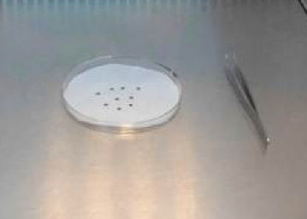
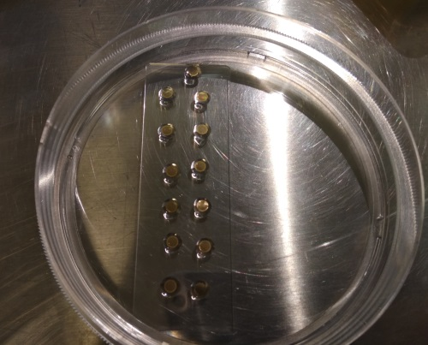
Deposit of Cell in suspension on grids
The grids are Quantifoil Micro Tools GmbH, (email: kay@quantifoil.com) QUANTIFOIL® R 2/2 on Au G200F1 finder grids, Holey Carbon Films / Item# N1-C16nAuG1-01)
) The Petri dish with the filter paper with the grid placed with the carbon film facing upward has to be radiated by 3hours with UV for sterilization.
3) Hydrophilize the carbon support foil by plasma treatment of the grids to increase sample spreading and better cell adhesion. Place grids carbon side up in the glow discharge chamber equipment and expose the grid to the plasma for 30 s to 15 min (using Ar or/and O2) depending on the equipment.
Optional: In case of problems with cells not attaching to the grid, use the following steps.
Functionalization of the grids with Polilysine:
In a glass Petri add 20ul drops of polilysine, then placed the grid with the carbon film on the drop.
Other option could be placed the grids with the carbon film facing
upward in a glass Petri dish and adding a drop of 60ul on the grid
Incubate 30min at 37ºC
Blotted the polilysine with a using Whatman® No.1 filter paper.

Slide 3
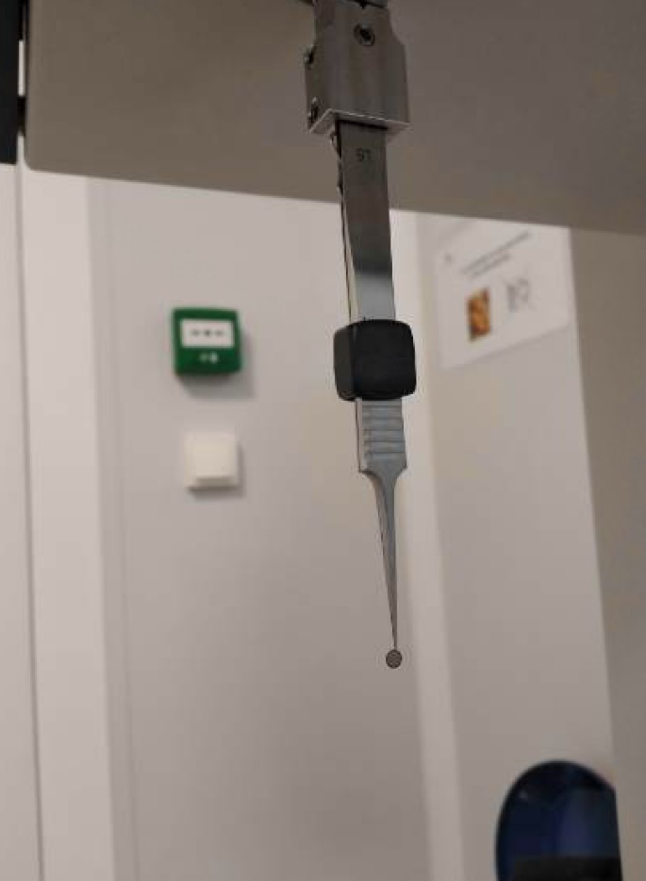
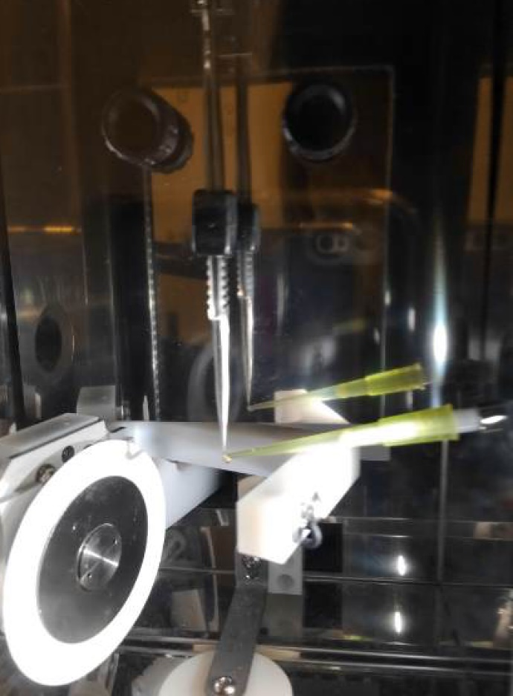
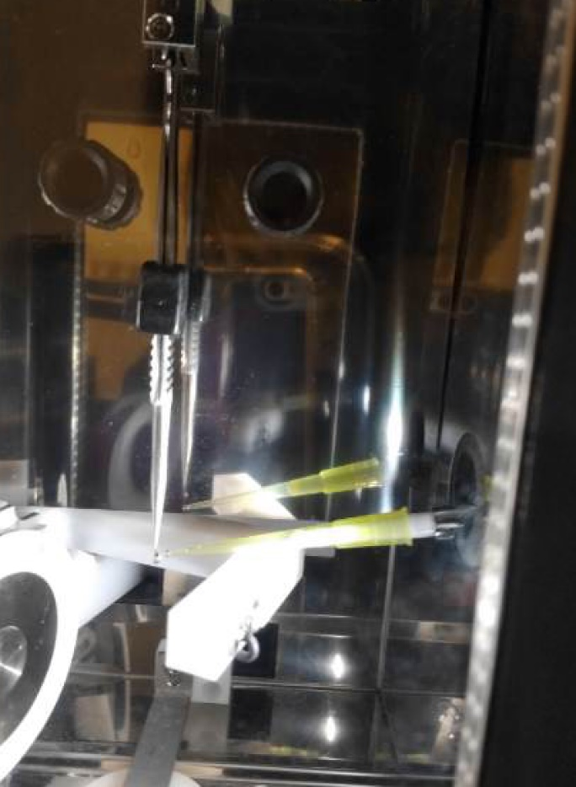
4) Over carbon film facing, follow the fiducial addition protocol and add 2 ul nanobeads
5) Over carbon film facing, add 4ul of cell in suspension at concentration
For eukaryotic cells 1-5 E6 cell/ml
For bacteria OD=0.3 .
The grid was left to incubate vertically for 5 minutes

Slide 4
6) Blotting 1-3s depending on the cell density and Plunge freezing

Slide 5
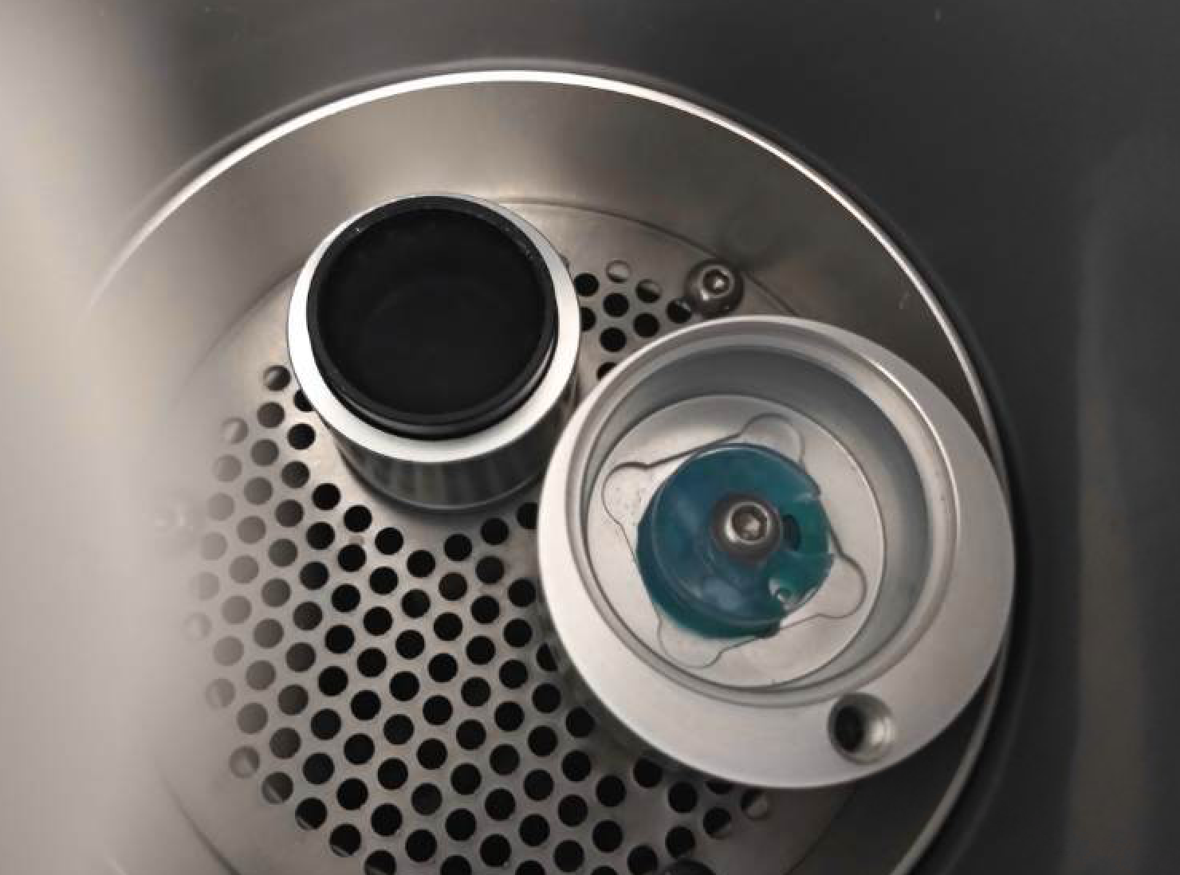
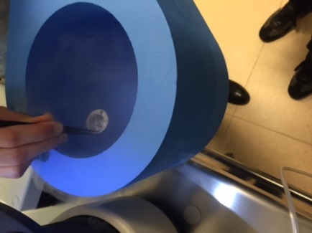
7) Take tweezers and remove lock (grabbing them firmly to maintain the grid). Transfer rapidly to the LN2 vessel. Once under the LN2, transfer to the holder quietly.
8) Repeat the cycles for each grid (go to step 4). We usually vitrified 4 grids of each condition and store in a white cryobox (that it has place exactly for 4 grids) properly labelled before the freezing.
9) Once filled, take LN2 vessel with holder and transfer to a rubber N2 dewar .

Slide 6
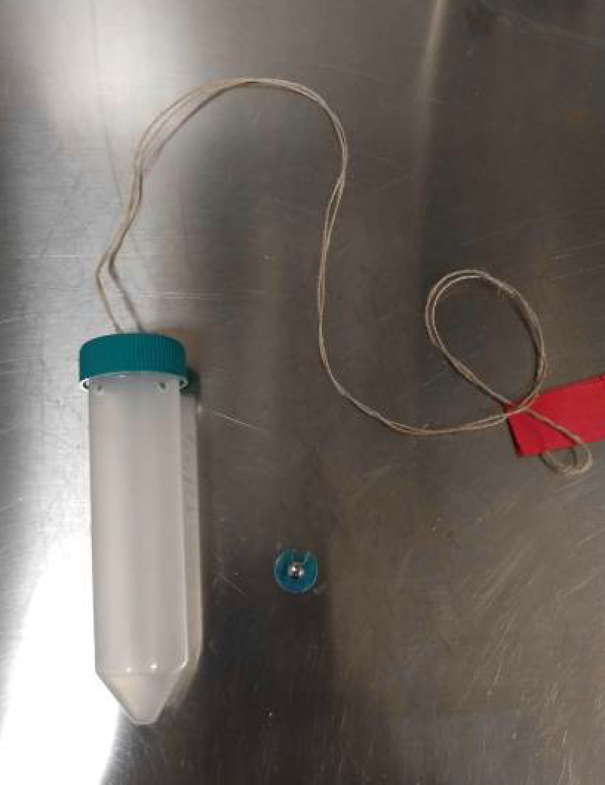
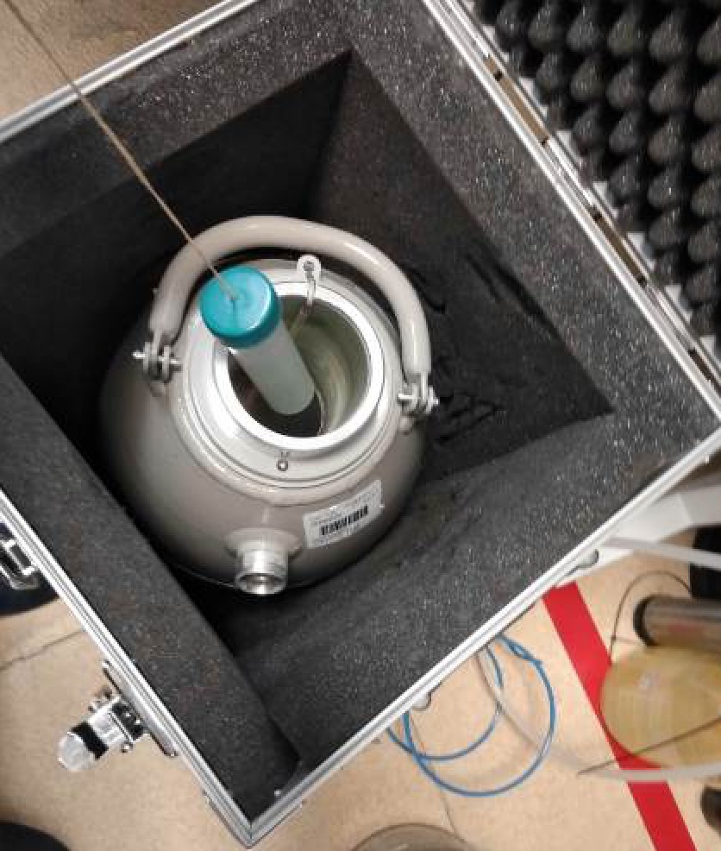
10) The cryo-grids boxes were transferred under liquid nitrogen conditions and stored in a 50-mL falcon tube with holes and a labeled rope in a transport dewar

