Slide 1
Notes:
Slide 1: Company Logo Full Page
Before you start editing the slides of your talk change to the Master Slide view:
Microsoft Office :Menu: View > Slide Master;
Macintosh – View > Master > Slide Master
Edit the following items:
On the Slide Master (first master slide) – lower area
a) On the left Delete the text and write the title of the event/Conference, Location
b) On the right delete the text and write the name and surname of the speaker and the date (day, month , year)
Close Master View

Slide 2
Studies on transient beam loading generated by the superconductive harmonic cavity
Marco Lonza
S. Dastan, S. Cleva, S. Di Mitri
(Elettra Sincrotrone Trieste)
Notes:
Slide 2: Title of the Presentation
Before you start editing the slides of your talk change to the Master Slide view:
Microsoft Office :Menu: View > Slide Master;
Macintosh – View > Master > Slide Master
Edit the following items:
On the Slide Master (first master slide) – lower area
a) On the left Delete the text and write the title of the event/Conference, Location
b) On the right delete the text and write the name and surname of the speaker and the date (day, month , year)
Close Master View
To start adding slides insert a new slide and select a Layout:
For Title & Subtitle
For text with bullet points
For Text
For Picture, graphs, visuals
Two columns
Blank

Slide 3
Outline
Transient beam loading due to a passive harmonic cavity and uneven filling pattern
Simulator based on analytic frequency-domain model
Elettra 2.0 studies
Conclusions
(Optional: measurements and 3HC characterization in the Elettra storage ring)
Notes:
Slide 3 – (..) : Content of the presentation
Insert a new slide: Home > “New Slide” and choose a slide Layout:
For Title & Subtitle
For text with bullet points
For Text
For Picture, graphs, visuals
Two columns
Blank
If you want Copy & paste an element from the Clip Board to the particular slide: 1. Click on a box to mark it.
2. Position the mouse pointer on the box frame: Copy! 3. Click on the particular slide: Paste!
How you intend to use the elements is your choice. You can combine the text block style with the background colour in different manner.

Slide 4
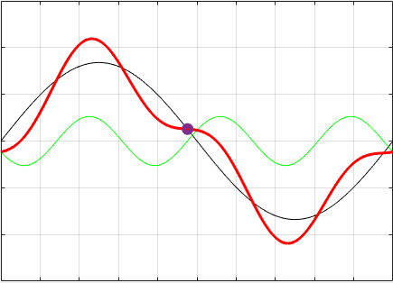
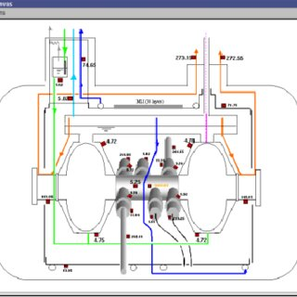
3HC Impact on Longitudinal Beam Dynamics
3HC
superconductive passive
third harmonic cavity
Bunch lengthening
3HC+dark gap: Transient Beam Loading
Variation of beam characteristics along the bunch train: stable phase, synchrotron tune, charge profile, bunch length, bunch lifetime, …
Lifetime increase
Landau damping
For Elettra 2.0 we need an estimation of the transient beam loading due to the third harmonic cavity to evaluate impacts on MBF systems (longitudinal modulator working at the 4th RF harmonics), crab cavities, hybrid mode, …
Notes:
Slide 3 – (..) : Content of the presentation
Insert a new slide: Home > “New Slide” and choose a slide Layout:
For Title & Subtitle
For text with bullet points
For Text
For Picture, graphs, visuals
Two columns
Blank
If you want Copy & paste an element from the Clip Board to the particular slide: 1. Click on a box to mark it.
2. Position the mouse pointer on the box frame: Copy! 3. Click on the particular slide: Paste!
How you intend to use the elements is your choice. You can combine the text block style with the background colour in different manner.

Slide 5
Transient Beam Loading
Transient beam loading is produced by RF cavities in the presence of a dark gap in the filling pattern
Generally speaking, the beam loading is the voltage induced by the beam in a cavity at the frequency of the bunches; in the fraction of one machine turn where the buckets are not filled, the voltage in the cavity freely oscillates at the cavity resonant frequency
This transient generates a periodic modulation of the cavity voltage, with period equal to the revolution time, resulting in different total voltage seen by the bunches depending on their longitudinal position
As a result, the bunch characteristics, such as synchronous phase, synchrotron frequency, charge profile and lifetime change along the bunch train
Notes:
Slide 3 – (..) : Content of the presentation
Insert a new slide: Home > “New Slide” and choose a slide Layout:
For Title & Subtitle
For text with bullet points
For Text
For Picture, graphs, visuals
Two columns
Blank
If you want Copy & paste an element from the Clip Board to the particular slide: 1. Click on a box to mark it.
2. Position the mouse pointer on the box frame: Copy! 3. Click on the particular slide: Paste!
How you intend to use the elements is your choice. You can combine the text block style with the background colour in different manner.

Slide 6
3HC Model and Longitudinal Beam Dynamics
Simulator developed in MATLAB
Analytical frequency-domain model of the beam and harmonic cavity
The beam is represented by a periodic (ω_{r}) signal made of pulses at ω_{RF} modulated in amplitude and phase; has a given spectrum
The harmonic cavity is a dynamic system with an INPUT (beam) and an OUTPUT (harmonic voltage)
The harmonic gap voltage modifies the bunch length and position (long. displacement of the bunches with respect to synchronous phase)
Iterate process until a stable, consistent solution is found: equilibrium bunch density. Normally a few iterations are sufficient to converge
Initial spectrum of the beam
Determine new beam spectrum
Calculate harmonic cavity response
Calculate effect on the beam
Simulator block diagram
Notes:
Slide 3 – (..) : Content of the presentation
Insert a new slide: Home > “New Slide” and choose a slide Layout:
For Title & Subtitle
For text with bullet points
For Text
For Picture, graphs, visuals
Two columns
Blank
If you want Copy & paste an element from the Clip Board to the particular slide: 1. Click on a box to mark it.
2. Position the mouse pointer on the box frame: Copy! 3. Click on the particular slide: Paste!
How you intend to use the elements is your choice. You can combine the text block style with the background colour in different manner.

Slide 7
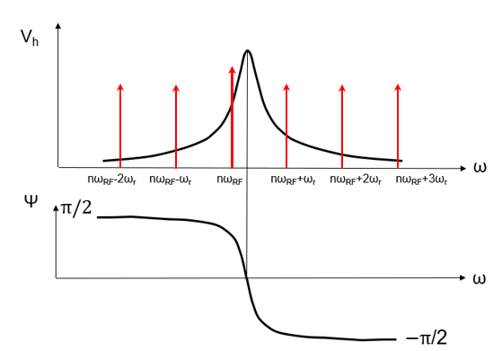
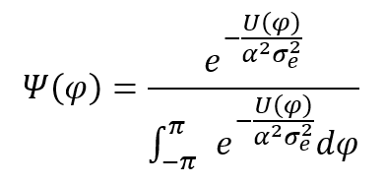
Analytical equations of the Model
The beam can be modelled by the “complex beam current”, an array of complex values each representing one of the bunches, where the module of each value is the bunch current and the phase is the bunch synchronous phase
1)
Complex Form Factor (=1 initial conditions)
2)
Complex Beam Current
3)
Harmonic cavity transfer function
4)
Harmonic Cavity Voltage
5)
Total voltage seen by the bunches
6)
RF potential
7)
Charge distribution
The equilibrium bunch density is obtained by iterating this process until a consistent stable solution is found; convergence is reached after ~200 iterations and a few seconds
From the equilibrium bunch charge distribution we can calculate the bunch characteristics (stable phase, bunch length, Touschek lifetime, etc.); the synchrotron frequency is determined analytically from the gradient of the total voltage seen by each bunch
Notes:
Slide 3 – (..) : Content of the presentation
Insert a new slide: Home > “New Slide” and choose a slide Layout:
For Title & Subtitle
For text with bullet points
For Text
For Picture, graphs, visuals
Two columns
Blank
If you want Copy & paste an element from the Clip Board to the particular slide: 1. Click on a box to mark it.
2. Position the mouse pointer on the box frame: Copy! 3. Click on the particular slide: Paste!
How you intend to use the elements is your choice. You can combine the text block style with the background colour in different manner.

Slide 8
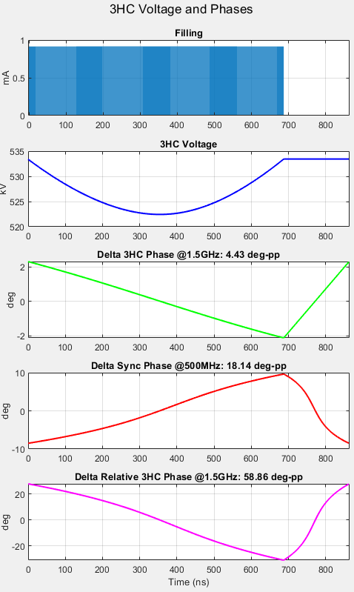
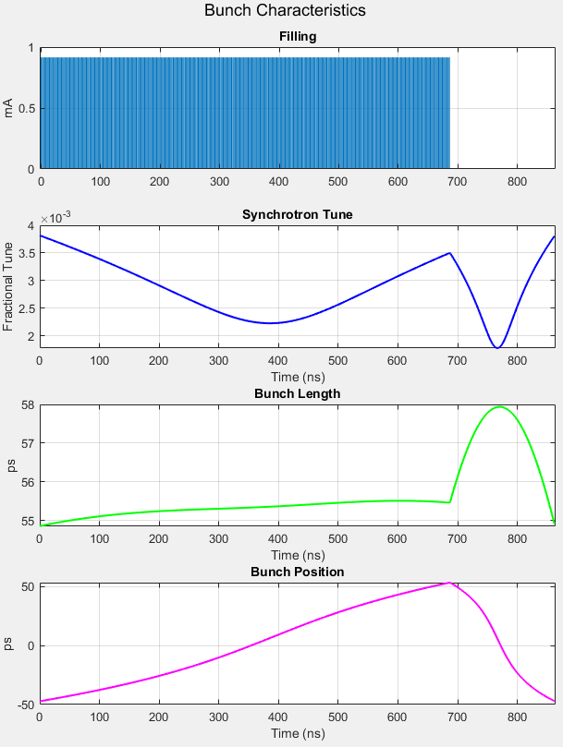
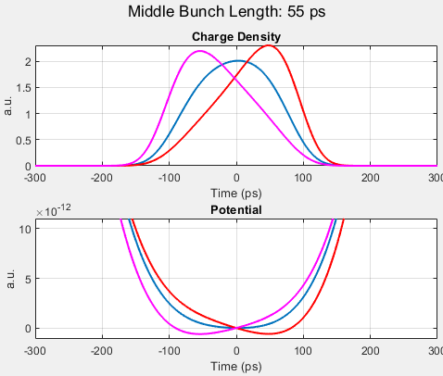
Results: harmonic cavity response and bunch characteristics
Notes:
Slide 3 – (..) : Content of the presentation
Insert a new slide: Home > “New Slide” and choose a slide Layout:
For Title & Subtitle
For text with bullet points
For Text
For Picture, graphs, visuals
Two columns
Blank
If you want Copy & paste an element from the Clip Board to the particular slide: 1. Click on a box to mark it.
2. Position the mouse pointer on the box frame: Copy! 3. Click on the particular slide: Paste!
How you intend to use the elements is your choice. You can combine the text block style with the background colour in different manner.

Slide 9
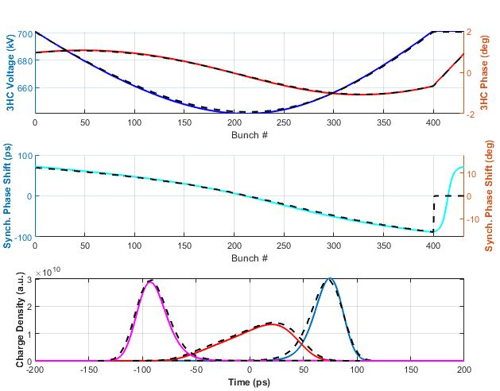
Simulations compared with mbtrack2
Comparison of results obtained from the Matlab simulator (solid lines) and mbtrack2 (dashed lines): 3HC voltage/phase and synchronous phase shift along the bunch train, and charge profile of the first/middle/last bunch (blue/red/magenta)
Notes:
Slide 3 – (..) : Content of the presentation
Insert a new slide: Home > “New Slide” and choose a slide Layout:
For Title & Subtitle
For text with bullet points
For Text
For Picture, graphs, visuals
Two columns
Blank
If you want Copy & paste an element from the Clip Board to the particular slide: 1. Click on a box to mark it.
2. Position the mouse pointer on the box frame: Copy! 3. Click on the particular slide: Paste!
How you intend to use the elements is your choice. You can combine the text block style with the background colour in different manner.

Slide 10
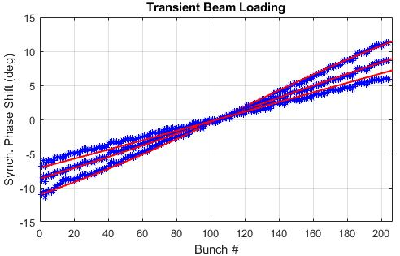
Simulations compared with real Elettra machine
Synchronous phase shift along the bunch train; simulation (red) and experimental (blue) data, with E = 2.0 GeV, Ib = ~200 mA, 50% filling pattern and three different detuning values 45, 60 and 70 kHz
Notes:
Slide 3 – (..) : Content of the presentation
Insert a new slide: Home > “New Slide” and choose a slide Layout:
For Title & Subtitle
For text with bullet points
For Text
For Picture, graphs, visuals
Two columns
Blank
If you want Copy & paste an element from the Clip Board to the particular slide: 1. Click on a box to mark it.
2. Position the mouse pointer on the box frame: Copy! 3. Click on the particular slide: Paste!
How you intend to use the elements is your choice. You can combine the text block style with the background colour in different manner.

Slide 11
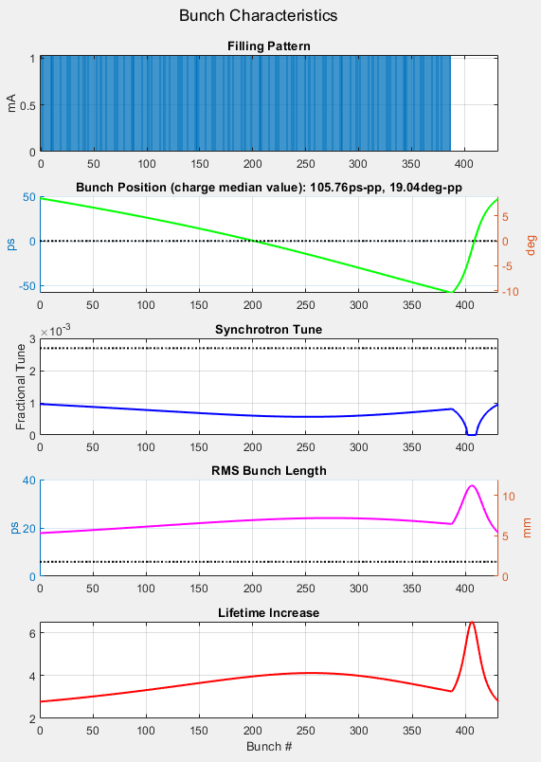
Concerns about the impact of transient beam loading on Elettra 2.0 beam characteristics
Elettra 2.0 studies
Stable phase variation, concern for: synchronous detectors, MBF, Crab, …
Low Synchrotron Frequency; concern for Mode Coupling Instability (variation of frequency in the train could help?)
Ununiform bunch lengthening: concern for the single bunch in the gap (Crab cavities)
Ununiform lifetime increase: can spoil the rectangular filling pattern
Notes:
Slide 3 – (..) : Content of the presentation
Insert a new slide: Home > “New Slide” and choose a slide Layout:
For Title & Subtitle
For text with bullet points
For Text
For Picture, graphs, visuals
Two columns
Blank
If you want Copy & paste an element from the Clip Board to the particular slide: 1. Click on a box to mark it.
2. Position the mouse pointer on the box frame: Copy! 3. Click on the particular slide: Paste!
How you intend to use the elements is your choice. You can combine the text block style with the background colour in different manner.

Slide 12
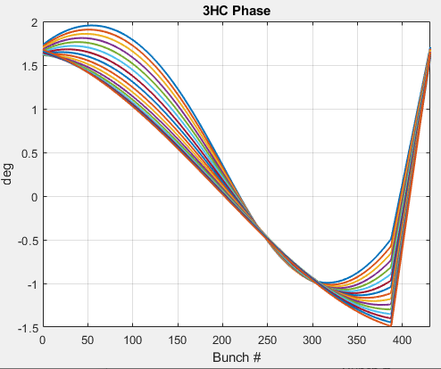
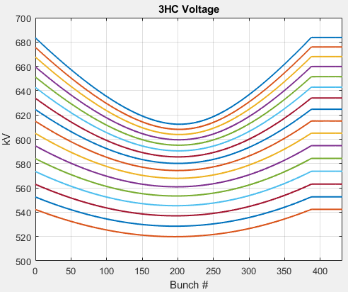
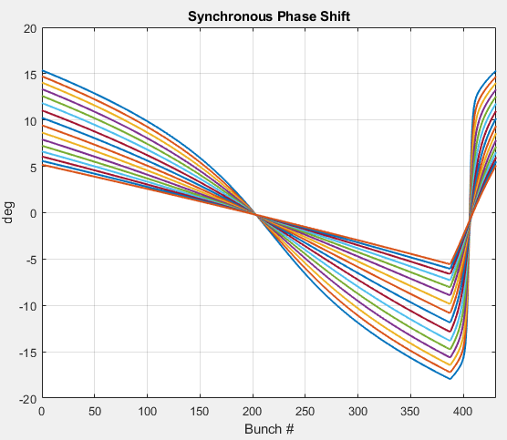
Transient beam loading effects vs. 3HC detuning
Electron beam
Energy: 2.4 GeV
Total current: 400 mA
filling pattern: 90%
3HC and main RF cavity included
3HC detuning from 70 to 100 kHz
RF
Frequency: 500 MHz
Total voltage: 2 MV
Detuning: 1 kHz
Q: 40000
R_{S}: 3.3 MΩ
3HC
Q: 2.10⁸
R_{S}/Q: 88 Ω
70 kHz
70 kHz
100 kHz
70 kHz
100 kHz
100 kHz
Notes:
Slide 3 – (..) : Content of the presentation
Insert a new slide: Home > “New Slide” and choose a slide Layout:
For Title & Subtitle
For text with bullet points
For Text
For Picture, graphs, visuals
Two columns
Blank
If you want Copy & paste an element from the Clip Board to the particular slide: 1. Click on a box to mark it.
2. Position the mouse pointer on the box frame: Copy! 3. Click on the particular slide: Paste!
How you intend to use the elements is your choice. You can combine the text block style with the background colour in different manner.

Slide 13
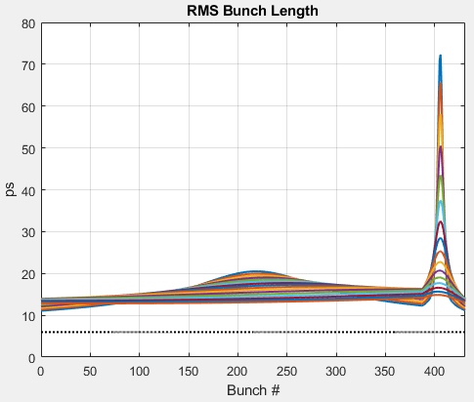
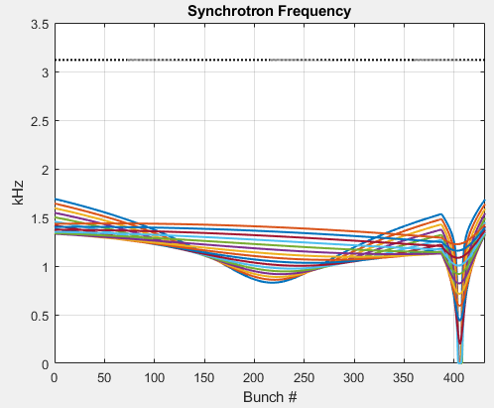
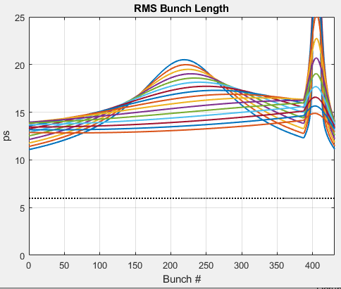
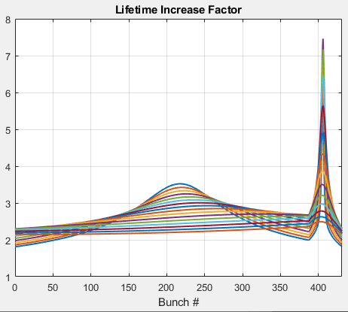
Transient beam loading effects vs. 3HC detuning
Nominal Value
100 kHz
70 kHz
70 kHz
100 kHz
Nominal Value
70 kHz
100 kHz
70 kHz
Nominal Value
100 kHz
Notes:
Slide 3 – (..) : Content of the presentation
Insert a new slide: Home > “New Slide” and choose a slide Layout:
For Title & Subtitle
For text with bullet points
For Text
For Picture, graphs, visuals
Two columns
Blank
If you want Copy & paste an element from the Clip Board to the particular slide: 1. Click on a box to mark it.
2. Position the mouse pointer on the box frame: Copy! 3. Click on the particular slide: Paste!
How you intend to use the elements is your choice. You can combine the text block style with the background colour in different manner.

Slide 14
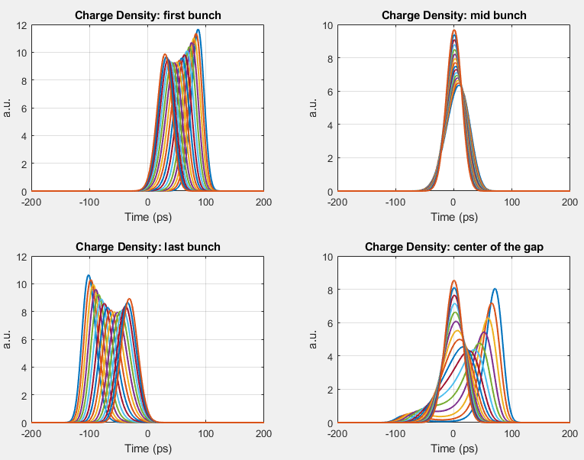
Bunch charge profile vs. 3HC detuning
100 kHz
70 kHz
100 kHz
70 kHz
100 kHz
70 kHz
70 kHz
100 kHz
Notes:
Slide 3 – (..) : Content of the presentation
Insert a new slide: Home > “New Slide” and choose a slide Layout:
For Title & Subtitle
For text with bullet points
For Text
For Picture, graphs, visuals
Two columns
Blank
If you want Copy & paste an element from the Clip Board to the particular slide: 1. Click on a box to mark it.
2. Position the mouse pointer on the box frame: Copy! 3. Click on the particular slide: Paste!
How you intend to use the elements is your choice. You can combine the text block style with the background colour in different manner.

Slide 15
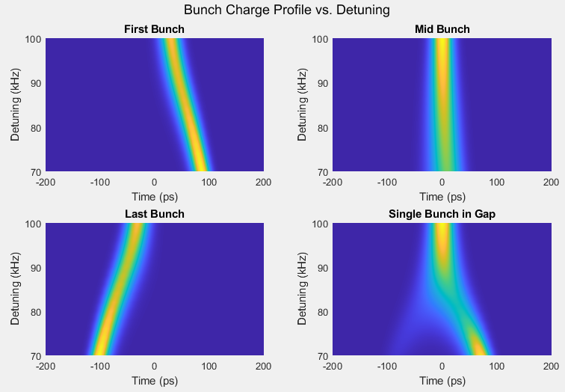
Bunch charge profile vs. 3HC detuning
The single bunch in the gap is the most affected by transient beam loading
Decreasing the detuning it starts splitting into two bunches
Notes:
Slide 3 – (..) : Content of the presentation
Insert a new slide: Home > “New Slide” and choose a slide Layout:
For Title & Subtitle
For text with bullet points
For Text
For Picture, graphs, visuals
Two columns
Blank
If you want Copy & paste an element from the Clip Board to the particular slide: 1. Click on a box to mark it.
2. Position the mouse pointer on the box frame: Copy! 3. Click on the particular slide: Paste!
How you intend to use the elements is your choice. You can combine the text block style with the background colour in different manner.

Slide 16
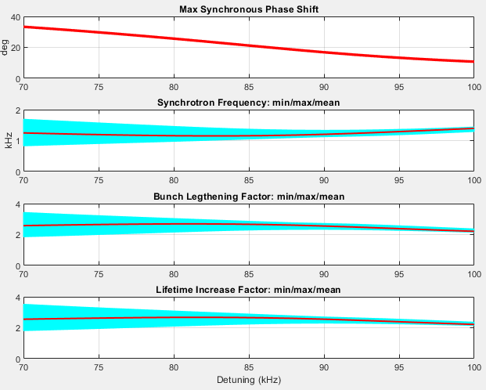
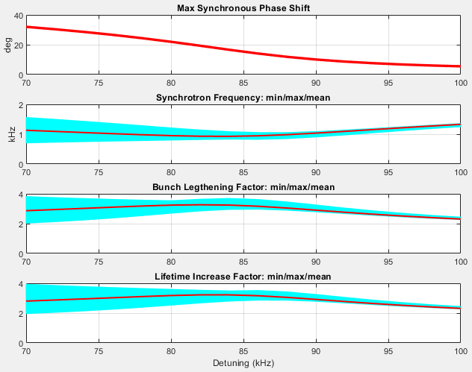
Bunch characteristics vs. harmonic cavity detuning
90% filling pattern
95% filling pattern
In order to have a good and uniform bunch lengthening and a reasonable synchronous phase shift along the bunch train, a good compromise is:
detuning = 90 kHz at 95% filling pattern
Max synchronous phase shift: 10º
Synchrotron frequency: ~1 kHz
Bunch lengthening factor: ~ 3
Touschek lifetime increase factor: ~ 3
Notes:
Slide 3 – (..) : Content of the presentation
Insert a new slide: Home > “New Slide” and choose a slide Layout:
For Title & Subtitle
For text with bullet points
For Text
For Picture, graphs, visuals
Two columns
Blank
If you want Copy & paste an element from the Clip Board to the particular slide: 1. Click on a box to mark it.
2. Position the mouse pointer on the box frame: Copy! 3. Click on the particular slide: Paste!
How you intend to use the elements is your choice. You can combine the text block style with the background colour in different manner.

Slide 17
Conclusions
Simulator based on an analytical frequency-domain model of the beam and third harmonic cavity (3HC), equilibrium bunch density distribution is obtained via an iterative process: convergence is obtained in a few seconds
Results in good agreement with mbtrack2 and Elettra experimental data
Transient beam loading due to the main RF accelerating cavities included in the simulator
The simulator is very efficient but is not suitable to study instabilities (Robinson, PTBL, …); elegant or mbtrack2 have to be used
Simulations of Elettra 2.0 have been carried out: a reasonable compromise has been found with limited negative impact of 3HC on the beam
Notes:
Slide 3 – (..) : Content of the presentation
Insert a new slide: Home > “New Slide” and choose a slide Layout:
For Title & Subtitle
For text with bullet points
For Text
For Picture, graphs, visuals
Two columns
Blank
If you want Copy & paste an element from the Clip Board to the particular slide: 1. Click on a box to mark it.
2. Position the mouse pointer on the box frame: Copy! 3. Click on the particular slide: Paste!
How you intend to use the elements is your choice. You can combine the text block style with the background colour in different manner.

Slide 18
References
M. Lonza, S. Cleva, S. Dastan, S. Di Mitri, “Transient beam loading studies in view of the Elettra 2.0 upgrade project”, presented at IPAC’23, Venice, Italy, May 2023, paper WEPA009
J. M. Byrd, S. De Santis, J. Jacob, and V. Serriere, “Transient beam loading effects in harmonic rf systems for light sources”, Phys. Rev. ST Accel. Beams, vol. 5, p. 092001, 2002. doi:10.1103/PhysRevSTAB.5.0920012
G. Penco and M. Svandrlik, “Experimental studies on tran-sient beam loading effects in the presence of a supercon-ducting third harmonic cavity”, Phys. Rev. ST Accel. Beams, vol. 9, p. 044401, 2006. doi:10.1103/PhysRevSTAB.9.044401
P. F. Tavares, Å. Andersson, A. Hansson, and J. Breunlin, “Equilibrium bunch density distribution with passive har-monic cavities in a storage ring”, Phys. Rev. ST Accel. Beams, vol. 17, p. 064401, 2014. doi:10.1103/PhysRevSTAB.17.064401
A. Gamelin and N. Yamamoto, “Equilibrium Bunch Density Distribution with Multiple Active and Passive RF Cavities”, in Proc. IPAC'21, Campinas, Brazil, May 2021, pp. 278-281. doi:10.18429/JACoW-IPAC2021-MOPAB069
Notes:
Slide 2: Title of the Presentation
Before you start editing the slides of your talk change to the Master Slide view:
Microsoft Office :Menu: View > Slide Master;
Macintosh – View > Master > Slide Master
Edit the following items:
On the Slide Master (first master slide) – lower area
a) On the left Delete the text and write the title of the event/Conference, Location
b) On the right delete the text and write the name and surname of the speaker and the date (day, month , year)
Close Master View
To start adding slides insert a new slide and select a Layout:
For Title & Subtitle
For text with bullet points
For Text
For Picture, graphs, visuals
Two columns
Blank

Slide 19
Notes:
Last Slide 1: Thanks to the audience

Slide 20
Notes:
Last Slide 2: Aerial Photo of Elettra

Slide 21
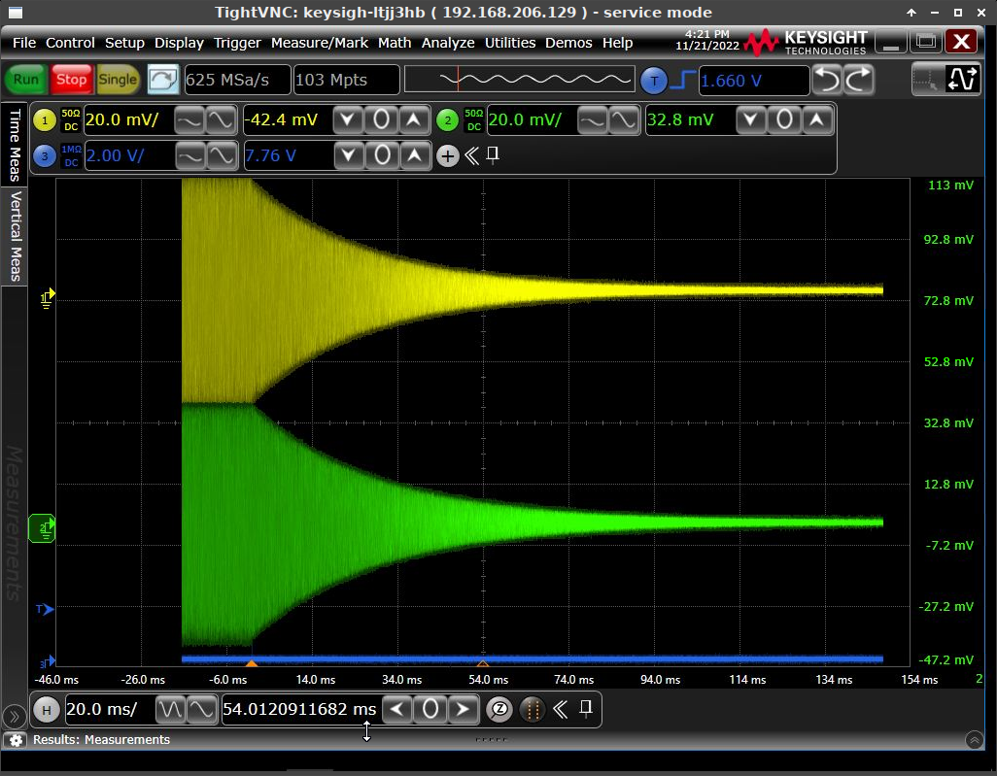
Elettra Machine and 3HC Characterization: 3HC Quality Factor
The decay time of the 3HC voltage after a commanded beam dump has been measured by acquiring with an oscilloscope the signal taken from both cavity pickups. The acquired data have been digitally I/Q demodulated and the amplitude decay fitted with exponential curves, eventually providing the time constant and thus the Q factor.
Cell# | Current | Detuning | τ | Q
 | (mA) | kHz | ms | x 10⁸
1 | 120 | 40 | 28.3 | 1.33
1 | 120 | 50 | 28.3 | 1.33
1 | 120 | 60 | 28.3 | 1.33
1 | 120 | 70 | 28.3 | 1.33
1 | 120 | 80 | 28.3 | 1.33
1 | 300 | 70 | 27.9 | 1.31
1 | 300 | 90 | 28.4 | 1.34
2 | 120 | 40 | 30.7 | 1.45
2 | 120 | 50 | 30.7 | 1.45
2 | 120 | 60 | 30.7 | 1.45
2 | 120 | 70 | 30.7 | 1.45
2 | 120 | 80 | 30.7 | 1.45
2 | 300 | 70 | 30.4 | 1.43
2 | 300 | 90 | 30.2 | 1.42
Notes:
Slide 3 – (..) : Content of the presentation
Insert a new slide: Home > “New Slide” and choose a slide Layout:
For Title & Subtitle
For text with bullet points
For Text
For Picture, graphs, visuals
Two columns
Blank
If you want Copy & paste an element from the Clip Board to the particular slide: 1. Click on a box to mark it.
2. Position the mouse pointer on the box frame: Copy! 3. Click on the particular slide: Paste!
How you intend to use the elements is your choice. You can combine the text block style with the background colour in different manner.

Slide 22
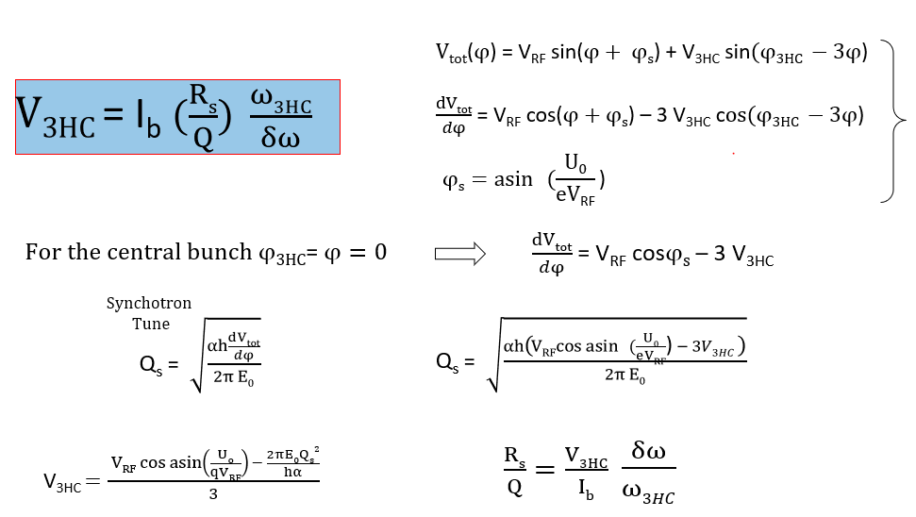
Elettra Machine and 3HC Characterization: 3HC Rs/Q
By measuring the synchrotron frequency of the central bunch in the bunch train, which is almost unaffected by the phase shift due to beam loading, we can first calculate the 3HC voltage and then Rs/Q. Preliminary measurements: calculated Rs/Q value 80 Ω, nominal value 88 Ω.
Notes:
Slide 3 – (..) : Content of the presentation
Insert a new slide: Home > “New Slide” and choose a slide Layout:
For Title & Subtitle
For text with bullet points
For Text
For Picture, graphs, visuals
Two columns
Blank
If you want Copy & paste an element from the Clip Board to the particular slide: 1. Click on a box to mark it.
2. Position the mouse pointer on the box frame: Copy! 3. Click on the particular slide: Paste!
How you intend to use the elements is your choice. You can combine the text block style with the background colour in different manner.

Slide 23
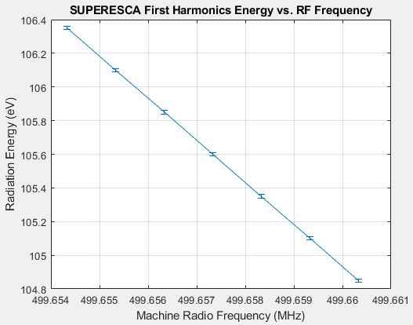
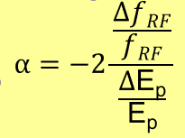
Elettra Machine and 3HC Characterization: Momentum compaction factor α
The momentum compaction factor α can be calculated with reasonable accuracy through measurements of the photon energy on a beamline at different electron energies.
Notes:
Slide 3 – (..) : Content of the presentation
Insert a new slide: Home > “New Slide” and choose a slide Layout:
For Title & Subtitle
For text with bullet points
For Text
For Picture, graphs, visuals
Two columns
Blank
If you want Copy & paste an element from the Clip Board to the particular slide: 1. Click on a box to mark it.
2. Position the mouse pointer on the box frame: Copy! 3. Click on the particular slide: Paste!
How you intend to use the elements is your choice. You can combine the text block style with the background colour in different manner.

