Slide 1
Diamond RF System -
Present Status and Diamond-II Upgrade

Slide 2
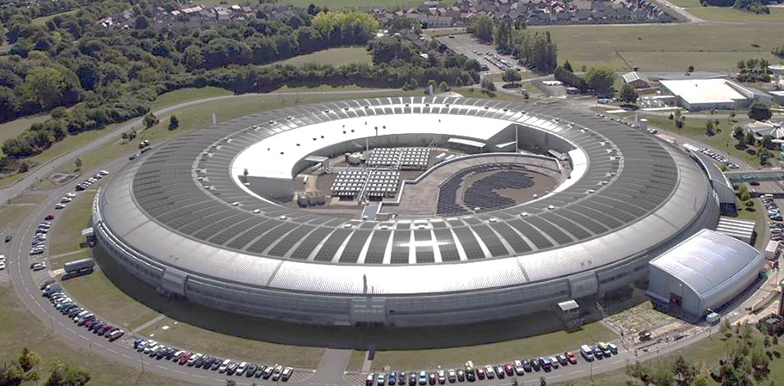
The Diamond Light Source

Slide 3
Introduction
Overview of present RF System
Reliability
Faults
IOT Operating Hours
Diamond-II Upgrade

Slide 4
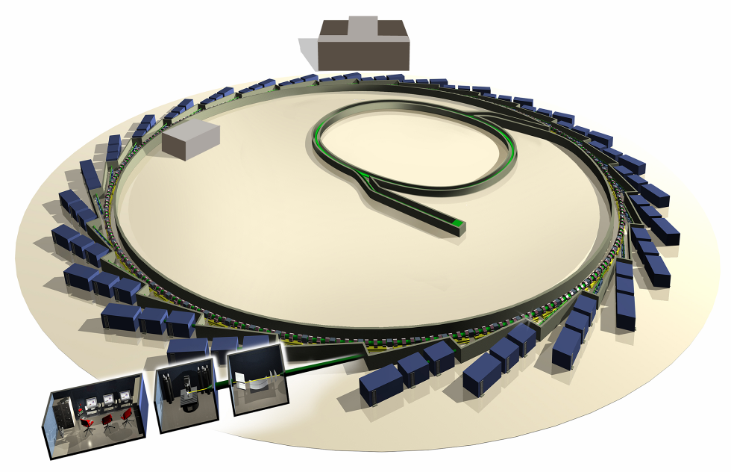
Diamond – The Accelerators
Diamond House
Booster Synchrotron
The “Machine”
Linear Accelerator
Storage Ring
Beamlines

Slide 5
The Present RF System
Linac (Pulsed)
  2 Klystrons
Booster (CW) – 2 Cavities
  80 kW IOT
  60 kW Ampegon SSA
Storage Ring (CW) – 2 SC Cavities, 3 NC Cavities
  3 x 300 Kw, each consisting of 4 x 80 kW IOTs
  One 300 kW amplifier split to supply 2 NC Cavities
  120 kW Cryoelectra SSA for recent 3rd NC Cavity
RF Test Facility
  80 kW Ampegon SSA – Cavity test and conditioning

Slide 6
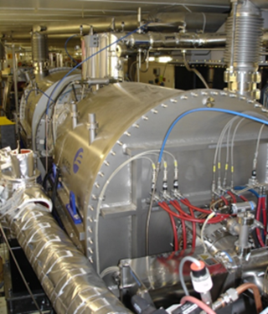
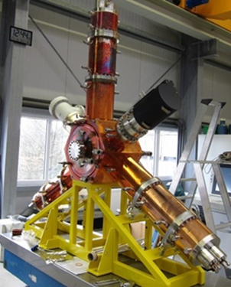
SR Cavities
SC Cavity
NC Cavity

Slide 7
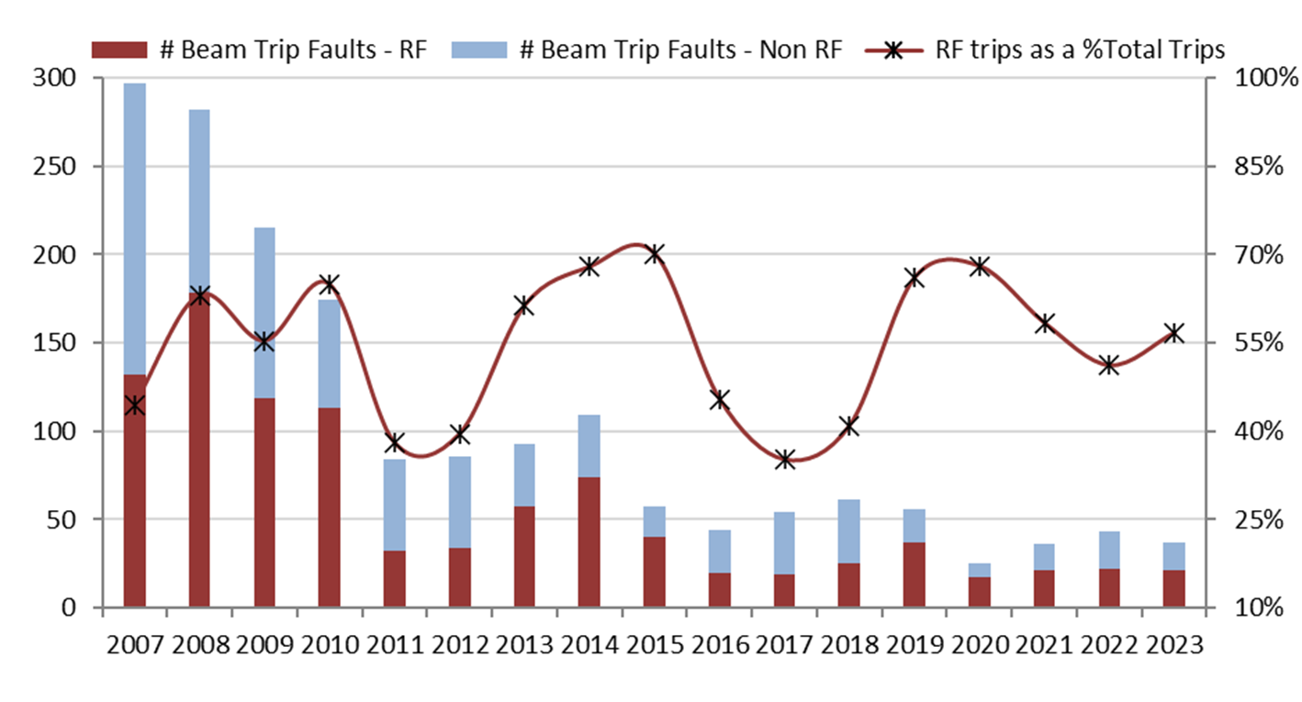
Reliability of the RF System & Diamond

Slide 8
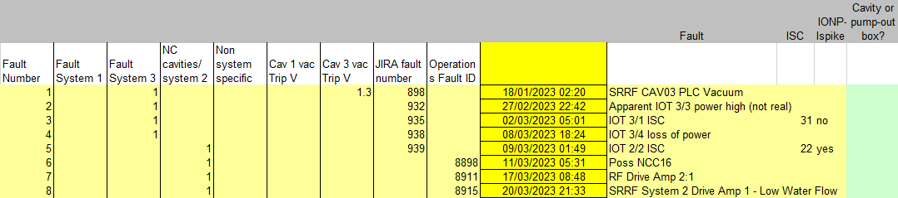
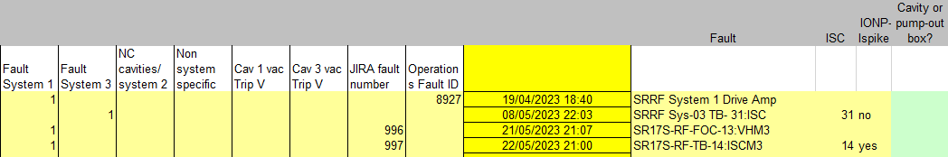
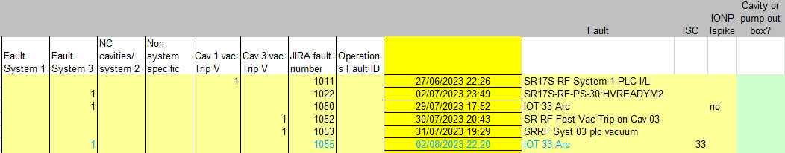
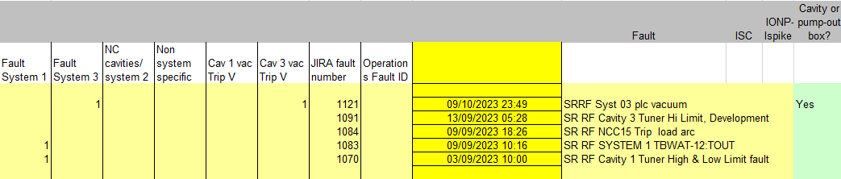
RF Trips/Run
2023-1
2023-2
2023-3
2023-4

Slide 9
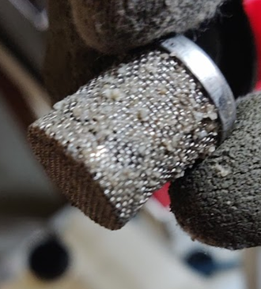
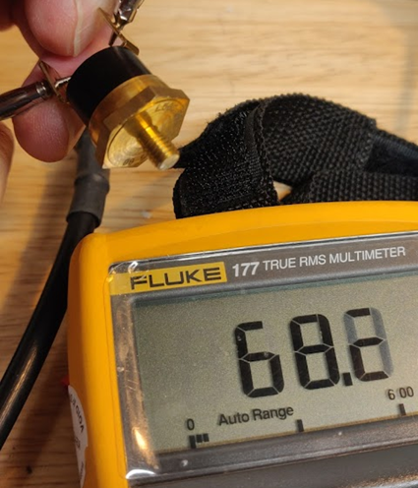
RF Amplifier Beam Trip Faults
ISCs x 5
DA 2:1 failed
DA 2:1 water flow -> Debris
TBWAT-12:TOUT -> Thermostat
FOC 1:3 VHM -> Control signal cable

Slide 10
RF Faults: Non-Operational
Booster 1 RF “ISC” -> IOT Input Cavity
Tuner Hi limit switch
3rd NC Cavity wave guide switch
Booster SSA 24V interlock PSU
System 3 IOT cooling Inverter VSD
Load Arc NC Cavity 3 load

Slide 11
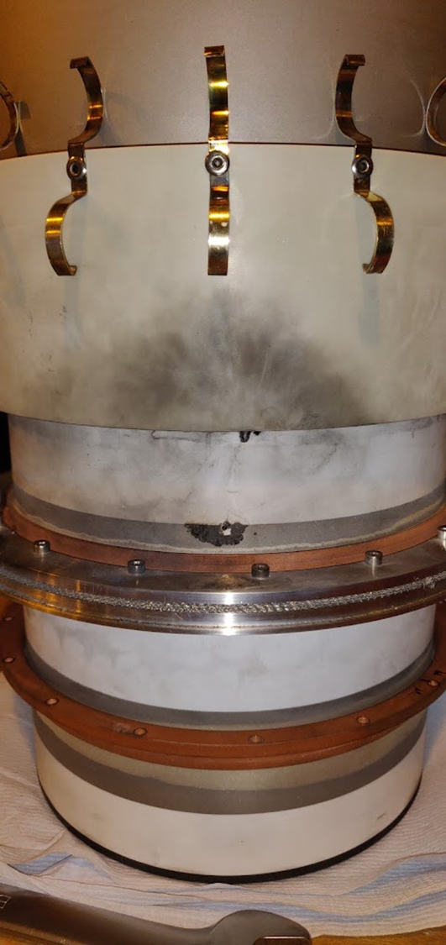
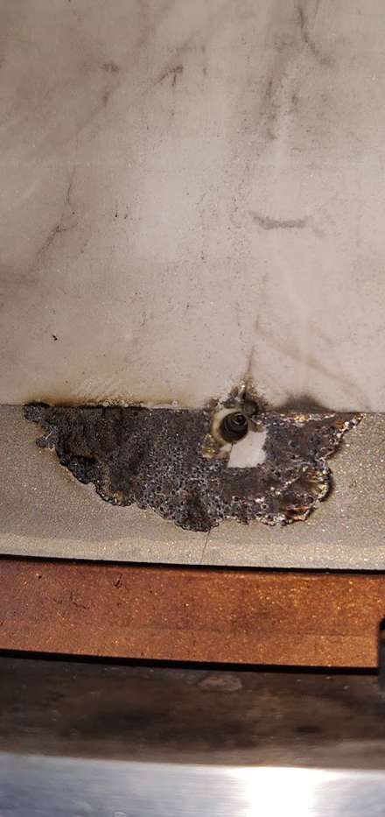
IOT Input Cavity: Ceramic Breakdown

Slide 12
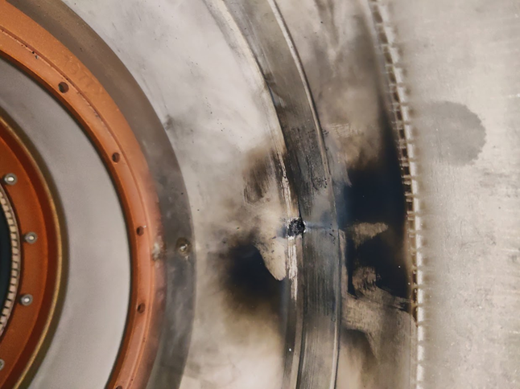
Inside Input Cavity

Slide 13
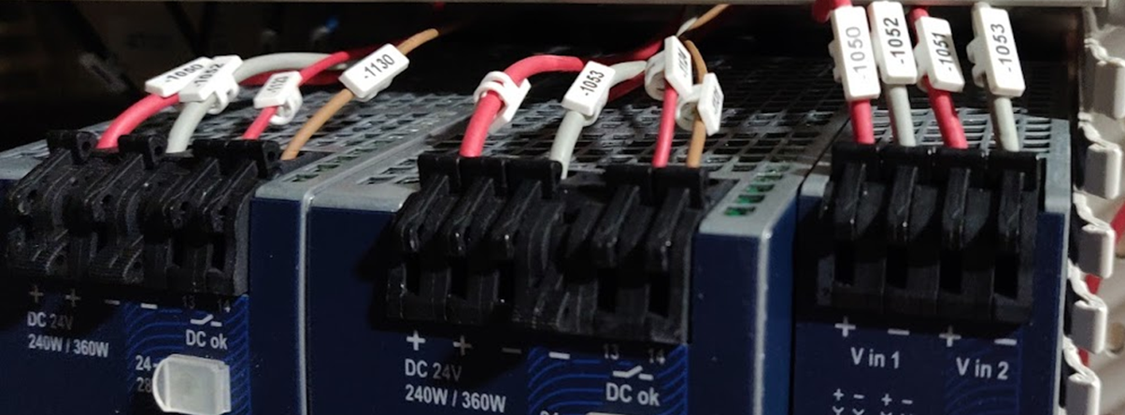
Booster 2: SSA Interlock 24V PSU
No ferrules

Slide 14
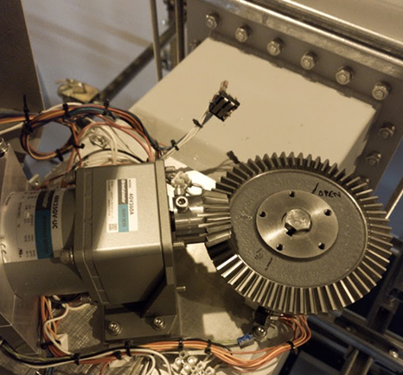
3rd NC Cavity: Waveguide Switch

Slide 15
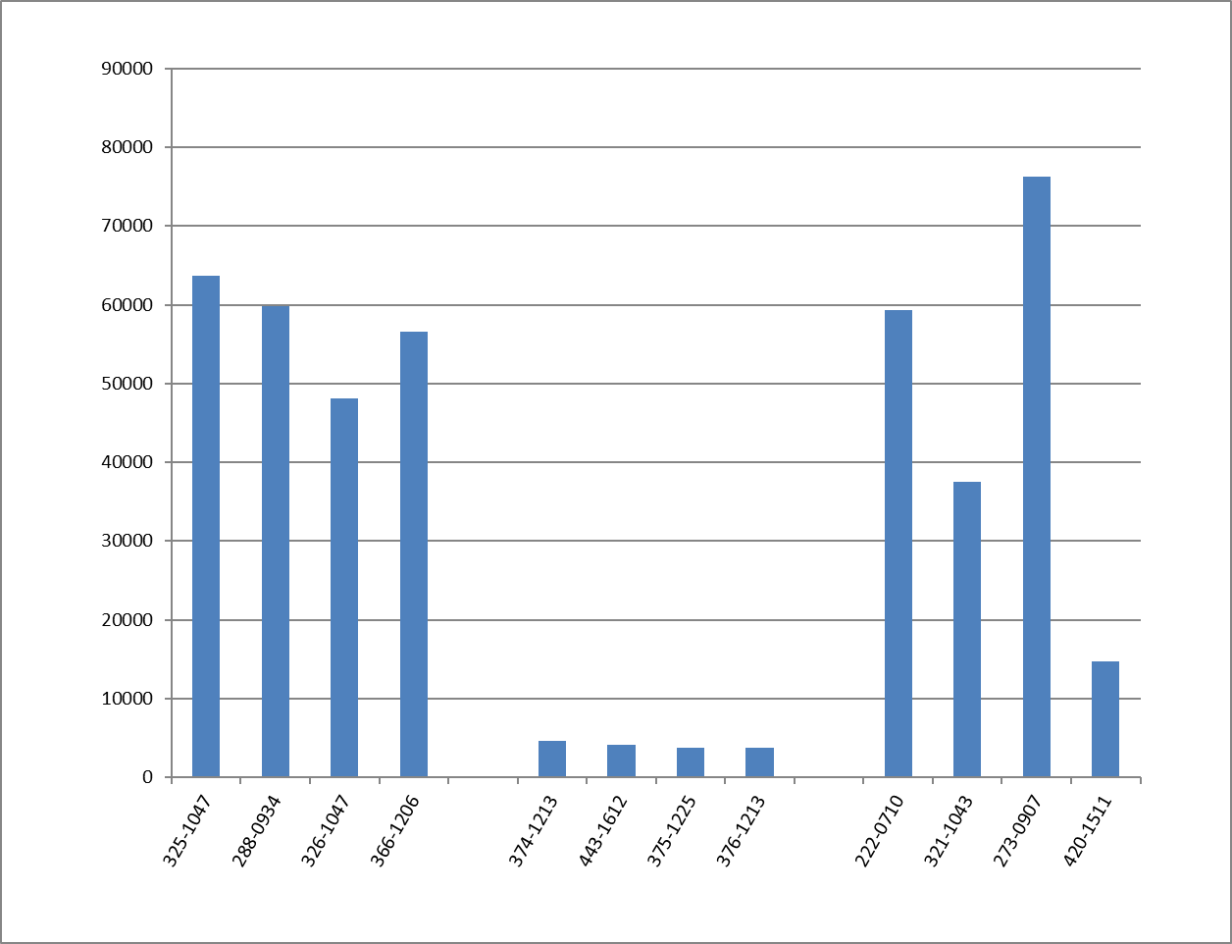
E2v IOT Operating Hours

Slide 16
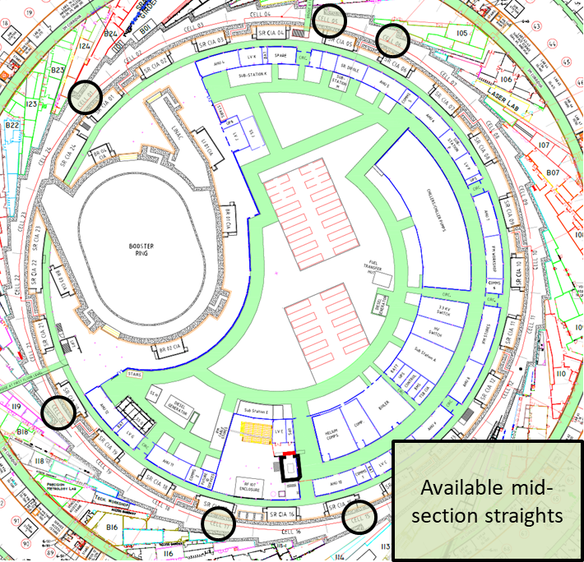
Diamond-II Upgrade
Diamond-I:
RF is concentrated in one area
Amplifiers in RF hall
Cavities in single RF straight
Diamond-II:
RF Cavities can be distributed in pairs around available mid-section straights
New beamline can be installed in present RF straight
Seven mid-section straights are available
Installation of most new amplifiers is possible with no impact on operating RF

Slide 17
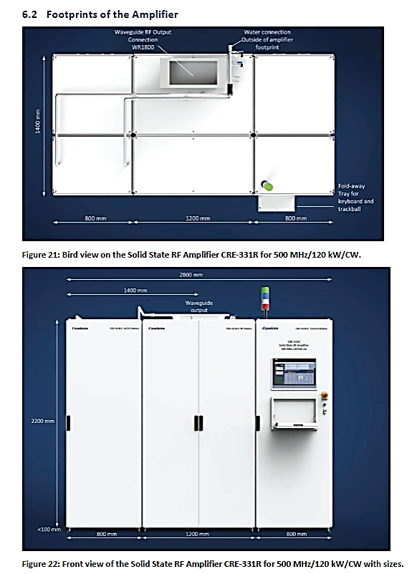
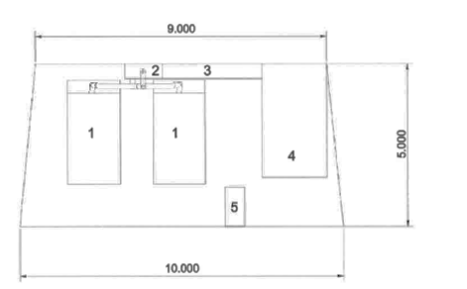
Compact SSA for Diamond-II
Amplifier units
Combiner
Transmission line
Circulator and load
Services
Specification for six SSAs for Diamond-II included a requirement to fit into available space between CIAs
  Five tenders received, all compliant
Decision made on a range of technical and commercial criteria
  Winning tender has been notified
  Order for 6 SSAs has been placed with Cryoelectra
  DLS to provide circulator and load

Slide 18
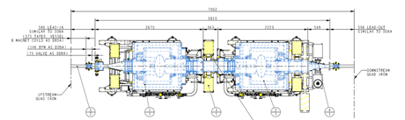
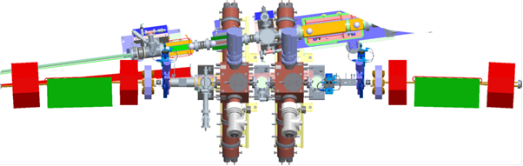
Cavity layout
A new beamline will be installed in what is now the Diamond-I RF straight
Cavities must move to mid-section straights
  Cryostat cannot fit in shorter straight and provide clearance for front ends
  HOM-dampers of NC cavity can fit around a modified front-end support
  Space must be provided for amplifiers
  Easier to fit multiple smaller amplifiers than smaller number of large amplifiers

Slide 19
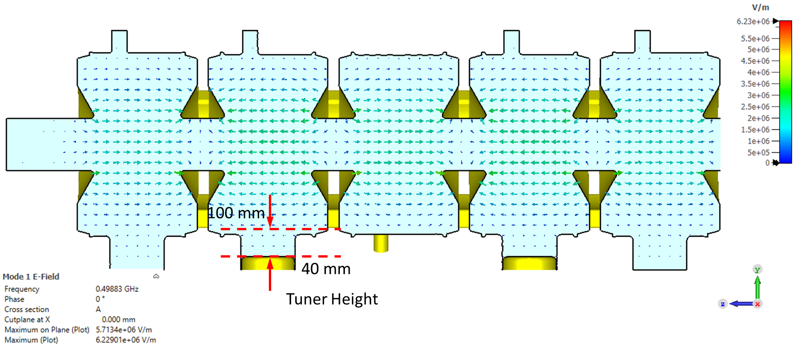
Booster Cavity Tuner range

Slide 20
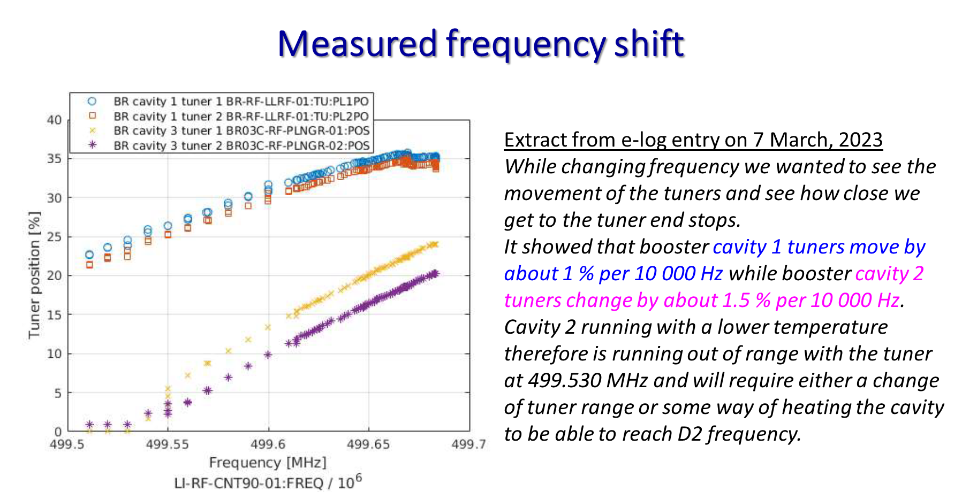
Booster RF – Frequency Shift
Diamond-II Frequency (499.51059 MHz)

Slide 21
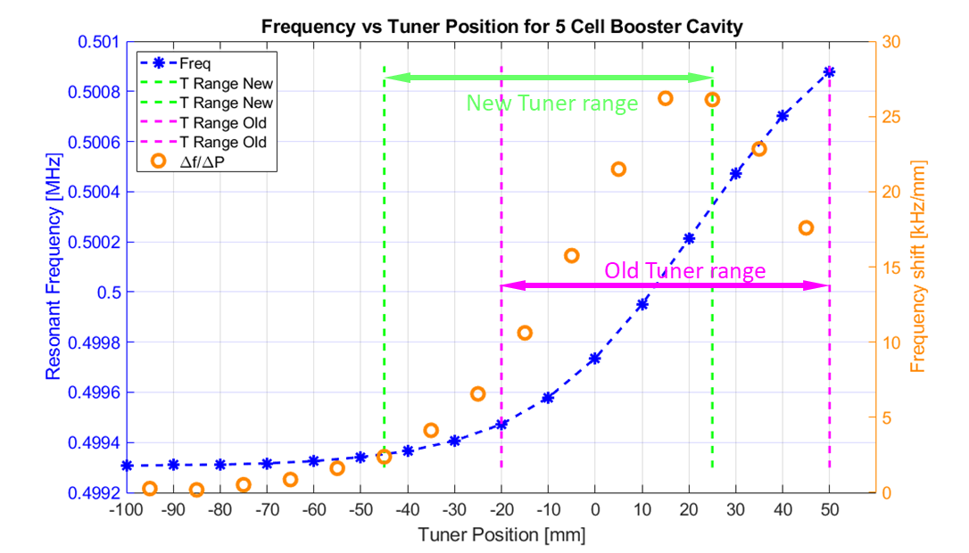
Frequency Issues – Booster
New CST results after tuner modification

Slide 22
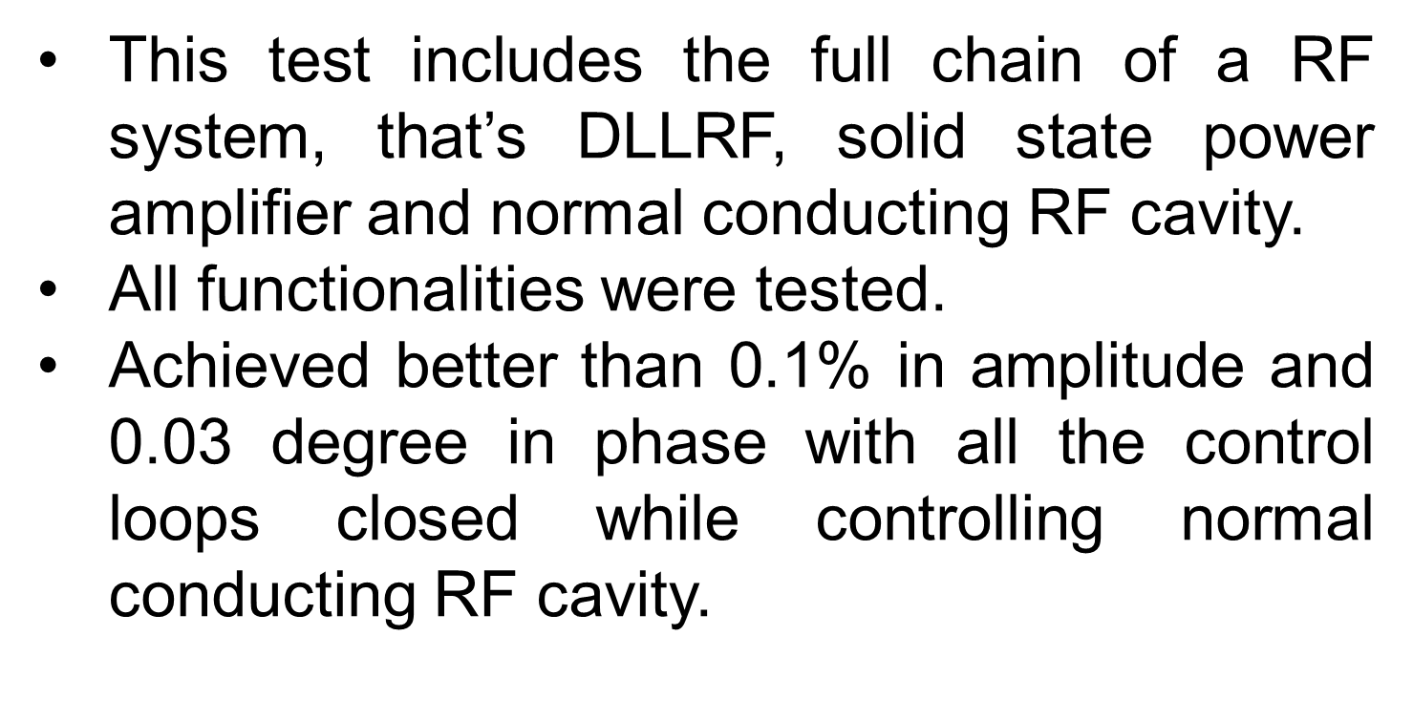
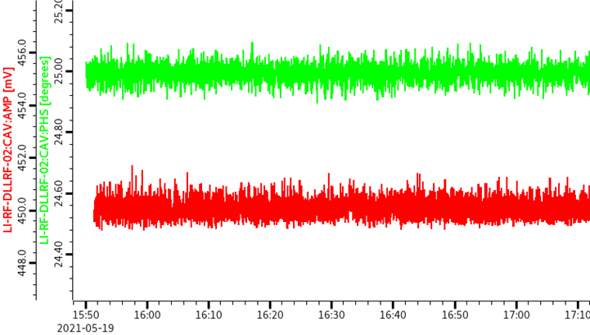
New DLLRF Tests on NC Cavity

Slide 23
Ongoing Projects – Linac SLED
SLED Cavity
SLED cavity upgrade
    To run 2 structure from one klystron and therefore improve resilience against system failures

Slide 24
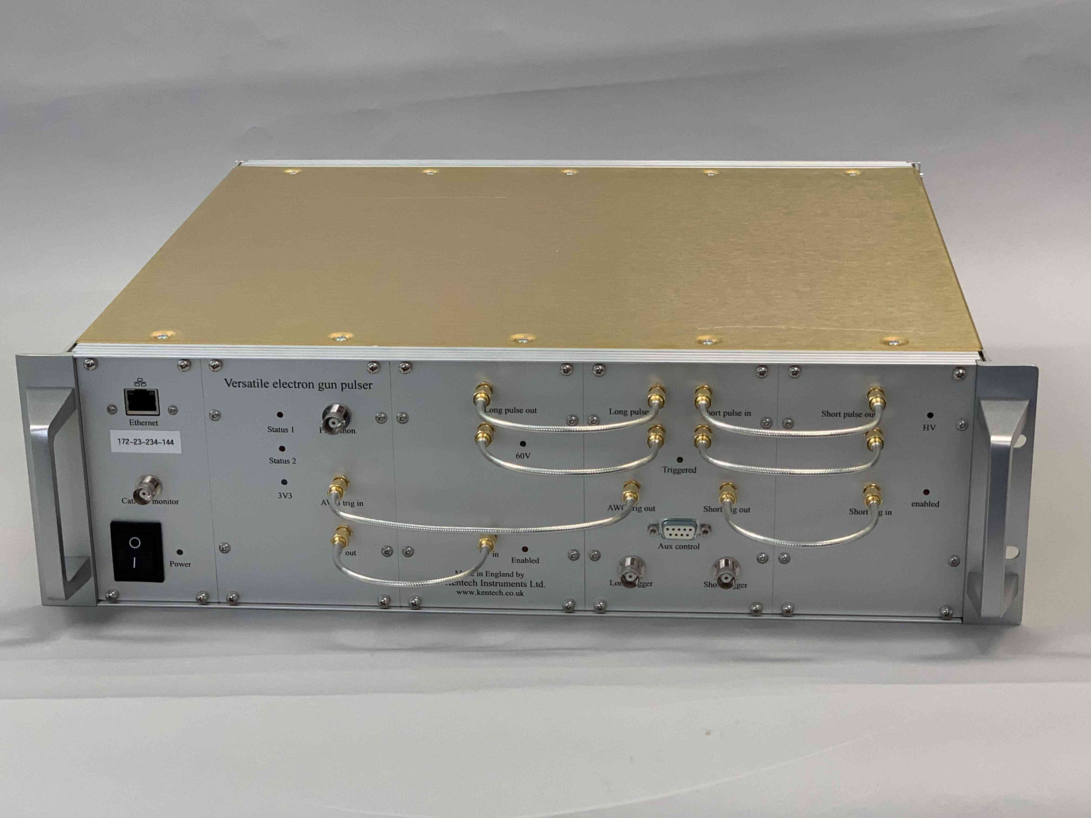
Ongoing Projects – Linac Gun
New pulser upgrade
    To upgrade gun output and flatness and get the ability to run multi-bunch top up

Slide 25
Summary
Conceptual design has been identified
  500MHz RF frequency
  7 normal conducting cavities
  7 solid state amplifiers
  Digital LLRF in microTCA format
  Third harmonic cavity
Next steps
  Install platforms for SSAs
  Modify booster tuner with spacer
  Finalise third harmonic cavity choice
  Diamond RF Group
  Pengda Gu, David Child, Marco Marziani, Peter Marten, Shivaji Pande, Adam Rankin, Anton Tropp

Slide 26
Thank you for your attention

