Slide 1
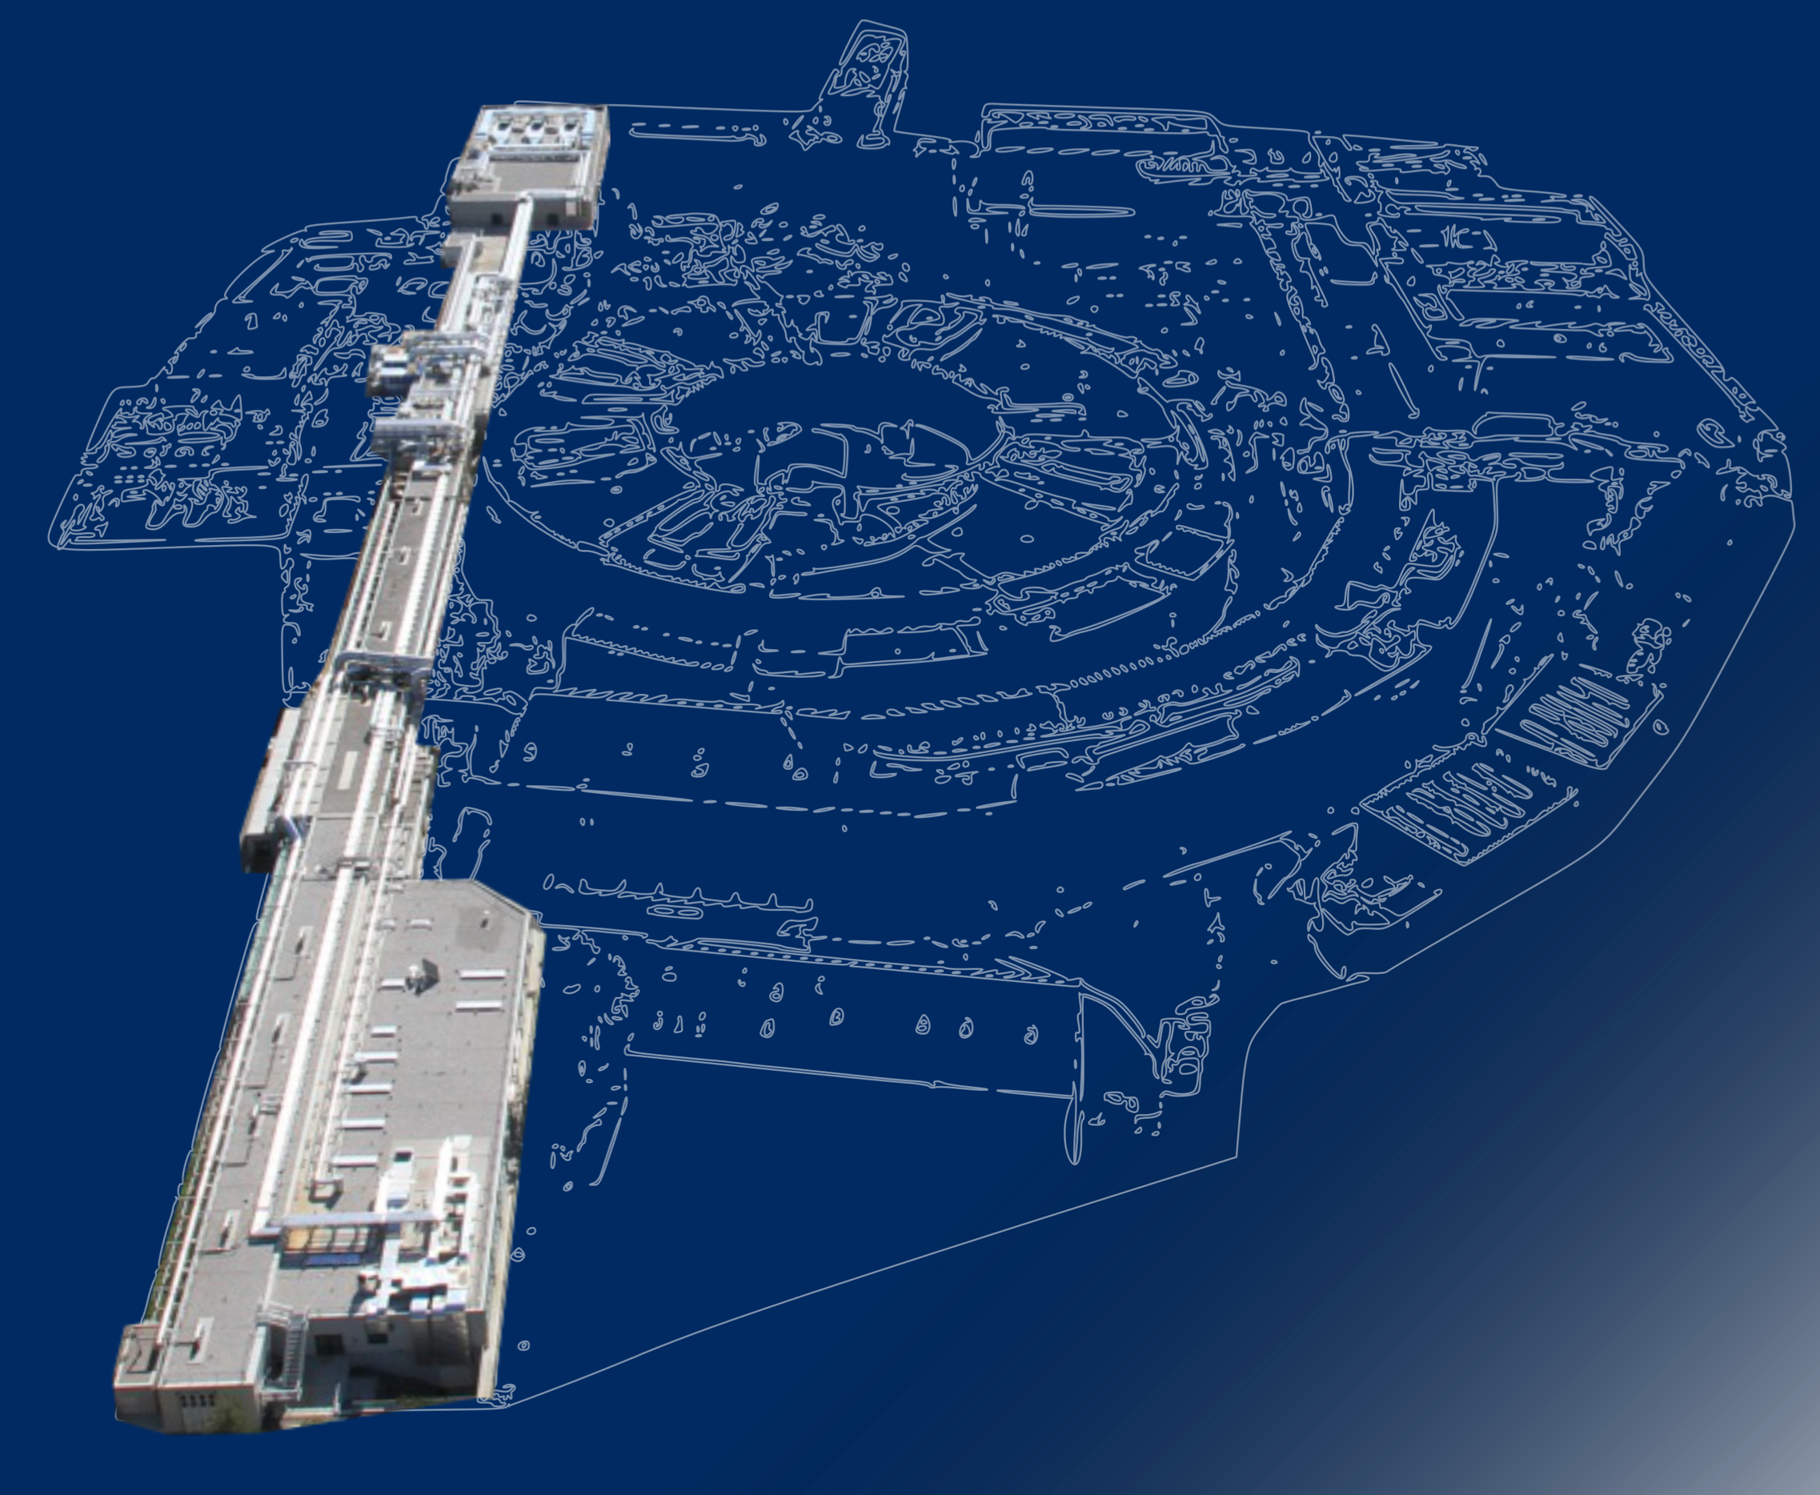
FERMI present status and future upgrade
Giuseppe Penco
On behalf of the FERMI Team

Slide 2
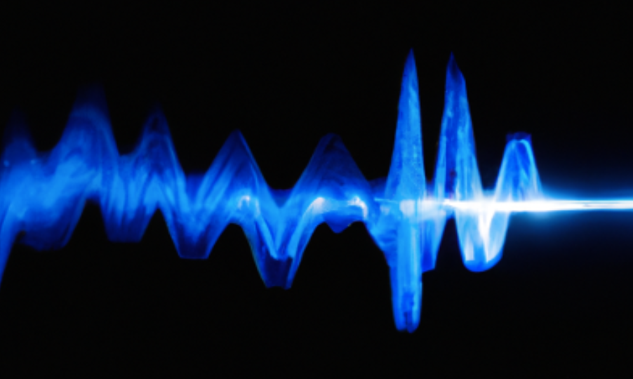

Outline
Introduction: FEL
FERMI: a fully coherent light source from VUV to soft x-ray
Near future upgrade (FEL-1 in EEHG)
Future upgrade: FERMI 2.0 into the water window and beyond
Trieste – 8-9 November 2023

Slide 3
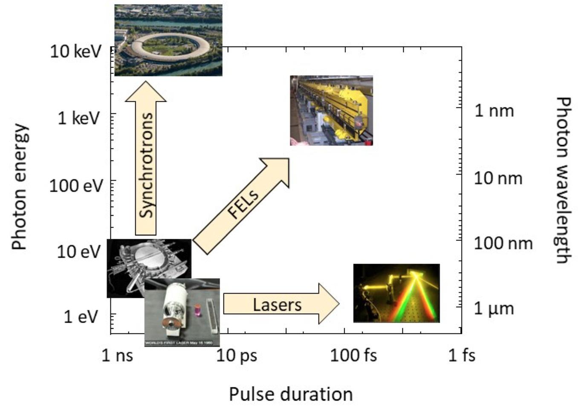
Free Electron Laser
EUV and X-ray beams, tunable in λ and polarization
Short (down to few optical cycles) high-brightness pulses of visible light
Trieste – 8-9 November 2023
Notes:
A large fraction of modern experimental science has been developed based on light sources, whose most prominent examples have been optical lasers and synchrotrons .

Slide 4
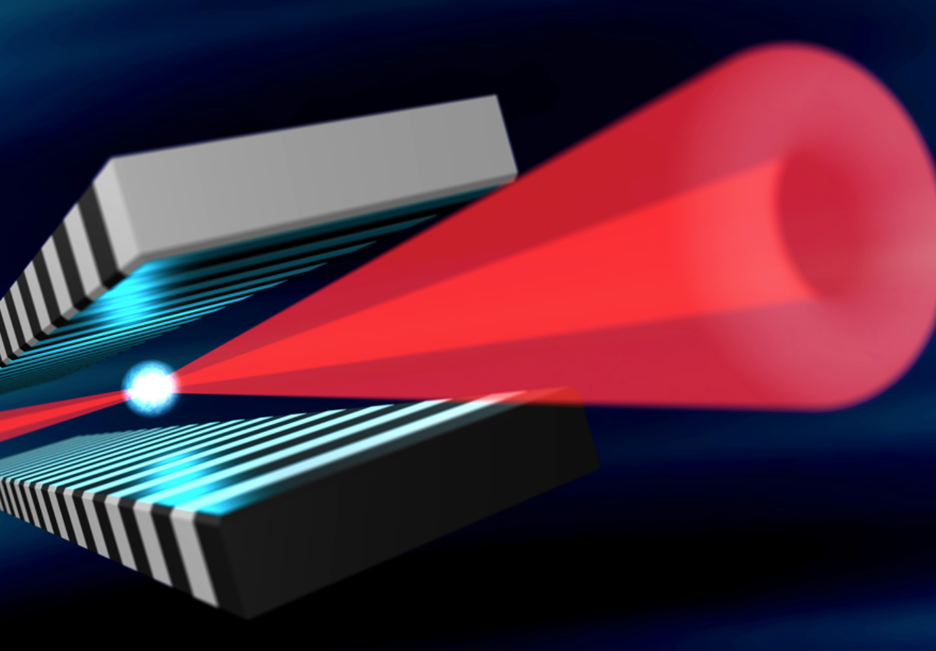
Free Electron Laser
EUV and X-ray beams, tunable in λ and polarization
EUV/X-ray free-electron lasers (FELs) point towards the diagonal between synchrotrons and lasers features: the generation of ultrafast and high-brightness pulses of EUV and X-ray photons
Short (down to few optical cycles) high-brightness pulses of visible light
Trieste – 8-9 November 2023

Slide 5
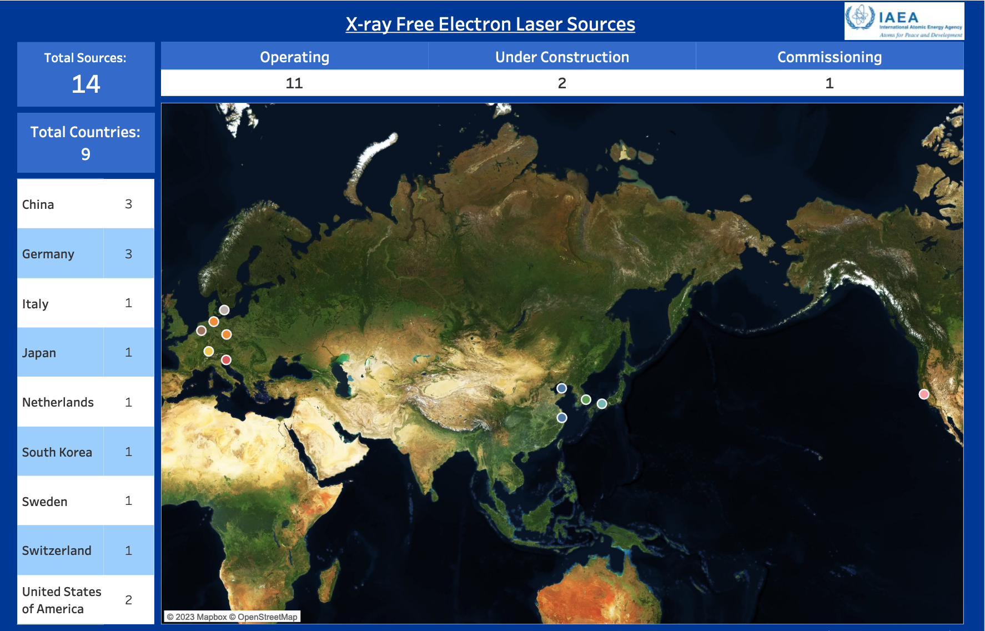
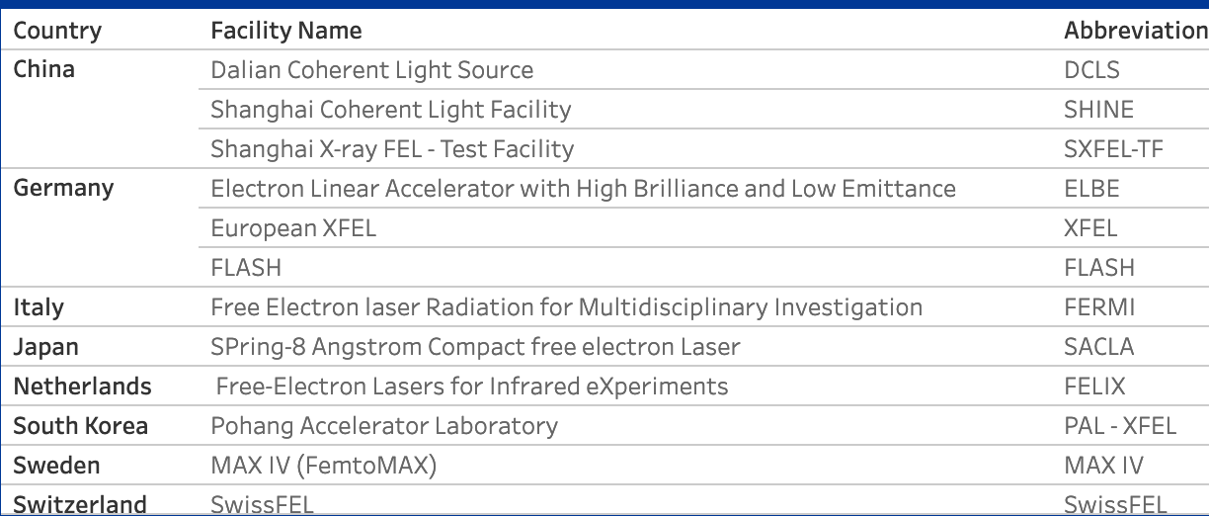
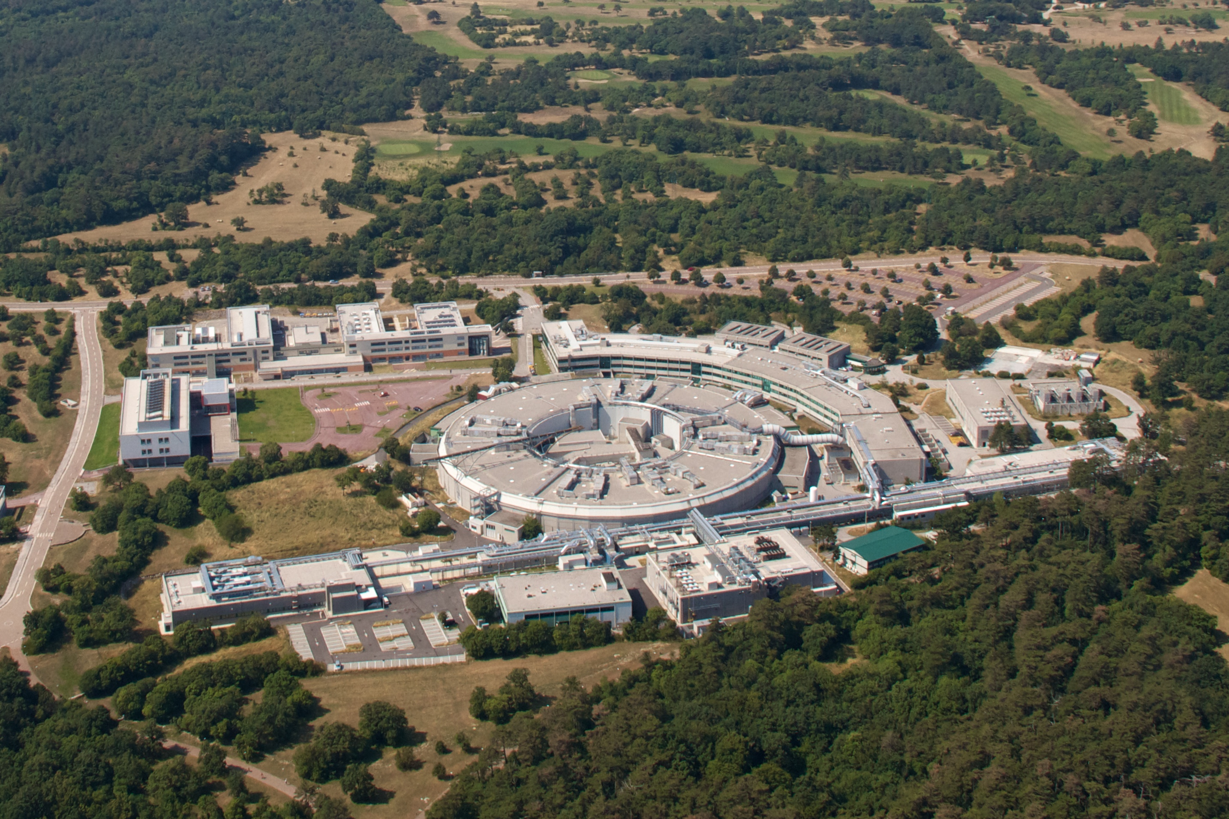
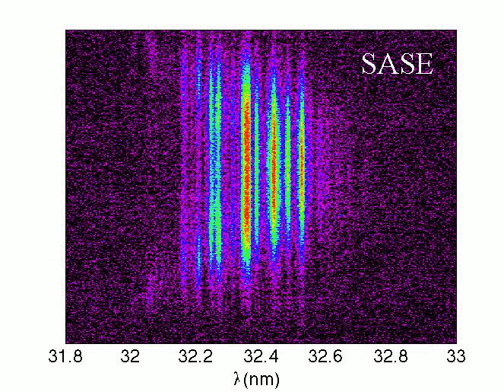
FELs around the world
https://nucleus.iaea.org/sites/accelerators/Pages/Interactive-Map-of-Accelerators.aspx
ELETTRA Synchrotron Light Source:
2.0 GeV and 2.4 GeV, top-up mode,
FERMI is the best approximation of a “true laser” among FELs
FERMI externally Seeded –
High Gain Harmonic Generation FELs
First e-beam in Aug 2008
First lasing in 2010
Linac up to 1.5 GeV
FEL-1: 100-20nm; FEL-2: 20-4nm
Trieste – 8-9 November 2023
Notes:
The pay-off is the spectral range

Slide 6
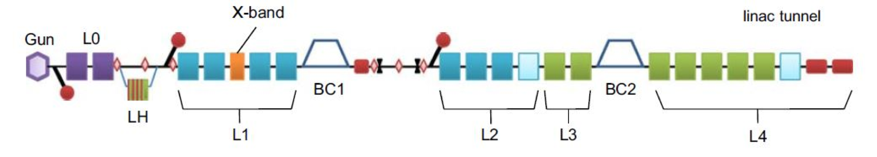
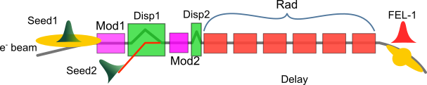
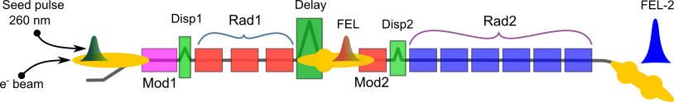
FERMI layout
S-band Linac (3 GHz)
Bunch Compressor ~280MeV (Ip~500-700A)
Injector 100MeV
E=0.9-1.6GeV
Q=500pC, 50Hz
FEL-1
(100-20nm)
FEL-1 upgraded to EEHG
FEL-2
(20-4nm)
Trieste – 8-9 November 2023

Slide 7
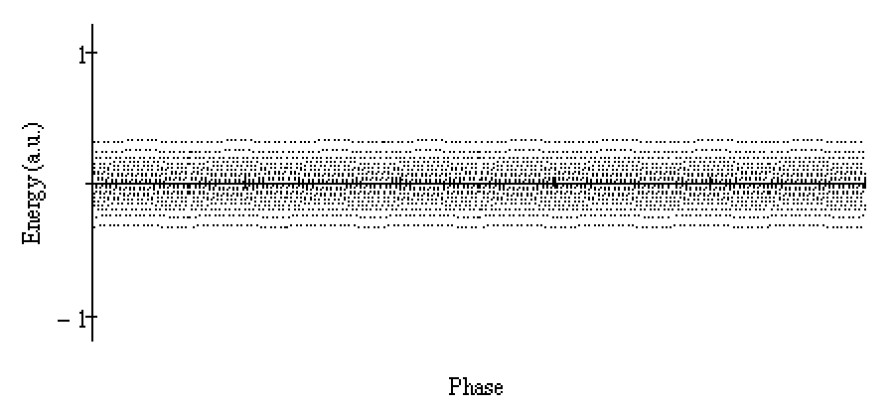
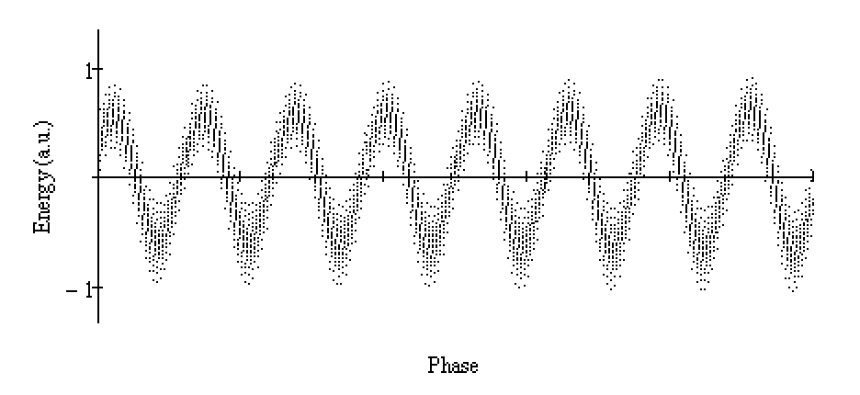
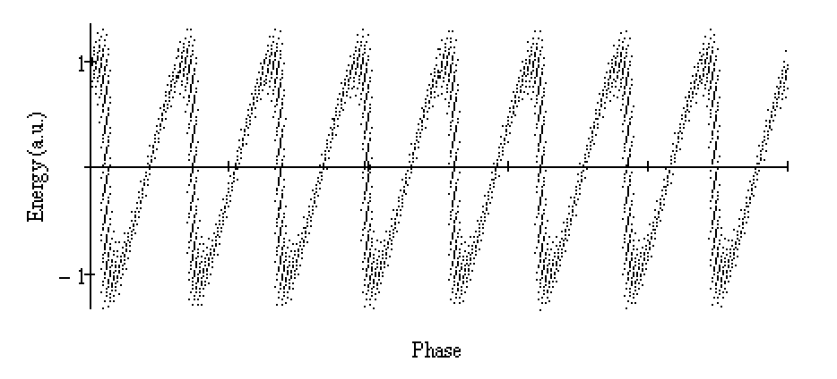
High Gain Harmonic Generation (HGHG)
HGHG scheme has been proposed to partially solve the lack of seeding sources at short wavelengths. More compact than SASE and fully temp. coherent
modulator
High gain radiator tuned at n^{th} harmonic
Seed
THG or
tuneable OPA
dispersion
n^{th} harmonic
radiation
Seed
e-beam
modulated e-beam
Fresh beam
Modulated beam
Bunched beam
Trieste – 8-9 November 2023

Slide 8
HGHG (double-stage cascade)
*L. H. Yu, I. Ben-Zvi, NIM 1993
Position:
1st mod.
1st rad.
2nd mod.
2nd rad.
DS1
DL
DS2
The seed @260nm
is on the tail of the e-beam
Seed
e-beam
n^{th} harmonic
(e.g. 20 nm)
The first stage converts the seed
to the n^{th} harmonic
(13th harmonic @20nm)
n^{th} x m^{th} harmonic
(e.g. 4 nm)
The delay line shifts the first stage output
to a fresh portion of the e-beam
The second stage converts the first stage
to the n^{th} x m^{th} harmonic of the seed
Trieste – 8-9 November 2023

Slide 9
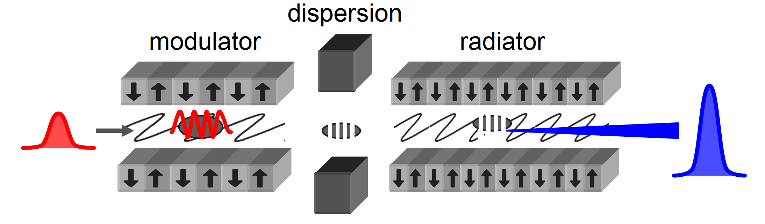
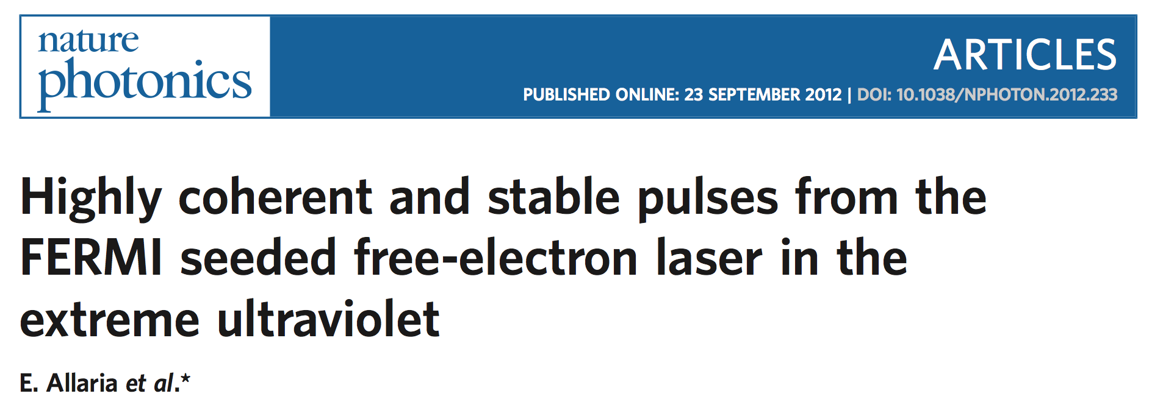
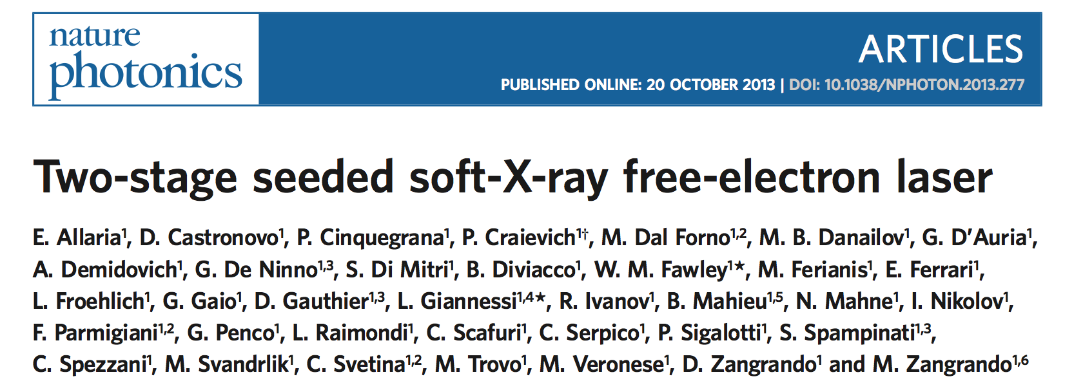
FERMI (High Gain Harmonic Generation):
FEL-1 and FEL-2
FEL-1 : Single stage HGHG
* Apple II type helical undulators (variable gap)
Seed Laser:
THG (~260nm)
OPA (230-260nm or 296-360nm)
Mod.
High gain radiator tuned at n^{th} harmonic
Dispersion
Spectral range: 20 – 100 nm
FEL-2 : Double stage HGHG with fresh bunch injection technique
1st mod.
1st rad.
2nd mod.
DS1
DL
DS2
2nd rad.
Spectral range: 4 - 20 nm
Trieste – 8-9 November 2023

Slide 10
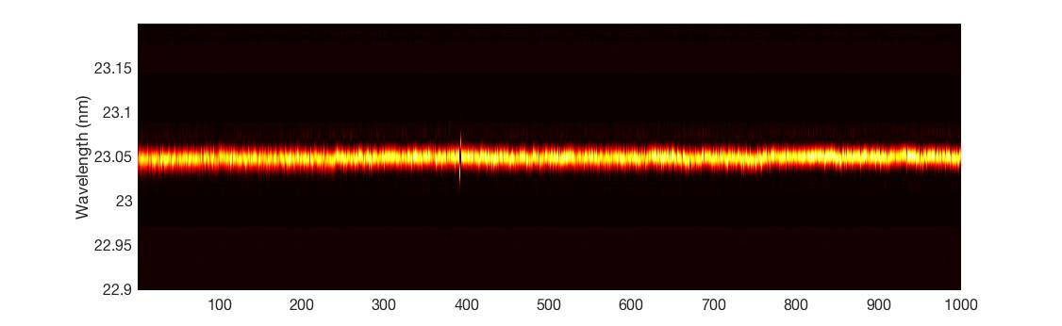
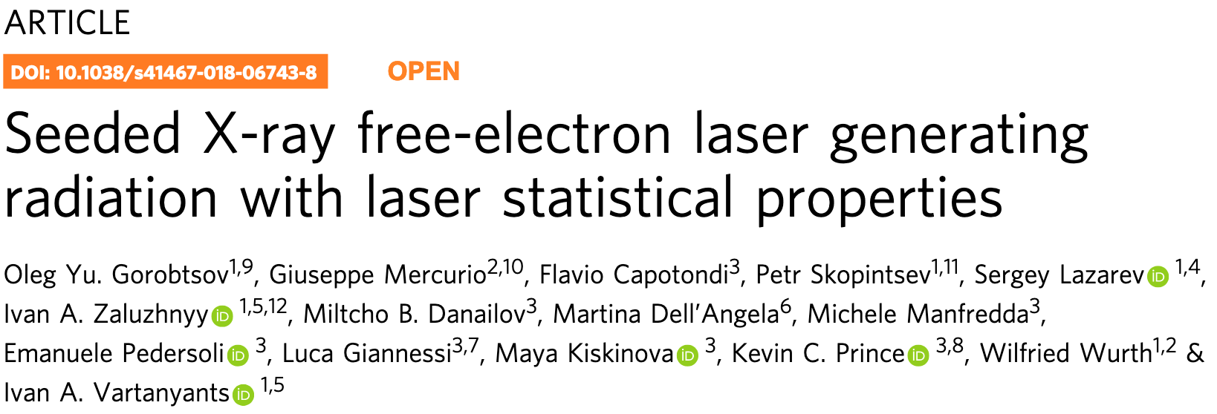
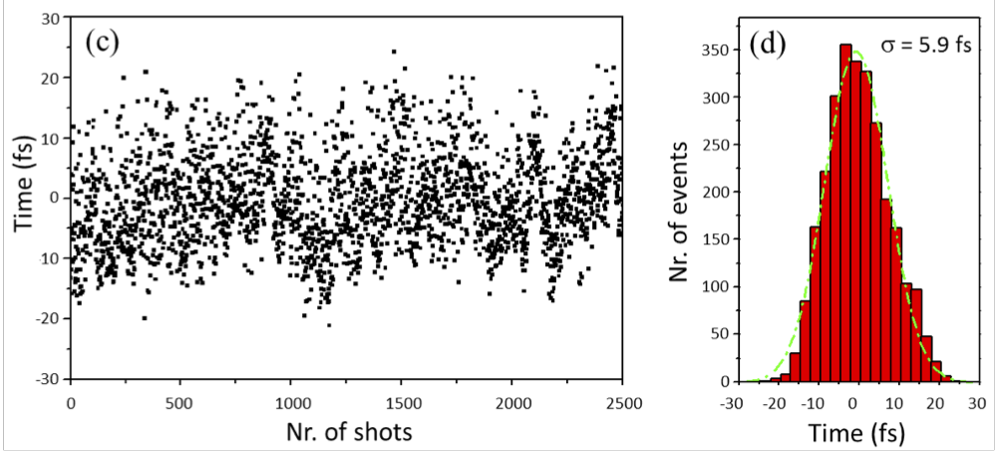
Spectral and temporal properties
The FEL inherits the coherence of the seed laser :
High degree of coherence
High reproducibility
Gorobtstov et al.
Temporal jitter < 6 fs
Thanks to the use of the seeding, FEL pulses are also synchronized to the pump-probe laser
M. Danailov et al. Optics Express, Vol. 22, Issue 11, 12869 (2014)

Slide 11
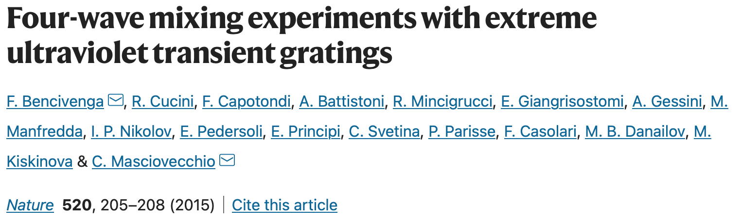
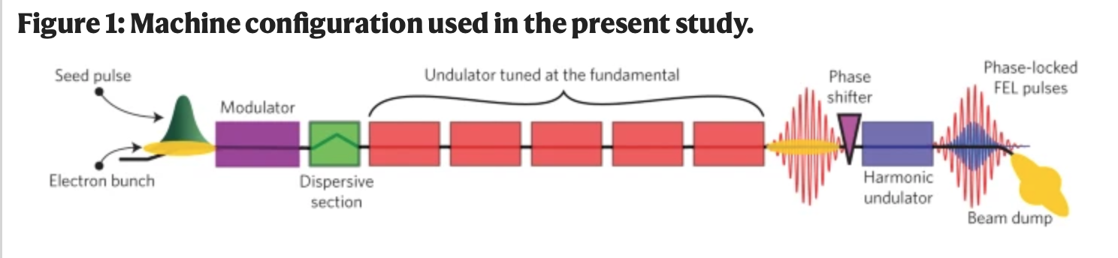
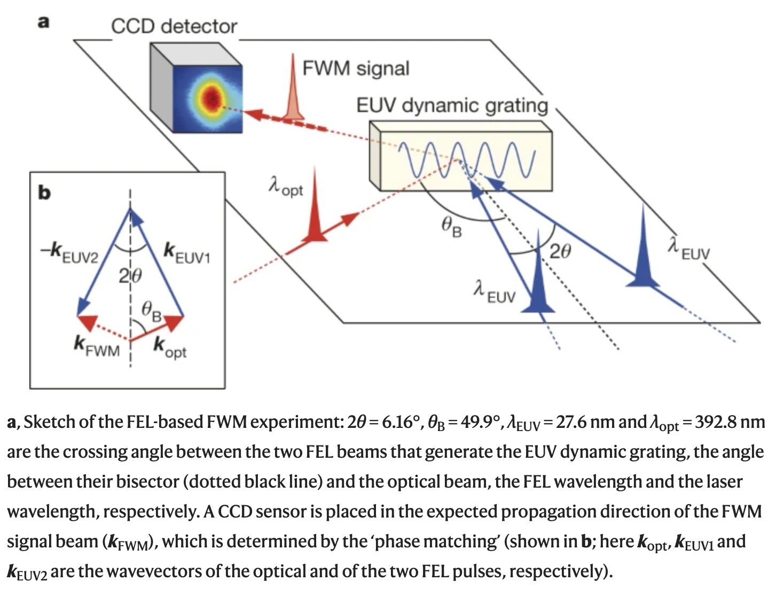
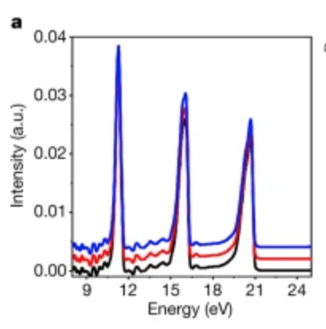
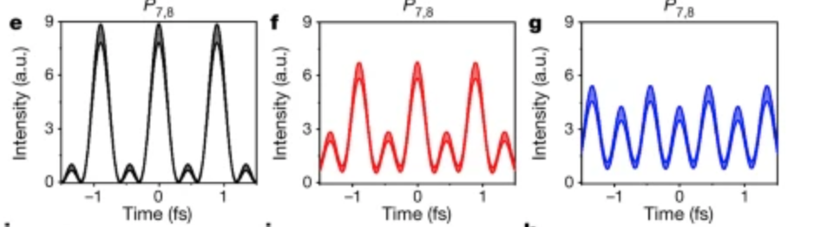
Some examples of applications of this fully coherent EUV and soft X-ray source
Coherent control with a temporal resolution of ~3 as!
Nature Photonics 10, pages 176–179 (2016)
Attosecond pulse shaping using a seeded FEL
Nature 578, 386-391 (2020)
Changing the phase between harmonics
Trieste – 8-9 November 2023

Slide 12
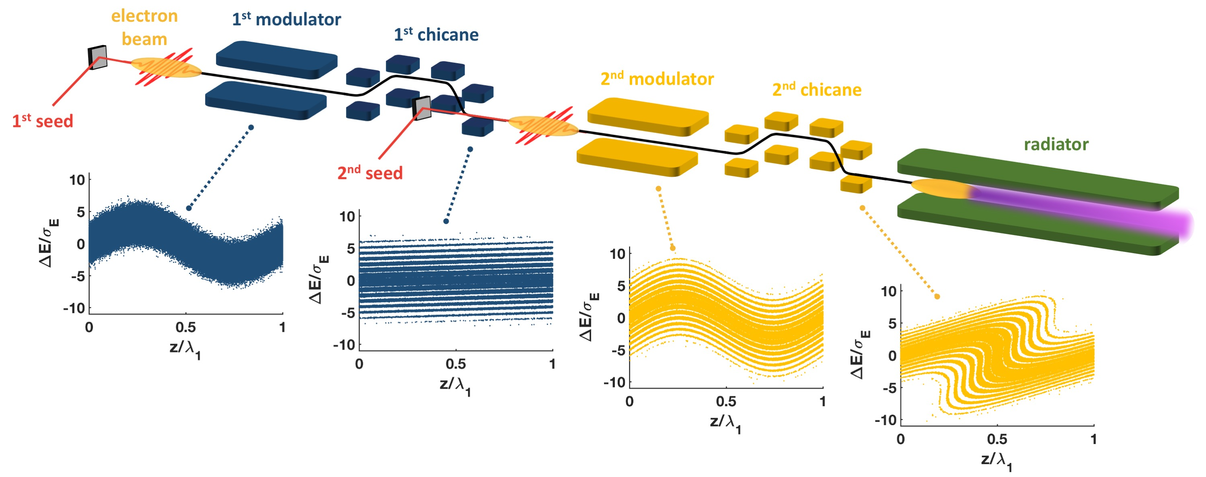
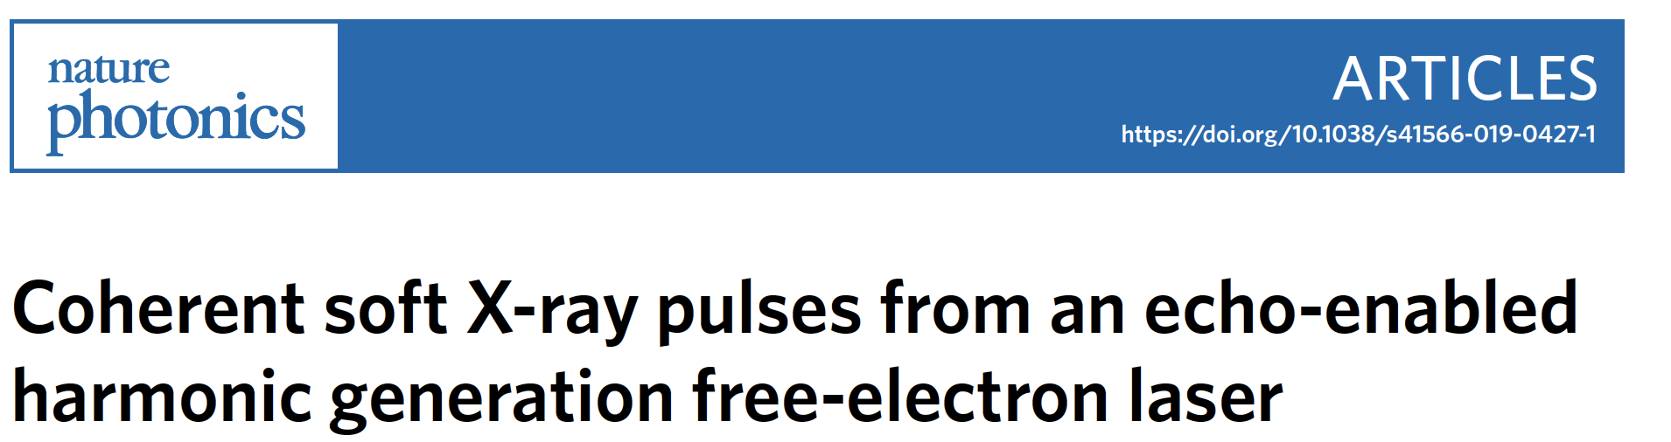
FERMI in EEHG mode
In 2018, The FERMI FEL2 layout was temporarily modified for test the Echo-Enabled Harmonic generation (EEHG) scheme (two interactions with two seeds and two dispersive sections).
B₁
A₁
A₂
B₂
P. R. Ribič, E. Allaria et al.
Now the ‘‘conventional’’ layout (double stage HGHG, fresh bunch) is restored
Trieste – 8-9 November 2023

Slide 13
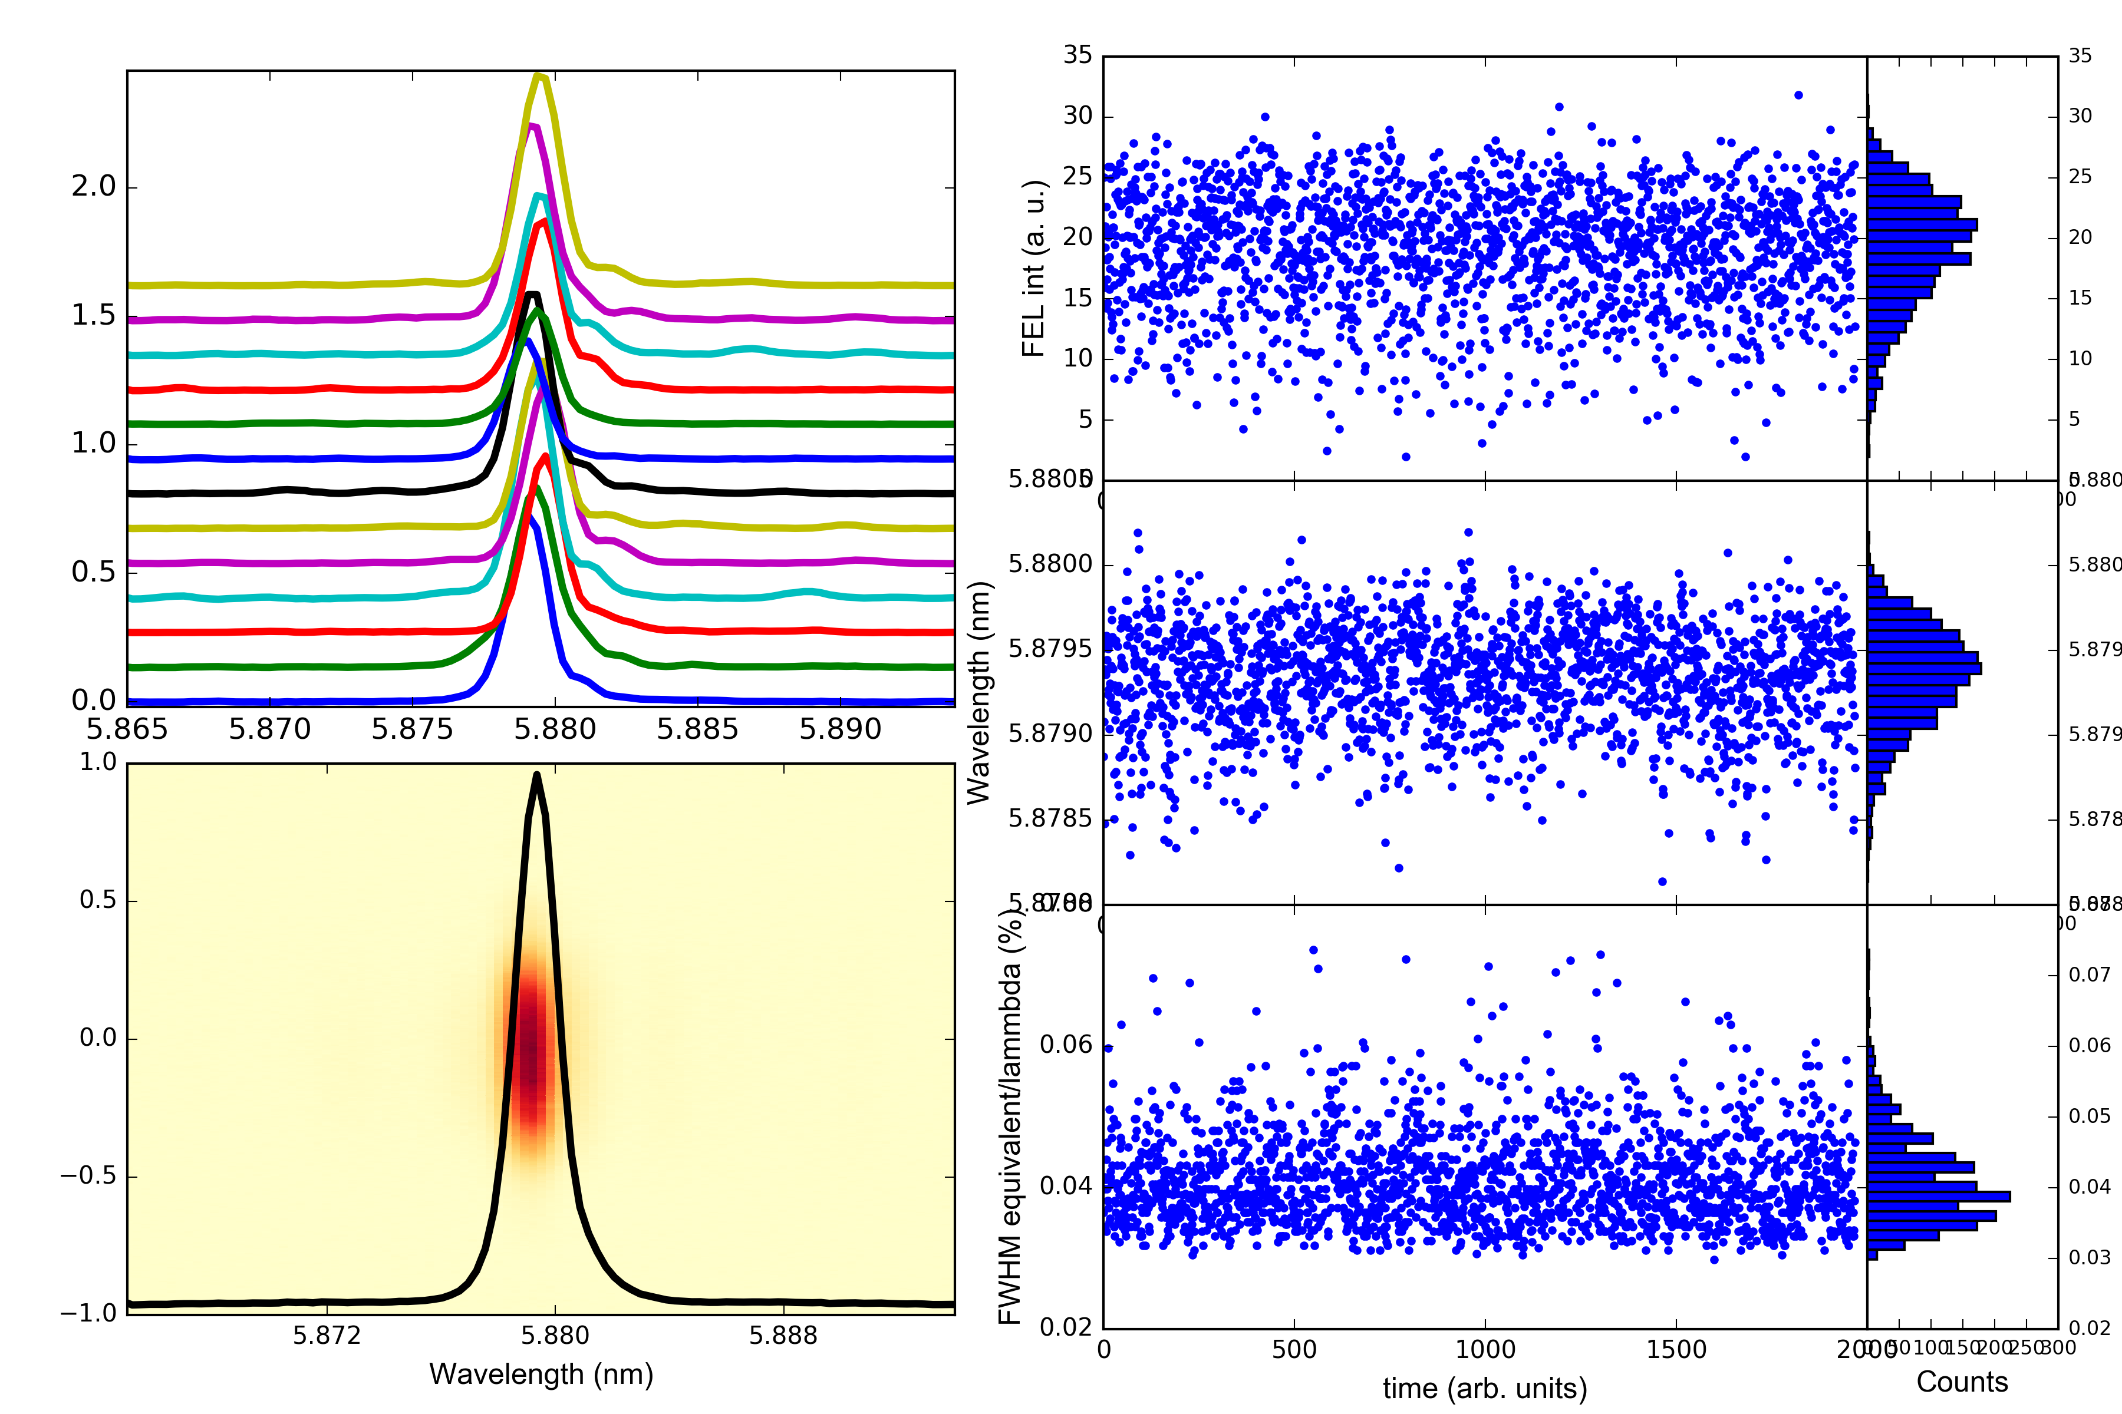
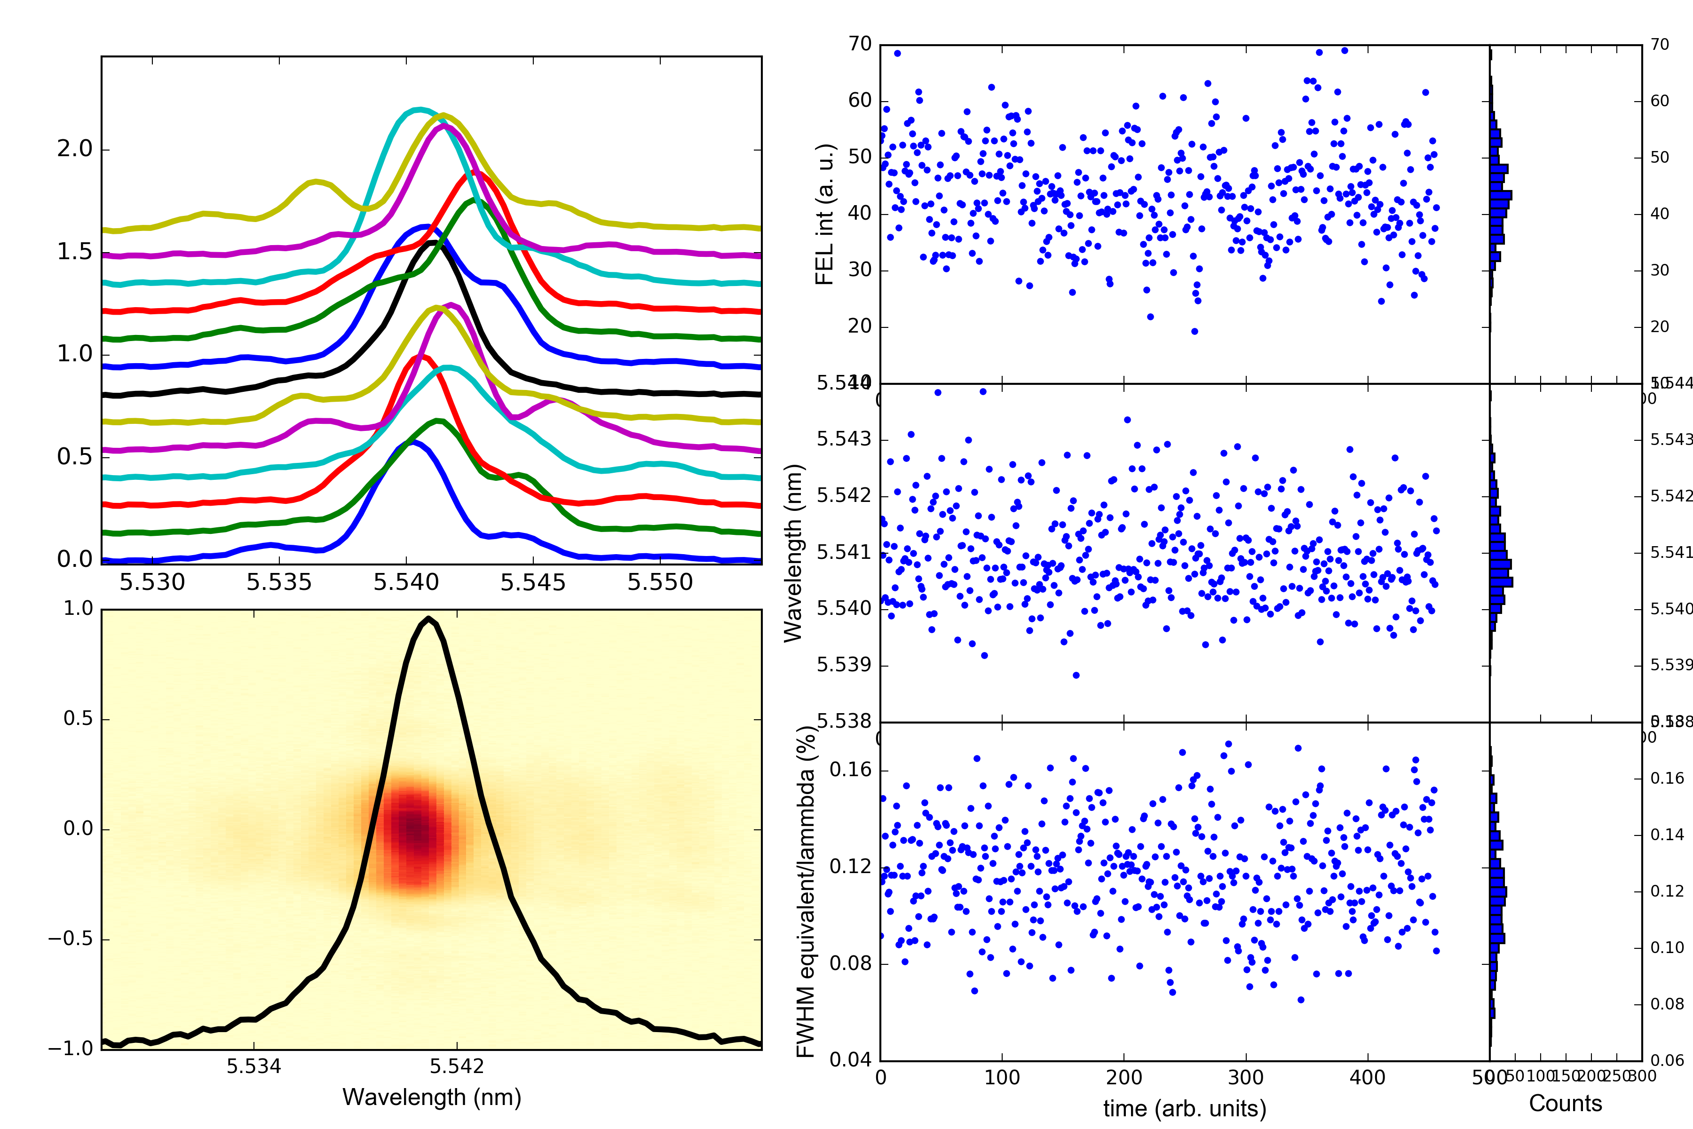
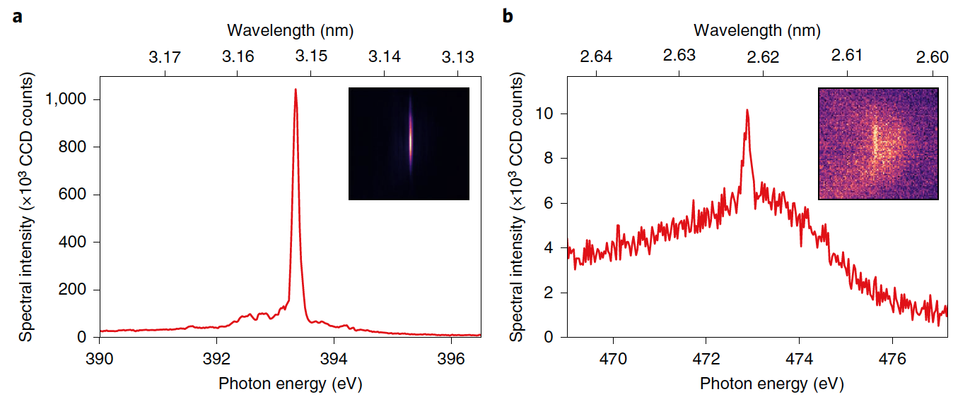
FERMI in Echo-enabled harmonic generation
EEHG has better spectral shape/stability, but lower pulse energy (below ~7 nm)
P. R. Ribič, E. Allaria et al.
EEHG
“conventional” (HGHG-FB)
5 nm
5 nm
Coherent emission at very high harmonics → wider range for single pass FELs !
Very low pulse energy was (no FEL gain) , comparable to the broadband spontaneous emission coming from the whole electron beam
h101 !
Trieste – 8-9 November 2023

Slide 14
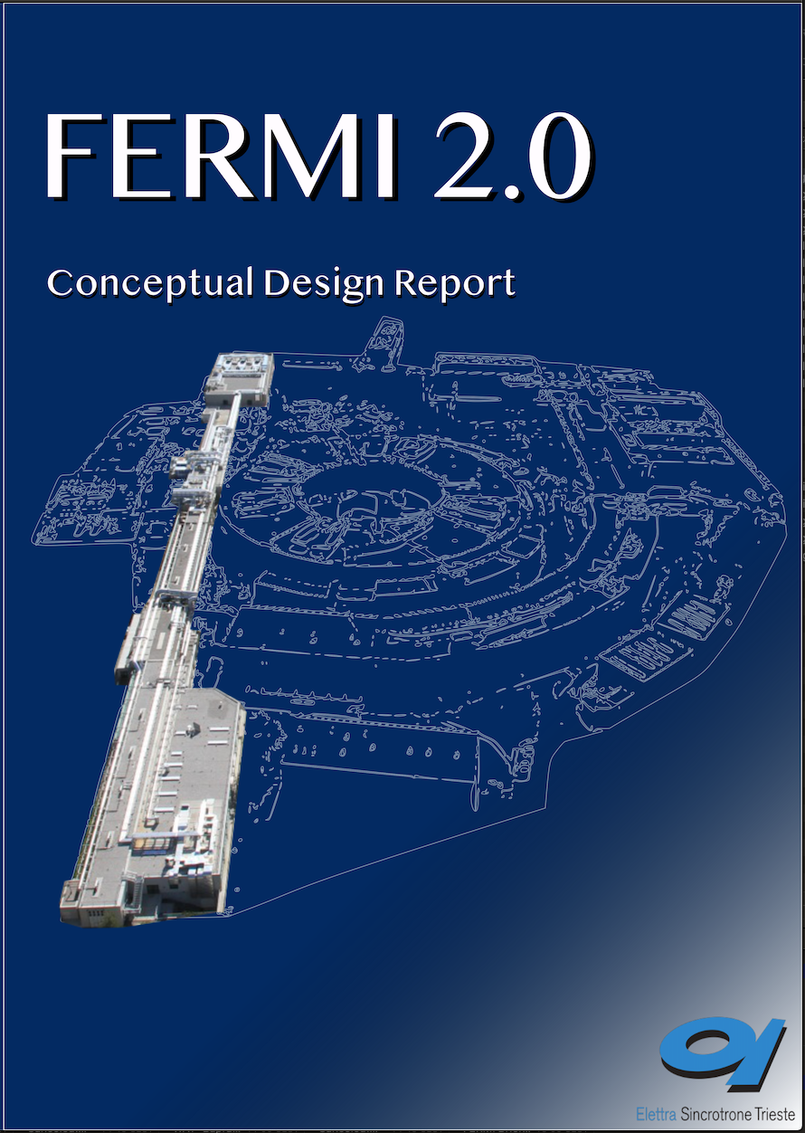
FERMI development strategy
Conclusions from Future of FERMI (FoF) workshop in 2016 were confirmed in subsequent MAC and SAC meetings:
⟶ Reduce pulse duration to the sub-10 fs range to resolve charge transfer processes, bond dynamics, vibrational dynamics.
«… new science opportunities become accessible in the ~10 fs (i.e. 5-15 fs) regime, and it is highly recommended to develop this capability at FERMI» (FERMI MAC SAC)
⟶ Extend photon energy range to N (410 eV), O (543 eV), and possibly beyond
« … it is highly recommended that FERMI pursue approaches that would extend the operating range to ~2 nm in the fundamental which coincides with the Oxygen k-edge» (FERMI SAC 2016)
« … pushing the short wavelength limit of FELs with external seeding is a scientific achievement by itself with impact on the international community of FEL builders and users» (FERMI MAC 2016)
Primary Goals:
Extend photon energy range to N (410 eV), O (543 eV) K-edges and possibly beyond, while preserving the features of a seeded FEL: coherence, fs-synchronization, control of the field properties.
Reduce FERMI pulse duration below 10 fs (in selected spectral ranges)
Trieste – 8-9 November 2023

Slide 15
New FEL-1 and FEL-2 lines
FEL-1
FEL-1 is converted to an EEHG FEL
FEL-1 original layout: HGHG spectral range 100-20 nm
NEW FLEXIBLE FEL-1 LAYOUT:
Still possible run in HGHG (M1+DS2);
New option: run in EEHG to extend the spectral range down to 10nm and improve the brightness
Commissioning on-going now
FEL-2 is still a double stage seeded FEL: the first stage is converted to an EEHG FEL
FEL-2 present: HGHG with fresh-bunch injection technique, spectral range 20-4 nm
EEHG (as FEL-1 new)
FEL-2 future: EEHG first stage with fresh-bunch injection technique, spectral range 20-2 nm
2027-2028
Trieste – 8-9 November 2023

Slide 16
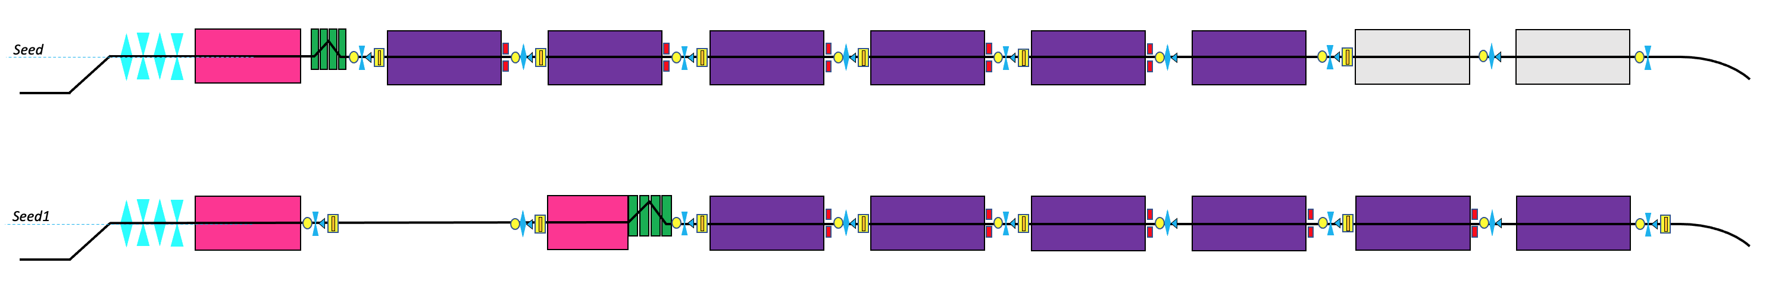
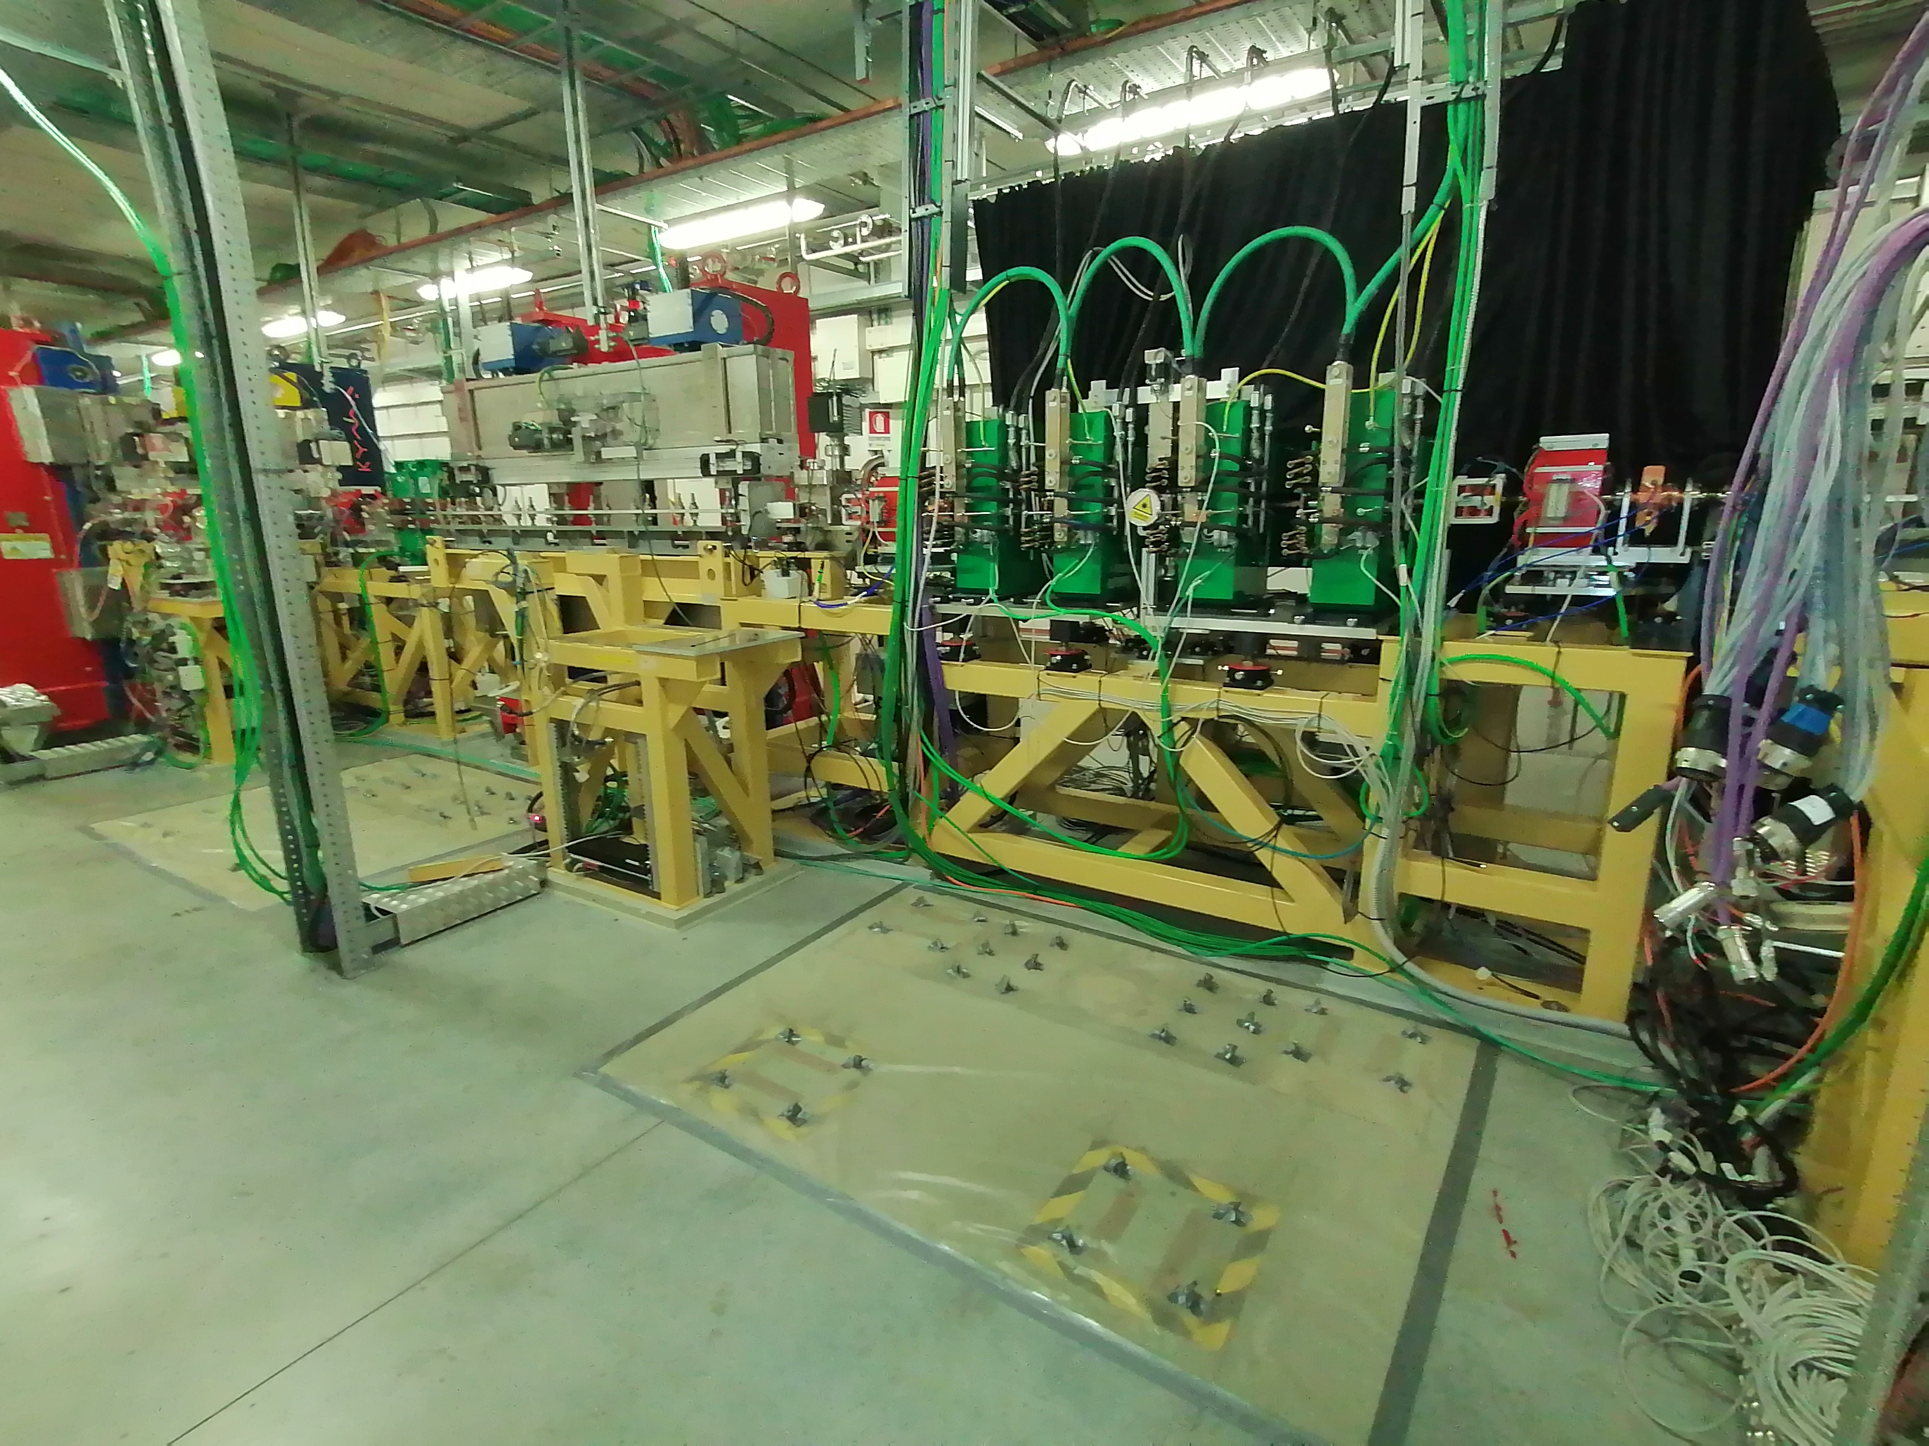
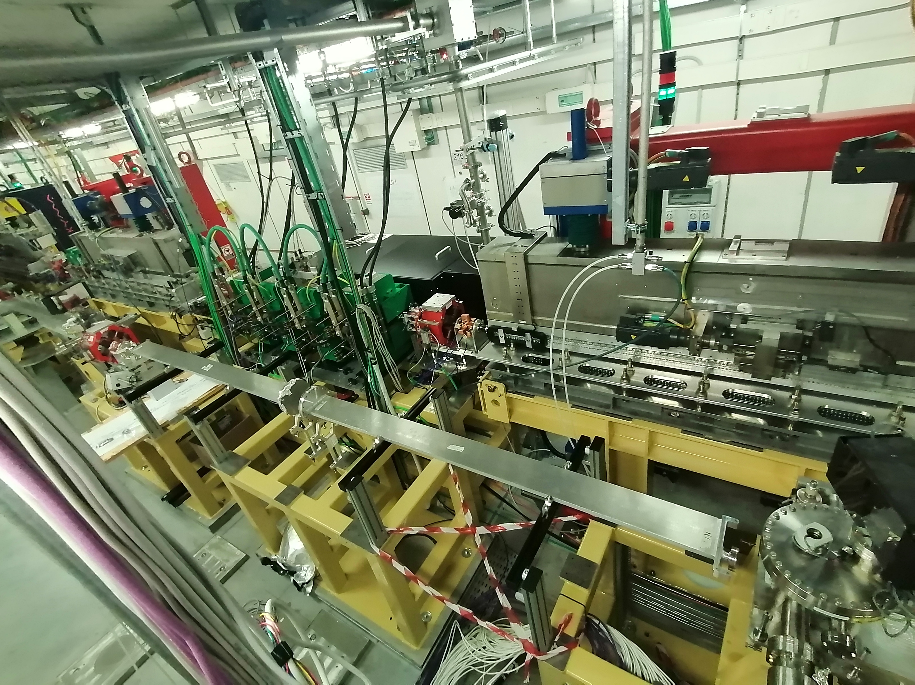
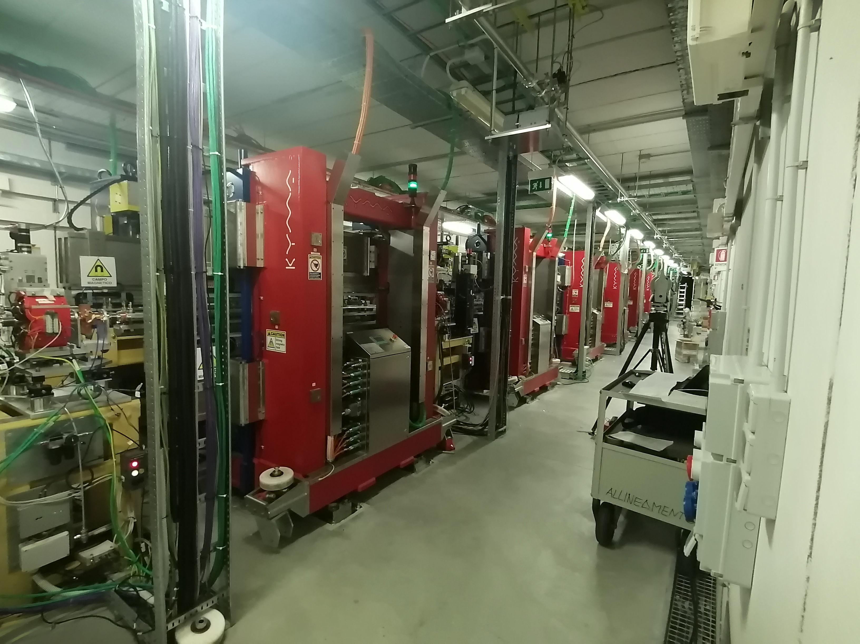
FEL-1 upgrade to EEHG – Summer Shutdown 2022
Ref. C. Spezzani
Trieste – 8-9 November 2023

Slide 17
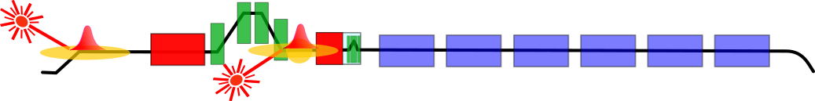
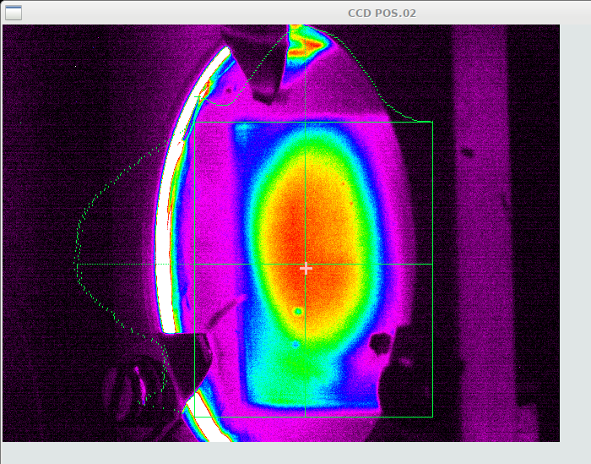
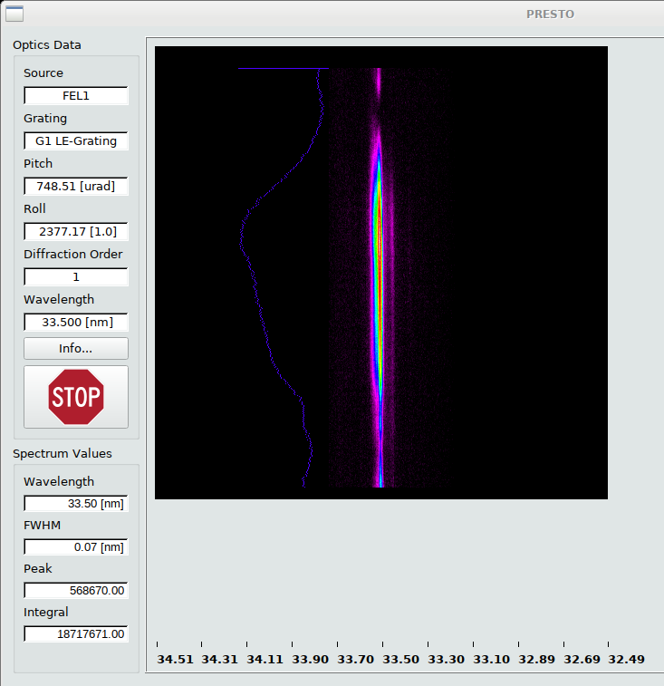
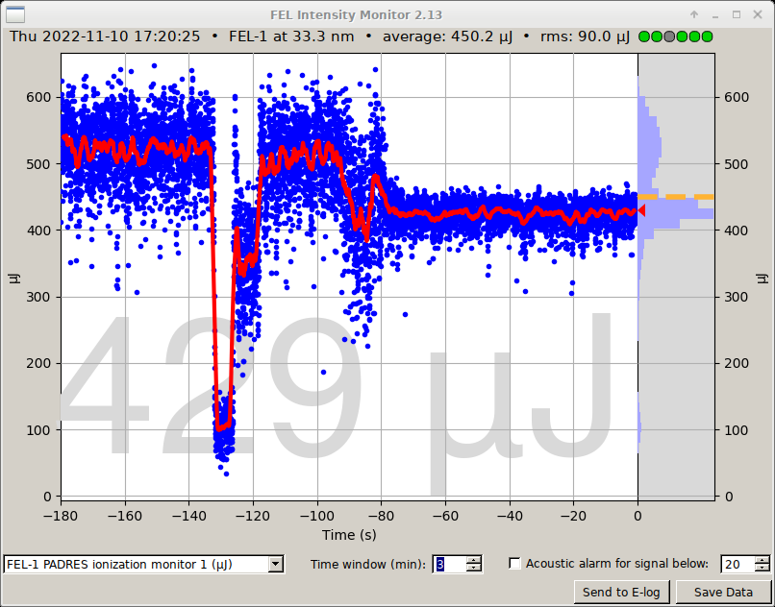
EEHG FEL-1 operated in HGHG successfully
DS1
DS2
Courtesy of E. Allaria
Despite the reduced number of periods, FEL-1 can be operated in HGHG using mod2 and seed1.
New options for two color FEL
Seed 1 on Modulator 1 + DS2 (DS1 set straight)
Very efficient HGHG signal measured using
Trieste – 8-9 November 2023

Slide 18
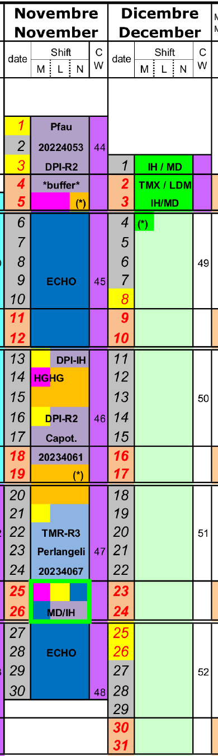
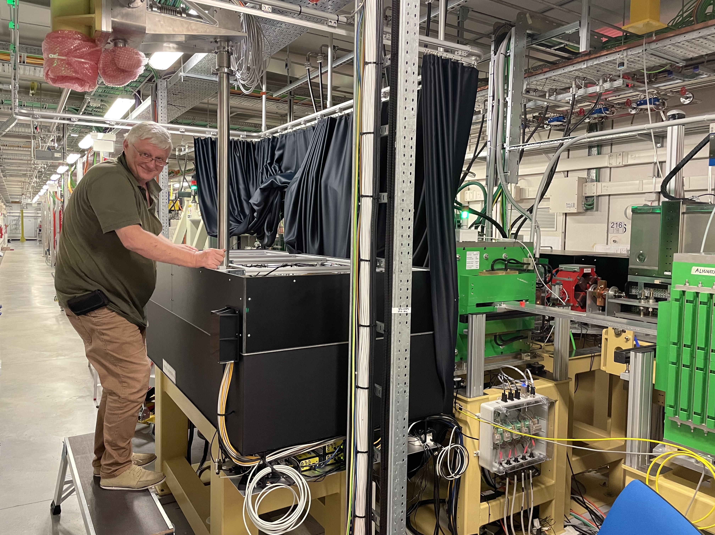
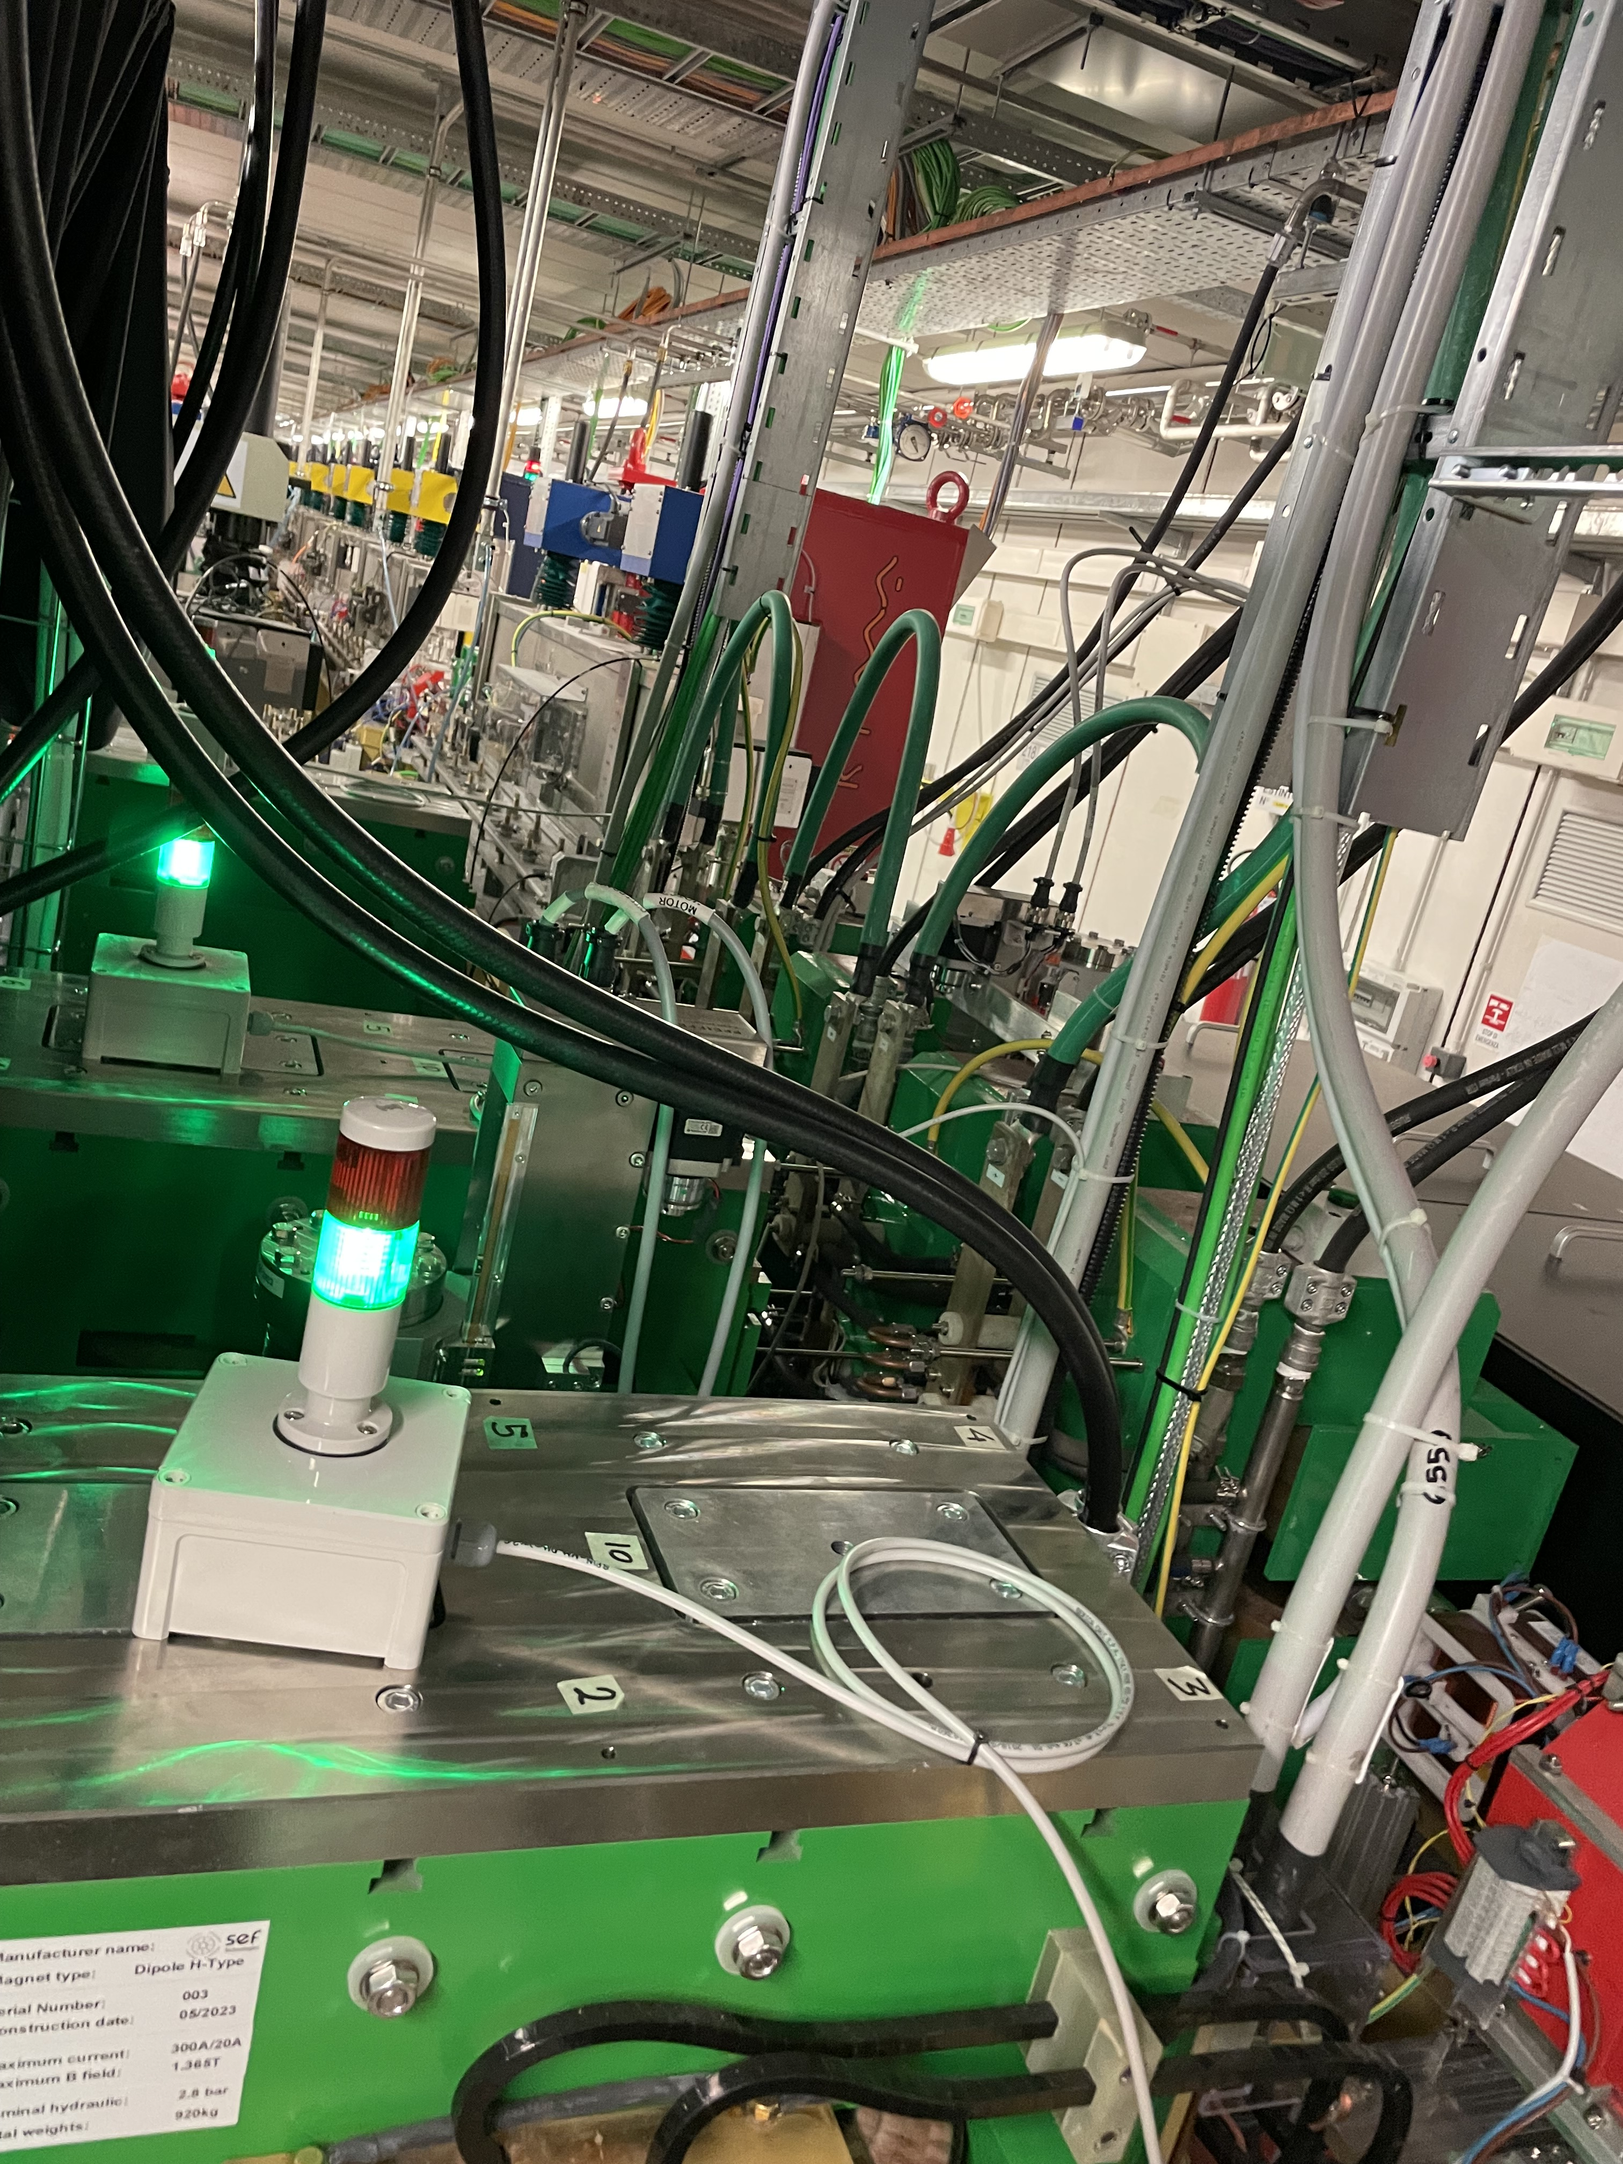
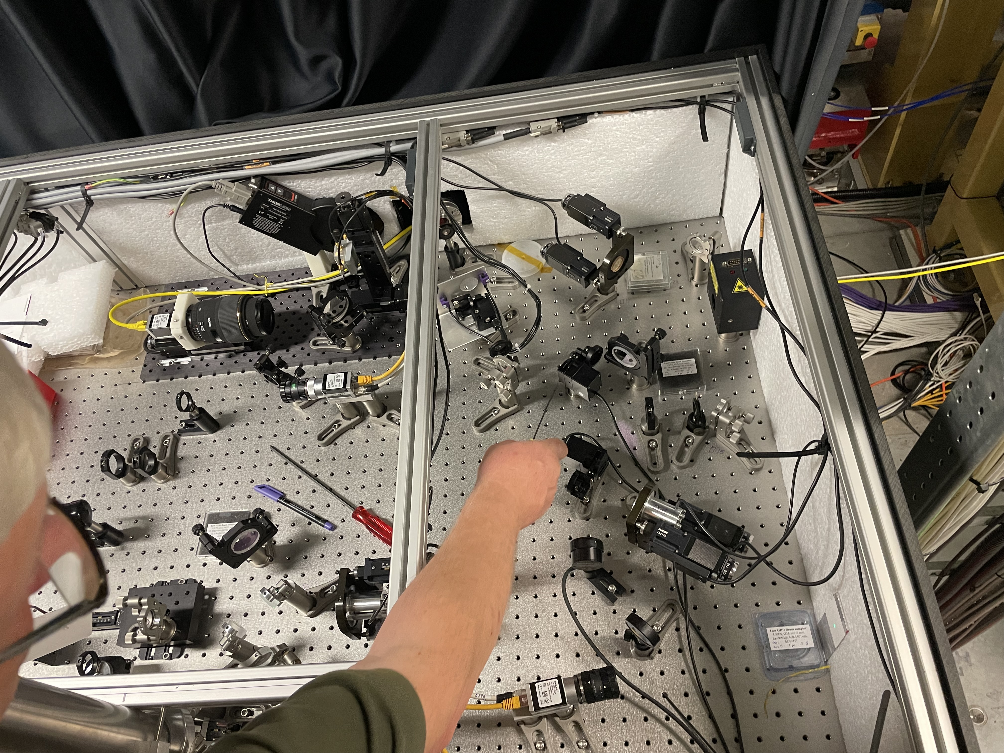
Completing EEHG setup, Commissioning in progress
Big Chicane installed in Summer 2023
EEHG commissioning
Trieste – 8-9 November 2023

Slide 19
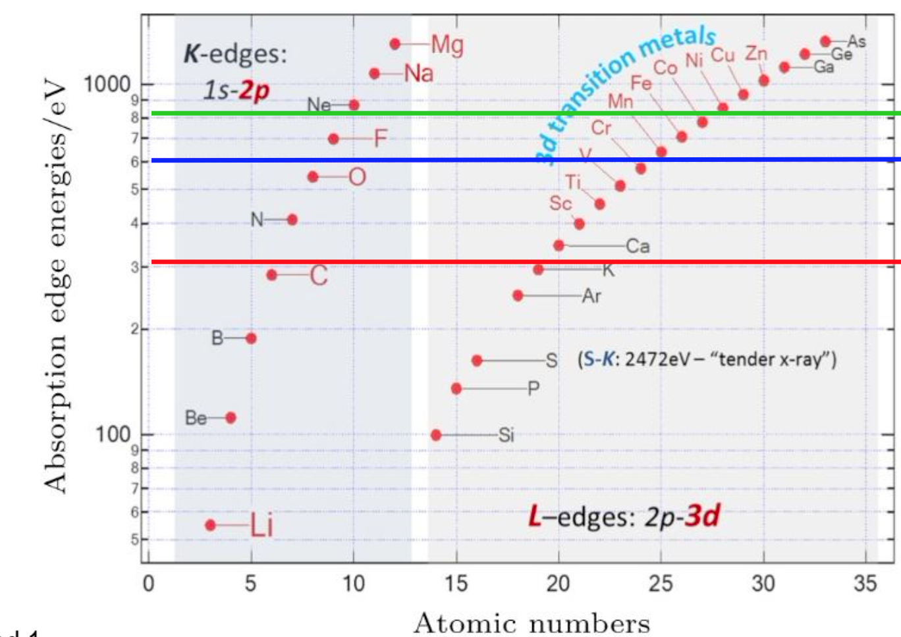
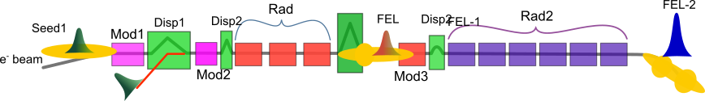
FERMI 2.0 upgrade
GOALS:
Extending the tuning range (2nm)
Producing shorter pulses (sub 10fs)
Preserving the FERMI uniqueness (coherence,…)
1.4 nm
2 nm
A new layout with new undulators is required together with an increased beam energy and quality for the 2 nm goal.
Study of possible schemes, including multi-stage HGHG, pure EEHG scheme and mix-mode EEHG + HGHG….
EEHG (h31)
HGHG (h4)
The best solution
Trieste – 8-9 November 2023

Slide 20
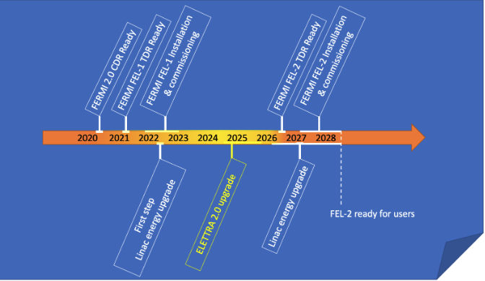
FERMI 2.0 upgrade timeline
FEL-1 upgrade ongoing
1.5GeV@50Hz/1.65GeV@10Hz
EEHG setup ready
FEL-2 upgrade will start after Elettra2.0 is completed

Slide 21
Conclusions
FERMI has been providing intense fully coherent photons from the VUV to the soft X-ray
The new FEL-1 layout was completed and Commissioning of FEL-1 in EEHG is on-going in these days: this experience will be very useful for the future upgrade.
The Upgrade of FEL-2 (in EEHG+HGHG mode) will allow to reach the oxygen K-edge and the transition metal L-edge at the fundamental wavelength
Trieste – 8-9 November 2023

Slide 22
Thank you

Slide 23
Spare slides

Slide 24
FEL-2 upgrade
The EEHG double stage with fresh-bunch injection (EEHG+FBIT) is the most promising scheme. This is confirmed by start-to end simulation
PROs:
Lower dispersions required (with respect to pure EEHG)
Reduced sensitivity to beam parameters (with respect to HGHG+FBIT)
Lower gain in the final amplifier required (with respect to pure EEHG): lower noise from the “unseeded” beam
Larger spectral separation between harmonics and reduced contamination from contiguous harmonics (with respect to pure EEHG)
Still generating two color FEL pulses from 1st & 2nd stages required e.g., in FWM on TIMER
More flexible:
  can operate in HGHG+FBIT as the present FEL-2
  can be operated in superradiance to produce short pulses
CONs:
It’s a double stage cascade: less stable, more challenging to generate multiple pulses
It’s based on the EEHG scheme, less easy to tune; to be verified in user operation
May require a short period undulator in the final radiator: reduced tuning range
Ringberg XFEL Meetings – Science with FELS, February, 5-8 2023

