Slide 1
Status Report BESSY + MLS
Bernhard Schriefer
8.11.23 – 9.11.23
ESLS-RF
Trieste / Italia

Slide 2
Status Report BESSY + MLS
Bernhard Schriefer
Cyberattack on HZB in June 2023
Metrology Light Source (MLS): Migration from IOT to SSA (Cryoelectra)
MLS: New Klystron Modulator ordered
BESSY: New Harmonic Cavities 1.5 GHz + 1.75 GHz
BESSY: SSA Maintenance
ESLS-RF
Trieste / Italia

Slide 3
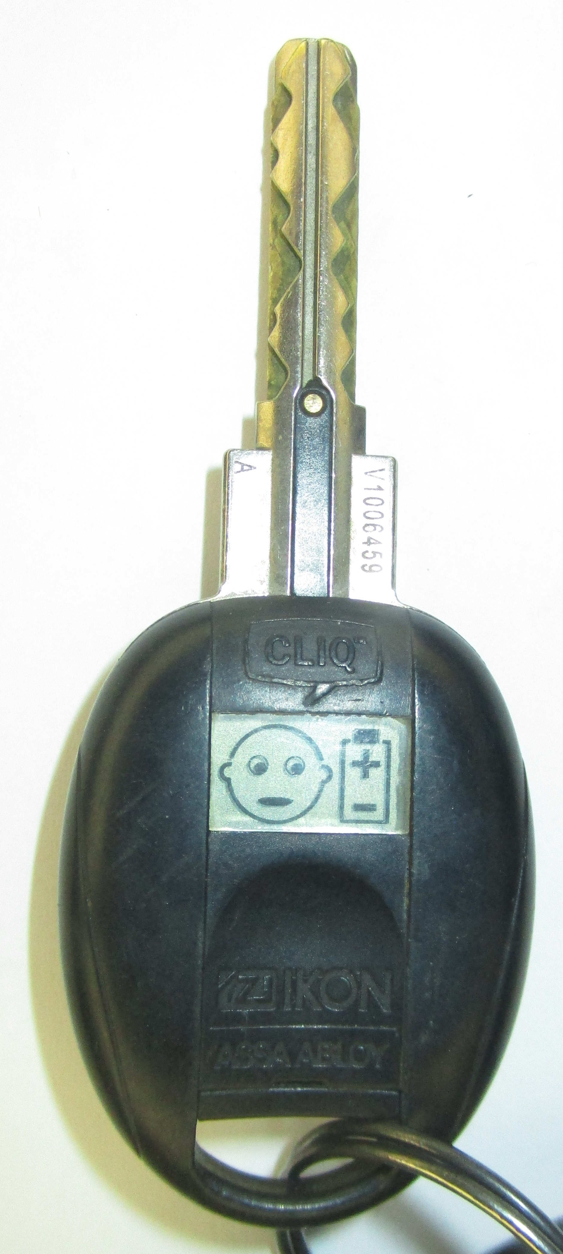
Cyberattack on HZB in June 2023
Starting on June 15 just after midnight, Ransomware was installed on most Windows systems that were online in the early hours after midnight
Everything was shut down that uses Windows, including Scopes etc.
On June 15 we lost
Email, Phone, Internet
Access to Intranet, Shared Files, Control System
Electronic Keys expire 30 days after last update, no further update possible
Access to purchasing system and system for attendance and vacation etc.
Bessy resumed operation on July 3rd
→ still struggling with consequences, and will be for some time to come

Slide 4
Cyberattack on HZB in June 2023
Metrology Light Source (MLS): Migration from IOT to SSA (Cryoelectra)
MLS: New Klystron Modulator ordered
BESSY: New Harmonic Cavities 1.5 GHz + 1.75 GHz
BESSY: SSA Maintenance
ESLS-RF
Trieste / Italia

Slide 5
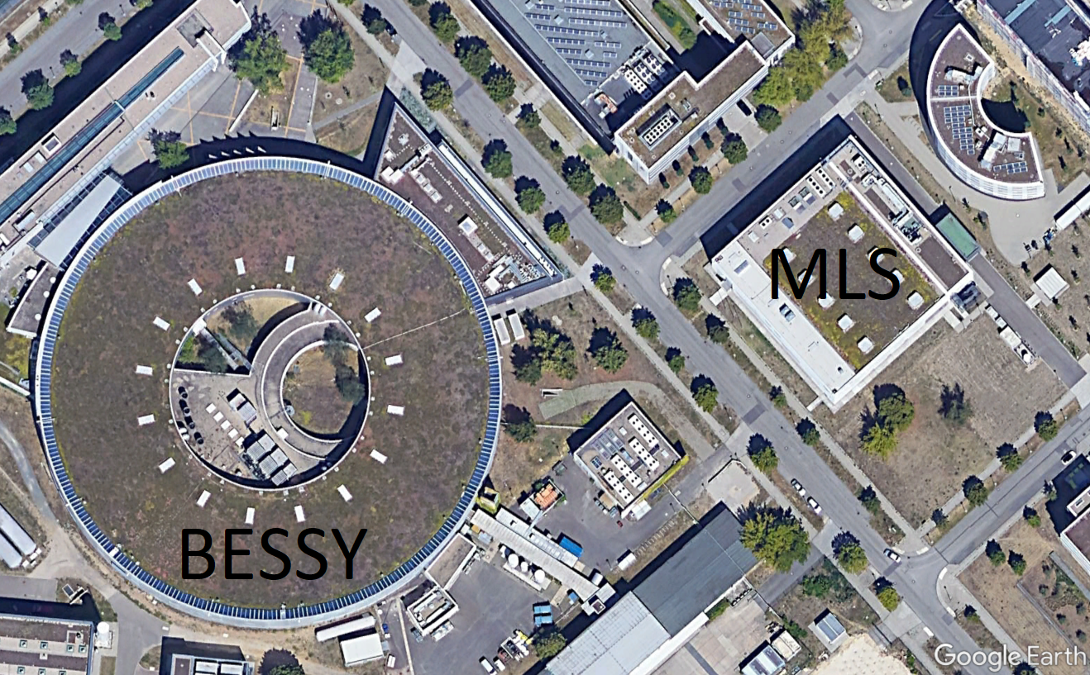
Metrology Light Source
Start 2004, First Beam 2007, user operation since 2008
Just across the street from BESSY
48m circumference
RF System: 500 MHz 80 kW
Microtron: 3 GHz
MLS
BESSY

Slide 6
IOT Transmitter 500 MHz 80 kW
In operation 2007 – April 2023
Power Supply from FuG
IOT from CPI (80 kW 40 kV 500 MHz)
Original type
Newer type
Last IOT had around 50.000 h of operation
Price for IOT around 40-60 k€ each in the past
HV Supply
Situation
LLRF
Last replacement recently due to vaccum problem with last IOT
Only one spare, original type, not fully compatible
IOT
Decision making
New Price ~ 400.000 k€ for IOT
Migration to Solid State Amplifier

Slide 7
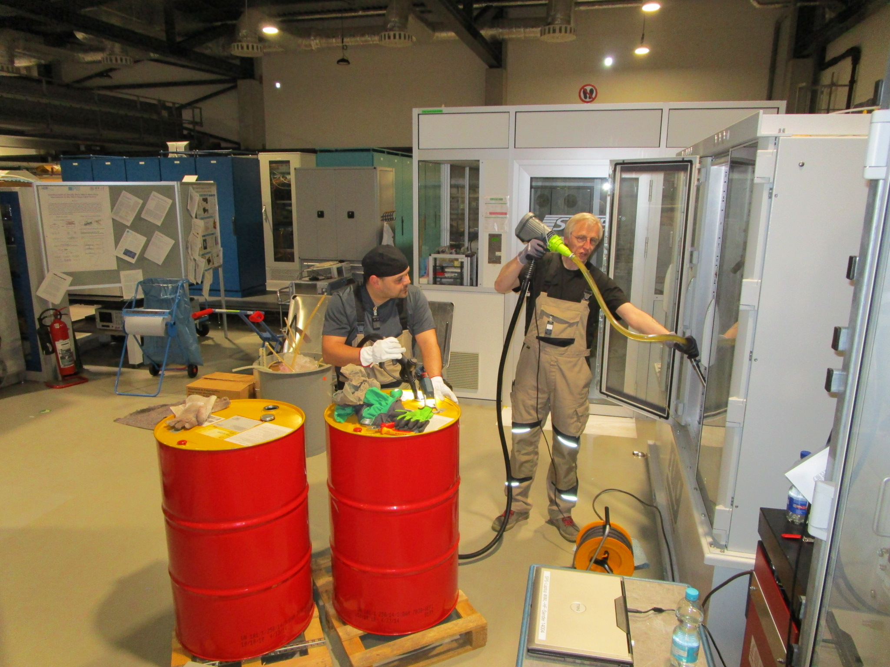
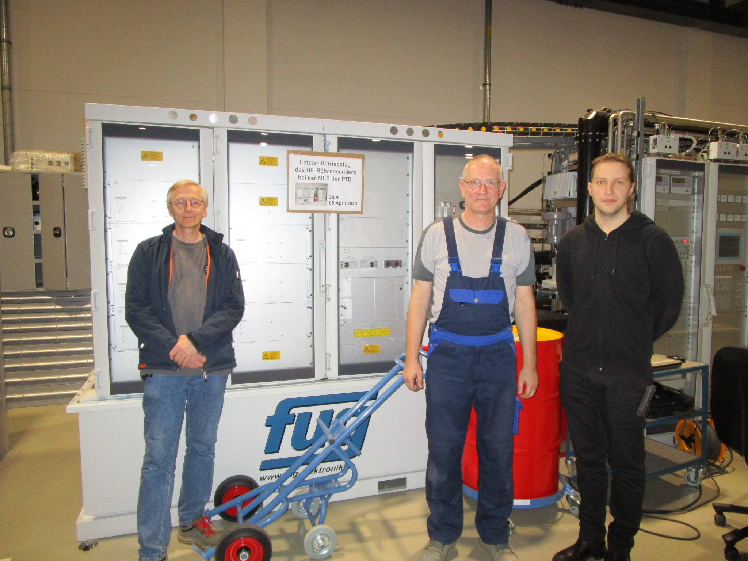
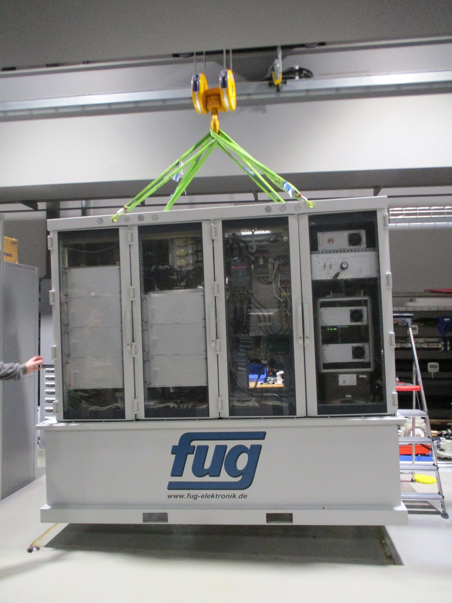
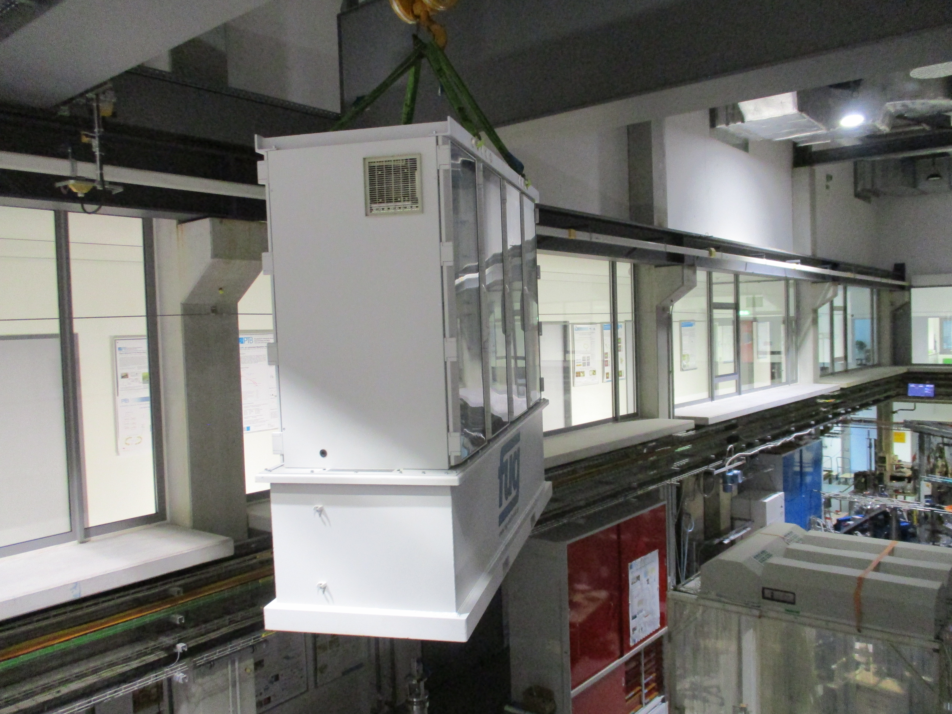
Teardown of IOT + HV PS
Starting on April 6, 2023
HV PS

Slide 8
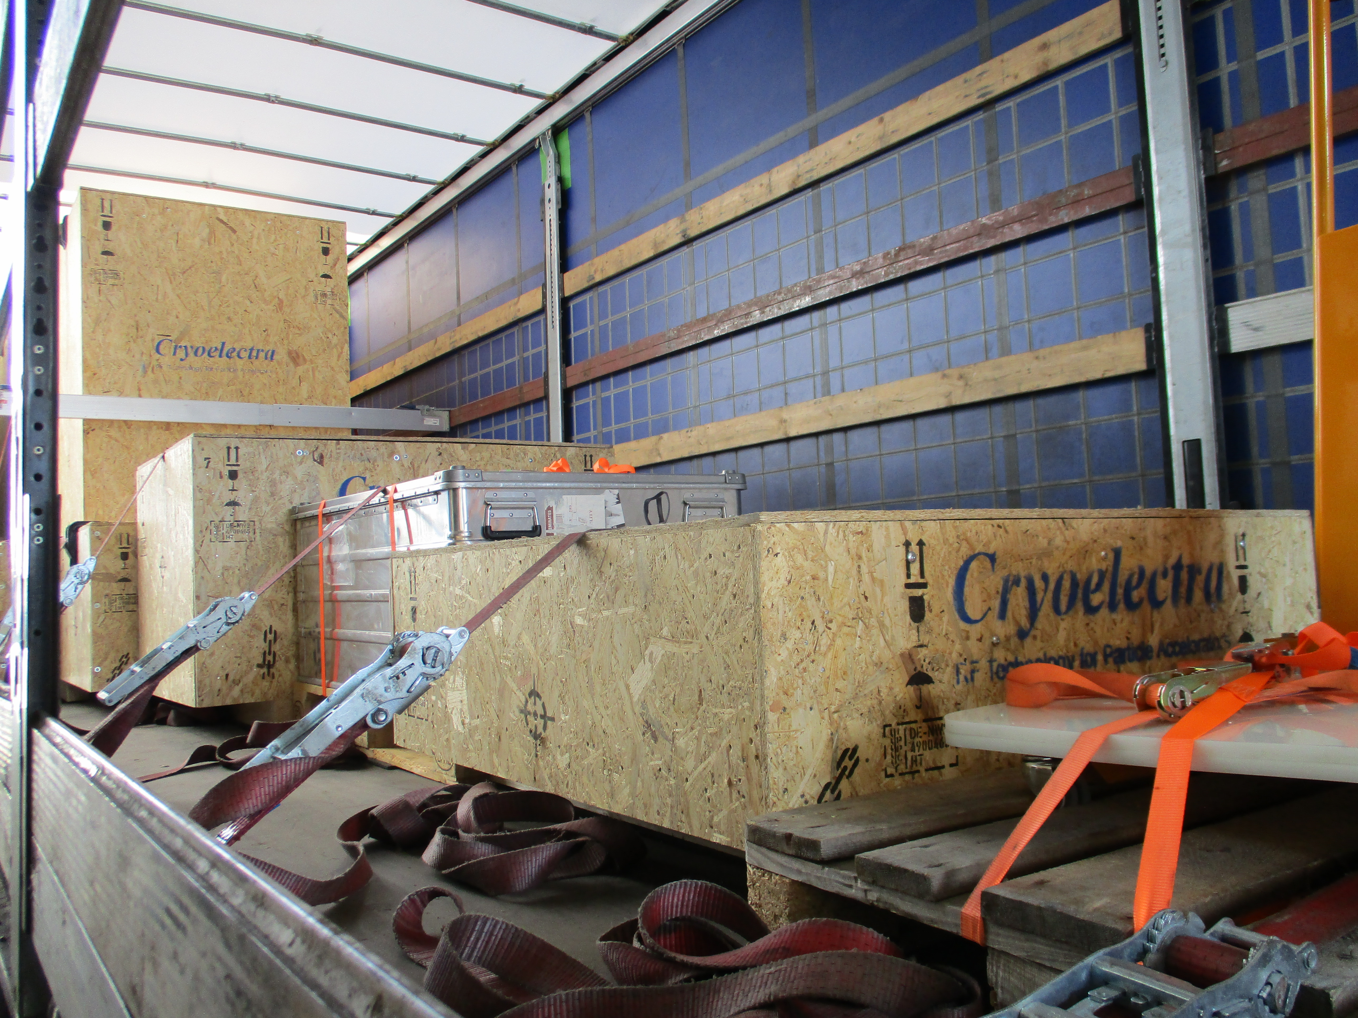
Arrival of New SSA (cryOelectra)
April 2023

Slide 9
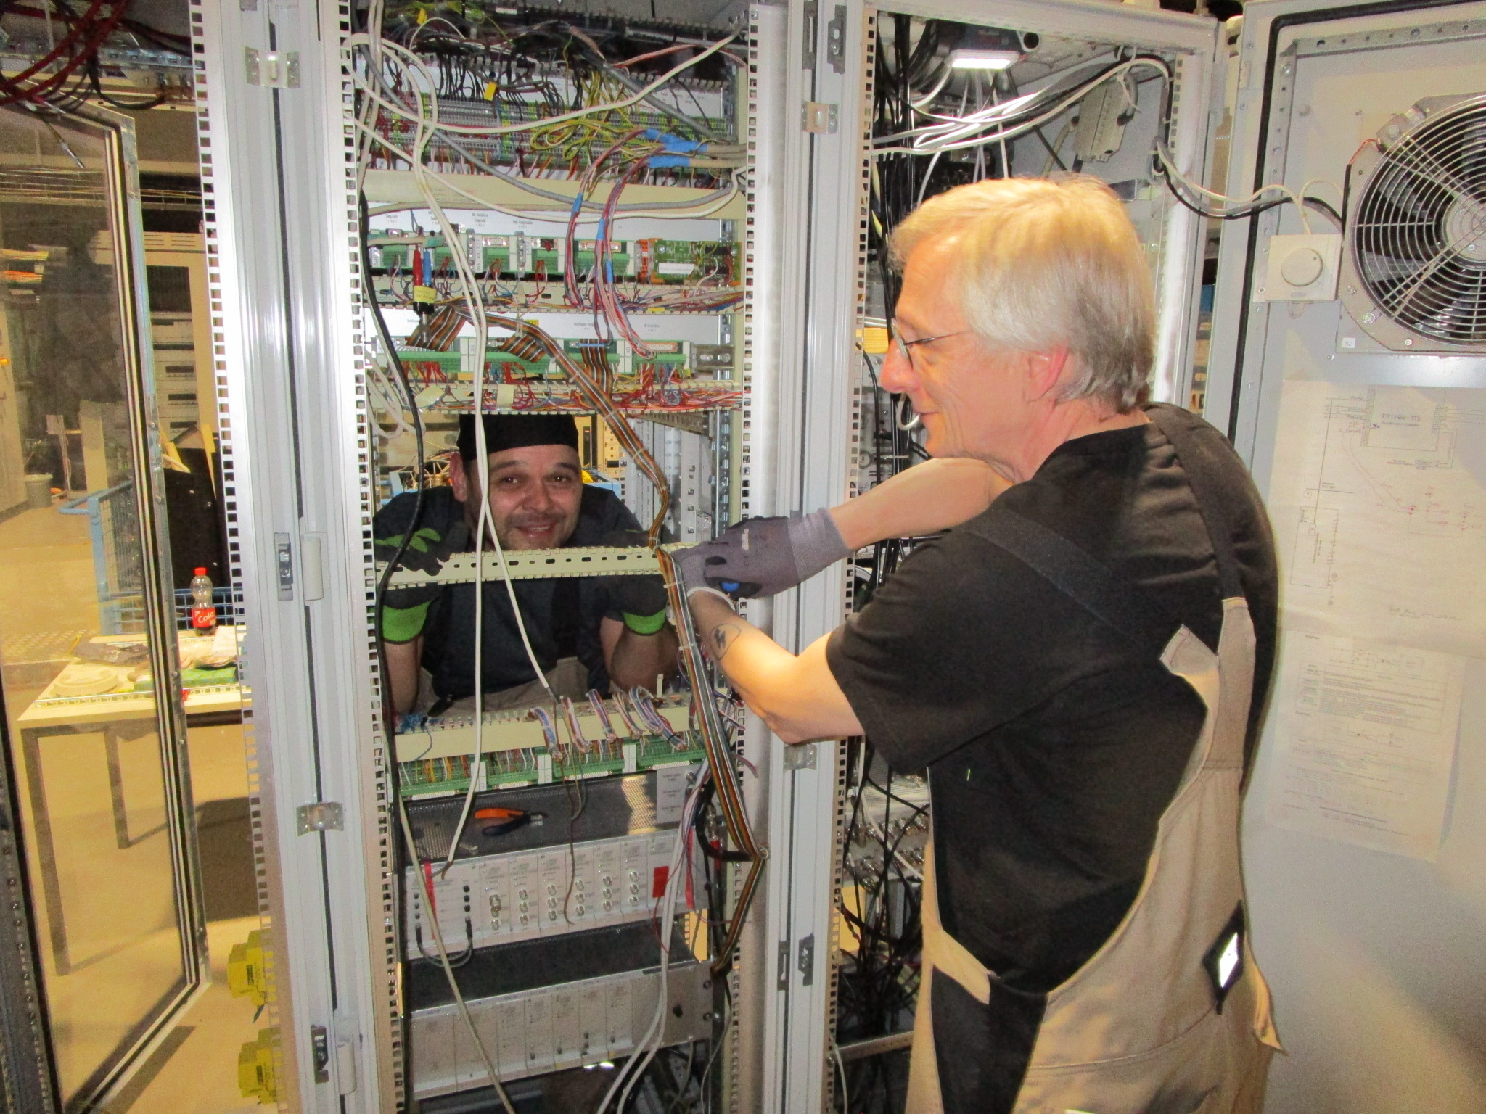
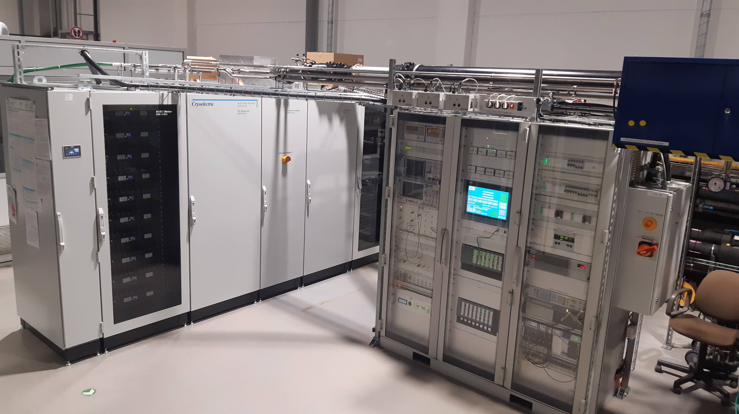
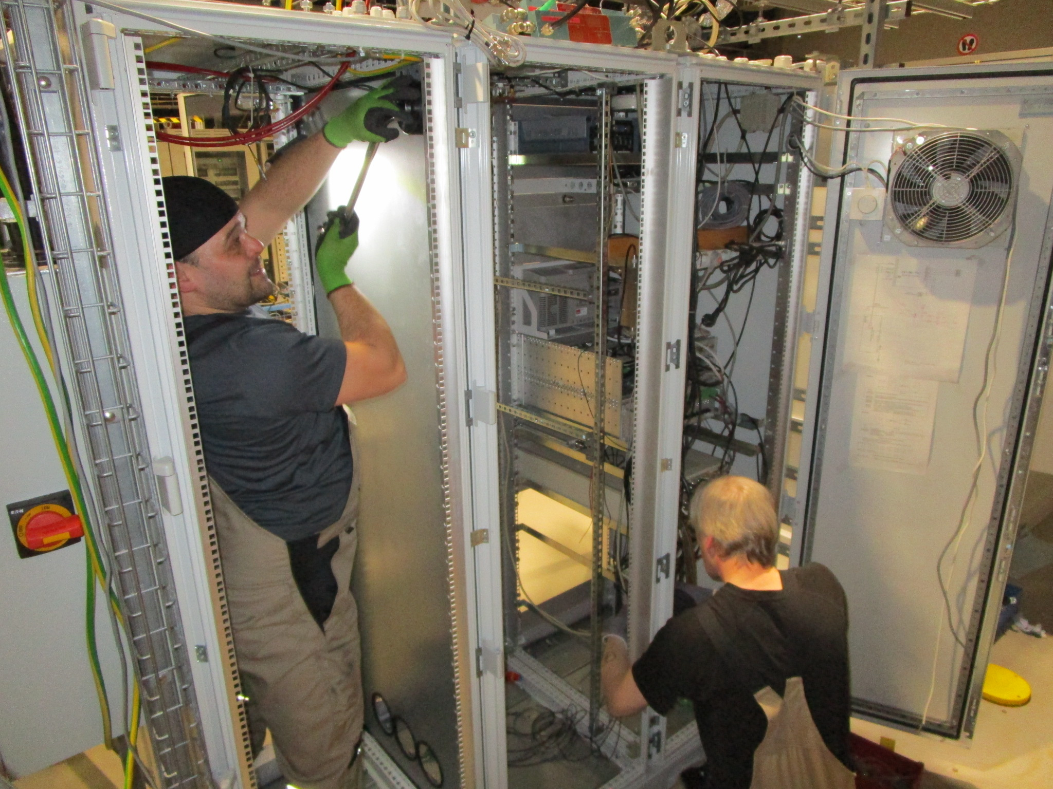
Migration IOT→ SSA
Since 2023

Slide 10
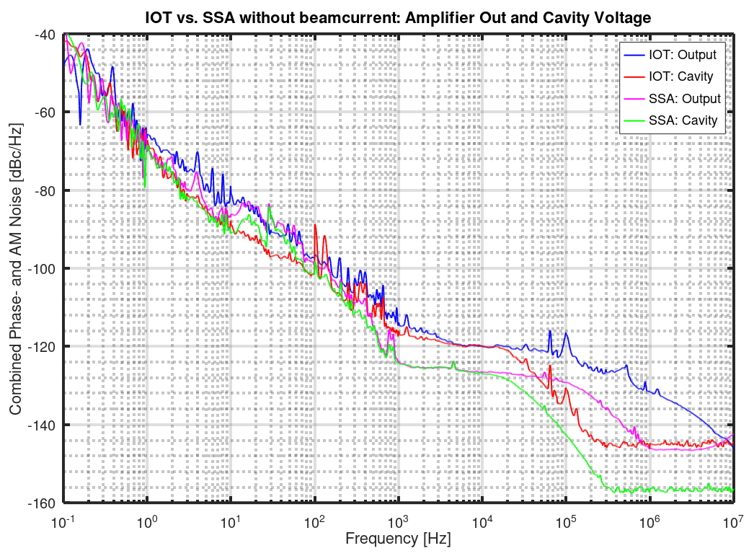
Performance of new amplifier

Slide 11
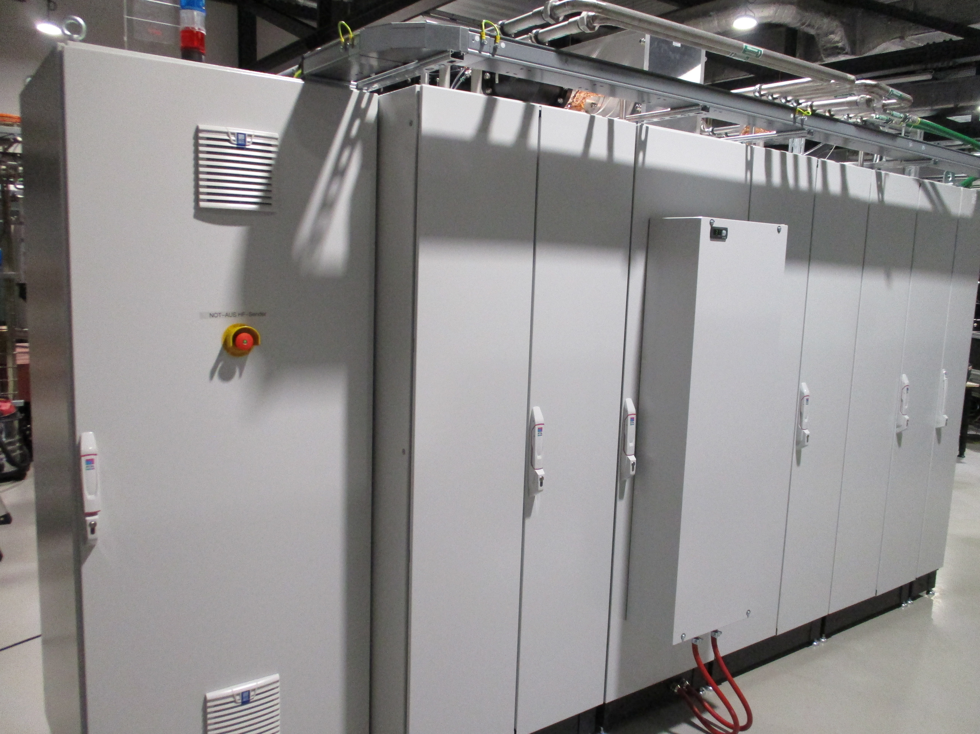
Arrival of New SSA (cryOelectra)
Finished work by end of May 2023
Back side
Front side
Upcoming Events:
Some work on Power Modules to further increase reliability
Modifications to increase efficiency

Slide 12
Cyberattack on HZB in June 2023
Metrology Light Source (MLS): Migration from IOT to SSA (Cryoelectra)
MLS: New Klystron Modulator ordered
BESSY: New Harmonic Cavities 1.5 GHz + 1.75 GHz
BESSY: SSA Maintenance
ESLS-RF
Trieste / Italia

Slide 13
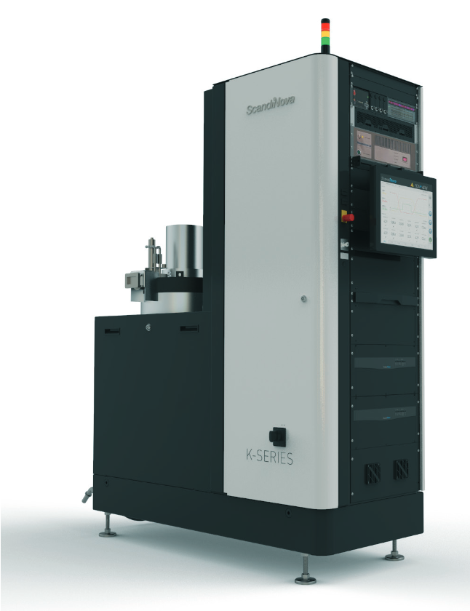
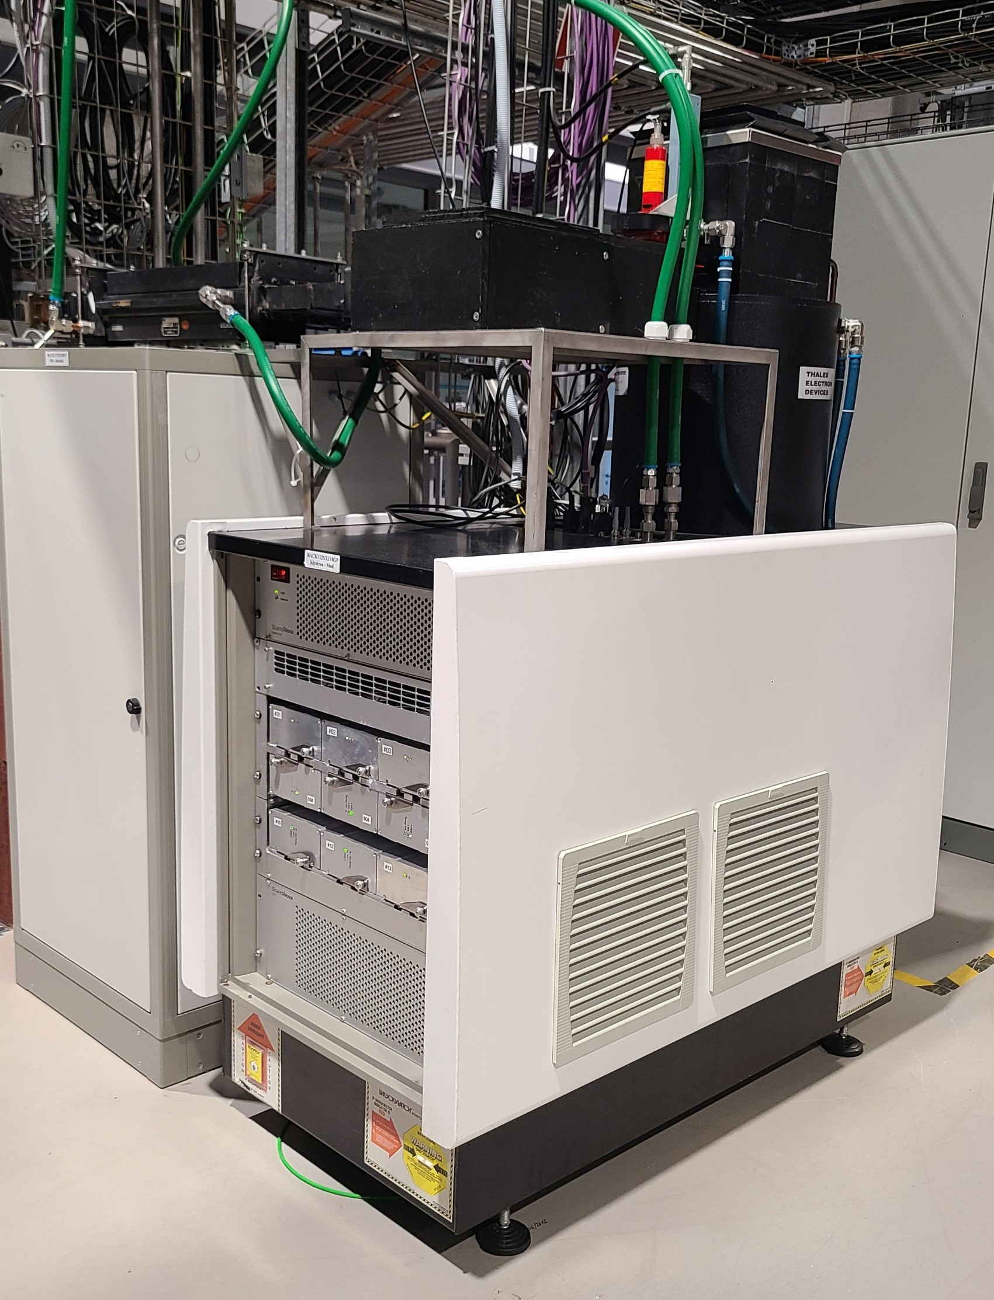
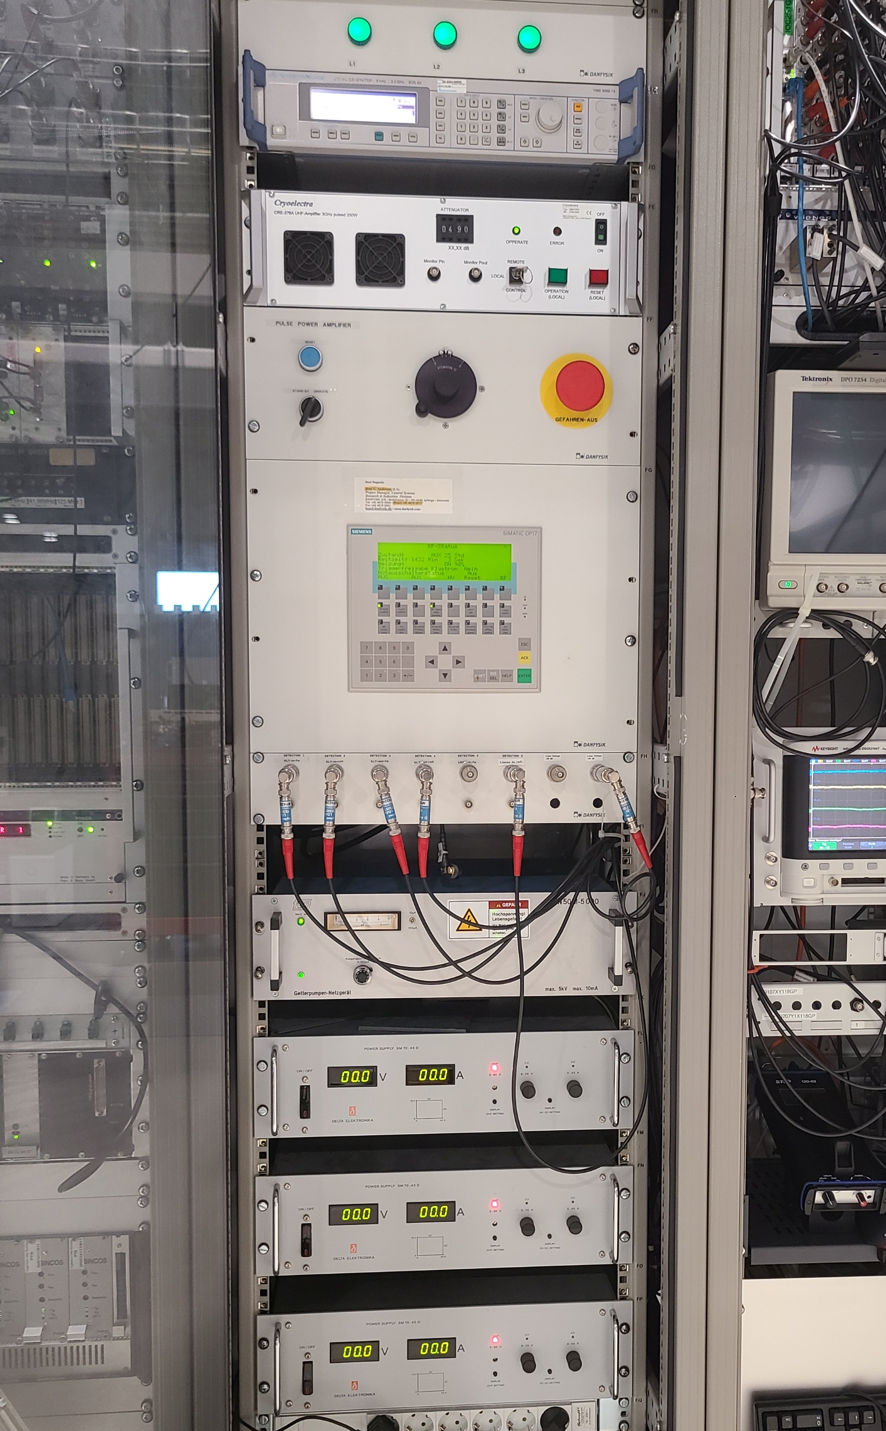
MLS Klystron-Modulator
Klystron-Modulator built by ScandiNova with Circulator
Control Rack with PLC, RF Generator, Pre-Amplifier and Solenoid/Focus-PS
Picture from scandinovasystems.com
The nine IGBT modules switch a maximum voltage of 1450 V.
After the pulse transformer the voltage is around 96 kV.
The output power of the klystron (TH2157) is 2.3 MW.
RF pulse is 3.3us
Canon Klystron E3779B
Peak Power 7.5 MW

Slide 14
Cyberattack on HZB in June 2023
Metrology Light Source (MLS): Migration from IOT to SSA (Cryoelectra)
MLS: New Klystron Modulator ordered
BESSY: New Harmonic Cavities 1.5 GHz + 1.75 GHz
BESSY: SSA Maintenance
ESLS-RF
Trieste / Italia

Slide 15
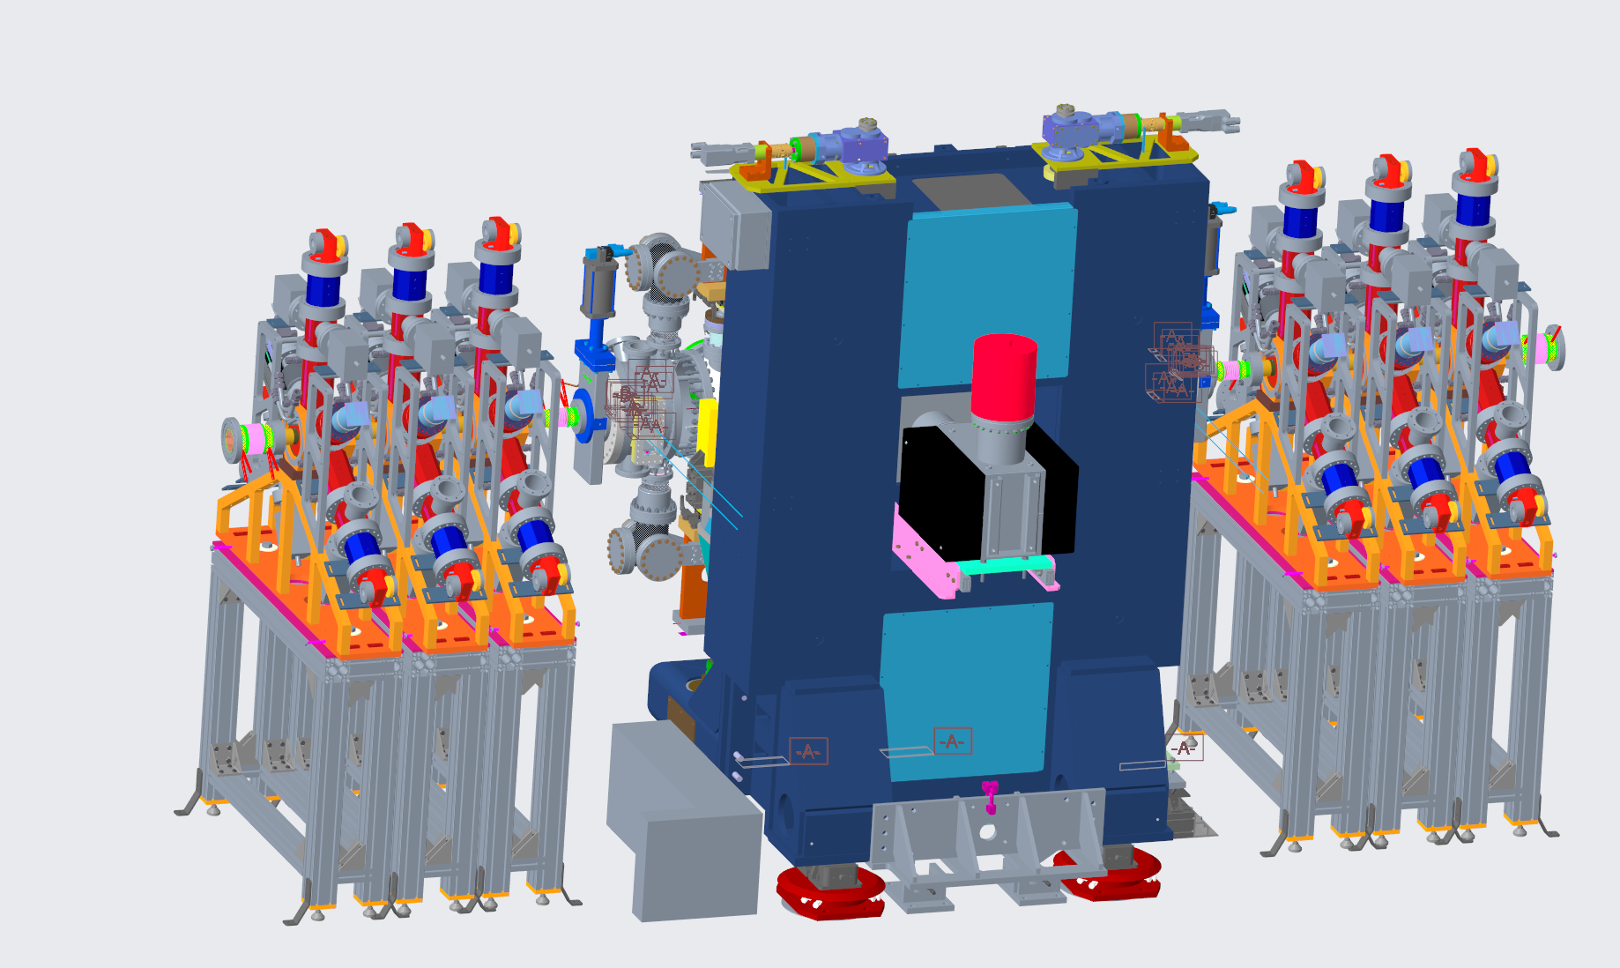
New harmonic cavities
One ALBA 1.5 GHz already tested
One 1.5 GHz 15 kW installed
Two more SSAs to come
Three Cavities to come next year 1.5 GHz
Three more in the future 1.75 GHz

Slide 16
Cyberattack on HZB in June 2023
Metrology Light Source (MLS): Migration from IOT to SSA (Cryoelectra)
MLS: New Klystron Modulator ordered
BESSY: New Harmonic Cavities 1.5 GHz + 1.75 GHz
BESSY: SSA Maintenance
ESLS-RF
Trieste / Italia

Slide 17
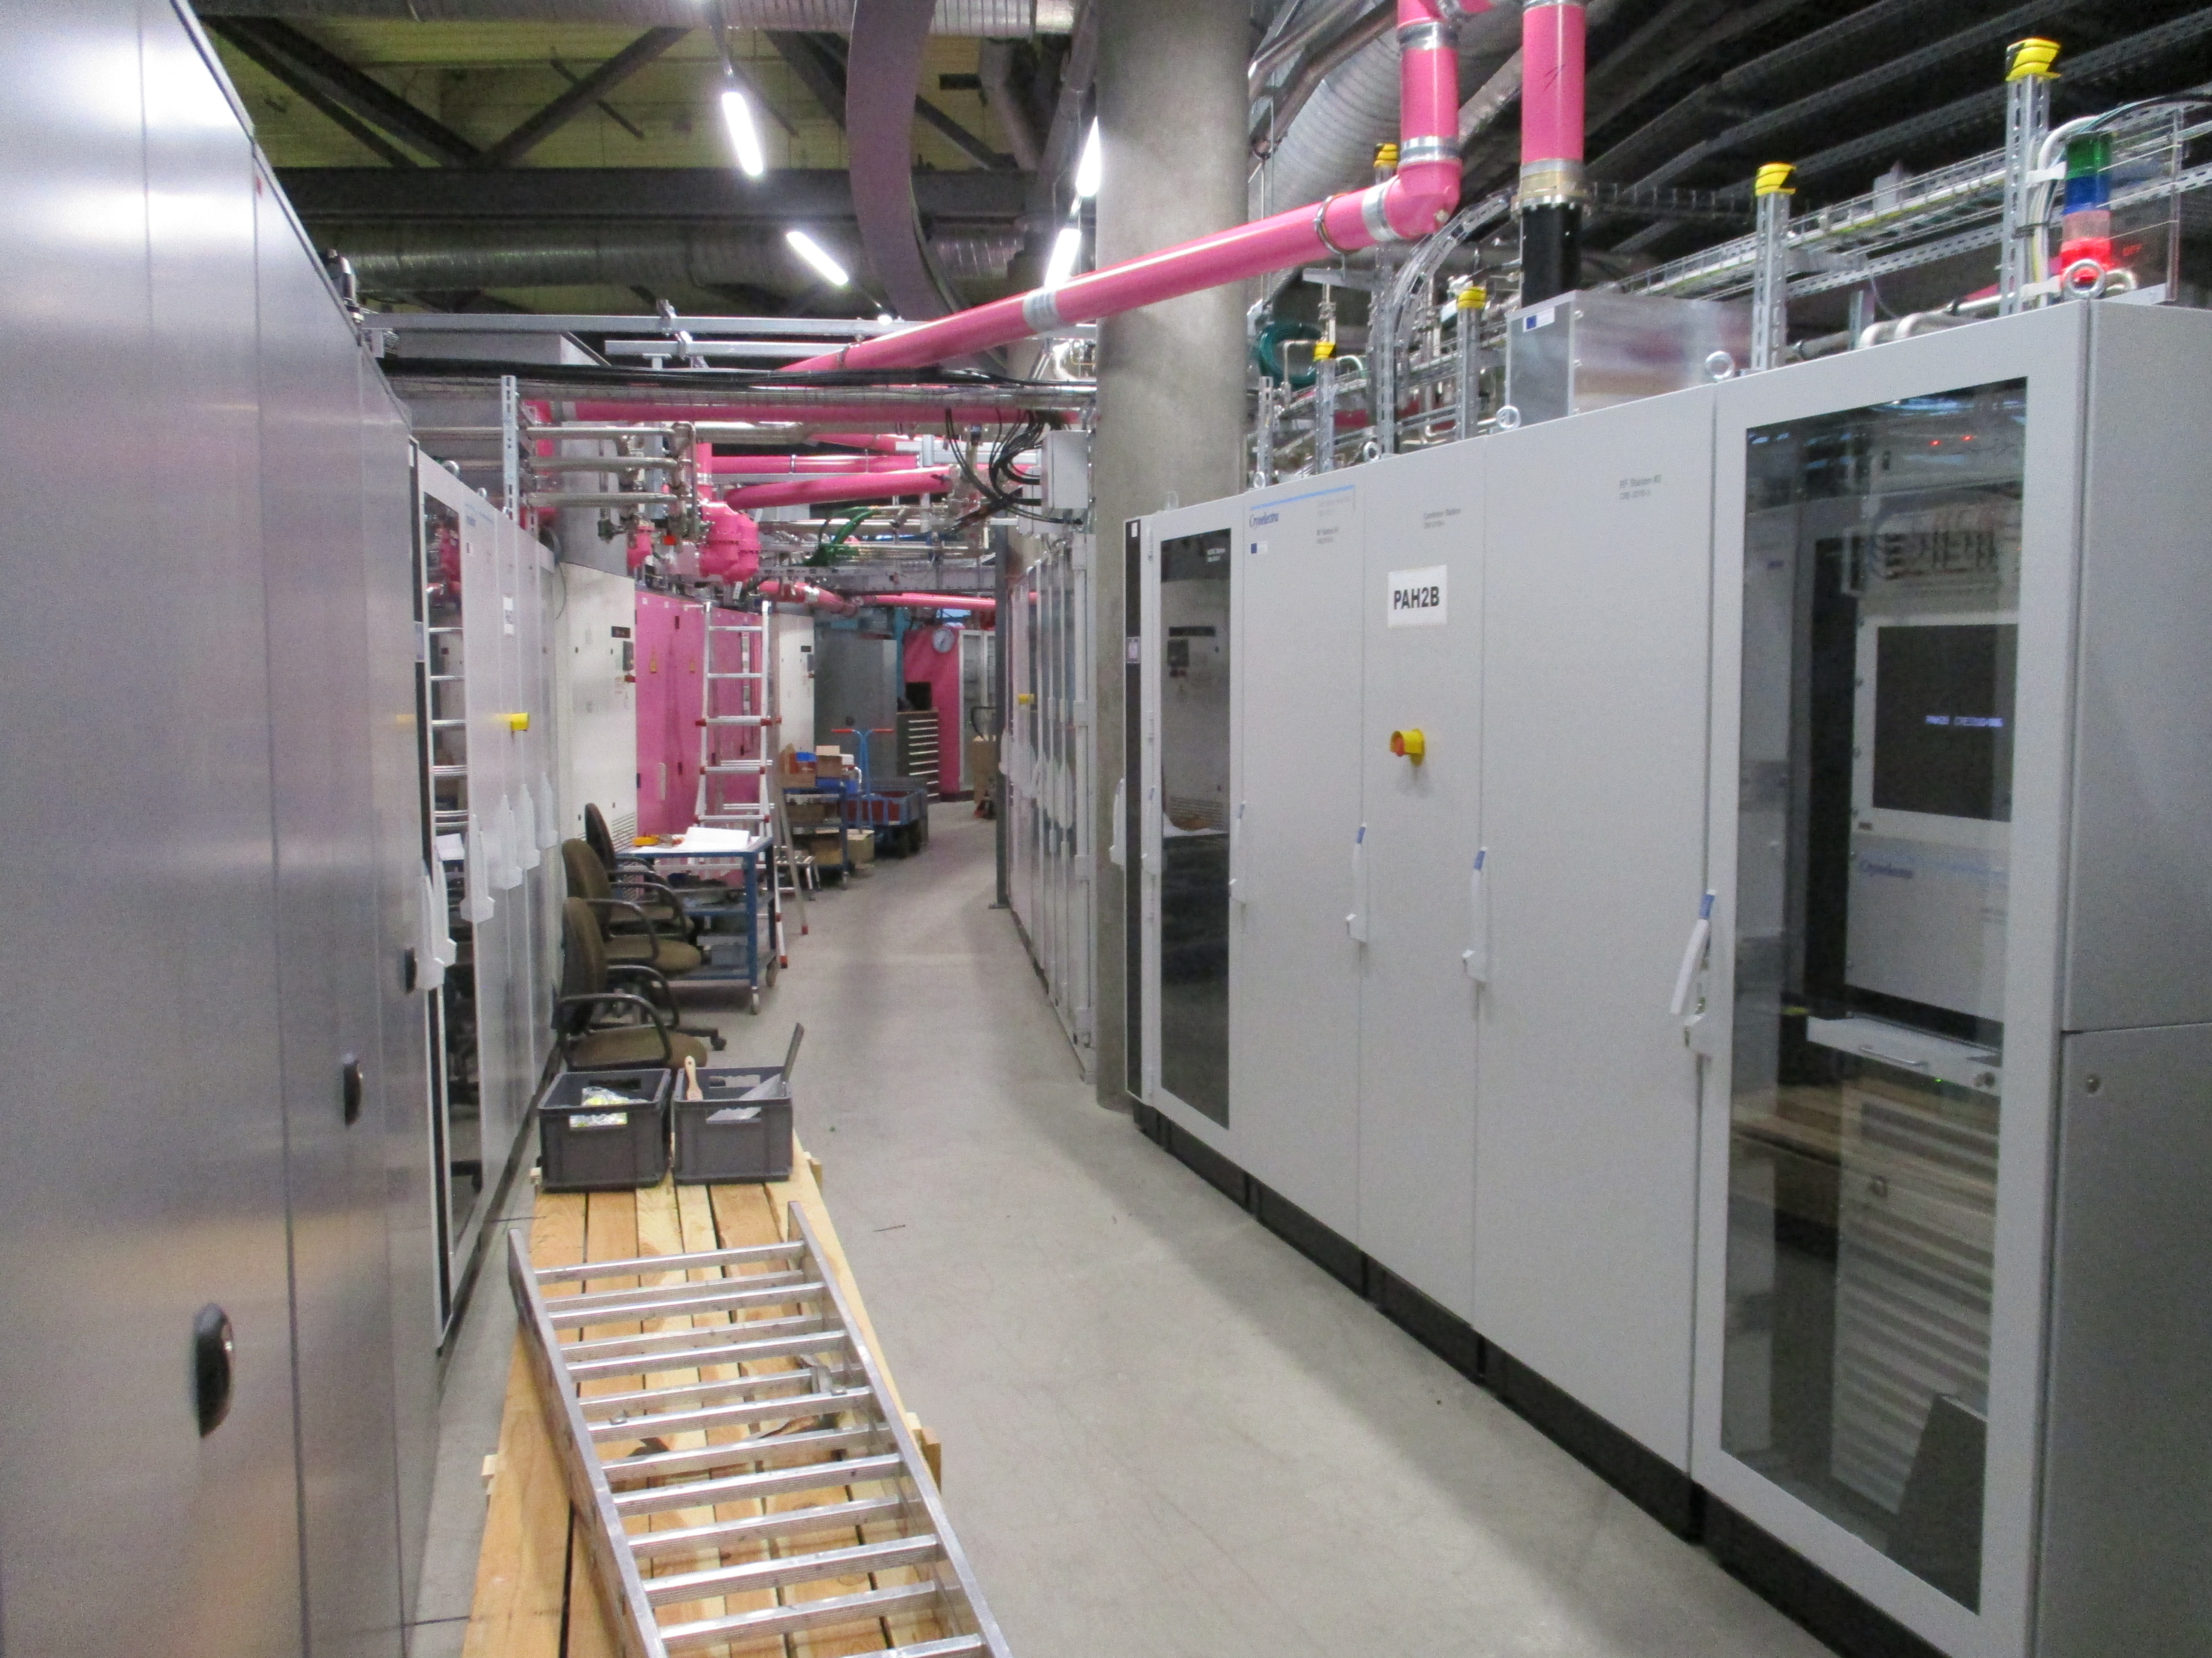
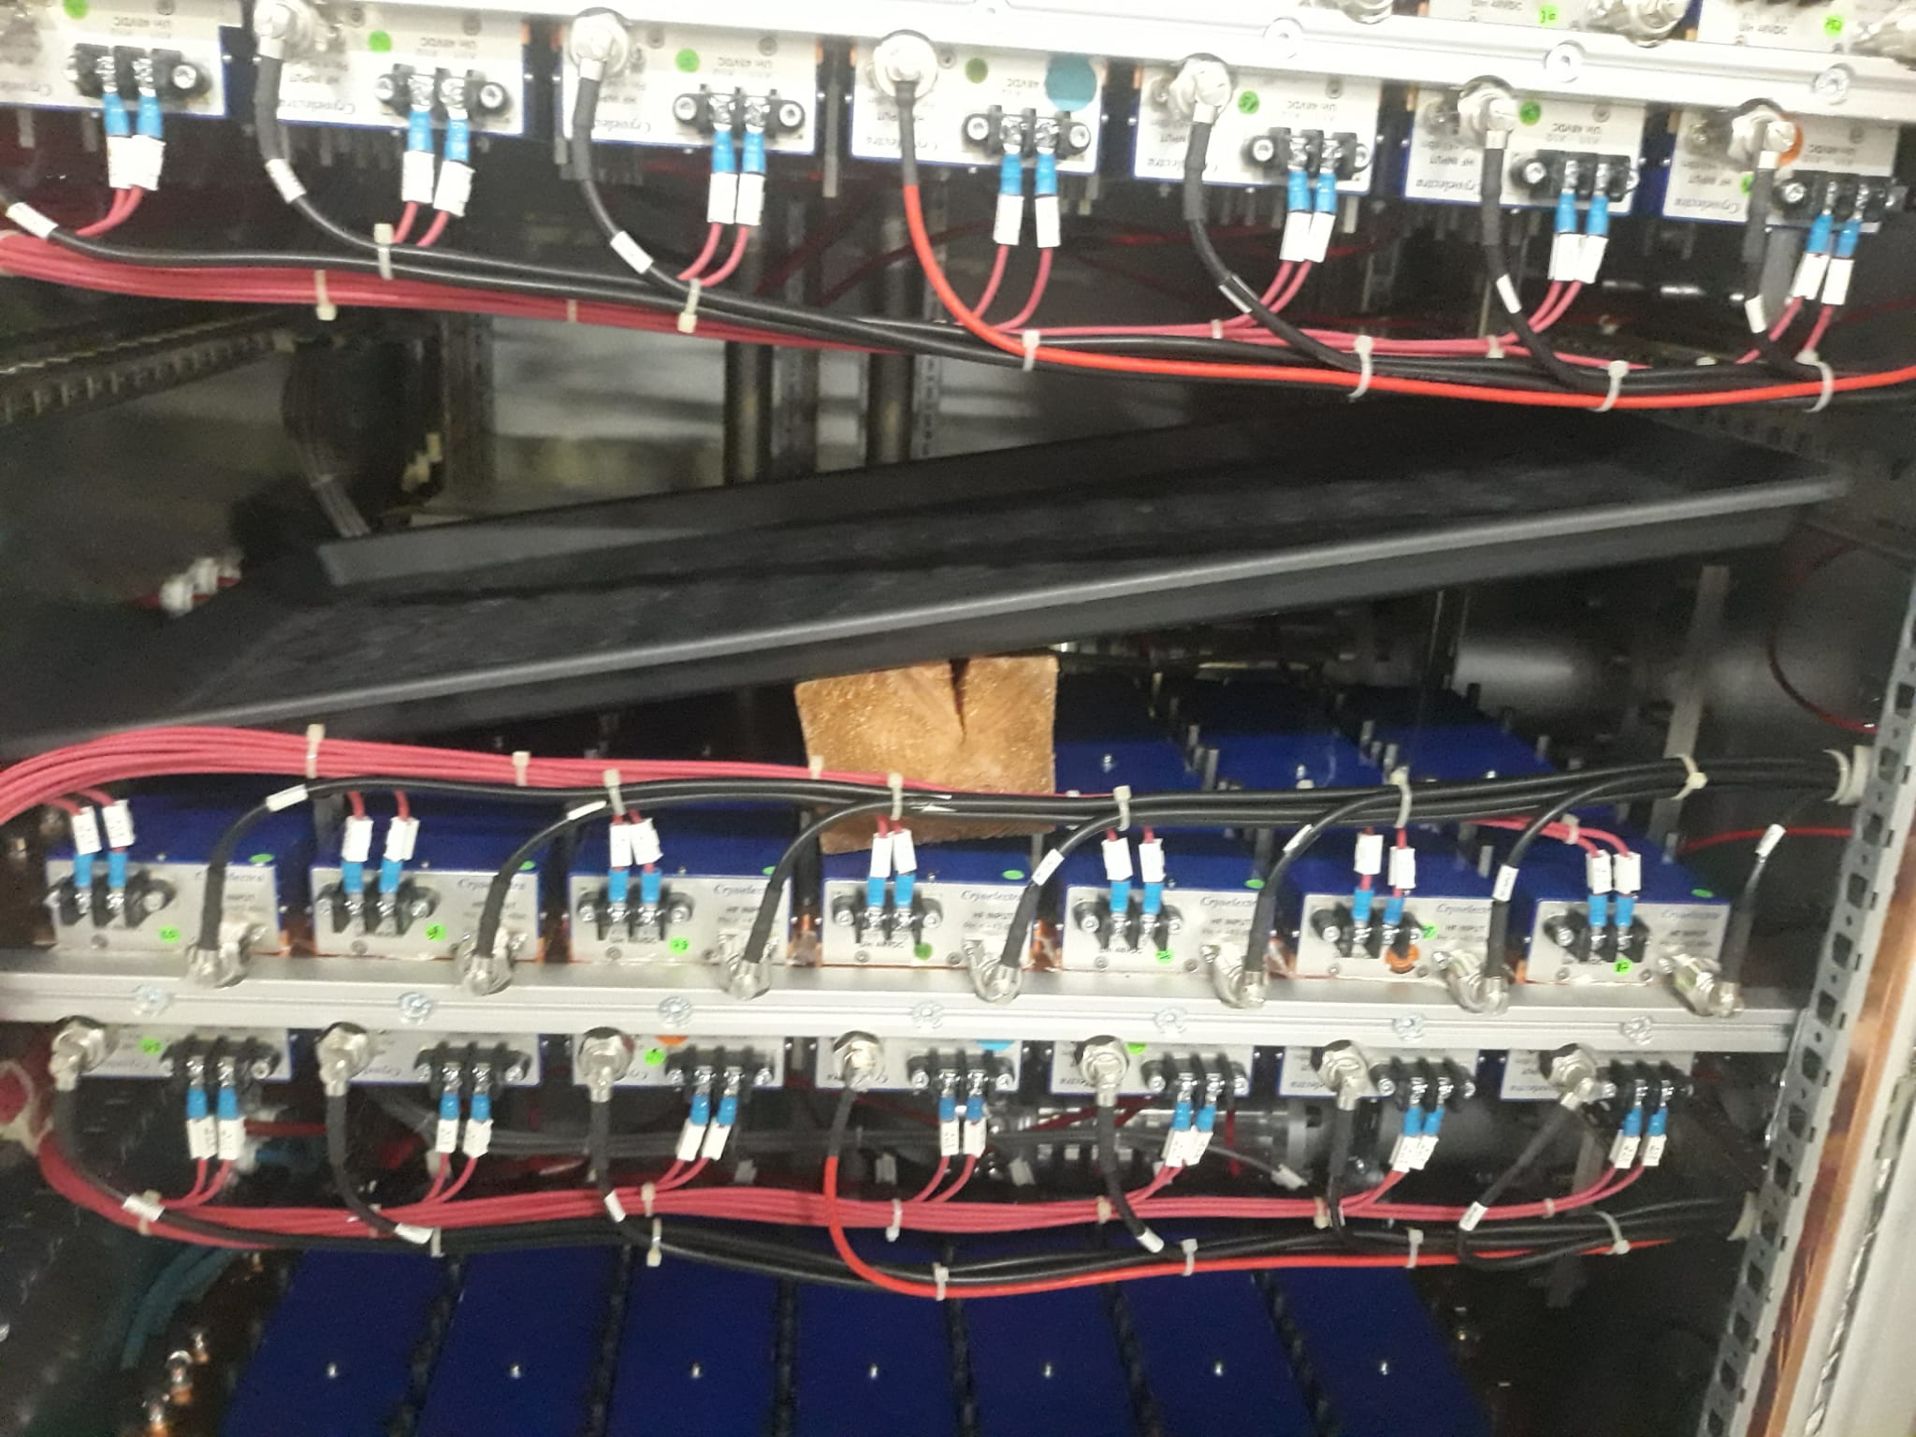
Bessy cryoelectra ssa Maintenance
Failures since October 2022
PAHB CRE331E-001 → No failure
PAH1R CRE331E-004 → 3 Modules replaced + Water Leak
PAH2R CRE331E-003 → 8 Modules replaced
PAH3R CRE331E-002 → 5 Modules replaced + Predriver 2
PAH4R CRE331E-001 → 3 Modules replaced
We are happy with reliability, only few failures
Picture from minicircuits.com

Slide 19
Thank You!
Questions?
ESLS-RF
Trieste / Italia

