Slide 1
Operation and Upgrade of the SLS RF Systems
Lukas Stingelin :: RF-Systems 1 :: Paul Scherrer Institute
26th European Synchrotron Light Source RF (ESLS-RF) workshop
organized by ELETTRA November 2023

Slide 2
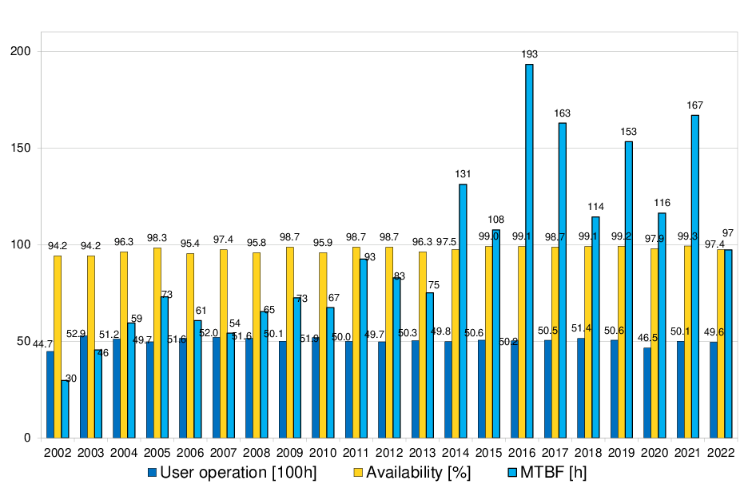
SLS-Operation Statistics 2021-2022
2021:
Best beam availability ever 99.3%
Short of a 16kV transformer
Failure of reflected power measurement in SSA
Failure of 6-way splitter in SSA
2022:
Taper-foil of Undulator blocked beam-path
Failure of Magnet-PS
Incident at Super-3HC (see slides)
FPF causes vacuum-interlocks
Klystron-vacuum-PS failure
LINAC Klystron Arcing

Slide 3
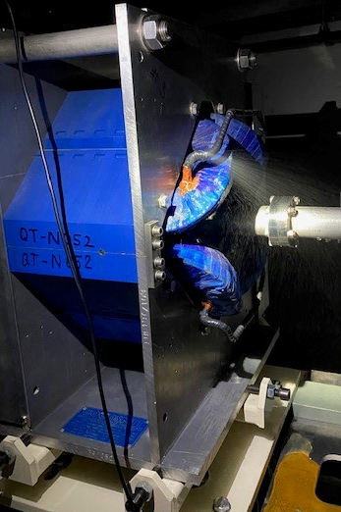
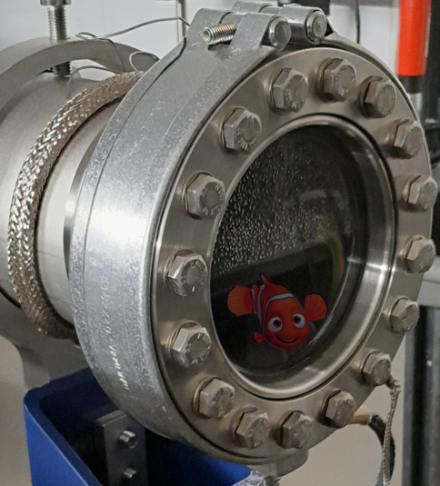
2023 SLS Failures and Issues
Water leak at Injector LINAC Quadrupole (17h) →
Defective water-leak sensor (1h)
Issues with Super-3HC Cryoplant (17h):
  Broken valve and contactor
  Broken compressor-screw
Water leaks at Booster RF-cavity
Issue with Circulator Temperature Compensation Unit (drifting reflected power)
LINAC Broken Charging-Unit → broke power contactor and tripped fuse.
Water-leak at diagnostics beam-line

Slide 4
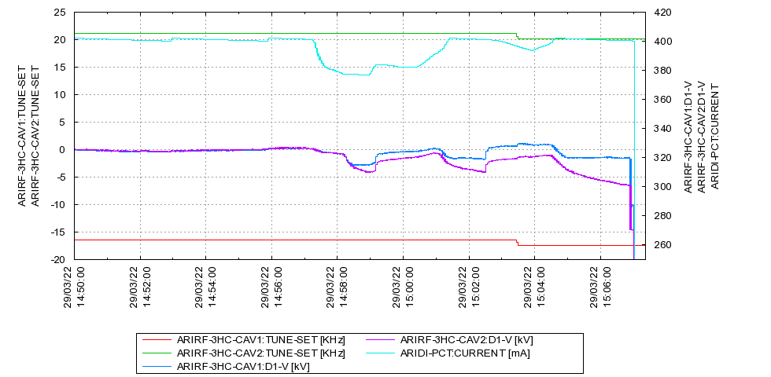
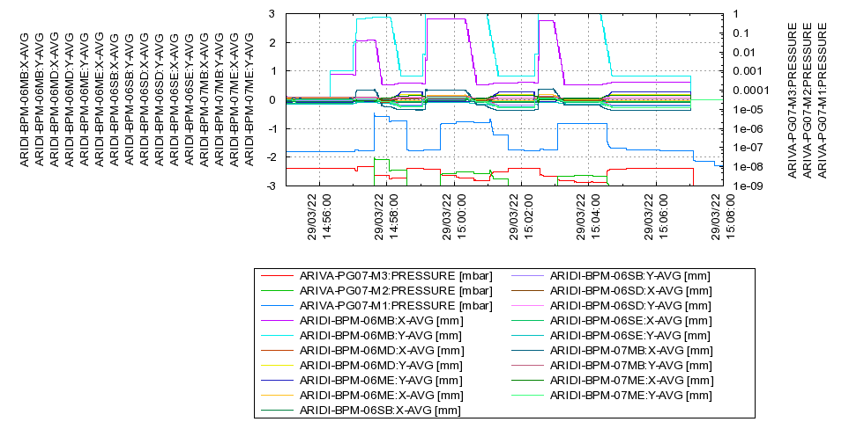
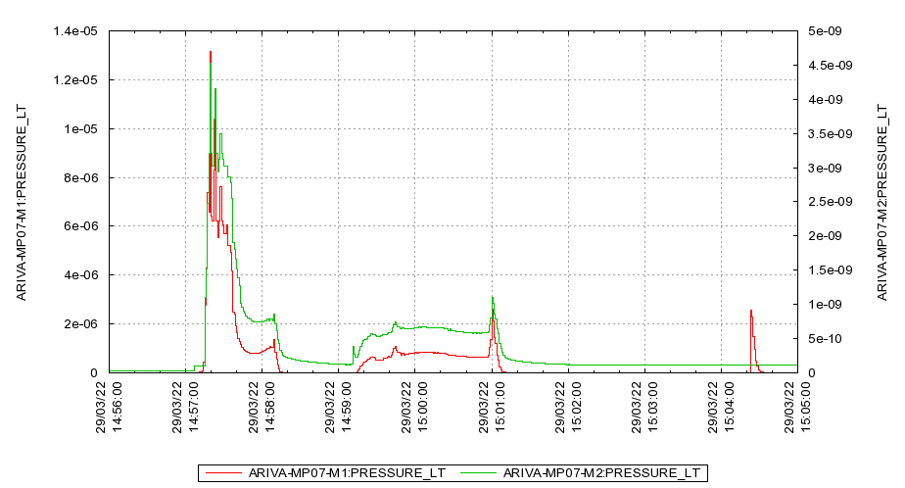
Super-3HC: March 2022 Incident
Orbit off by several mm!
Orbit problems, current drops
Beam-loss (CBI)
Vacuum increase, voltage asymmetry starts
Operator tries to increase voltages
During machine development shift, experiments with orbit bumps.
Faillure of BPM system caused large orbit excursion
Vacuum at chamber before Super-3HC and after reached 1E-5mbar!
Asymmetry stays during accumulation and drifts over 10s of minutes to new equilibrium.
Vacuum-controller did not interlock the beam!

Slide 5
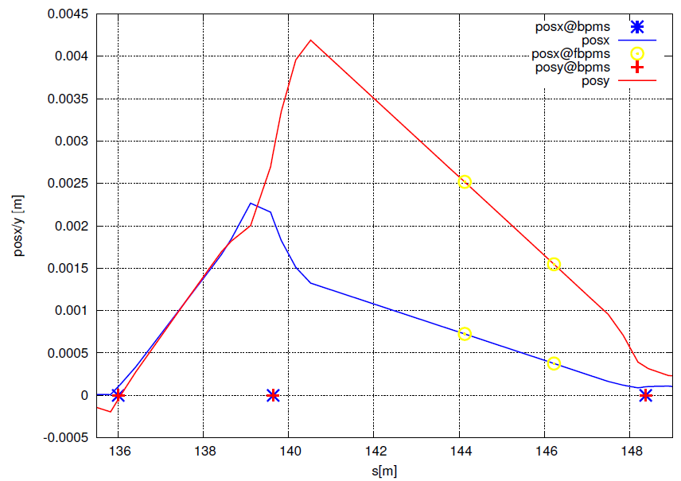
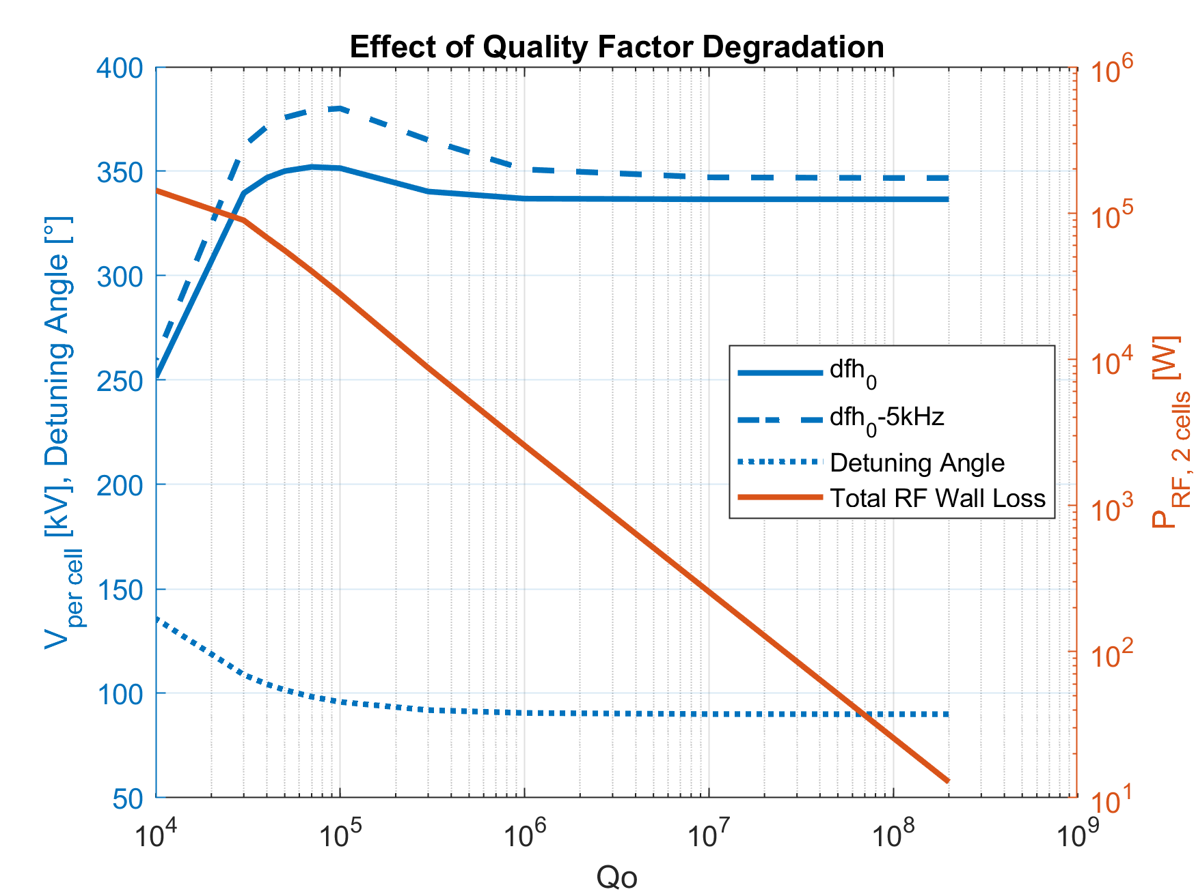
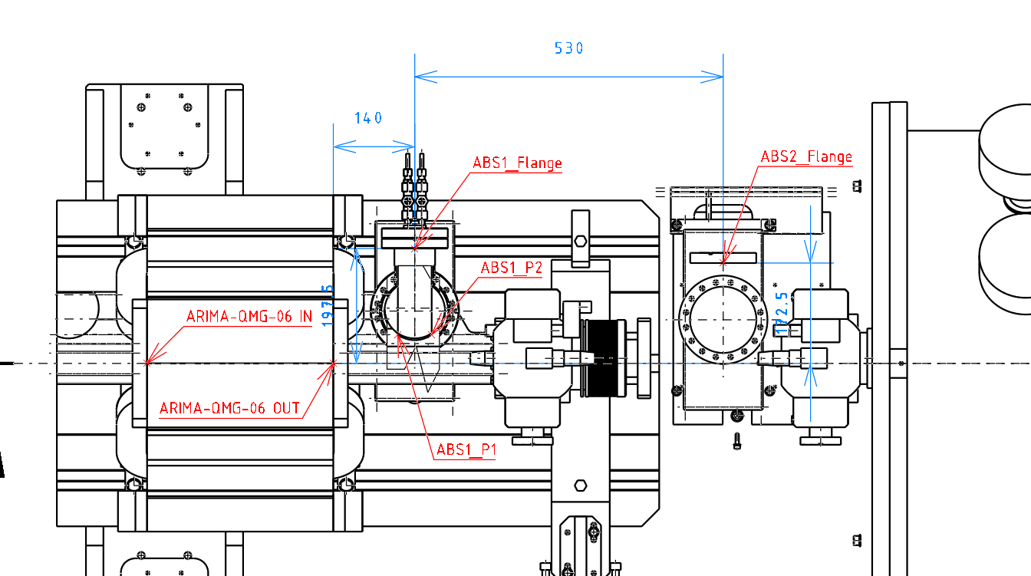
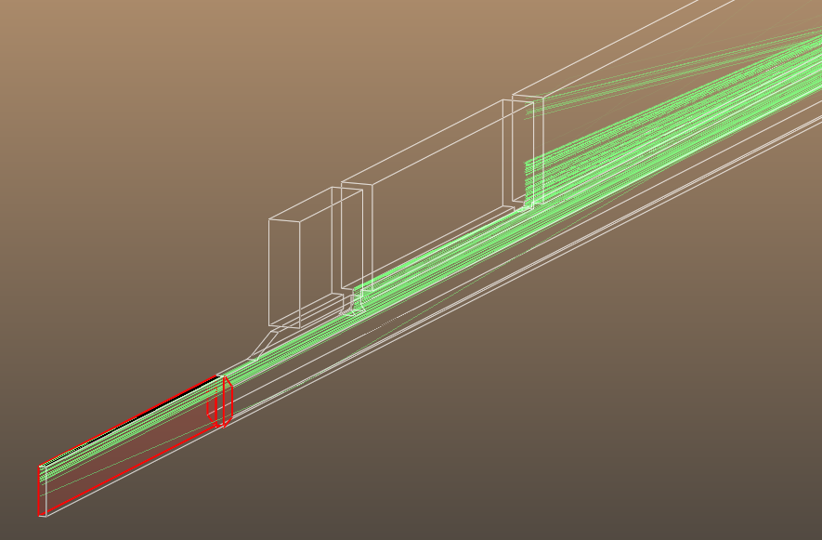
Super-3HC: March 2022 Incident
Reconstruction of distorted orbit and Synrad Calculation
Heating due to trapped mode at valve, bellow?
Synchrotron-radition?
Quality factor degradation cannot be the explanation →
Reconstructed orbit during the first incident:
Bending magnet Be06m is around s=137m
Super-3HC is after s=141m,
its flange-to-flange length: 1.1m
Orbid data: M. Boege, Synrad template: L. Schuz, Locations: N.Kirchgeorg
After the incident: detuning of the Super-3HC changed by -5.5kHz (cav 1) and -10kHz (cav 2) for the same voltage
No obvious change in LHe consumption
Synrad: Increased power at tapers before and after the cavity

Slide 6
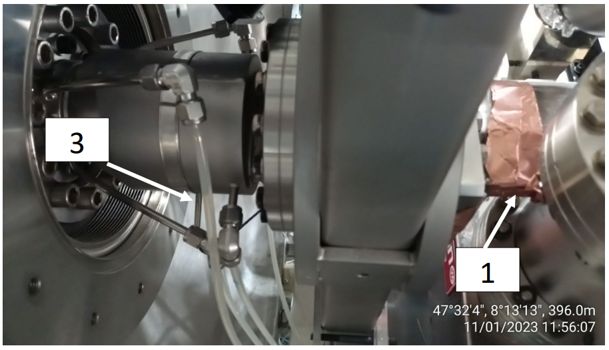
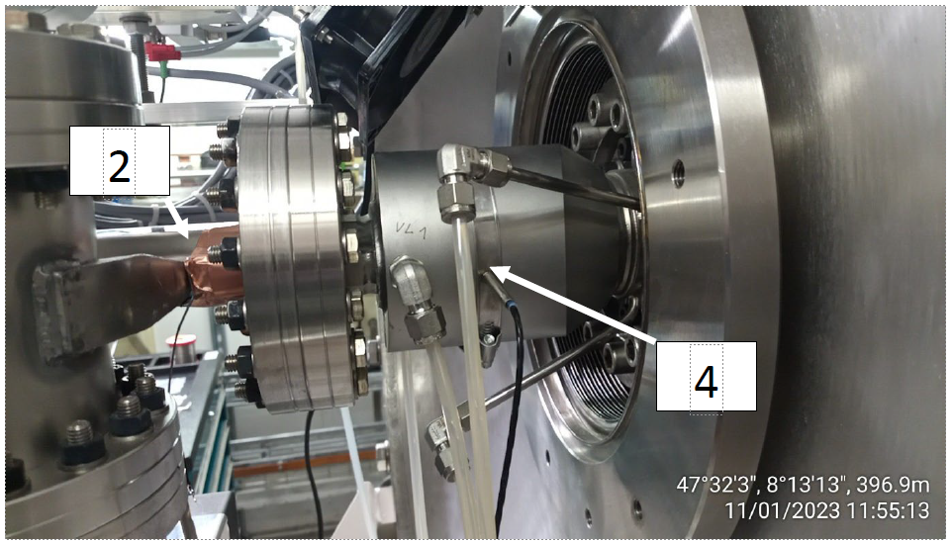
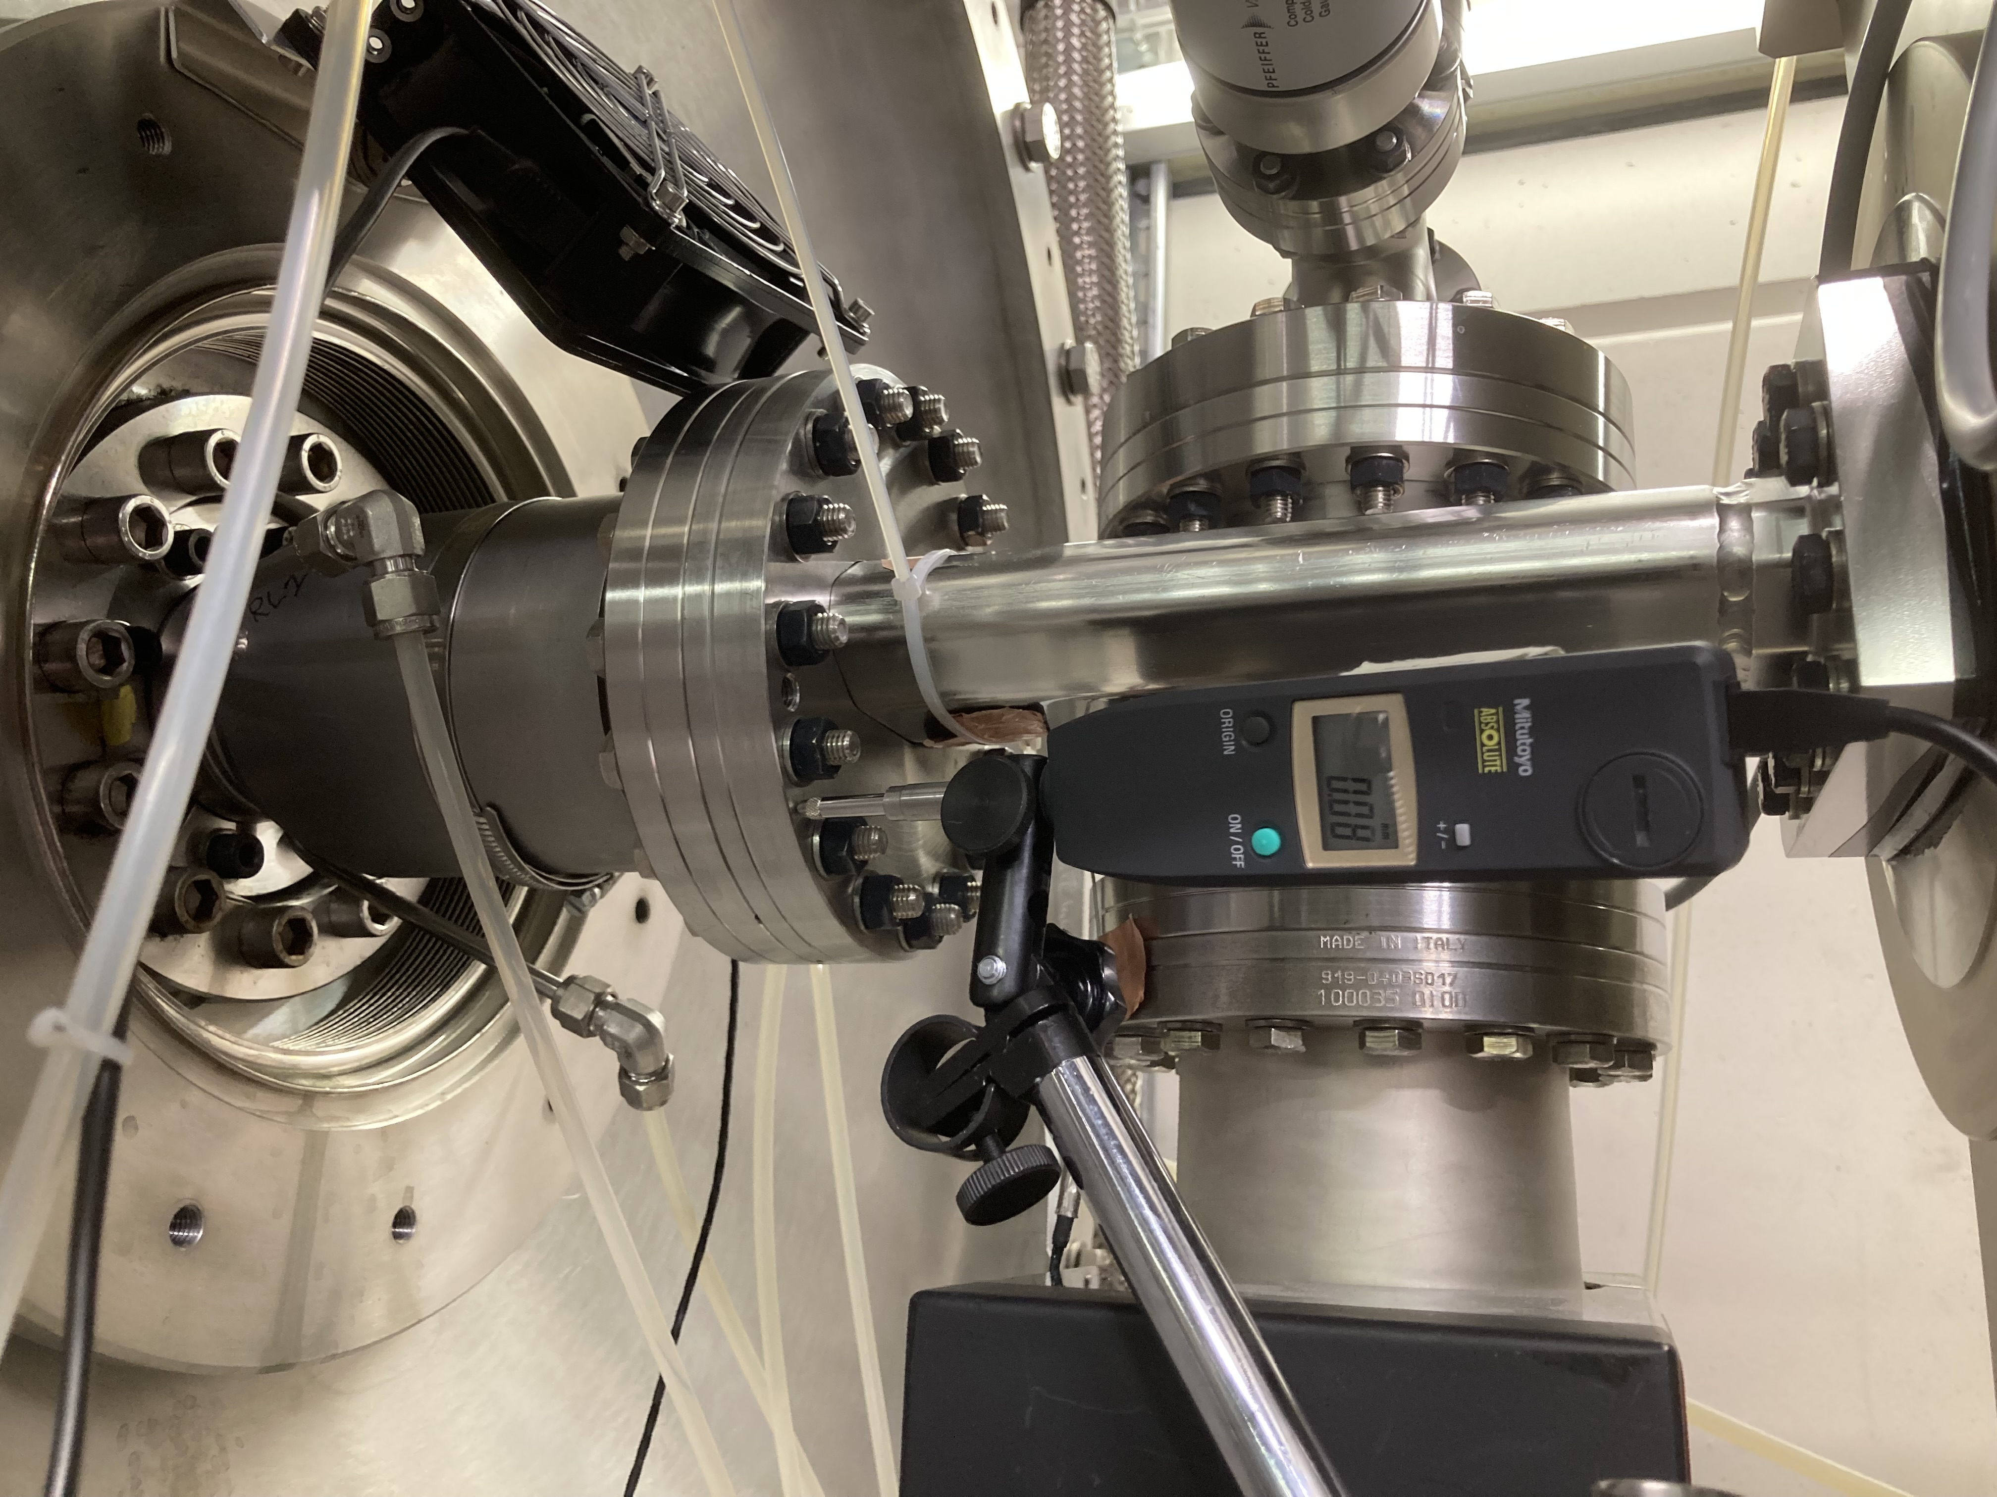
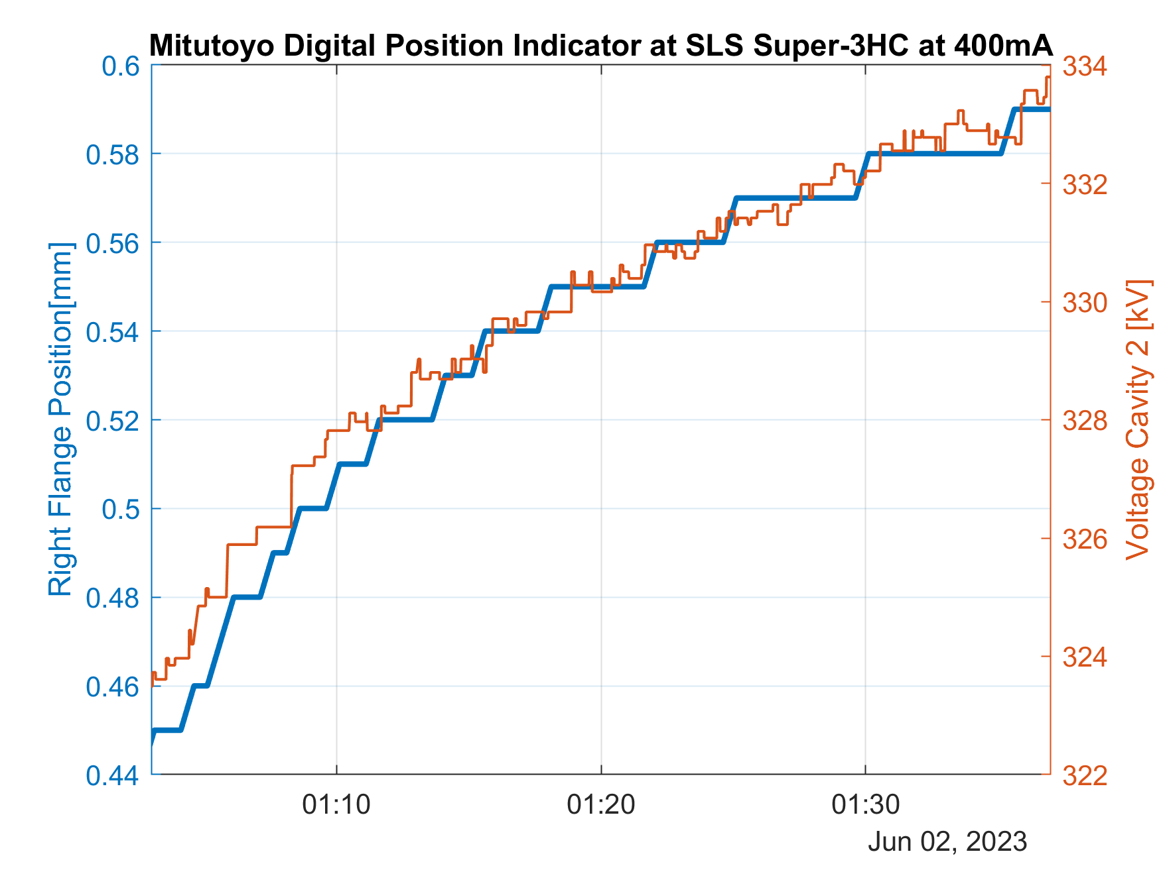
Super-3HC: March 2022 Incident
Investigations: Measurement of Flange Temperature and Movement
Temperature change 0…400mA:
ΔT₁=+4.3°C ΔT₂=+3.2°C
ΔT₃=+0.4°C ΔT₄=+0.3°C
View from outer wall: beam comes from the right!
Longitudinal position of the flange changes with same time-constant as the voltage-drift
← (after accumulation 0…400mA)
Driving offset-bumps with up to 0.5mm horizontally and 1.6mm vertically did not show any significant effect.
Installation by D. Kunz
View from inner wall: beam comes from the left!

Slide 7
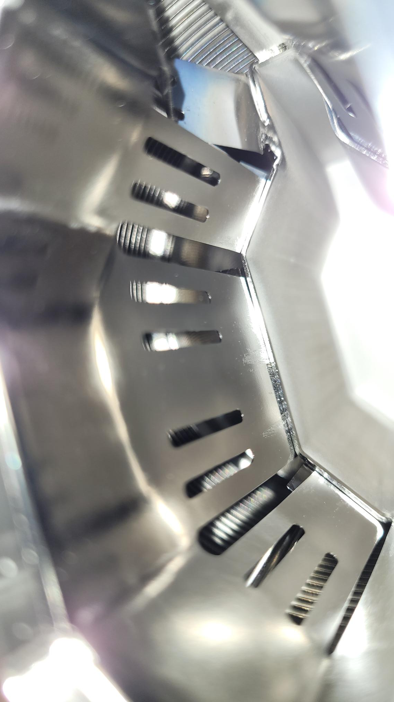
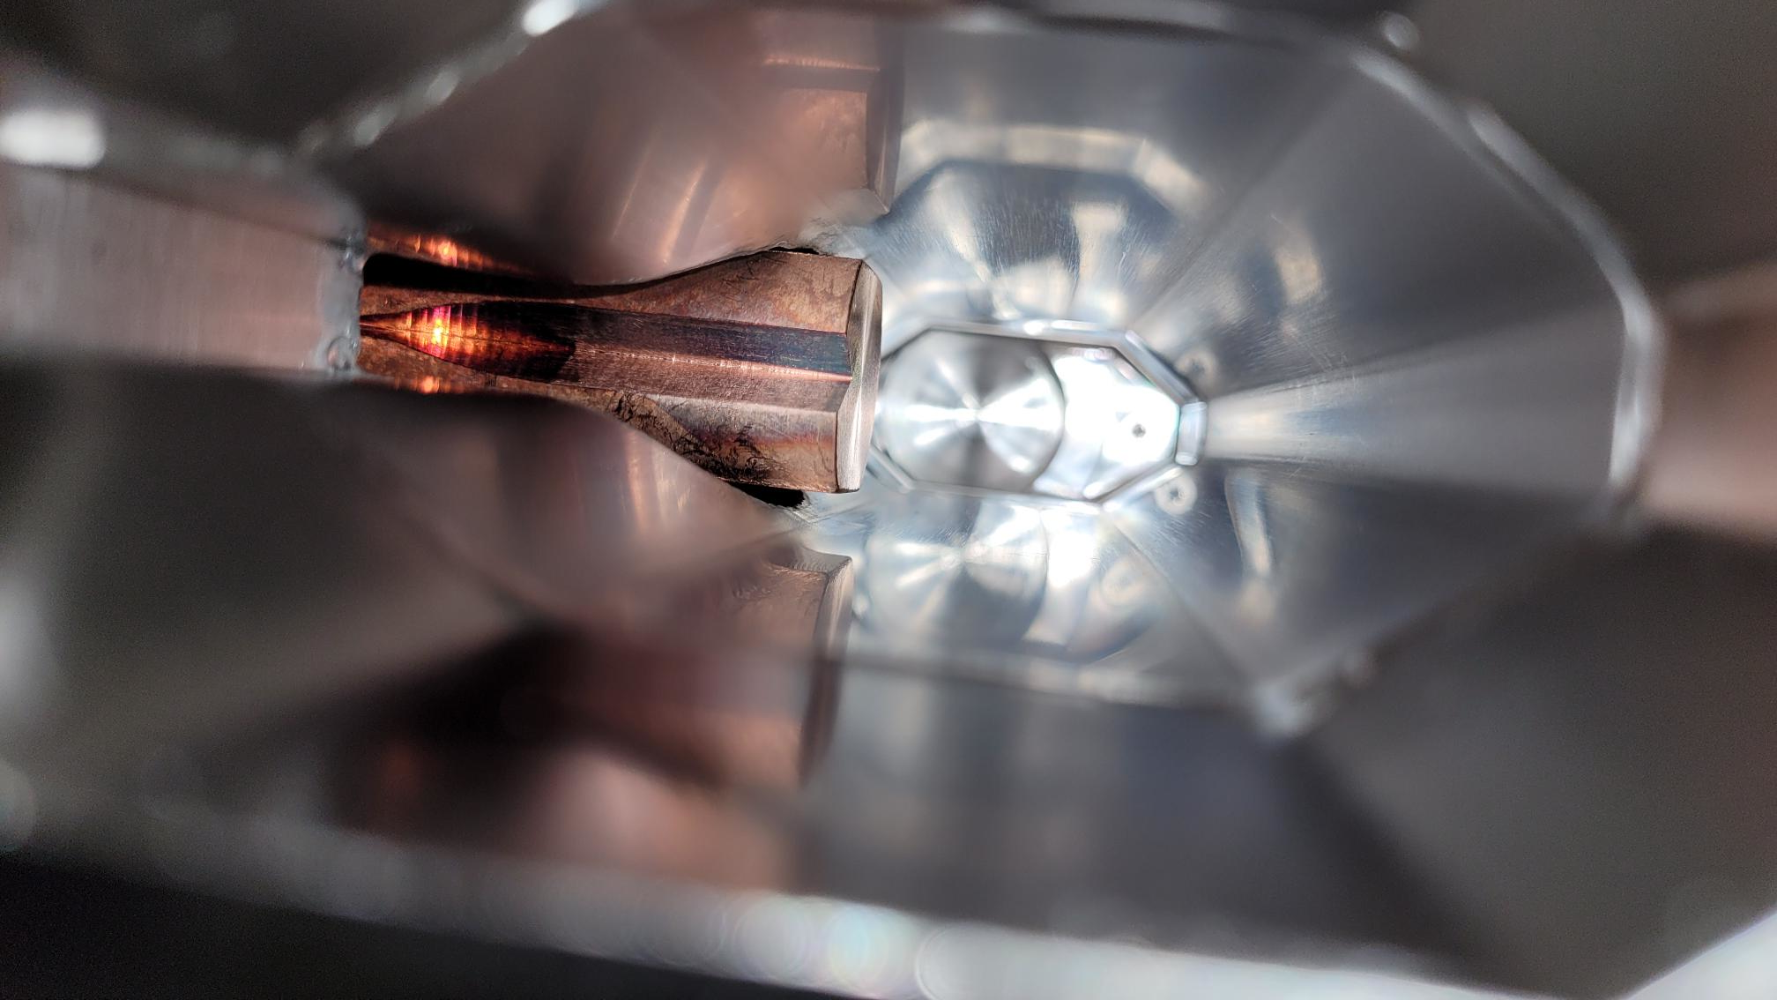
Post Mortem Pictures during SLS Disassembly
Bellow in front of the Super-3HC: →
Inspection shows a molten, welded and bent RF finger
Absorber in front of the Super-3HC: →
Some traces at vacuum chamber and absorber-block
Needs closer inspection.

Slide 8
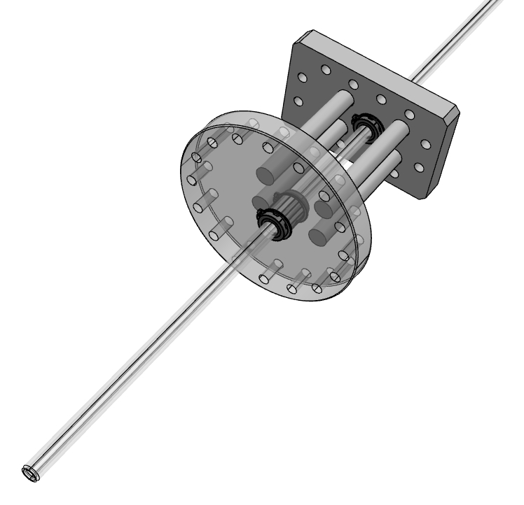
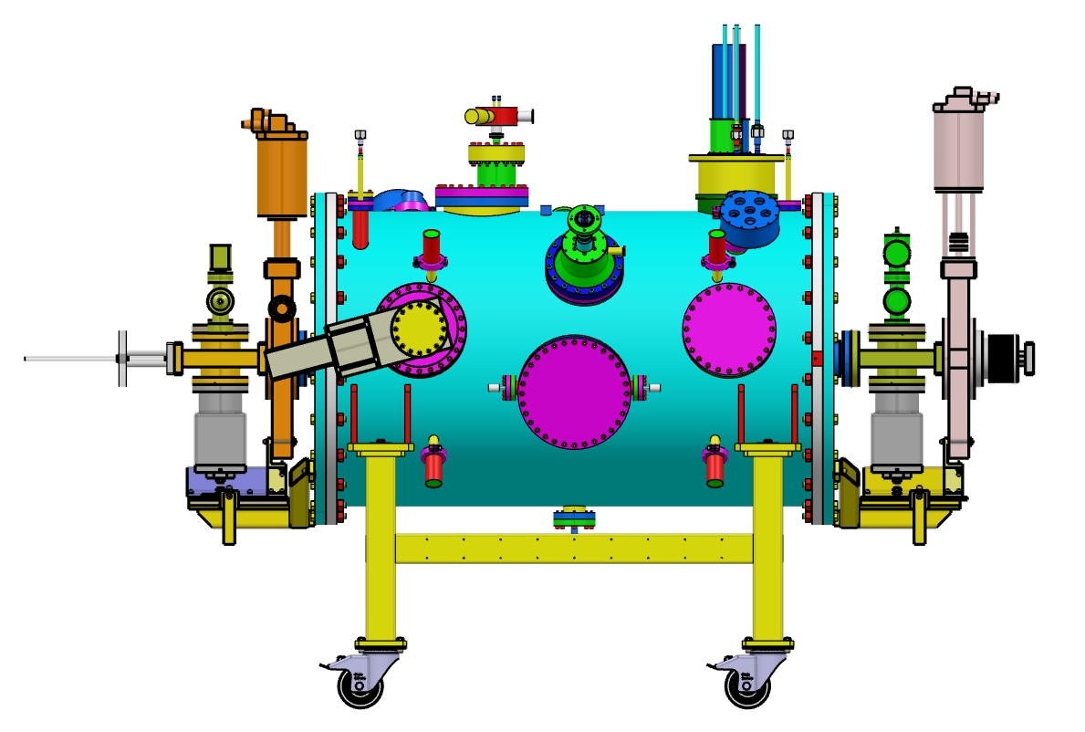
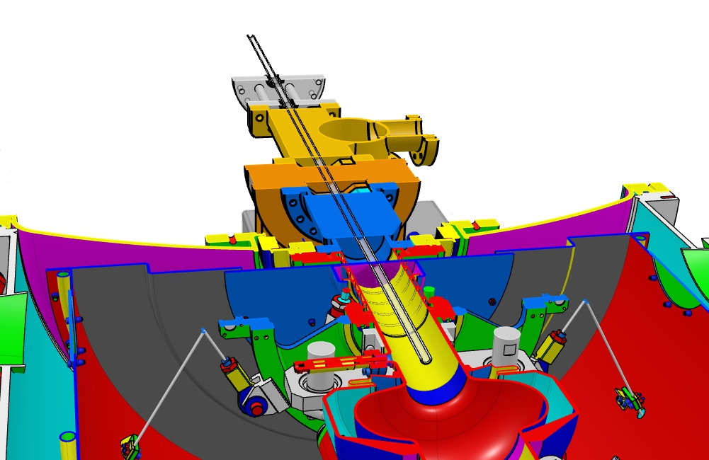
Super-3HC – Design of Inspection Tool
→ Setup for eventual inspection with endoscope
Linear ball bearings
Flange upstream
Flange downstream
PMMA pipe D_{a}=12mm / D_{i}=10mm
Slide: R. Rotundo 8.6.2023
→ Trolley for clean-room.

Slide 9
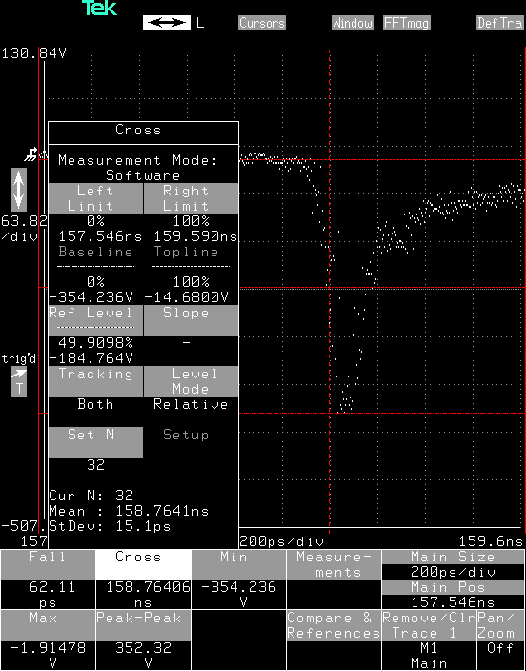
LINAC: Optimized e-gun Pulser Board
← Optimized board:
Marx puls generator configuration
350V, 60ps rise-time, jitter: 15ps
Fwhm: 150ps
Courtesy: Marcos Gaspar.

Slide 10
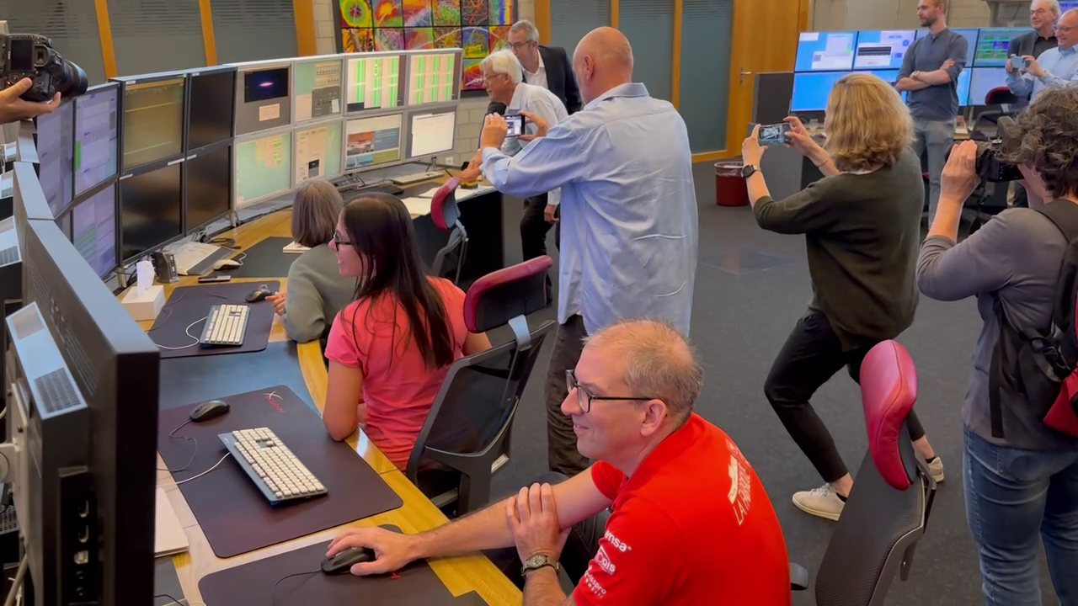
Last Beam of SLS1 and Ceremonial Beam-Dump

Slide 11
SLS RF works
Done:
Modification of 500MHz Teststand for RI-cavity.
LINAC Klystron: HV-Pulse recording
LINAC Klystron HV-Pulses reduced from 6.1us to 4.8us
LINAC e-gun: pulser board upgrade to shorter bunches
In Progress:
Storage-Ring: LLRF upgrade
SLS2 RF Upgrade → See next slides

Slide 12
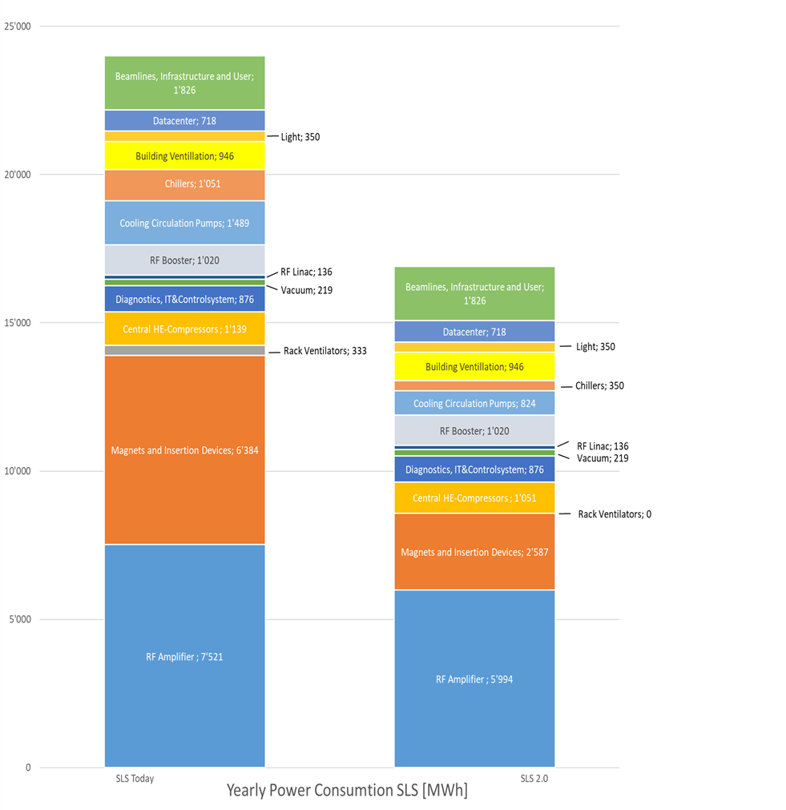
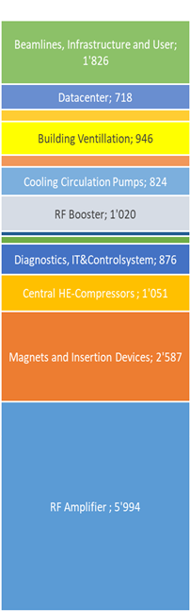
More radiated X-ray power for users
Less electricity consumption
SLS → SLS2.0
E_{e-} 2.4 GeV → 2.7 GeV
P_{SR} 310 kW → 365 kW
W_{elec}/y 24 GWh → 17 GWh
W_{elec}-W_{PV}/y 17 GWh → 15.5 GWh
Key savings:
Electromagnets → permanent magnets
Klystrons → solid state amplifiers
Standard pumps → regulated pumps for cooling
Tar paper roof → PV cladded roof
Power Economy SLS2.0 vs. SLS incl. PV roof
≈ -30%
≈ -35%
Courtesy: SLS2 Project Management
PV: 1.0-1.5 GWh/y

Slide 13
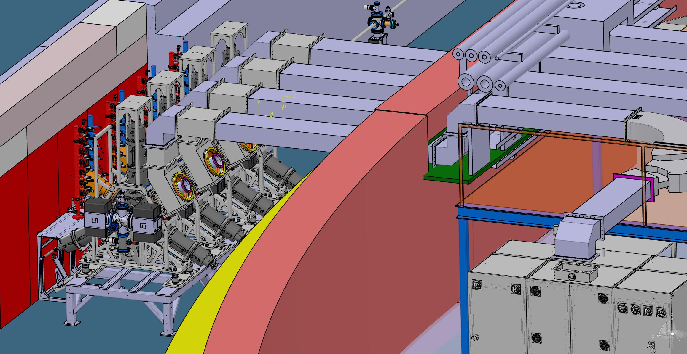
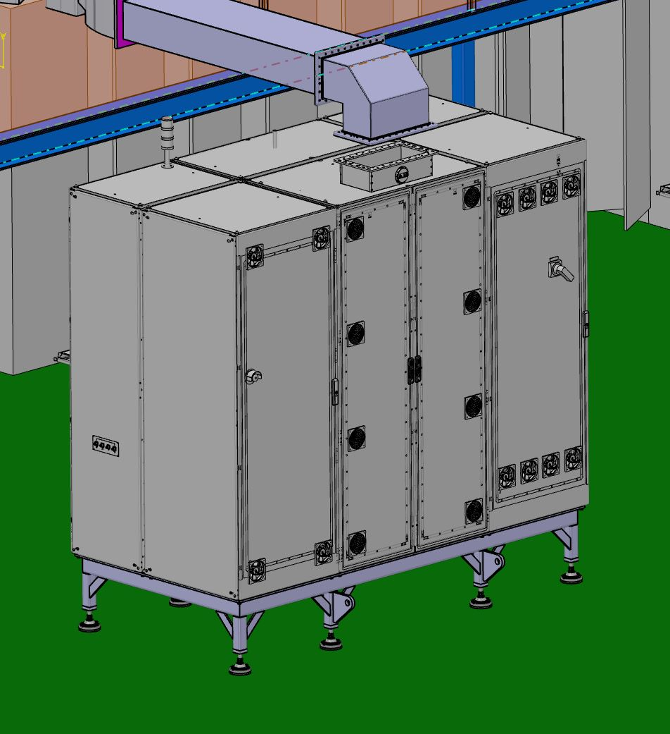
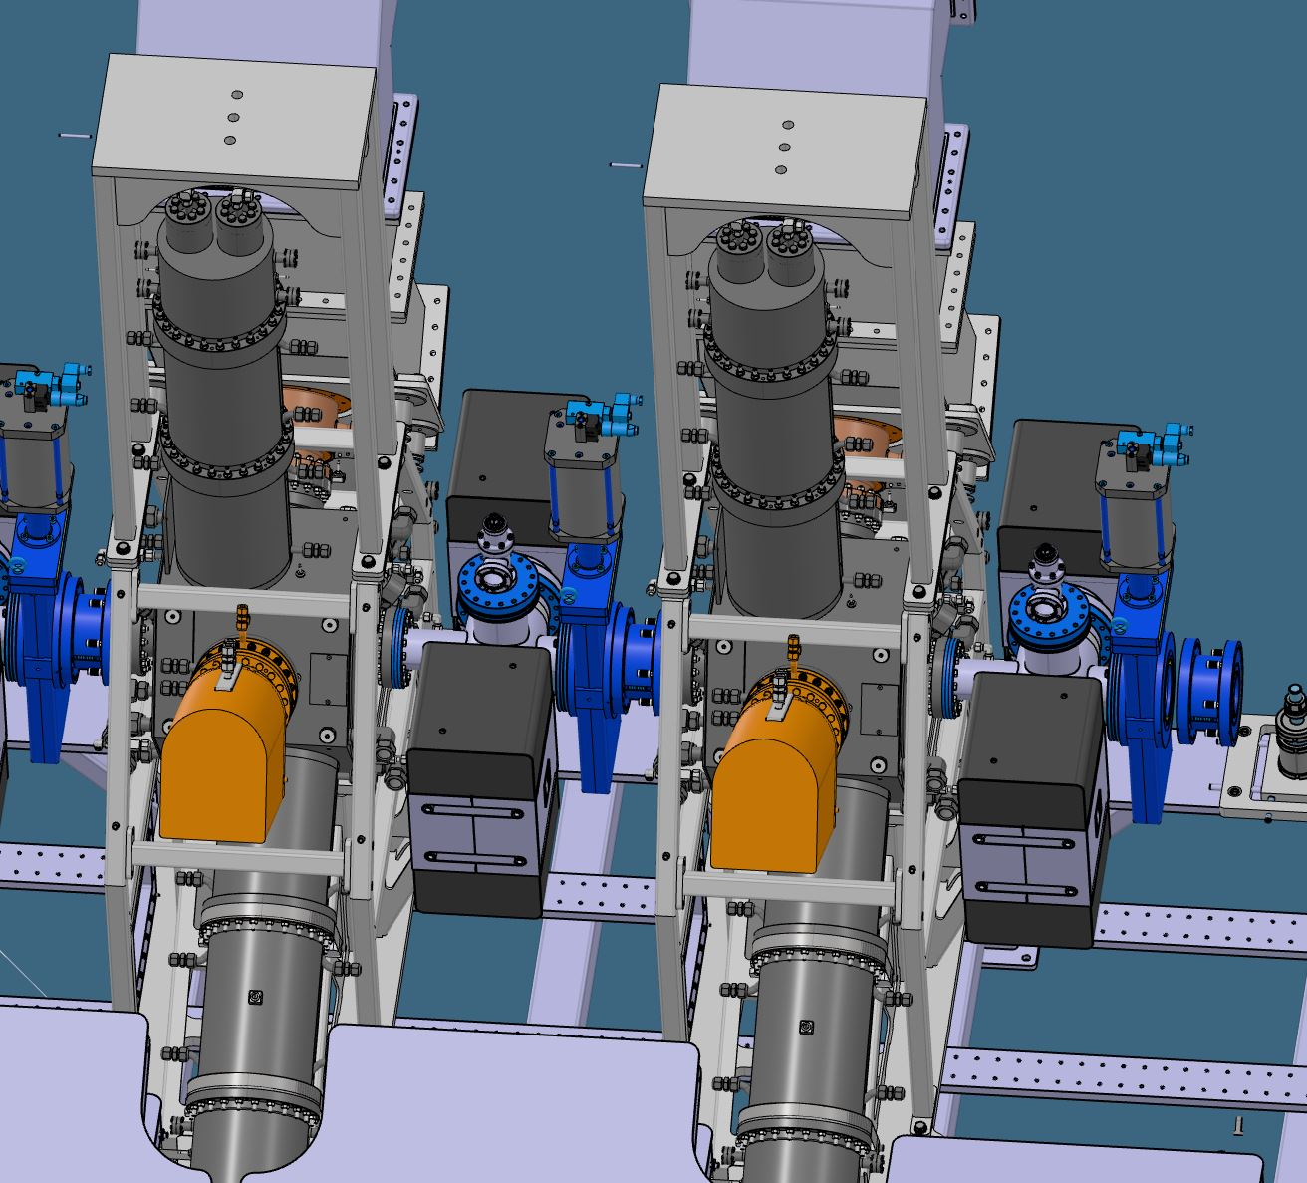
Status Storage Ring RF-Systems and Interfaces
Cavities ordered at RI (4+1 spare). 1 received and tested.
Amplifiers ordered at Cryoelectra (4x150kW)
Supports construction in progress
Concept of tunnel modification, passages and waveguide shielding finished.
Waveguides ordered
(some old will be cut and re-welded)
Design of cavity vacuum components finished
Modified Teststand
RF «clean-room» operational for installation and inspection.

Slide 14
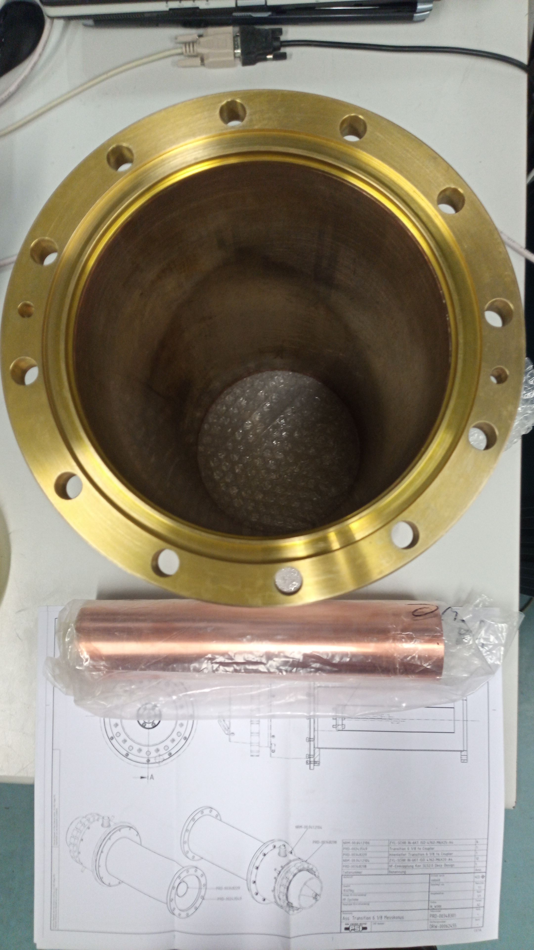
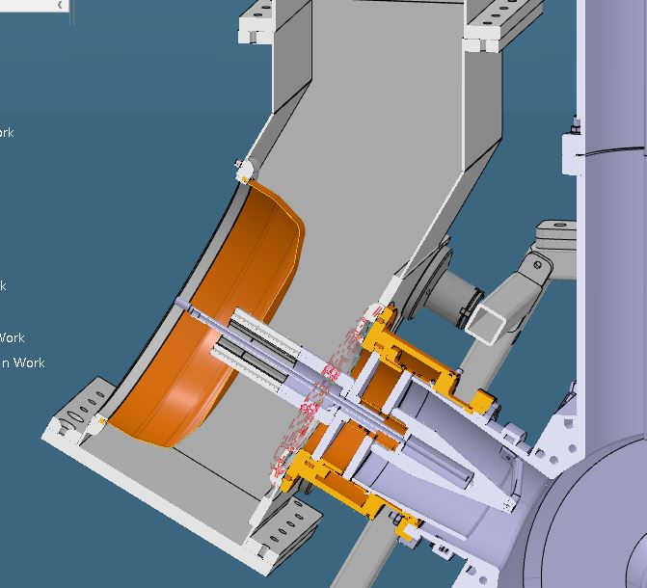
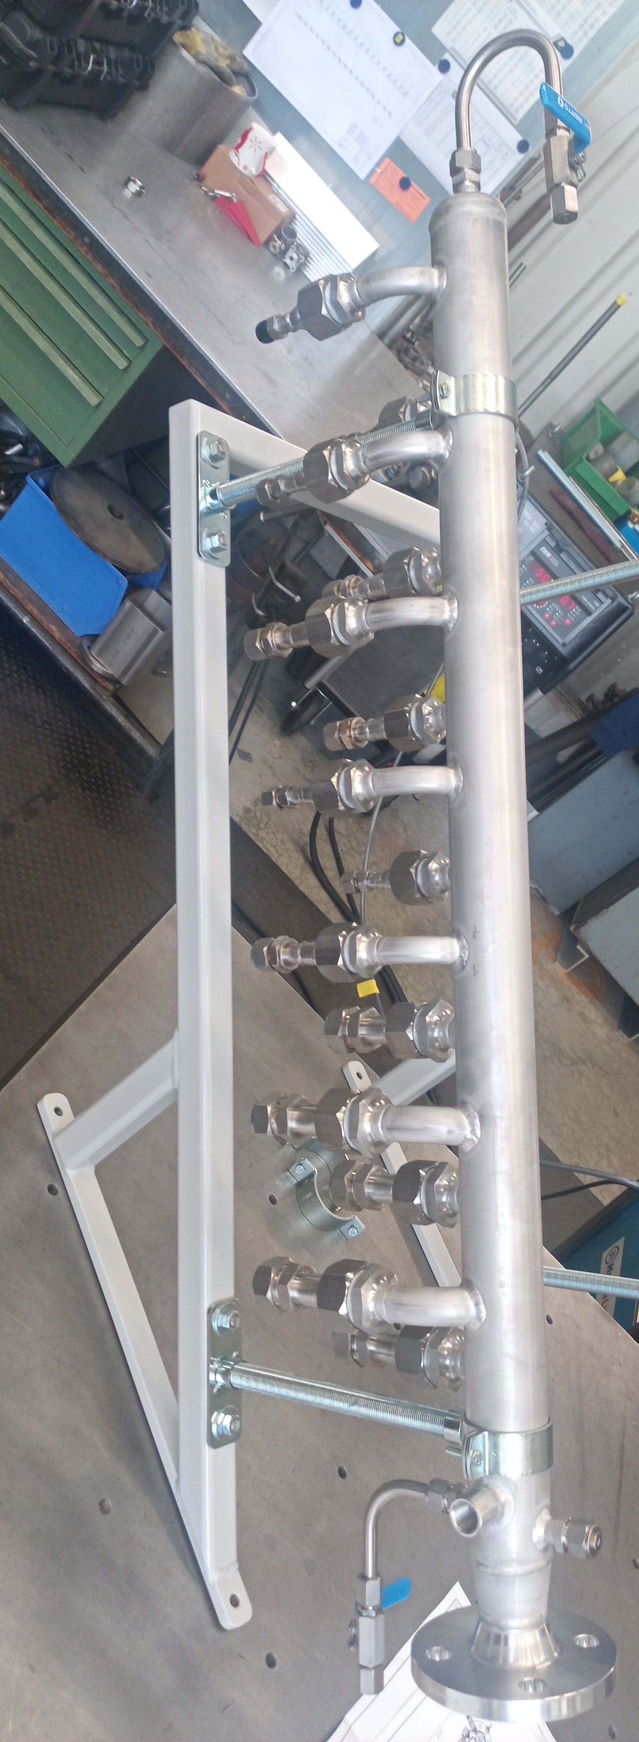
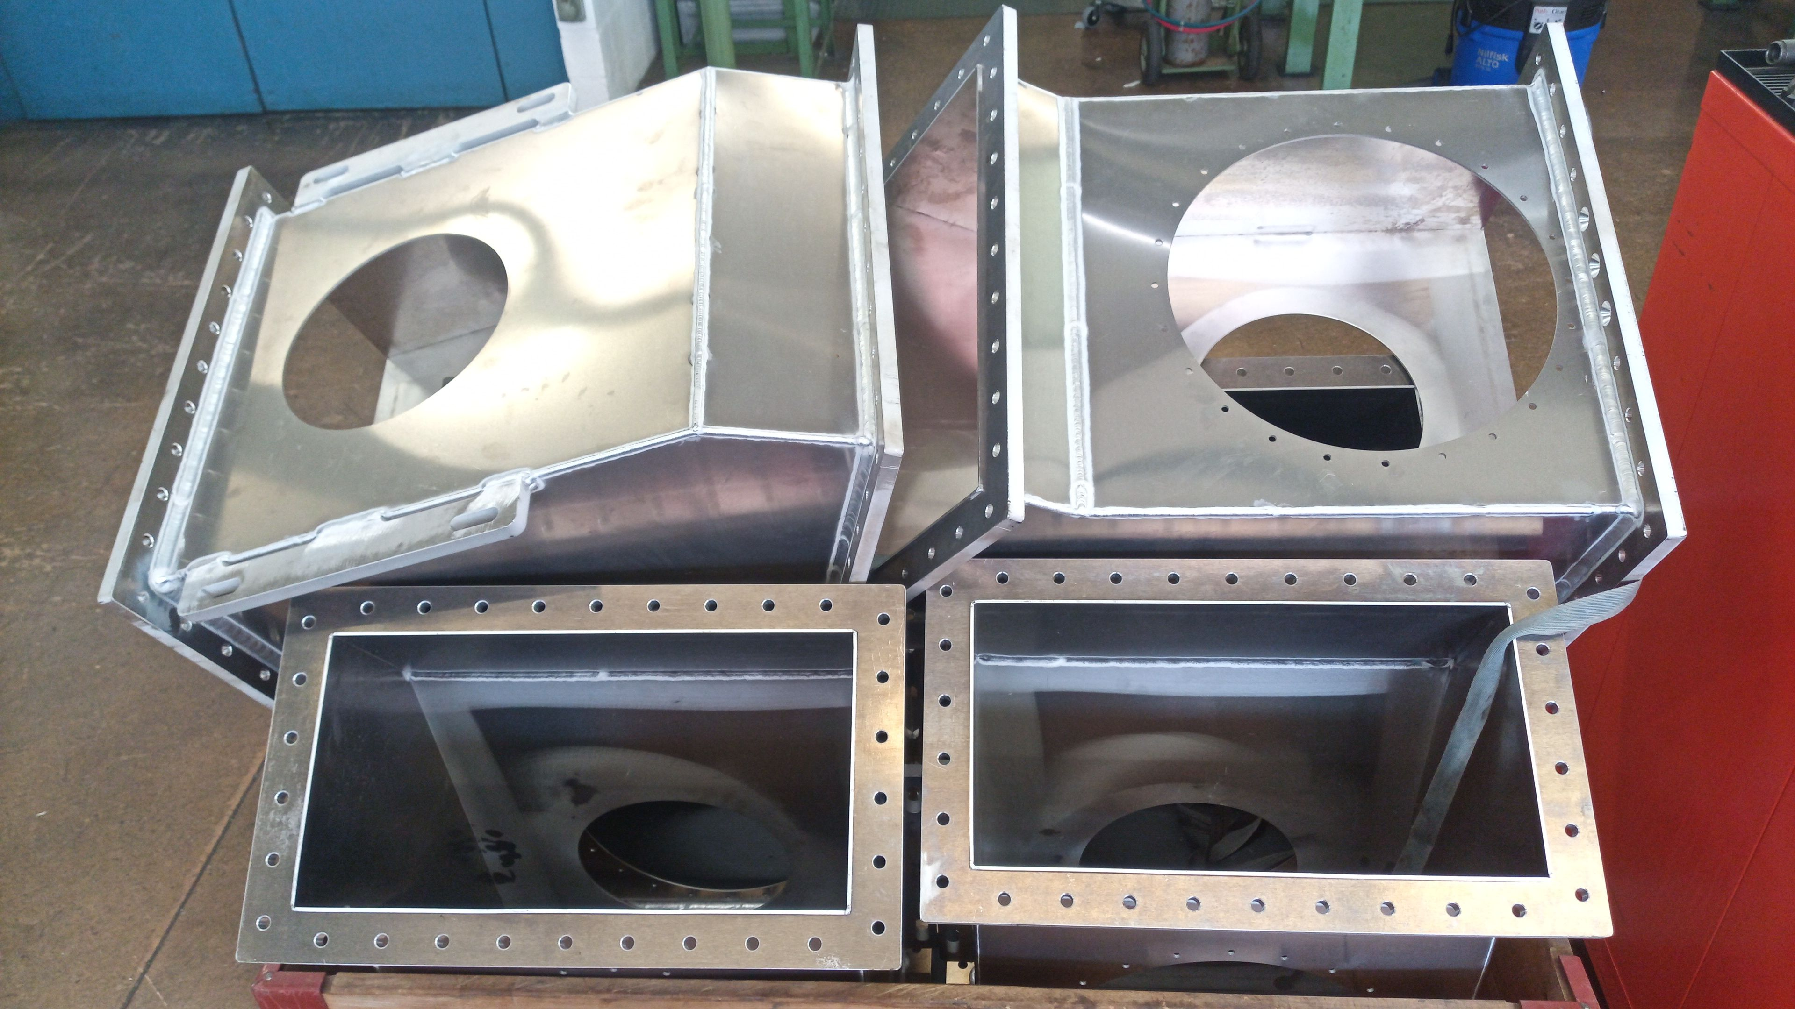
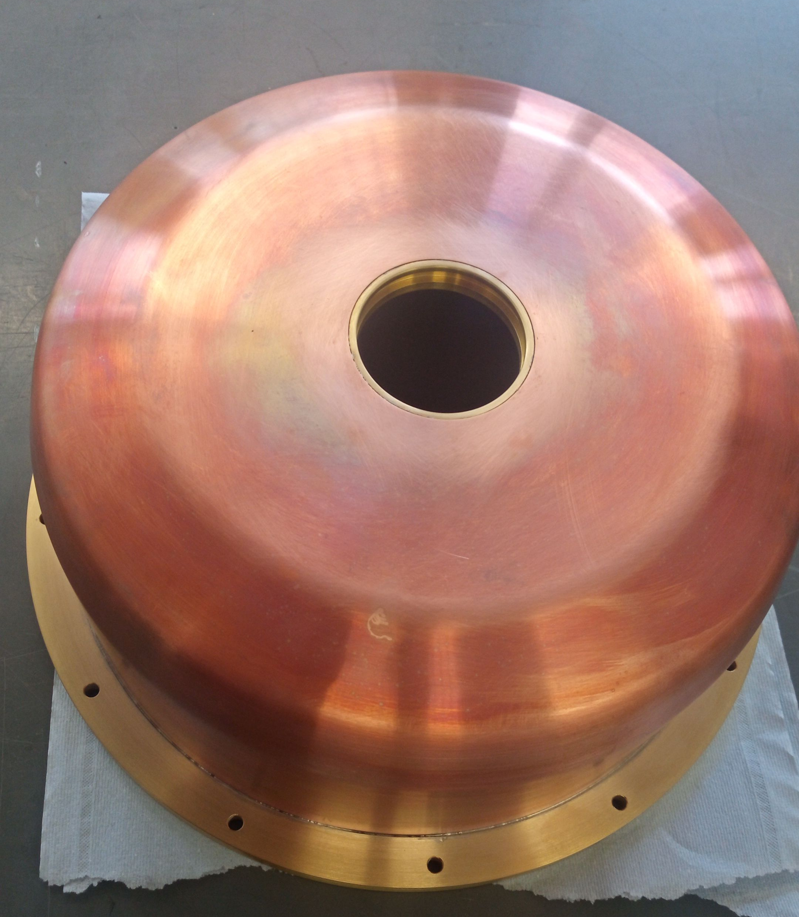
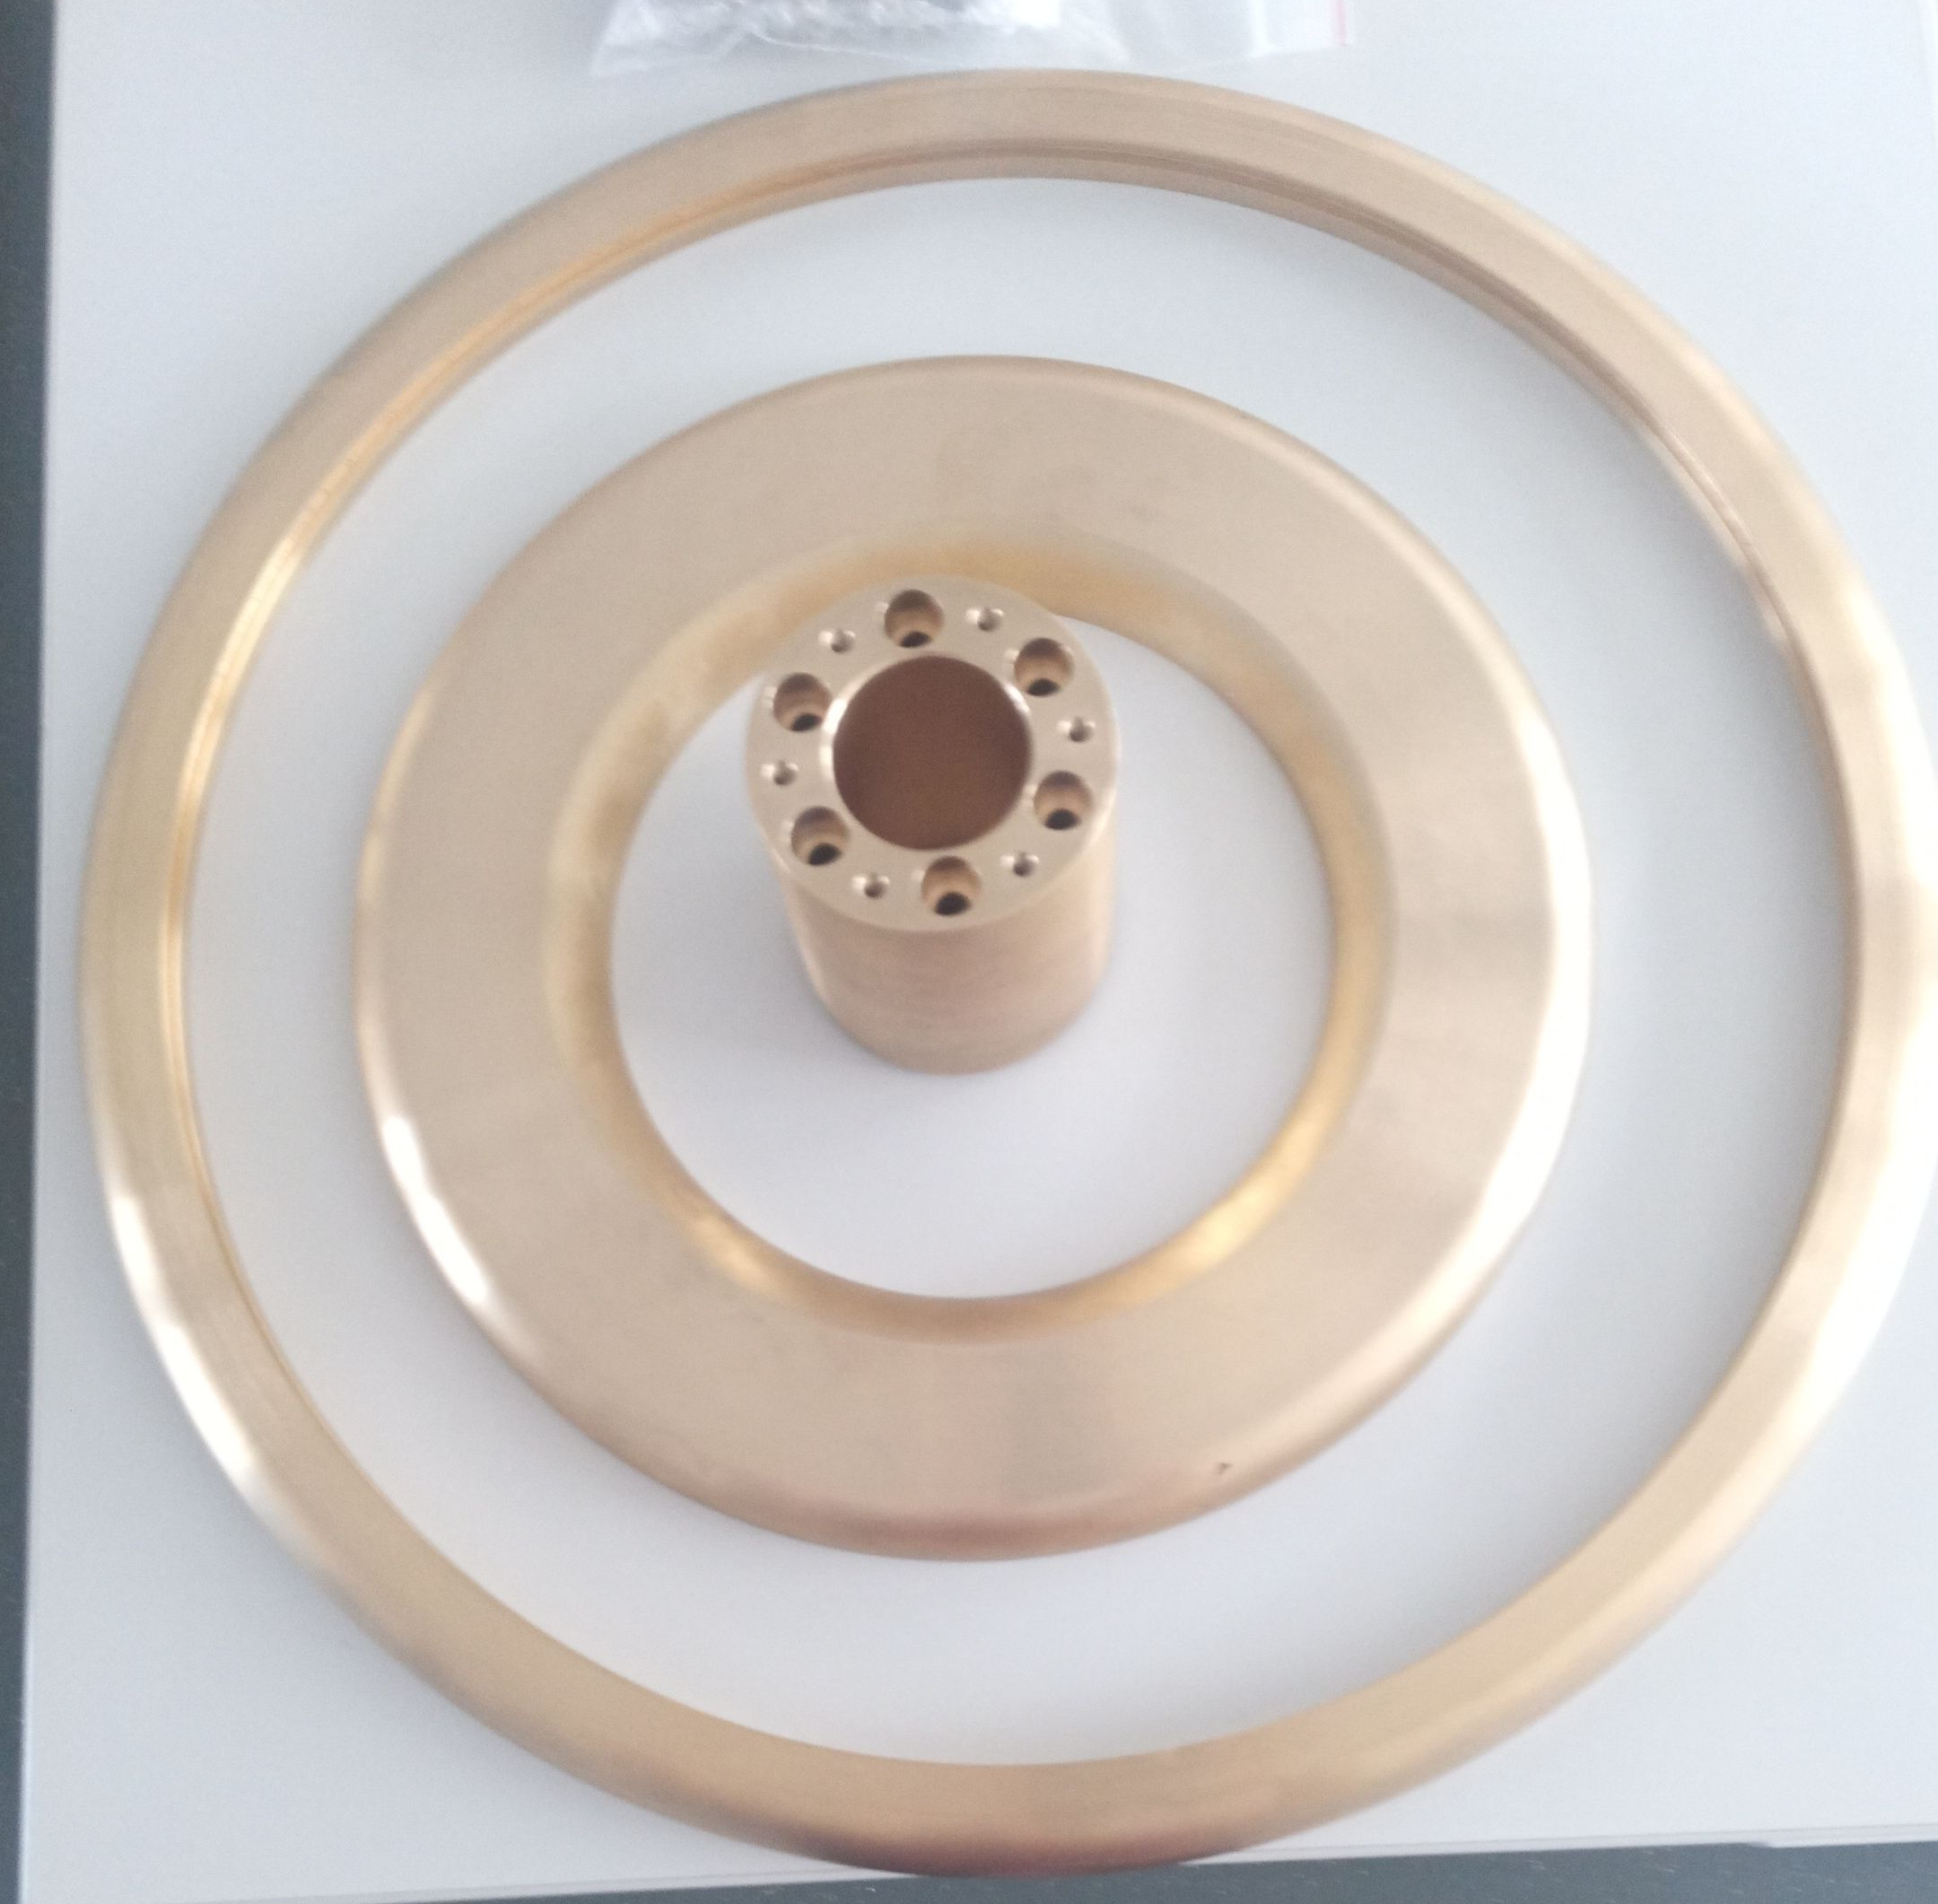
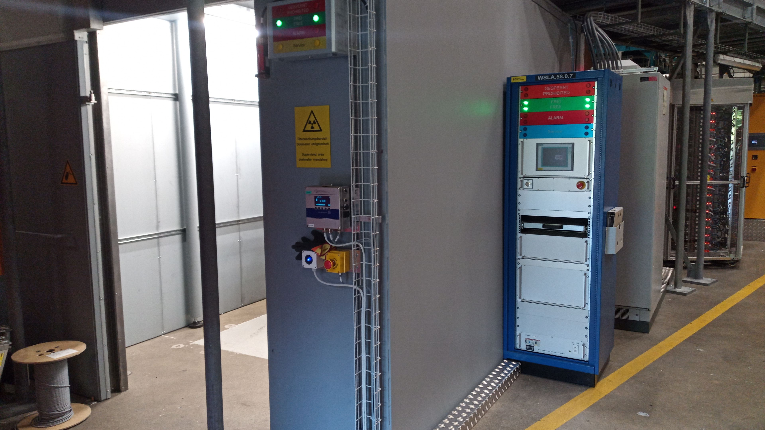
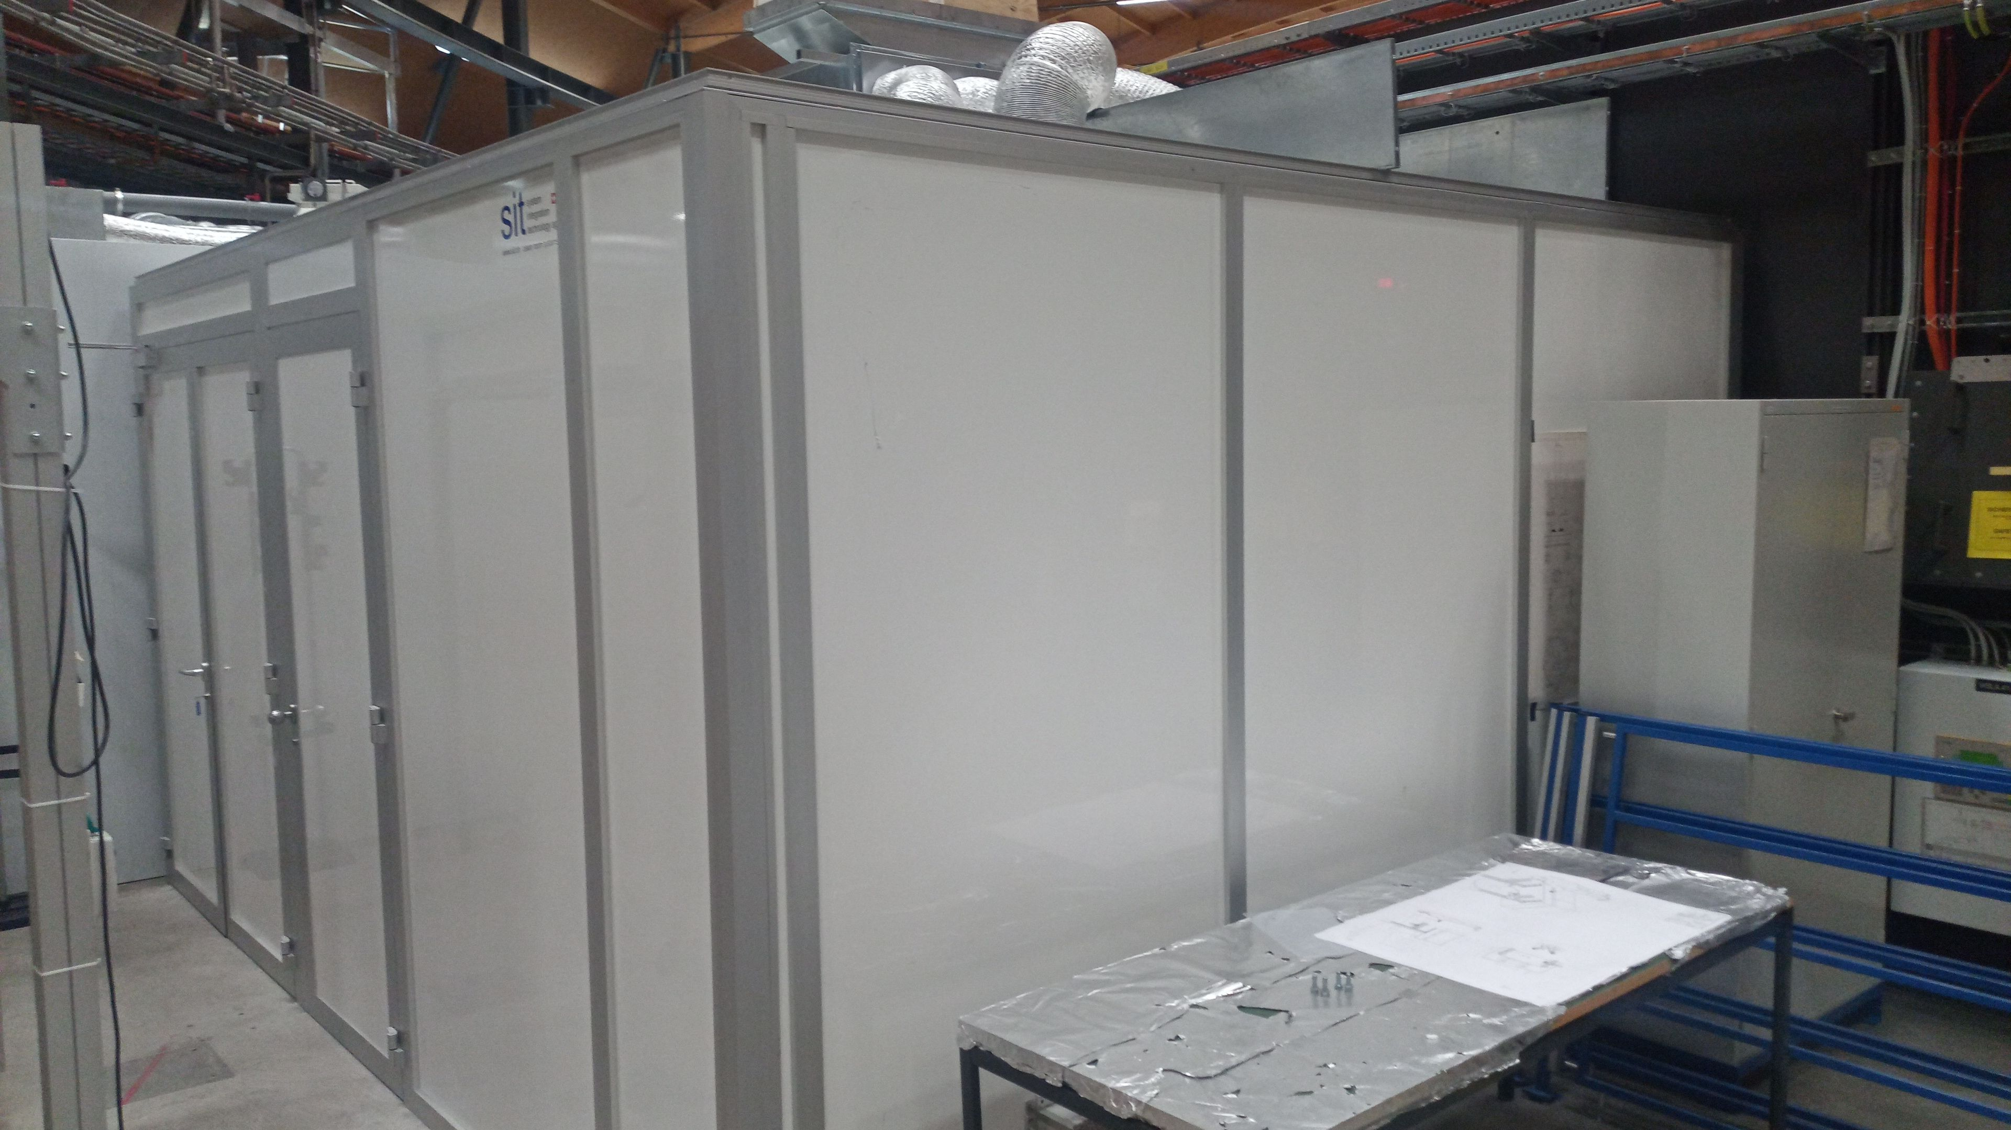
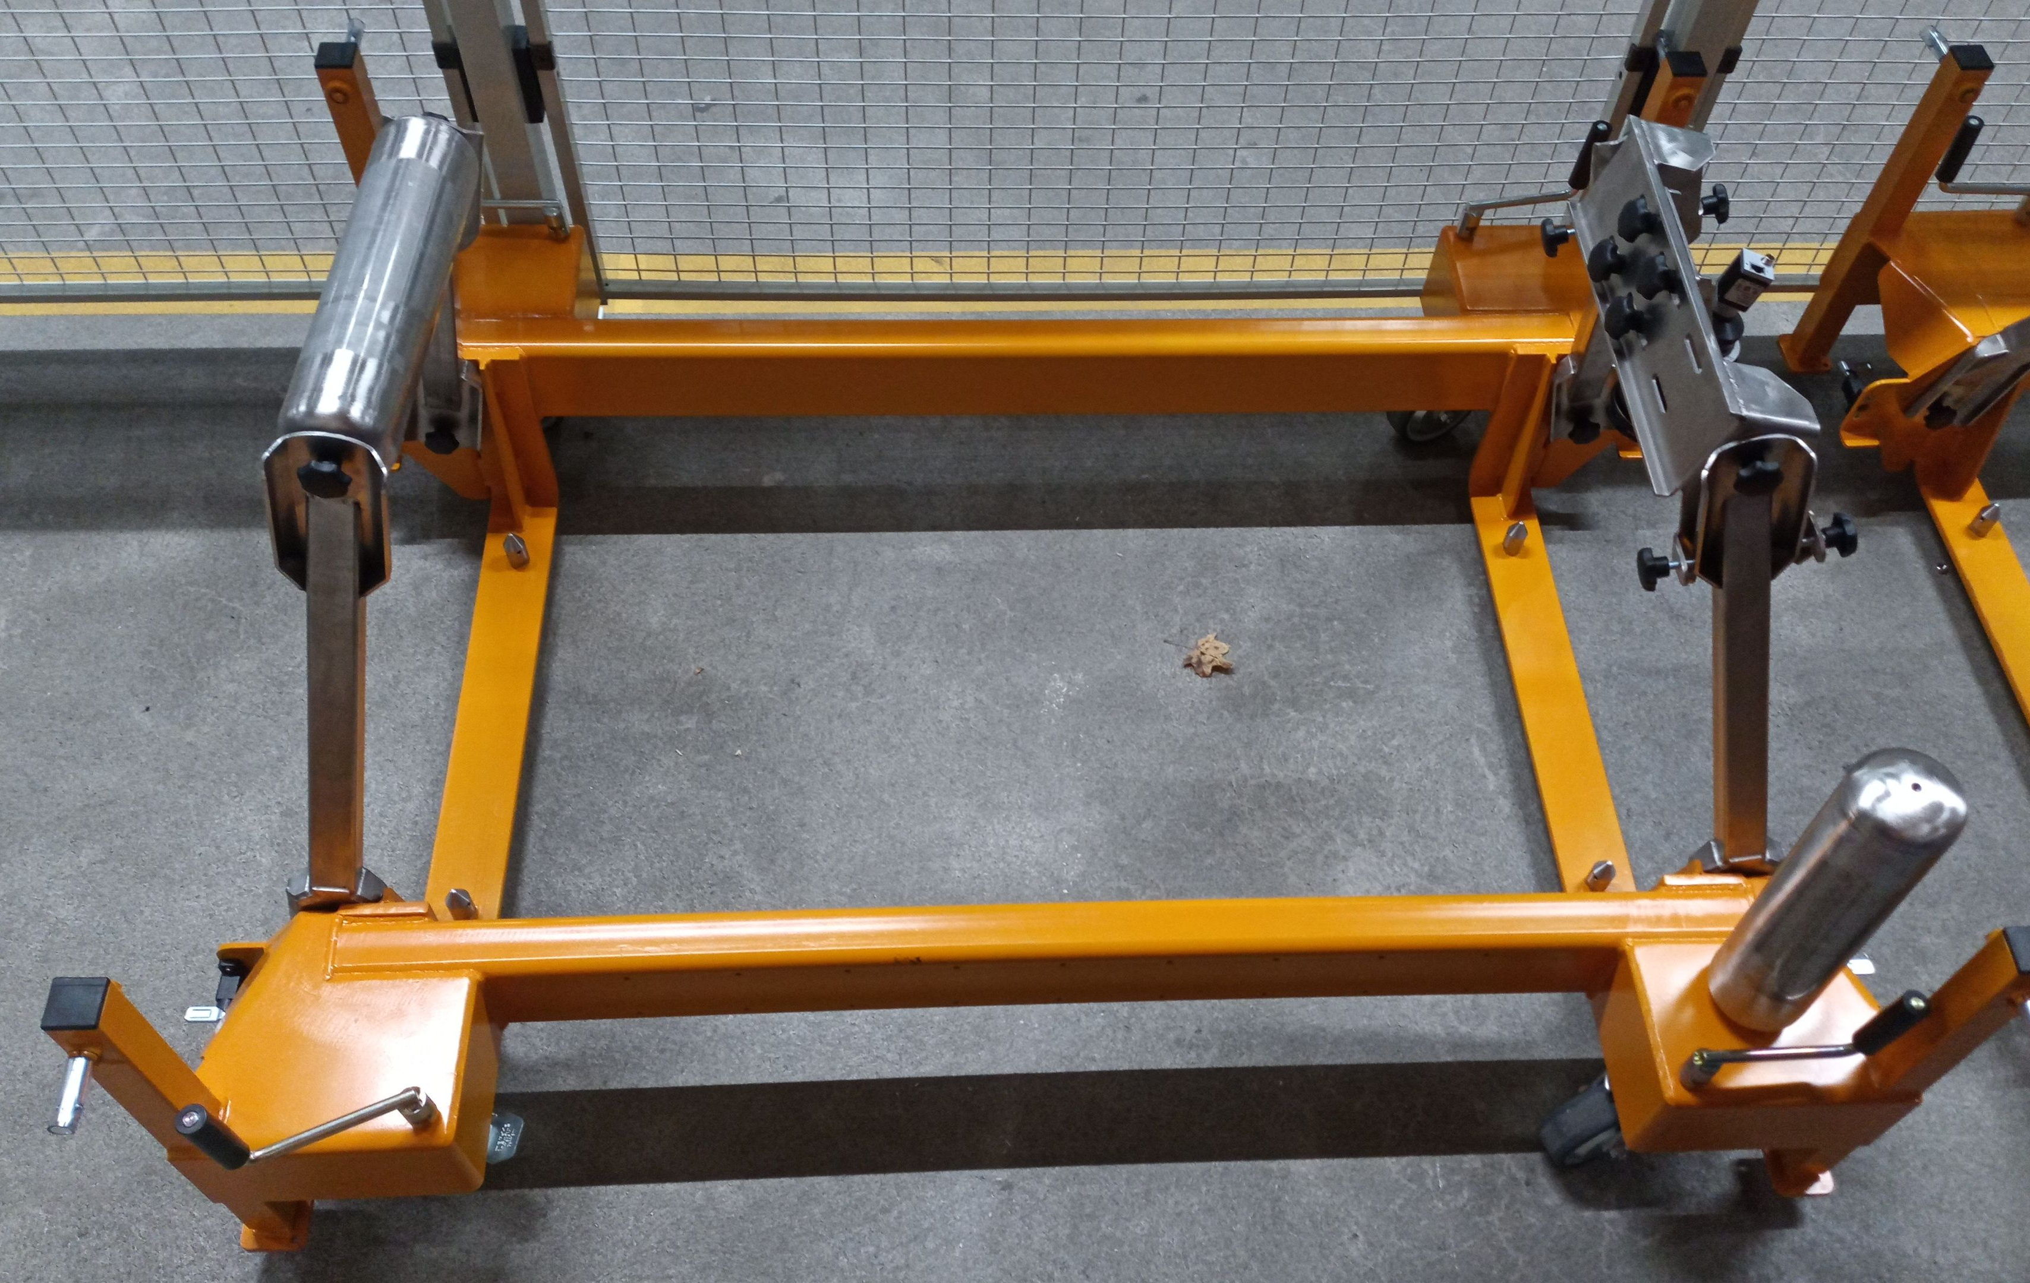
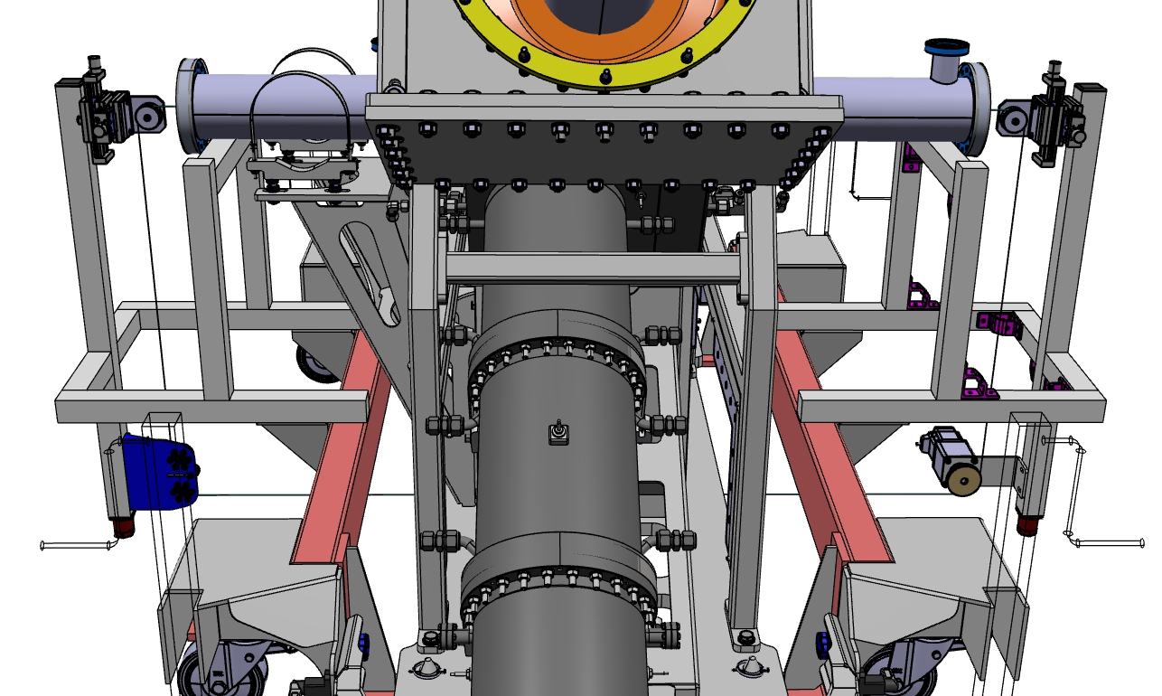
Cavity «Accessories»
Power coupler measurement adapter
Cavity upper support frame and patch panels
Trolley and bead-pull setup
Coax-to waveguide adapter (similar to DESY-design)
Cooling distribution: built prototype
Teststand cooling

Slide 15
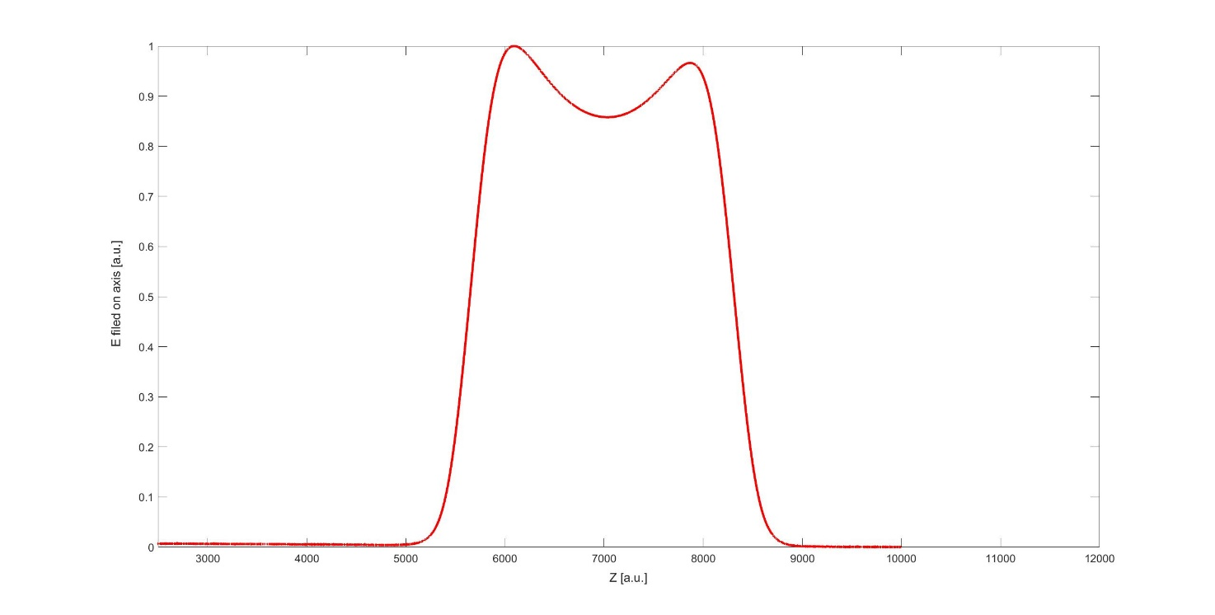
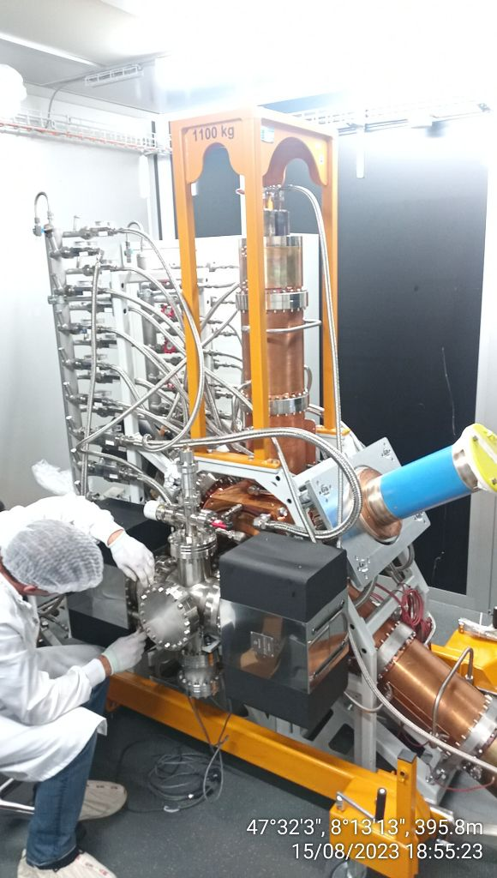
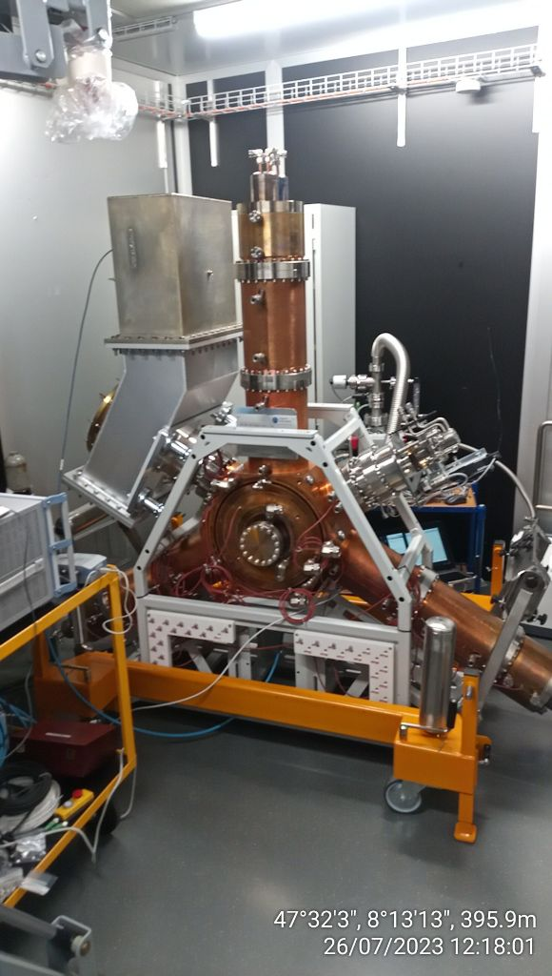
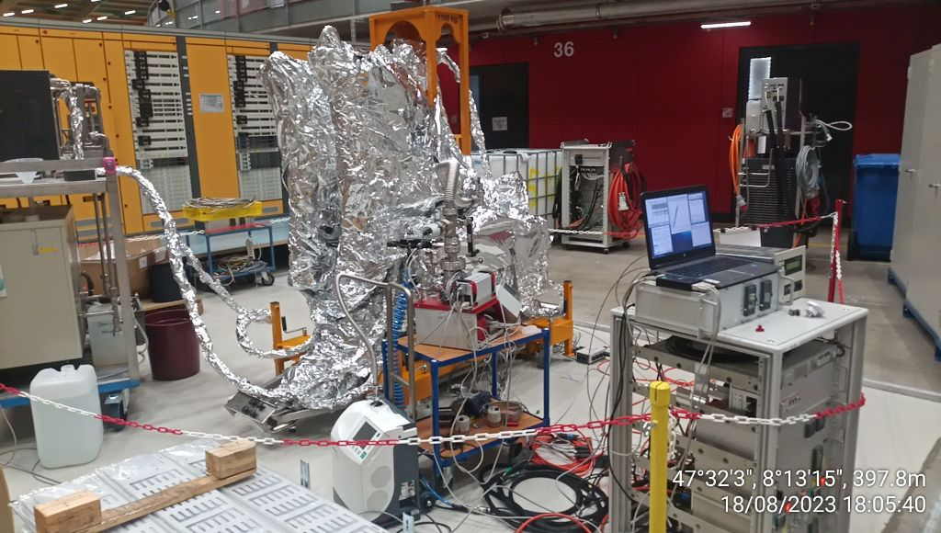
First Site Acceptance Test of SLS2 Cavity
Bead-Pull measurement shows asymmetry on operation-mode (as expected.)
Installation in the
RF clean-room
Fine-tuning of the coax-waveguide transition
Bake-out with hot water and electric tapes.

Slide 16
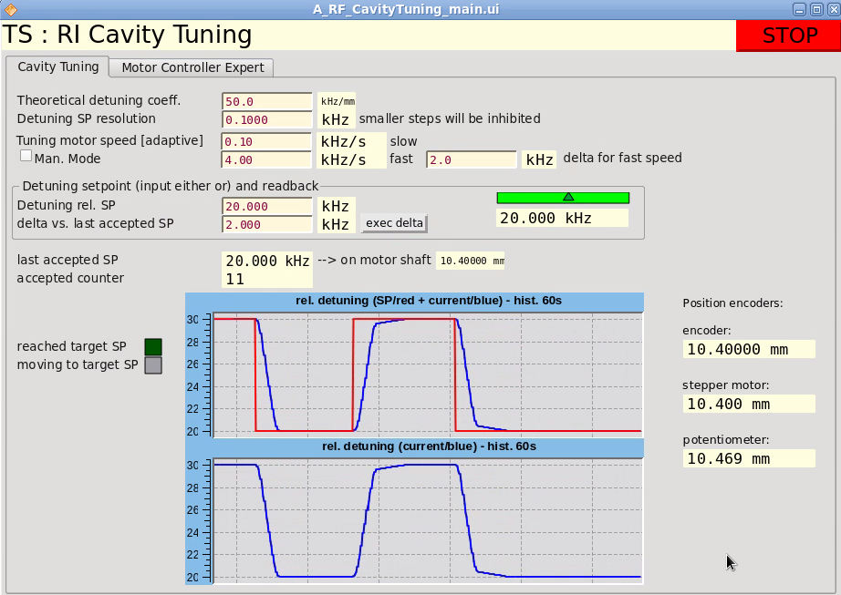
First Site Acceptance Test of SLS2 Cavity
Setup of Tuner-control:
Implemented resolution-threshold on frequency error
Fast speed for large corrections
Slow speed for small corrections

Slide 17
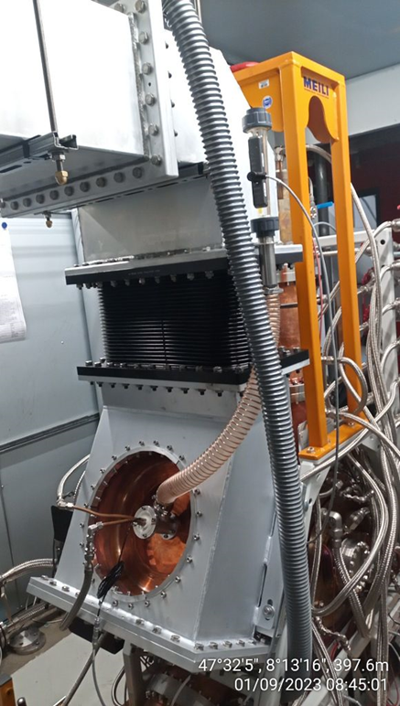
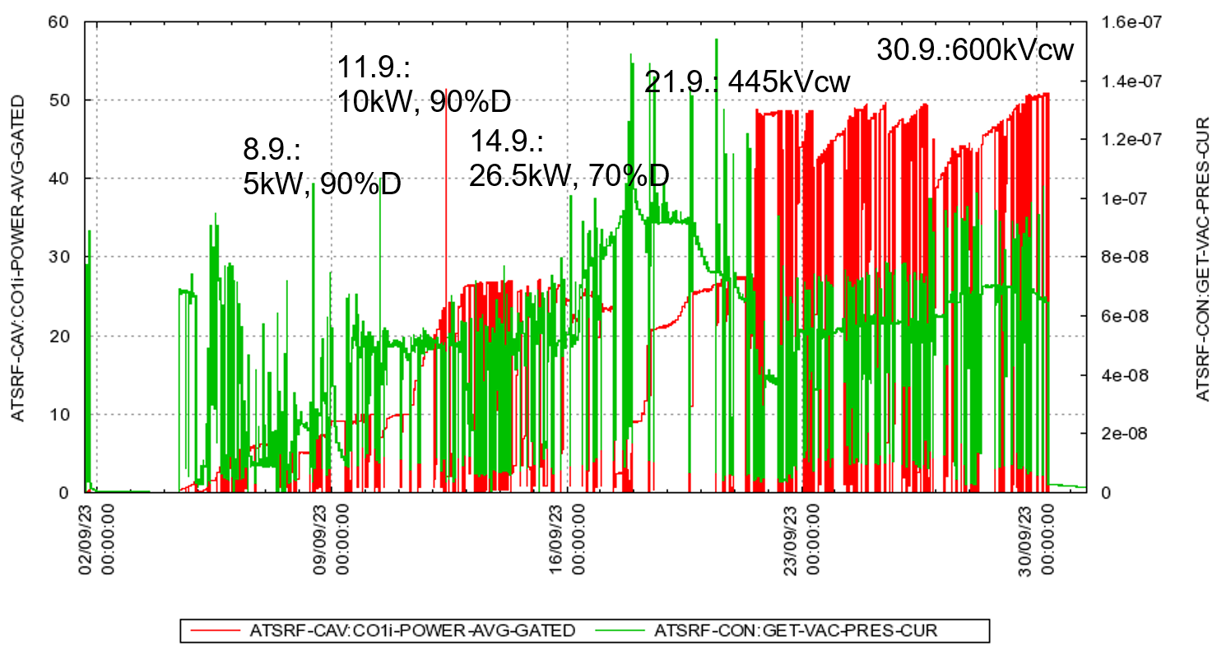
First Site Acceptance Test of SLS2 Cavity
Power conditioning took about 1 month!
Cavity installed in the high power teststand.

Slide 18
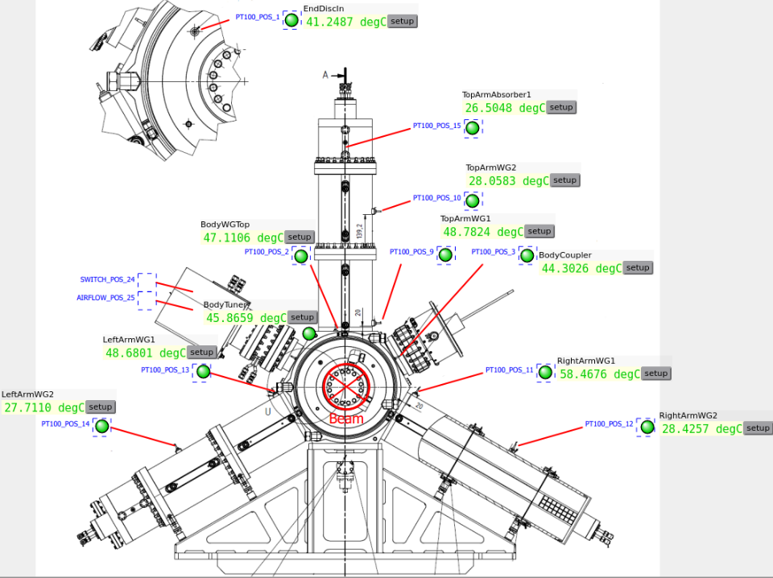
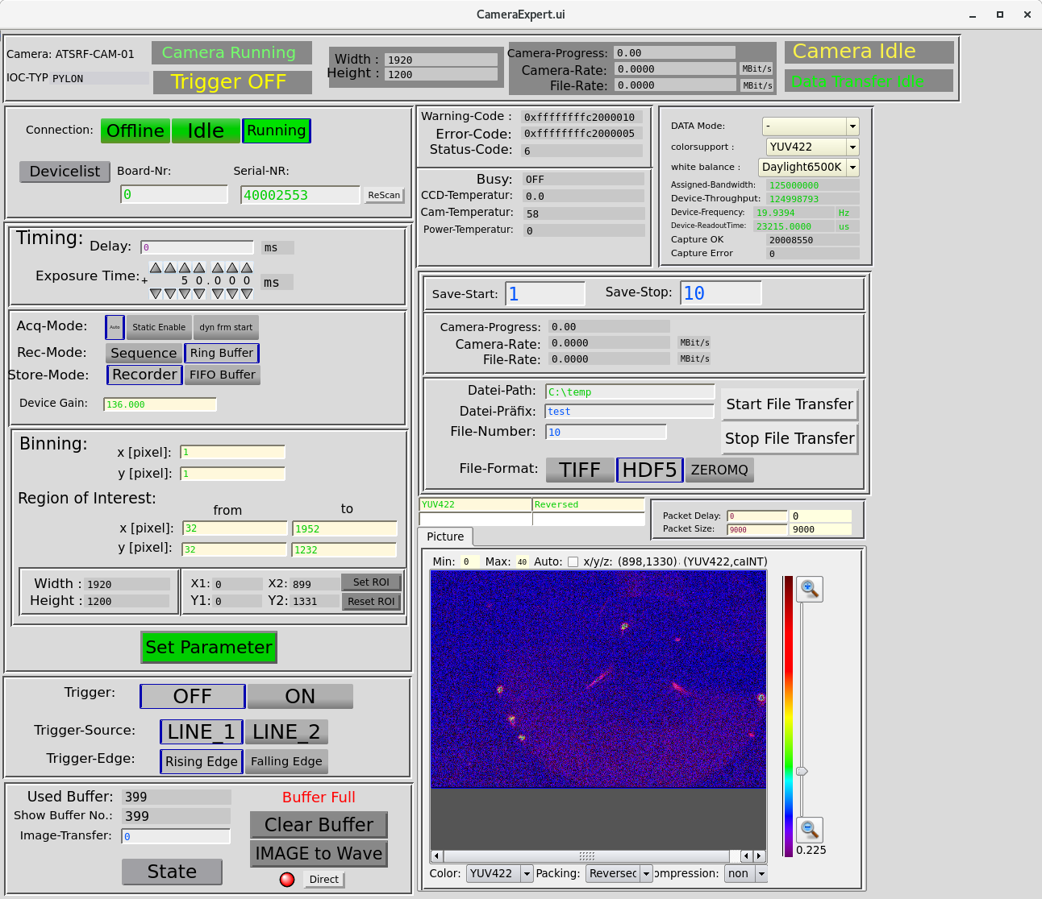
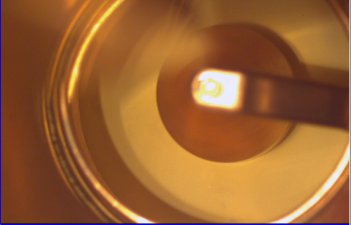
First Site Acceptance Test of SLS2 Cavity
Optical effects at coupler
Set of temperatures at 600kVcw, (~140 l/min)
→ Temperature at WG1 next to coupler reaches 58°C

Slide 19
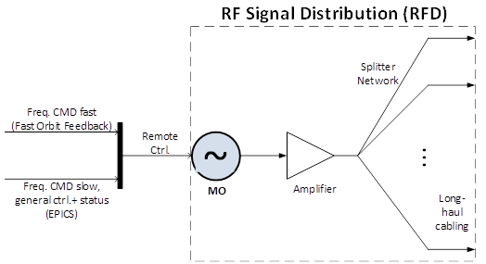
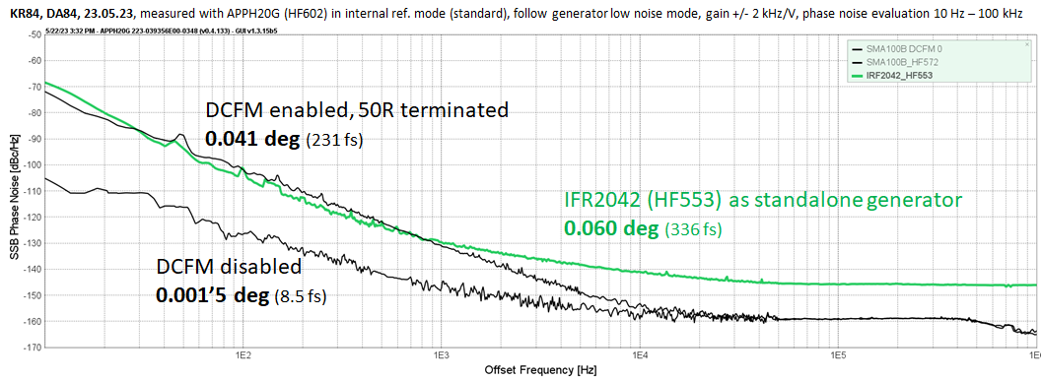
SLS2 500 MHz Phase Ref. – RF Signal Distribution
SMA100B + Ultra-low phase noise option, DCFM disabled
Freq. Remote ctrl. via LAN (slow cmd rate max. 5-10 Hz) or USB (fast cmd rate max. 100-200 Hz)
Coax 1/2 inch,
some are isolated
Old 50 W amp.
modif. With new PS
to remove many spurs
Remarks:
Ideally the frequency would be ramped continously, no freq. steps to avoid the BPMs respond with artificial steps on their orbit reading (on the bw limited channels).
Want to avoid DCFM in order to get the best
phase noise that is provided by the generator.
SMA100B’s analog freq. ramp option produce
phase jumps at start/stop → cannot use!
Compromise to use USB with cmd rate of
e.g. 100 Hz and 0.1 Hz/step
→ ramping rate 10 Hz/sec.
Fig. 1: Conceptual block diagram
Slide: R. Kalt, group 8417, 25.10.2023
Fig 2: Phase noise of single stand alone generator SMA100B (black traces) and
SLS-1 IFR2042 (green trace), the IFR2042 with DCFM enabled was not measured.

Slide 20
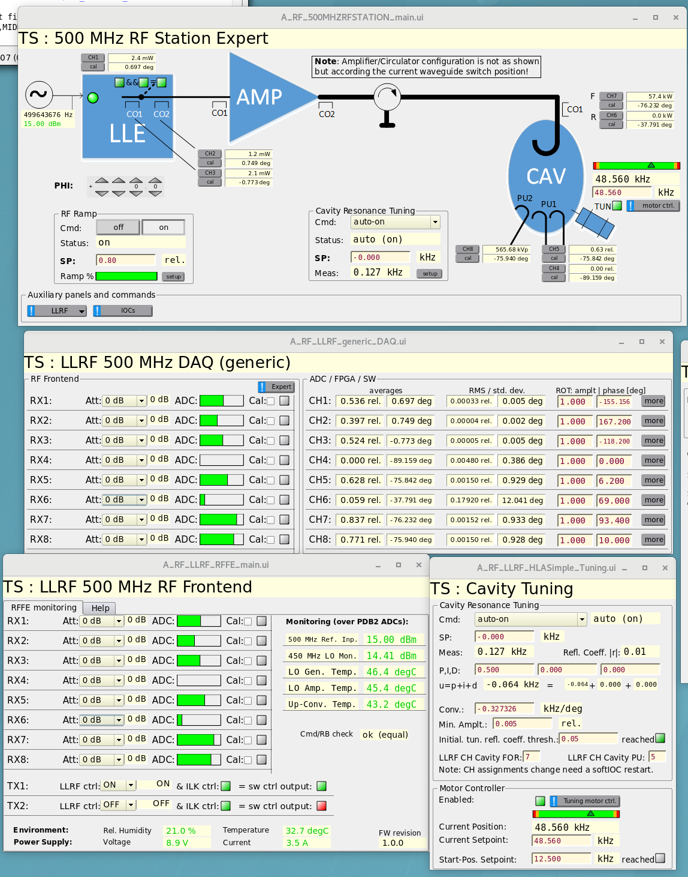
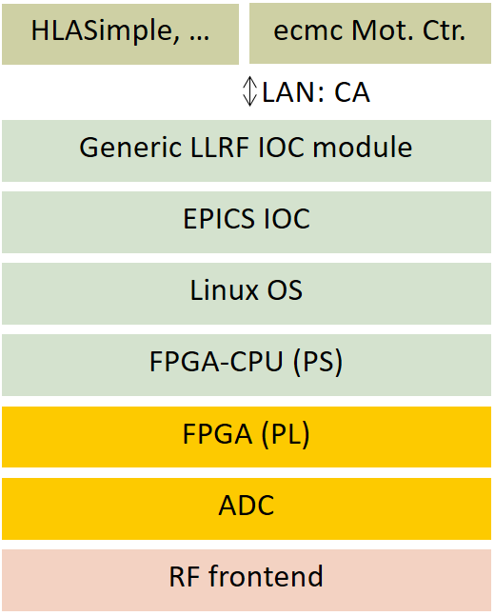
LLRF 500 MHz
57 kW
Status
Since March 2023 low power (50 W) test place with Elettra cavity
April-September 2023 high power testing with existing Elettra + RI cavity RF conditioning
On-going Fw/Sw/Ctrls-Integration, Layers:
  FPGA impl. on-going: DAQ, Actuator,
  fast RF FB-loops
  Generic IOC on-going: DAQ with synchr.
  time-stamps
  HLA IOC on-going: Ramping & state ctrl.,
  resonance tuning, physical units
  calibrations
566 kVp
Legend: Done, not yet done
Fig. 1: Panels screenshot on 2023-04-25 at SLS test stand
run open-loop, only cavity tuning loop active.
Outlook
Implementation of Fw/Sw/IOC functionalities as defined in the requirements.
Hw series production/procurement, verification, characterization
Slide: R. Kalt, group 8417, 25.10.2023

Slide 21

RF Interlock
Purpose: Equipment protection for an
RF station as a whole. All personal safety
relevant signal are directly processed at the
HPRF amplifier.
Completely separated from LLRF in order to
simplify the long-term maintenance.
EtherCAT is used as real-time bus communication between the devices and for control system integration (Fig. 1), ecmc as EtherCAT master / IOC.
Logic located in small Spartan-type FPGA inside the «RF ILK Unit».
Reaction time from 1 us (fast inputs, e.g. RF peak detectors) up to 2 ms (slow inputs, e.g. standard 24 V or 4-20 mA inputs).
Provides a fast sum hw-signal «RF-READY» (ok/nok = 5V/0V) towards LLRF in order to synchronize and trigger LLRF actions like: RF start, RF stop + post-mortem DAQ’s.
Slide: R. Kalt, group 8417, 25.10.2023
RF ILK
RF-READY
OK/NOK
LLRF

Slide 22

Super-3HC Upgrade of Tuning System
After 20 years operation, we plan to renew the tuning-system:
Existing and spare-system has excessive torque and might self-destroy.
→Upgrade and modification proposal:
New parts are in colour:
- Phytron Steppermotor with planetary gear and revolver encoder
- Rollvis leadscrew
+56mm
-56mm
Slide: R. Rotundo 8.6.2023

Slide 23

Super-3HC Upgrade of Tuning System
Completely extended: fits into the existing shape
Slide: R. Rotundo 8.6.2023

Slide 24
Wir schaffen Wissen – heute für morgen
Thanks for your attention!
Questions?

