Slide 1
RF technology in SOLEIL II
Lu ZHAO
On Behalf of the RF & LINAC Group
and P. Marchand (scientific advisor)

Slide 2
SOLEIL II
Objectives :
Address present and future scientific and societal challenges through a reconstruction of the storage ring with an emittance < 100 pm.rad, 100 times brighter beams and adapted beamlines.
Keep the broad energy range from THz to hard X-rays and almost all the operation modes of the present SOLEIL machine.
SOLEIL II reference planning

Slide 3
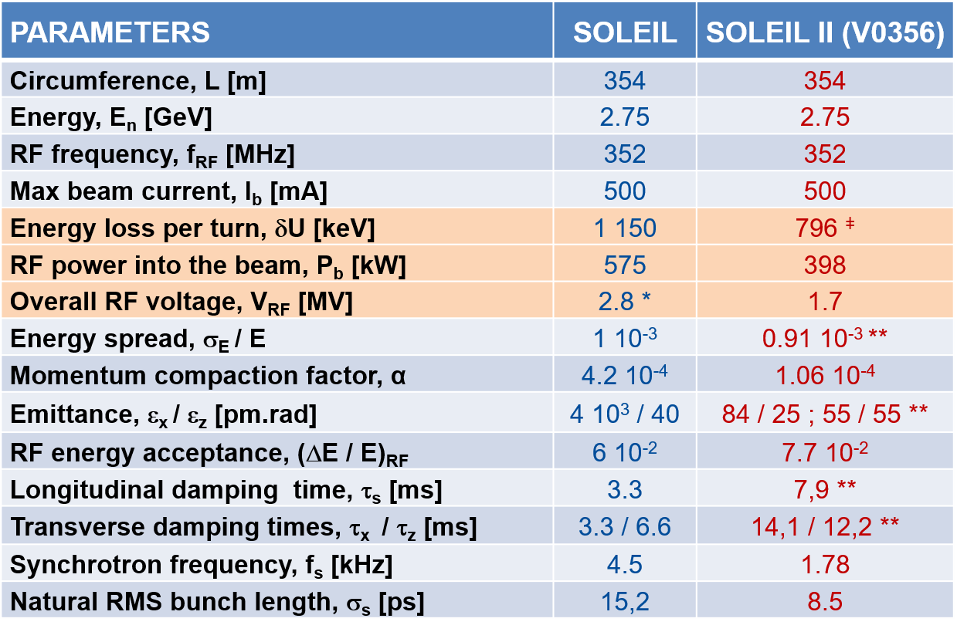
Main SR parameters & fundamental RF specifications
^{ǂ} Including 312 keV for the ID’s
* 2.8 MV in standard operation,
3.2 MV in low α mode (α_{nom} / 25)
** Without ID’s contribution
Loulergue, A., et al. "TDR baseline lattice for SOLEIL II upgrade project. 14th IPAC, Venice, Italy

Slide 4
RF Activities
RF Cavities
4 Normal Conducting (NC) ESRF-EBS type cavities (352MHz)
Harmonic RF system (SC vs NC)
RF Power Amplifier and Distribution (Waveguide layout)
SSA Power Supply Upgrade
New Power plant layout
Upgrade of the SSA supervision system
Low-Level RF (LLRF)
Devices
Analog Frond-End (AFE)
Test at SOLEIL with 450mA beam

Slide 5
352 MHz fundamental cavities (MC)
 | 4 (3) NC cavities ESRF-EBS
Length [m] | ~ 4.20
Redundancy | Yes
V_{RF} [MV] | 1.7 (1.6)
P_{b} [kW] | 398
V_{cav} [kV] | 425 (533)
P_{dis} [kW] | 4 x 18 (3 x 29)
P_{cav} [kW] | 118 (162)
P_{cav} [kW] | 150 (185)
Coupling | ß_{c} = 5
Passive
SC HC
NC HC
Collaboration with ESRF to benefit from their EBS-type 352 MHz HOM-damped cavities → Plans and specifications that they used for their call for tender have been received
4 NC ESRF-EBS-type cavities will be necessary to provide redundancy (possibility to run with 3 cavities out of 4 in nominal 500 mA operation mode)
For ESRF EBS fondamental power coupler P_{max} ~ 160 kW
→ Collab. with CERN for LHC type power coupler (P_{max} >> 200 kW)
RF parameters based on V0356 lattice including 312 keV ID loss

Slide 6
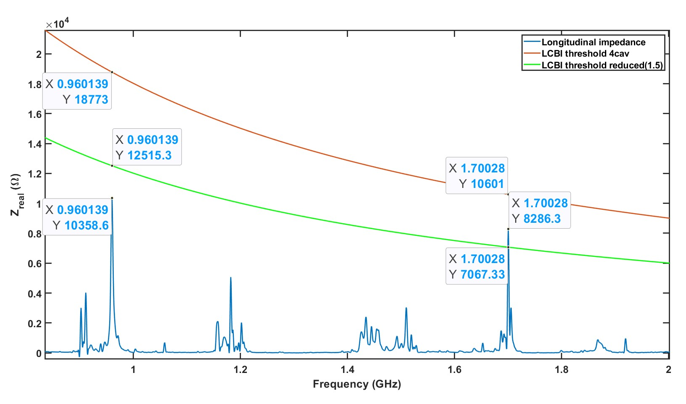
Longitudinal impedance
Coupled bunch instabilities threshold calculation :
CST
$$Z_{long}^{th}\left(ω\right)≃\frac{4π}{τ_{long}α_{c}}⋅\frac{E_{beam}}{I_{beam}}⋅\frac{ω_{s}}{ω_{rev}}⋅\frac{1}{ω}$$
Danger mode @ 1,7 GHz
Its impedance is about 28% smaller than the LCBI threshold for 4 cavities (from the above approximate formula). However, it is about 15% higher than the anticipated reduced LCBI threshold with HC ( to be confirmed by further simulations).
Possible cure:
Longitudinal Bunch-by-Bunch Feedback

Slide 7
Harmonic RF system
Main purpose :
Lengthen the bunches up to ~ 100 ps FWHM and thus reduce their charge density to preserve the low emittance and insure suitable beam lifetime
Initial specifications aimed at allowing :
Short bunch production (~10 ps FWHM) → ~1.7 MV needed @ 3$×$F_{RF}
Hybrid mode with asymmetric beam filling pattern
→ transient beam loading (TBL) issues
Such high RF voltage requirement together with available space constraints along the ring and attempts to reduce TBL justified the choice of SC cavity technology as the most suitable one.
SOLEIL II 3rd harmonic case
V [MV]
V_{1h} = 1.7 MV
V_{1h} + V_{3h}
V_{3h} = 0.53 MV
Long bunch
Long bunch
But after the CDR, it was decided to remove from the baseline specification the option of producing short bunches (~10 ps FWHM) and the non-uniform beam filling patterns with long bunches (~100 ps FWHM) so NC technology option for harmonic system had to be investigated and compared to the SC one.
Bunch lengthening : phase and amplitude of V_{3h}
adjusted such that the overall voltage is flat at ϕ_{s}
For V_{3h} ≈ V_{1h} / 3 ≈ 0.53 MV, τ ≈ 4 τ_{o} ≈ 100 ps FWHM

Slide 8
SC HC vs. NC HC
SC HC vs. NC HC
A SC HC version, based on a Super-3HC type Cryomodule @ 1.41 (or 1.06 GHz), has been evaluated in collaboration with CEA and CERN. In parallel, a NC HC version, based on an ESRF-EBS 1.41 GHz 2-cell cavity (or an assembly of two single-cell cavities), has been evaluated in collaboration with ESRF and KEK.
New operation mode specification for SOLEIL II : priority to high average current modes (500 mA in 416 bunches, uniformly filled and 200 mA in 32 bunches, evenly spaced).
SUPER3HC cryomodule
Comparison resume
The passive SC remains the best option in terms of bunch lengthening factor (BLF) and operational « ease » but its investment cost is higher by about a factor 4 (~ 2 M€) as compared to the passive NC (~ 0.5 M€), which should provide lower, nevertheless acceptable, BLF for the 2 operation modes (500 mA in 416 bunches, 200 mA in 32 bunches) and moreover the best operational reliability (no RF power source, no cryogenics). The MC power margin is enough to compensate for the NC HC wall dissipation of about 50 kW at 500 kV.
The active NC HC (investment cost ~ 1 M€) is still under study; with RF feedbacks (RFFB), it could achieve comparable BLF as the passive SC ; however its operational control is much more critical (feasibility to be demonstrated).
Considering the new operation mode specification, energy price increase and budget constraints, we now consider the following two-phase strategy as the most attractive for the HC :
Phase 1 : begin with 1 passive NC HC 4H of the ESRF-EBS type
Phase 2 : after experience feedback, if needed, add a power coupler + power source (SSA based on GaN) to convert the passive cavity into an active one

Slide 9
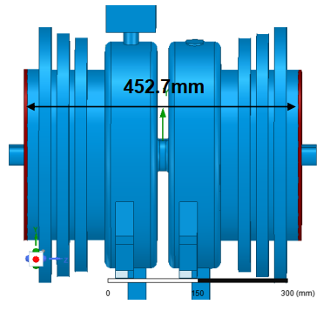
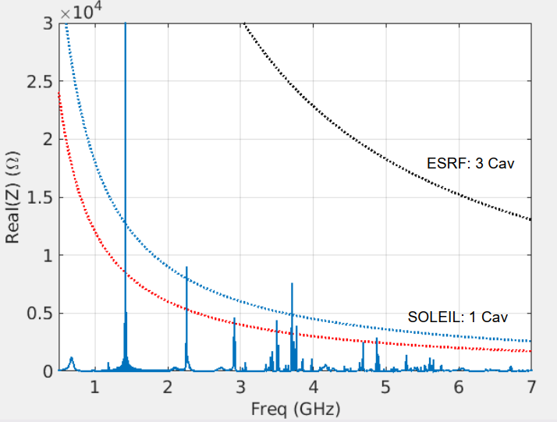
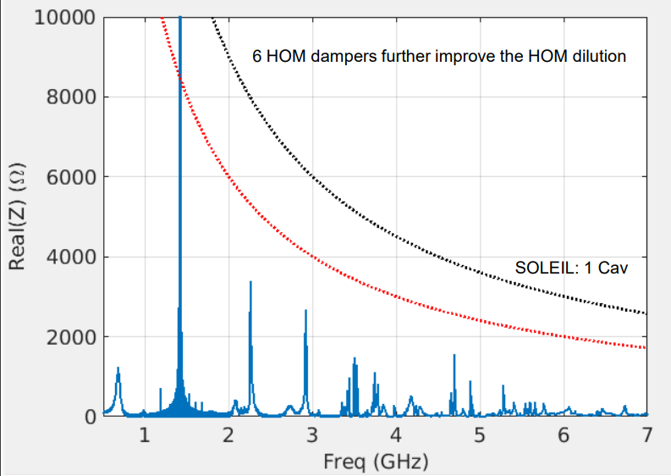
ESRF-EBS 4th HC (1.41 GHz)
2-cell cavity
Rs = 2,4 $MΩ /$ cav
$Q_{0}$ = 36 000
$R/Q$ = $65 Ω$ / cav
$N_{cav}$= 1
w/o HC
with HC
LCBI threshold for SOLEIL II case with 1 cavity is a factor of almost 8 lower than ESRF-EBS case with 3 cavities !!
→ Mitigations : HOM dampers and/or longitudinal b.b.b. feedback
GDFIDL
w/o HC
Preliminary simulations show sufficient HOM attenuations by using 2 or 3 HOM dampers per cell
with HC
ESRF simulations in the framework of WP3 collaboration among ESRF, KEK, and SOLEIL – Design and implementation of a harmonic RF system with TBL compensation

Slide 10
352 MHz Power Sources
Objective : Reuse the four SSPA’s in the SOLEIL II SR, after power supply and supervision system upgrade + other adaptations, as for instance connecting each tower directly on the waveguide → Gain in flexibility.
Power supply upgrade : Rectifier + DC/DC converters replacement by direct AC/DC converters
Redundancy, easy maintenance, reduced time to repair, solved obsolescence issues and cost reduction
Efficiency improvement
Total actual efficiency = 87% (96% rectifier and 90% DC/DC converters)
Increased to 96% with new AC/DC converters
AC/DC converter voltage remote control allows to match for maximum efficiency over whole power range (impossible presently: components set to reach max efficiency only at max power – 1dB compression)
Power supply upgrade plan
From begining, 1 x 50 kW will be installed every 2-3 months in the SR to benefit from four fully upgraded 200 kW SSPA’S by the mid-2028 for SOLEIL II

Slide 11
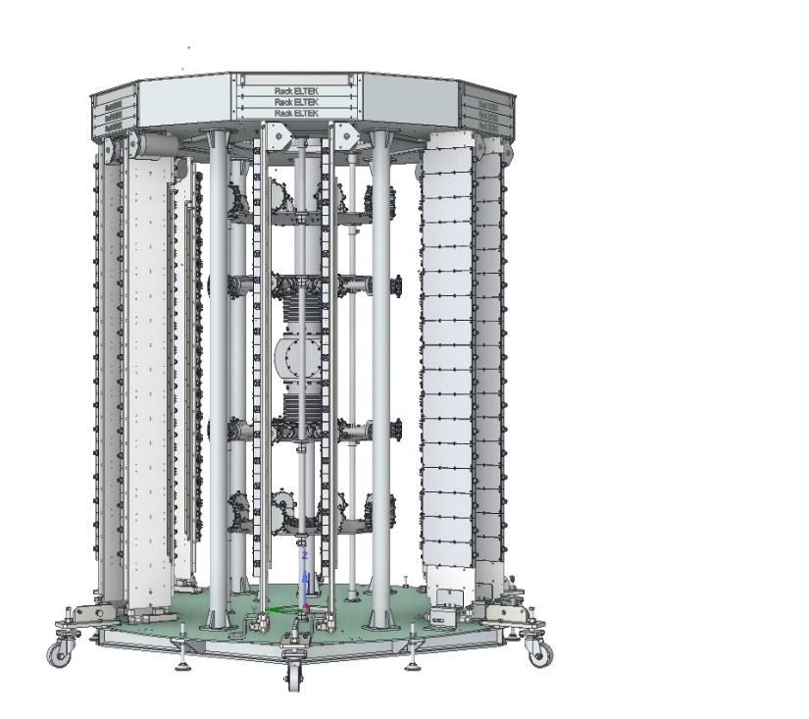
Power Supply Upgrade
Beam current | 450 mA | 500 mA
Overall RF power | 506 kW | 562 kW
Electric power (4 SSPA’s in present SOLEIL machine) | 1148 kW | 1278 kW
Electric power (4 upgraded SSPA’s @ 50 V) | 1019 kW | 1081 kW
Electric power (4 upgraded SSPA’s @ 44 V) | 894 kW | 952 kW
Maximum consomption reduction (44 V) | 22.1% | 25.5%
8 x 3 kW power converters
5 x 24 kW AC/DC racks (19" 3U)
5 x SSPA control rack (19" 1U)
New dissipater orientation to optimize and reduce power cable length
Support pipes with bigger diameter, adapted to the new power supply weight
Power savings of 1.75 GWh max per year
250 k€ savings per year
Compensate the investment cost in ~ 4 years
3D view of a future upgraded SSPA RF tower with new AC/DC power converters

Slide 12
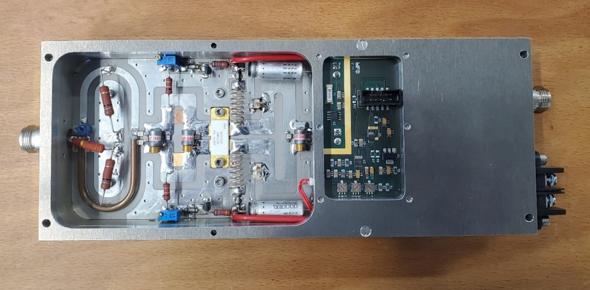
Power Supply Upgrade
Current measurements were initially done in the DC/DC converter.
New architecture → RF module modifications : Electronic mezzanine card for supervision (1 x T° sensor on circulator load to evaluate reflected power + 1 current sensor)
Mezzanine measurement PCB
PCB mechanical support
Module modifications

Slide 13
Upgrade of the SSA supervision system
Architecture modification : 5 “secondary” µcontrollers per tower, all linked to 1”main” µcontroller for the complete amplifier

Slide 14
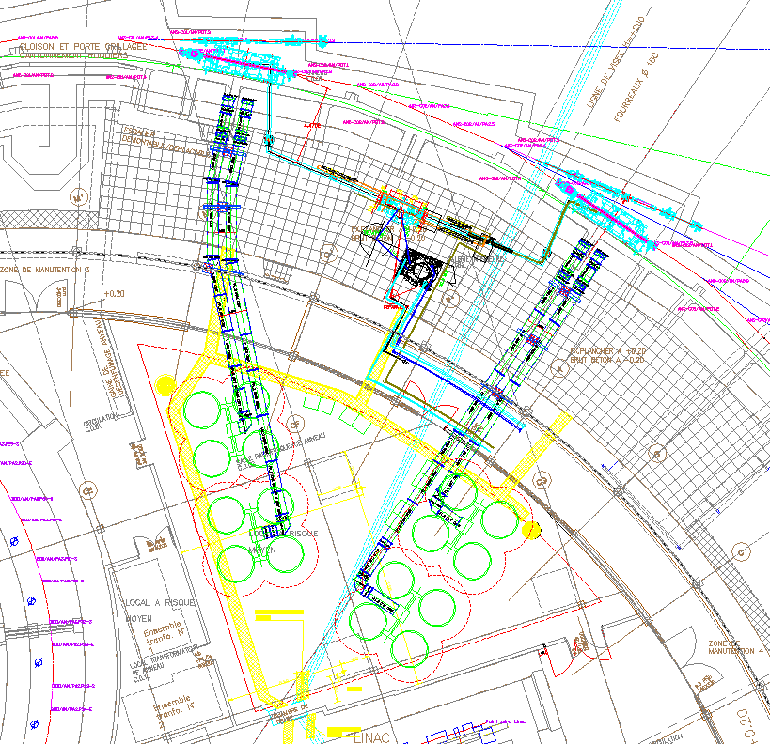
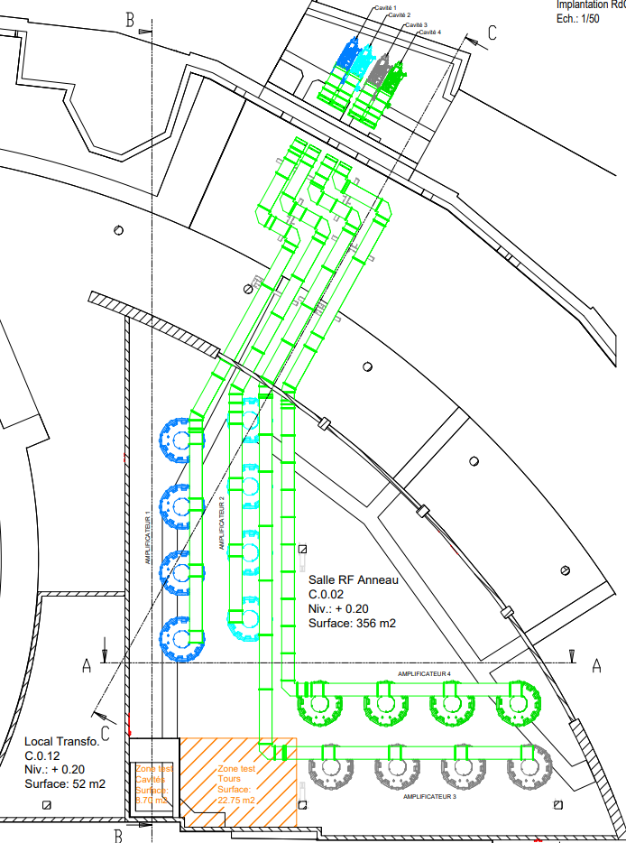
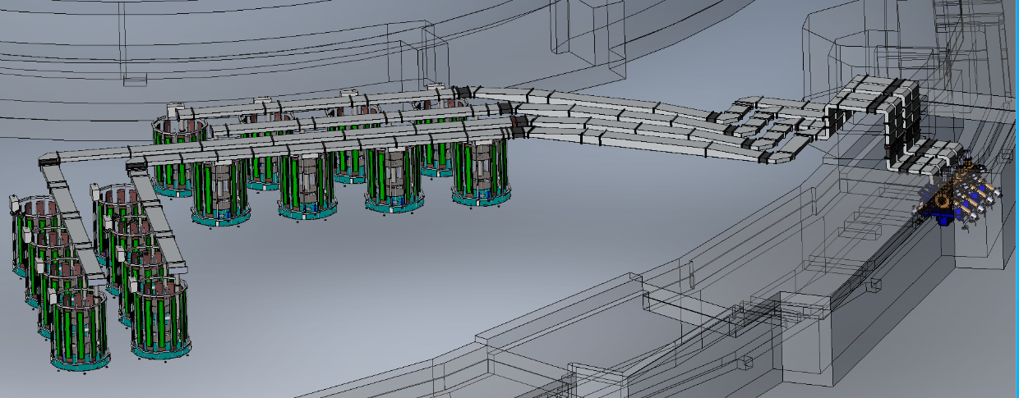
Power Source layout
4 MC
CM2
CM1
A3
A4
A1
A2
Present SOLEIL RF layout
4 SSPA’s & 2 cryomodules
SOLEIL II RF layout
4 SSPA’s & 4 NC cavities

Slide 15
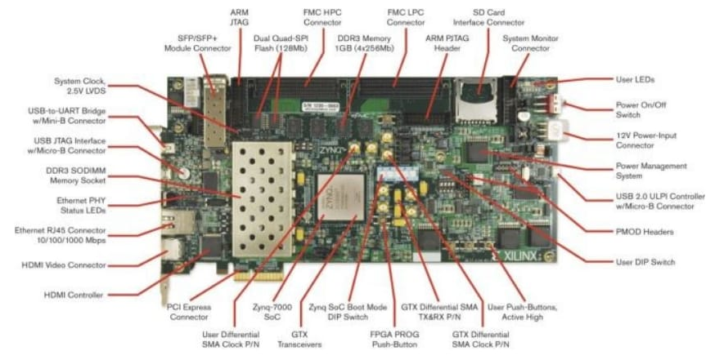
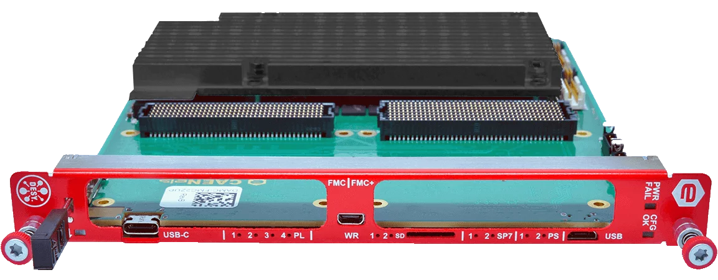
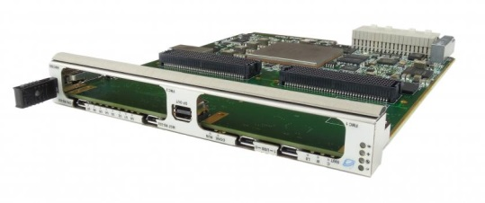
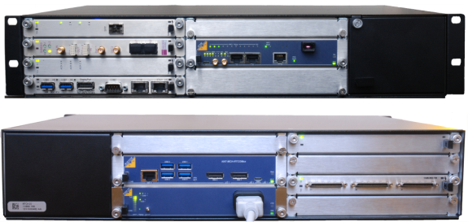
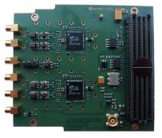
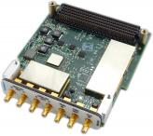
Digital LLRF, we played with some devices …
ZC706 Zynq evaluation board
DAMC-FMC2ZUP (CAENels)
Vadatech VT812
AMC580
Native-R2 µTCA platform, MCH-PHYS80 (NAT Europe)
FMC LXD31K4-DC 4 channel 16-bit ADC/DAC (Logic-X )
FMC-4CH-125 (Techway)
FMC224 (Vadatech)

Slide 16
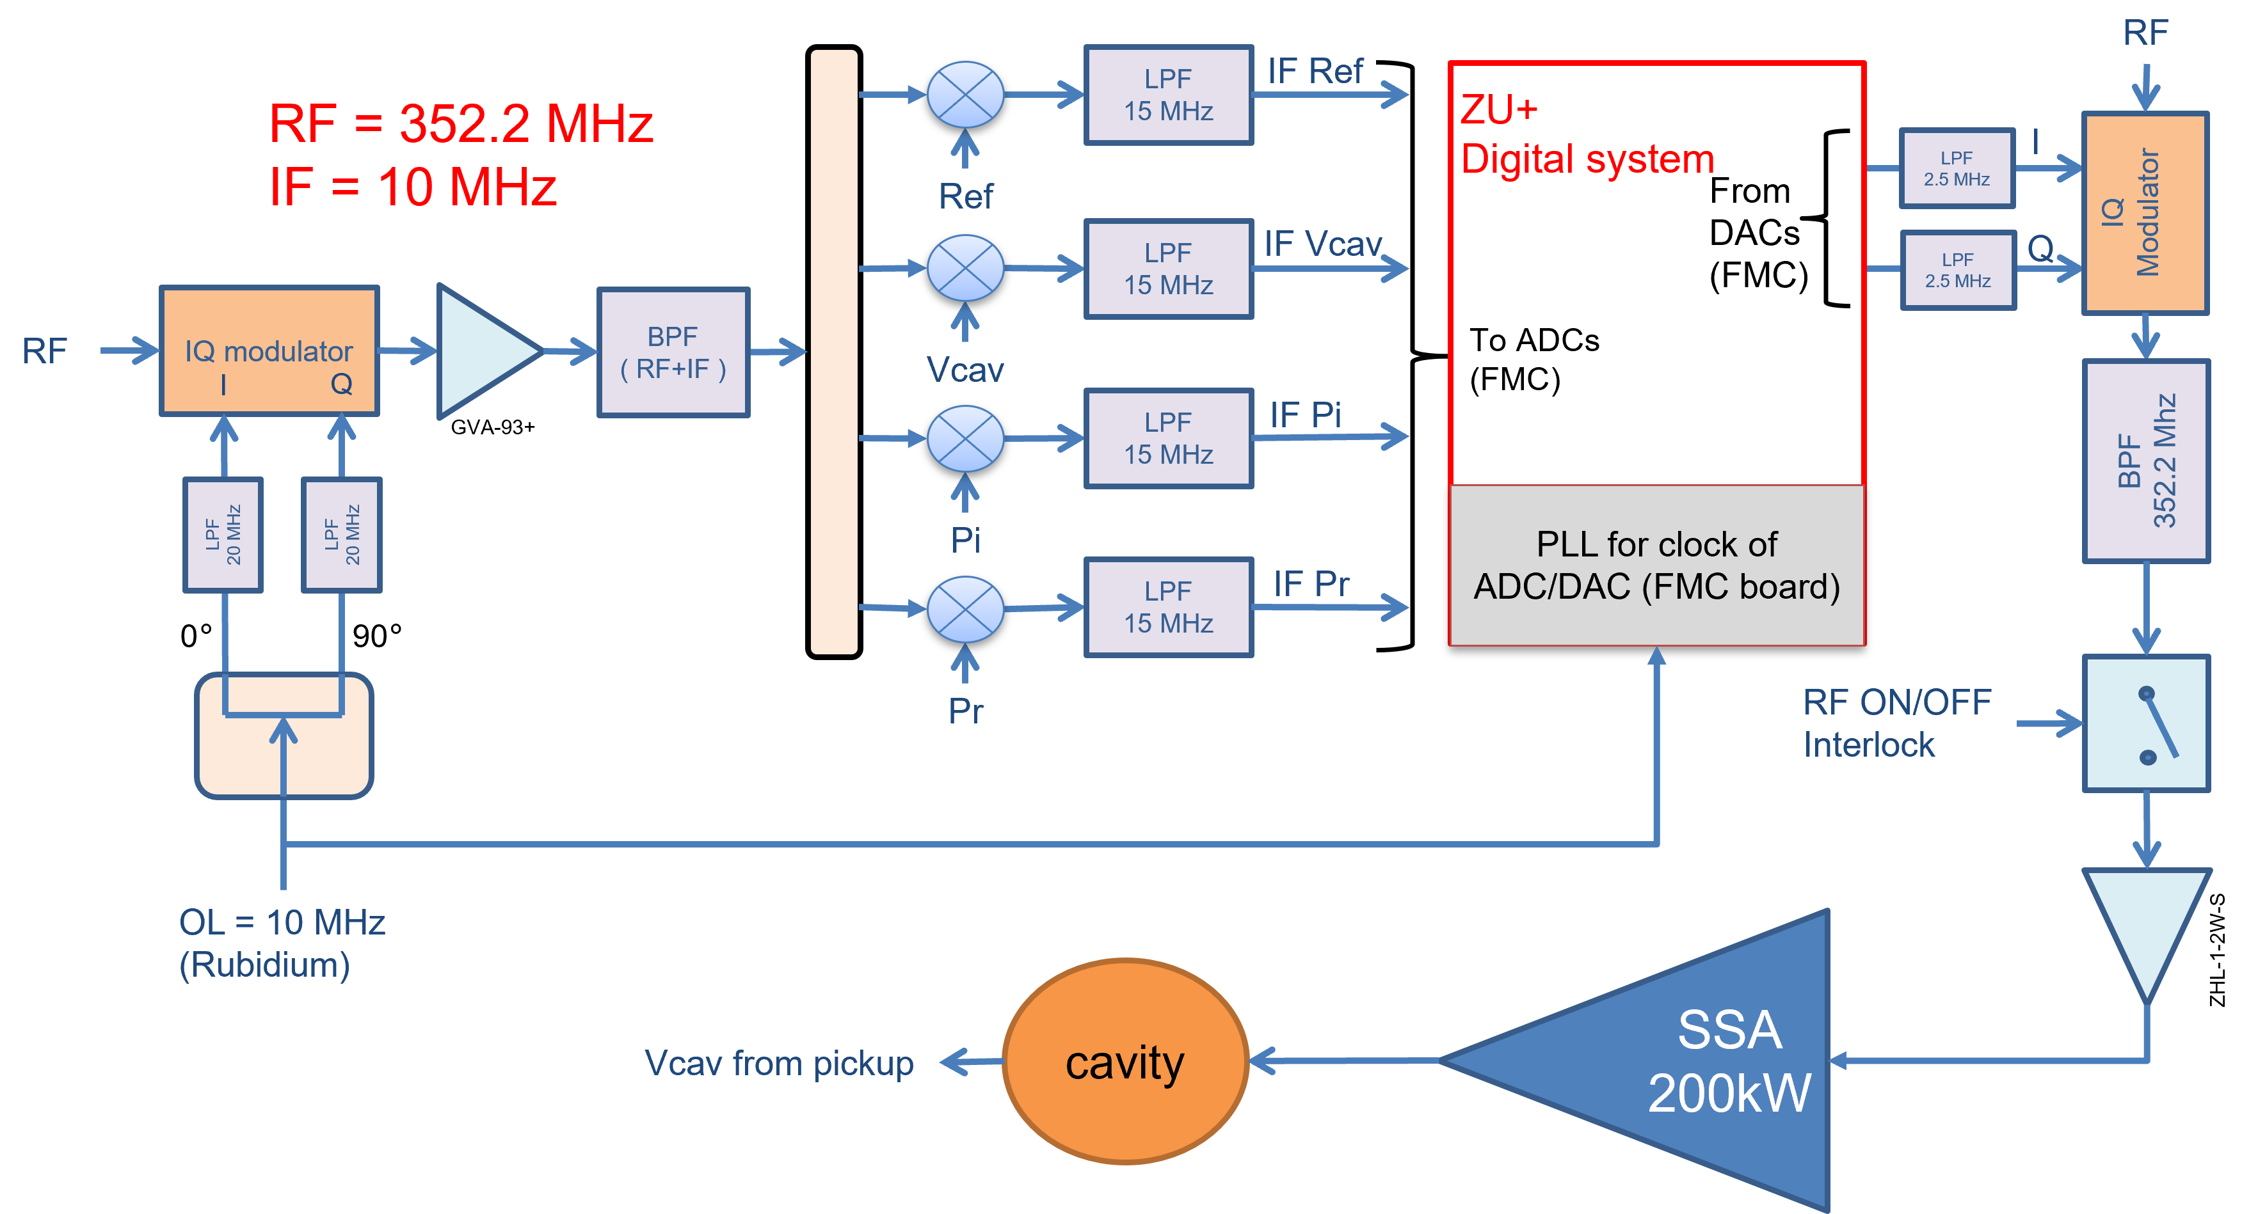
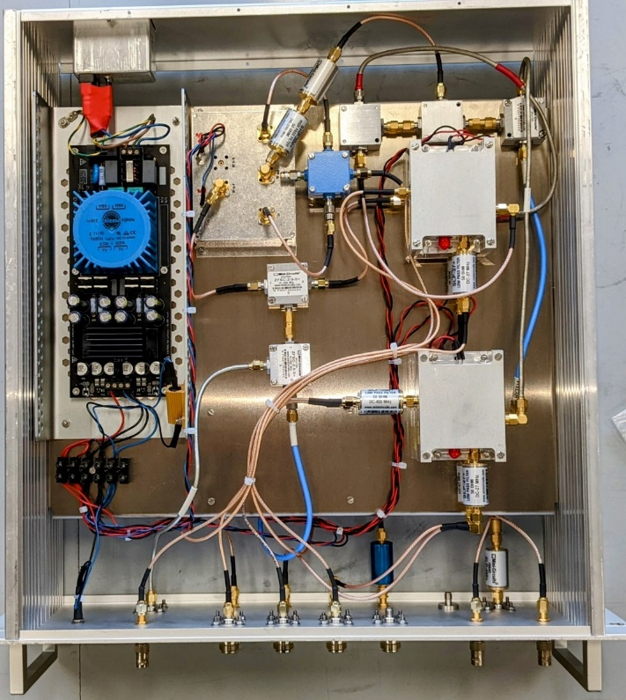
Analog Frond-End (AFE)
Analog Frond-End(AFE) : the IQ measurement is performed at an Intermediate Frequency (IF) of 10 MHz, which is obtained through an active mixer (Analog Devices, ADL5801).
Jitter level of IF output: depends on the LO and RF signal level.

Slide 17
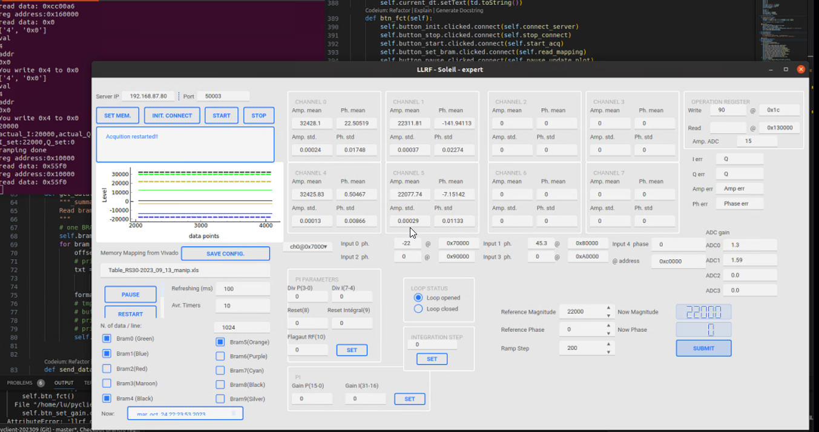
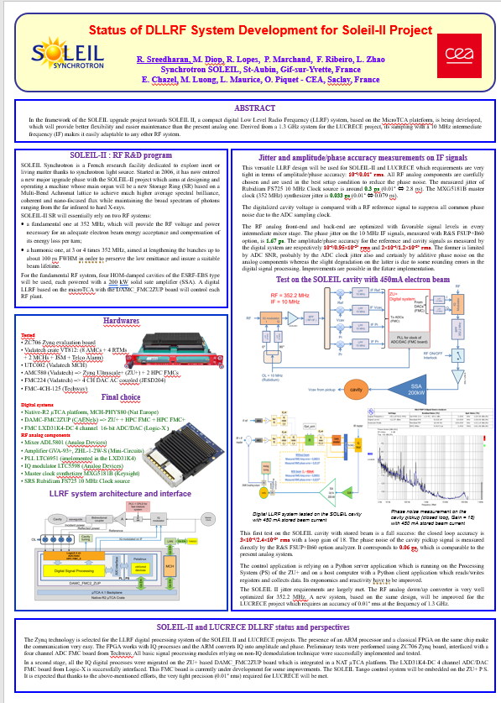
D-LLRF test on SOEIL with 450mA beam
Server
Digital LLRF GUI
Client – Server model
Client
LLRF2023 Gyeongju,
Republic of Korea
Accuracy :
3×10⁻⁴/2.4×10⁻²° rms
Loop gain of 18
Successfully stored 450 mA beam with actual SOLEIL cavity.
The phase noise of the cavity pickup signal is measured directly by the R&S FSUP+B60 option analyzer. It corresponds to 0.06 ps, which is as well as the present analog system.

Slide 18
Summary
SOLEIL II :
352 MHz RF accelerating structures → 4 x ESRF-EBS type cavities, simulation shows reasonable stability margin w.r.t longitudinal and transverse impedance thresholds for CBI
Harmonic RF system → Favored option : Start with a NC passive HC of the ESRF-EBS type (1.41 GHz) and, in a 2nd phase, if needed, upgrade it towards an active system (Project of collaboration with ESRF)
352 MHz power sources → reuse 4 x SSPA’s presently running at SOLEIL + Power Supply upgrade with new high efficiency AC/DC power converters to save up to 25.5% of electrical consumption while providing more redundancy
Digital LLRF → a generic digital system, based on µTCA, which can be adapted to these RF systems (fundamental, harmonic), is being developed and validated.

Slide 19
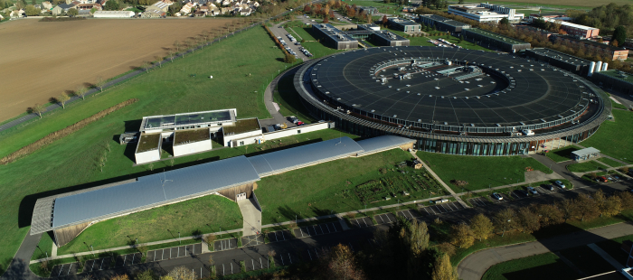
Thanks to the SOLEIL II project team

