Slide 1
PETRA IV RF System Amplitude and Phase Control
First tests of the µTCA based digital amplitude & phase control loop
Arvid Eislage
Hamburg, 2021-11-09

Slide 2
PETRA IV RF System Amplitude and Phase Control
First tests of the µTCA based digital amplitude and phase control loop
Arvid Eislage
Hamburg, 2021-11-09-2021

Slide 3
RF System Amplitude and Phase control at the µTCA Test Stand
Fast Digital control loop for the 500MHz RF System
Test Stand set up
PETRA IV (DESY IV) RF system overview
Test set up
Plan of the control loop
Plan of the control loop firmware hardware assembly
Control loop operation
Open loop adjustment
System identification Controller
System MIMO Controller parameter
03 Disturbance Feedforward Control
Control loop damping (spectrum)
Control loop damping different SSA output power
Control loop damping simulation

Slide 4
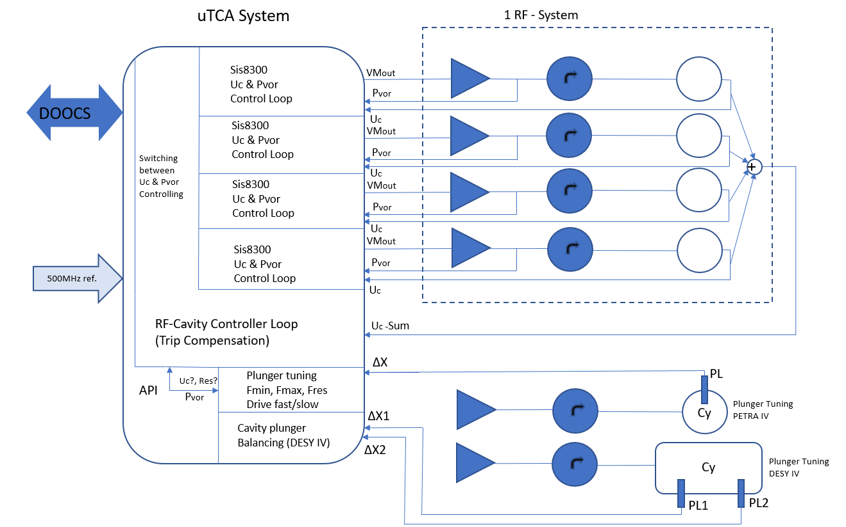
01 Test Stand Set Up
PETRA IV (DESY IV) RF system overview
The Test Stand is a
fraction of the planed
PETRA IV RF system

Slide 5
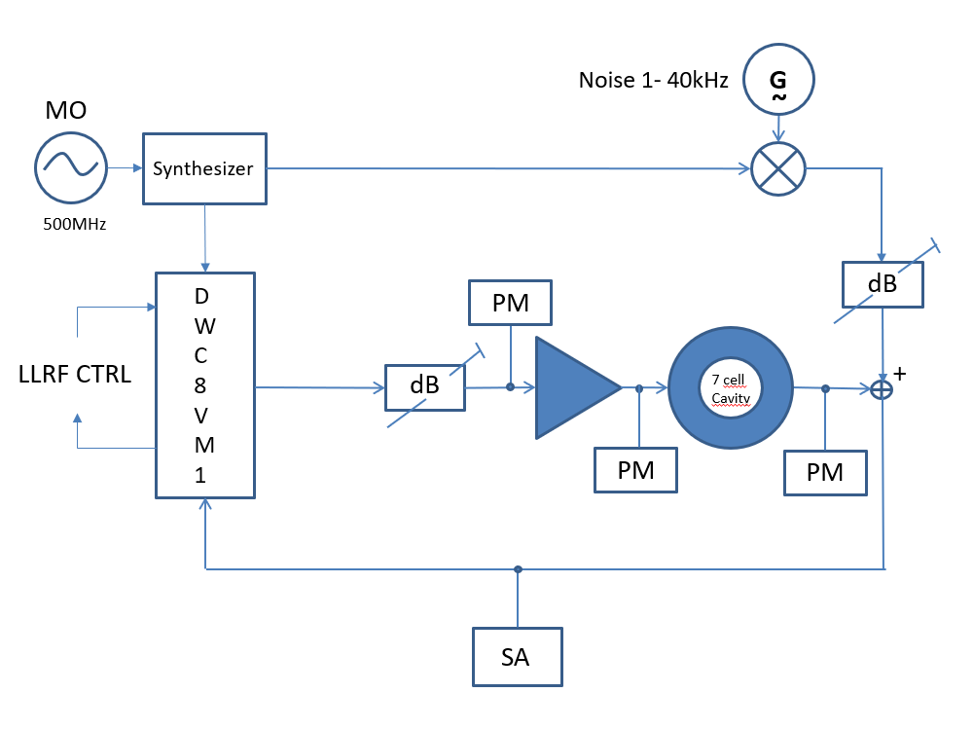
01 Test Stand Set Up
Sketch of the set up
MO - Master Oscillator
PM - Power Meter
SA - Spectrum Analyzer
Down Converter DWC8VM1
SSA Gain ~50dBm
7 cell Cavity PETRA Typ
SSA

Slide 6
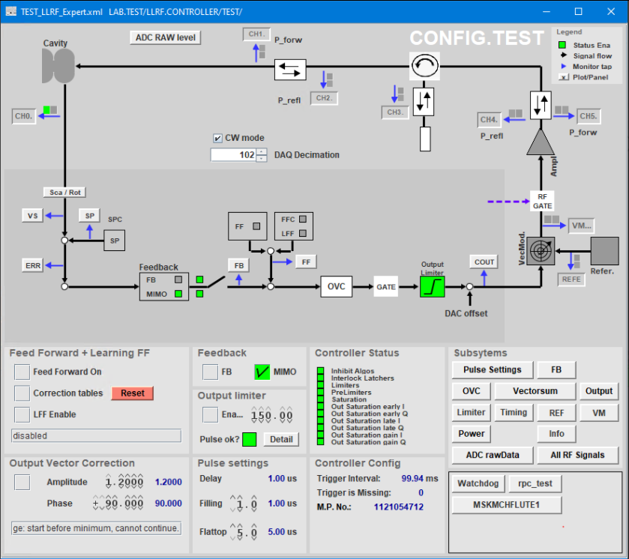
01 Test Stand Set Up
Plan of the control loop
Visualization single cavity control
JDDD
- Java DOOCS Data Display
DOOCS
- Distributed Object-Oriented Control System

Slide 7
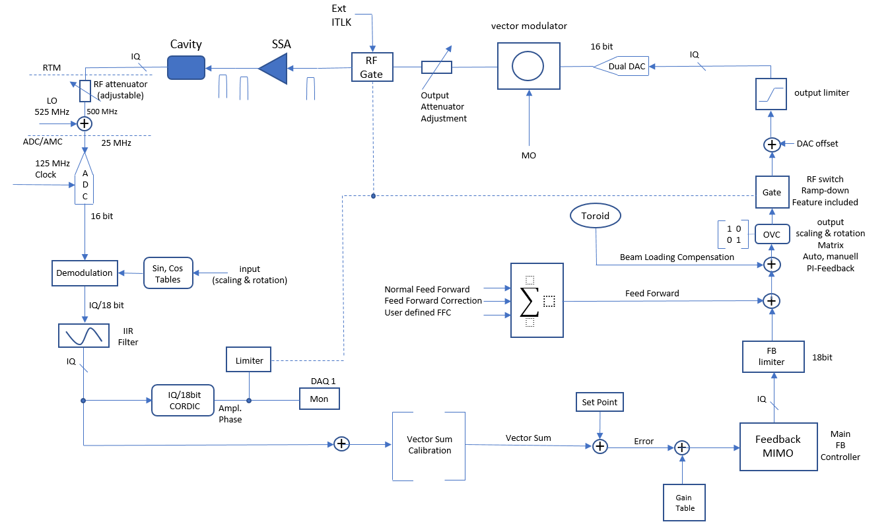
01 Test Stand Set Up
Plan of the control loop firmware hardware assembly

Slide 8
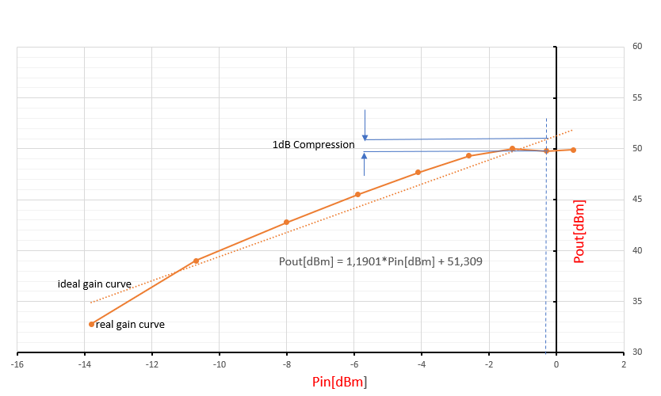
02 Control loop operation
Open loop adjustment
In order to avoid clipping on input channels and limitation of the VM output power signal, adjustment is needed.
Therefore the behavior of the Solid State Amplifier has to be taken into account.
[dBm]

Slide 9
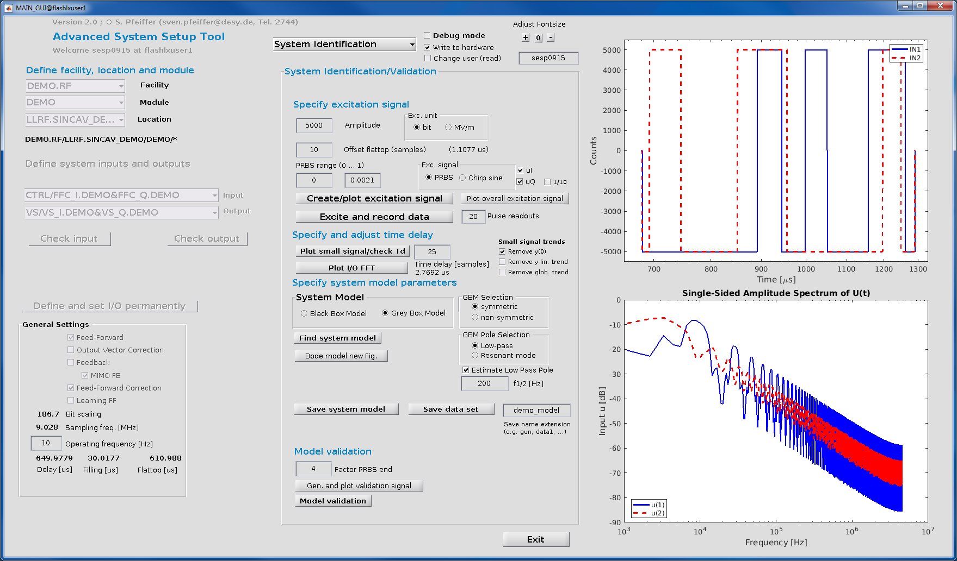
02 Control loop operation
System Identification, Controller
Advanced System Setup
Tool. Developed and
maintained by S. Pfeiffer
and C. Schmidt MSK
Department.

Slide 10
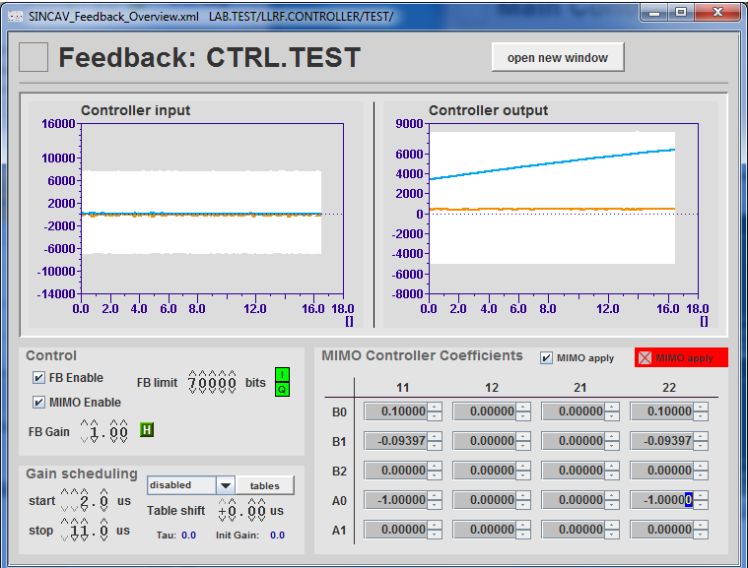
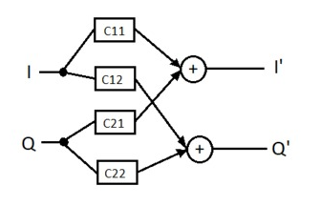
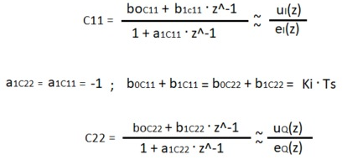
02 Control loop operation
System MIMO controller parameter
MIMO - Multiple In Multiple Out
Example PI Controller Ts and Ki translated
In MIMO Controller Coefficients

Slide 11
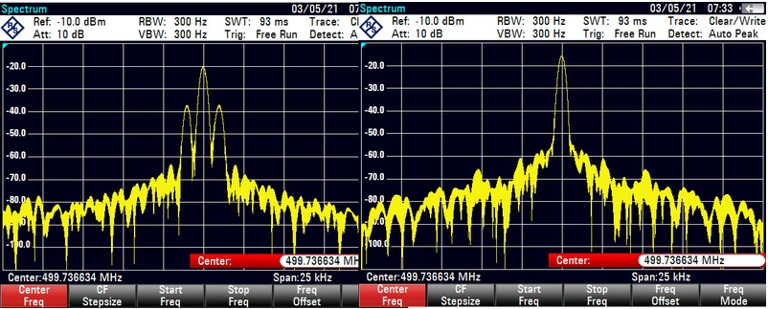
03 Disturbance Feedforward Control
Control loop damping spectrum
MIMO OFF
MIMO ON
Damping effect of interfering signal at 2 kHz carrier at 499.736634 MHz, noise threshold 40 dB below carrier

Slide 12
03 Disturbance Feedforward Control
Control loop damping different SSA output power
Damping/dB
Control loop damping interfering signal at different output power stages of the Solid State Amplifier

Slide 13
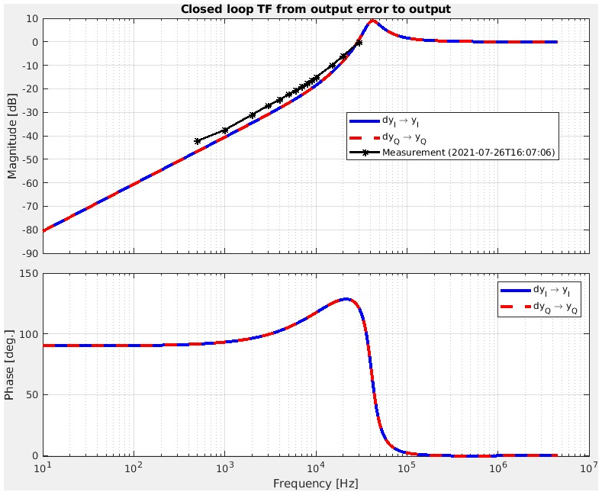
03 Disturbance Feedforward Control
Control loop damping simulation
Simulation tool Matlab
Ts = 0.9008
Ki = -0.89
FB Gain 0.5
Simulation from S. Pfeiffer (DESY dep. MSK) for the given interfering signal and Control Loop parameters

Slide 14
Thank you for your attention

Slide 15
Arvid Eislage
MHF-E
arvid.eislage@desy.de
+494089983332

